Slide 1
Lesson 3

Slide 2
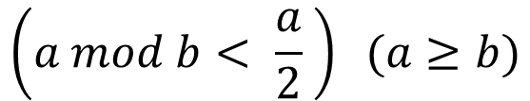

Greatest common divisor (GCD)
Just use Euclid’s algorithm
The time complexity is: $O(\log{n)}$
$$\left(a mod b< \frac{a}{2} \right) (a≥b)$$

Slide 3
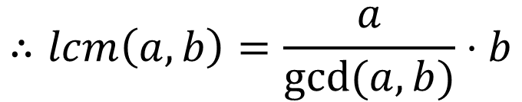
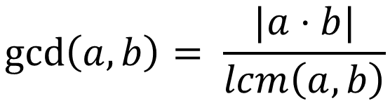
Least common multiple (LCM)
$$\gcd\left(a,b\right)= \frac{|a⋅b|}{lcm\left(a, b\right)}$$
$$∴lcm\left(a,b\right)=\frac{a}{gcd⁡(a,b)}⋅b$$

Slide 4
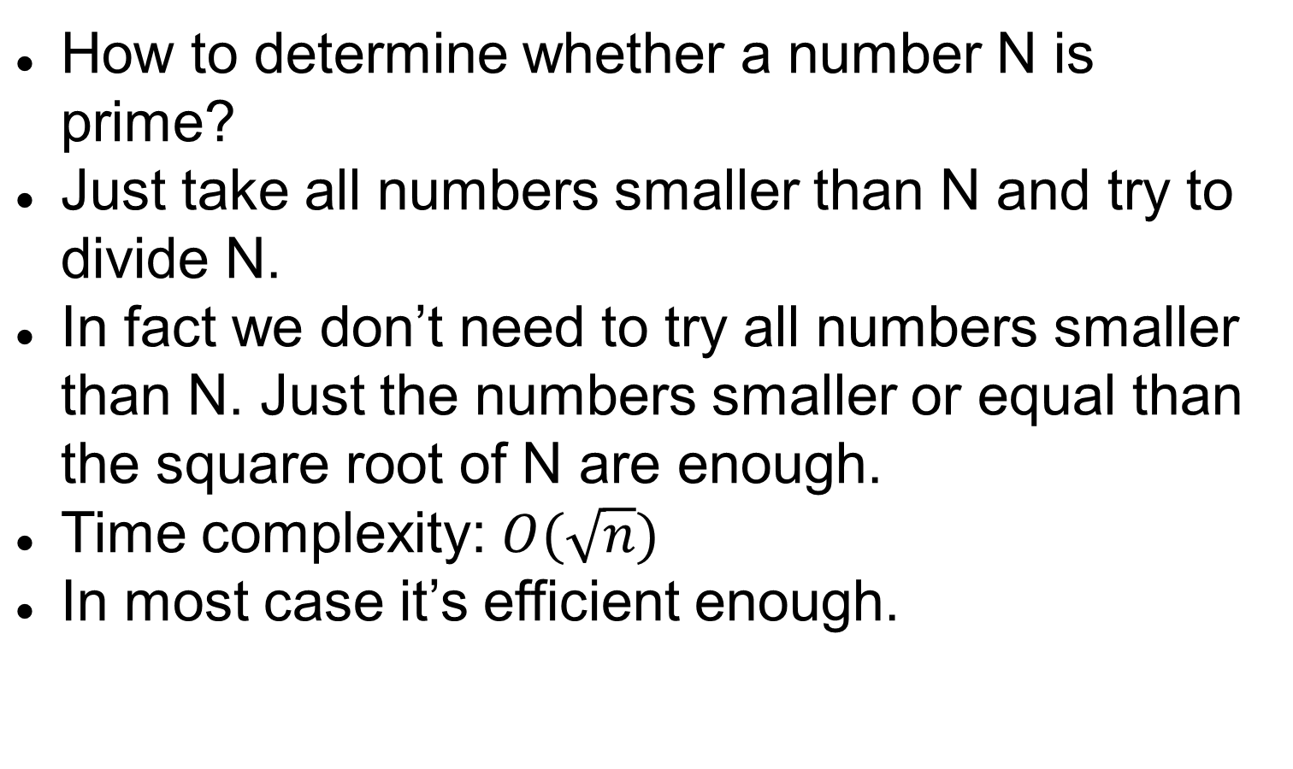
Prime number
How to determine whether a number N is prime?
Just take all numbers smaller than N and try to divide N.
In fact we don’t need to try all numbers smaller than N. Just the numbers smaller or equal than the square root of N are enough.
Time complexity: $O(\sqrt{n})$
In most case it’s efficient enough.

Slide 5

Sieve methods
Sieve of Eratosthenes
Time complexity: $O(n\log{\log{n})}$

Slide 6
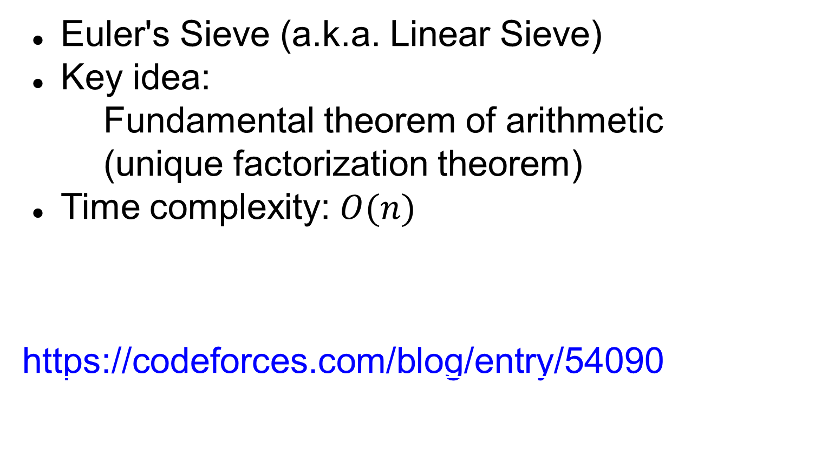
Sieve methods
Euler's Sieve (a.k.a. Linear Sieve)
Key idea:
Fundamental theorem of arithmetic
(unique factorization theorem)
Time complexity: $O(n)$
https://codeforces.com/blog/entry/54090

Slide 7
Fundamental theorem of arithmetic
Every integer greater than 1 either is a prime number itself or can be represented as the product of prime numbers.

