Slide 1
How Data Analytics and the 3-point Shot Changed the NBA
Jeff Watson

Slide 2
Key Points
The NBA is a dynamic league
Recent innovators shaped and evolved the game
A lot of this change was the product of data analytics

Slide 3
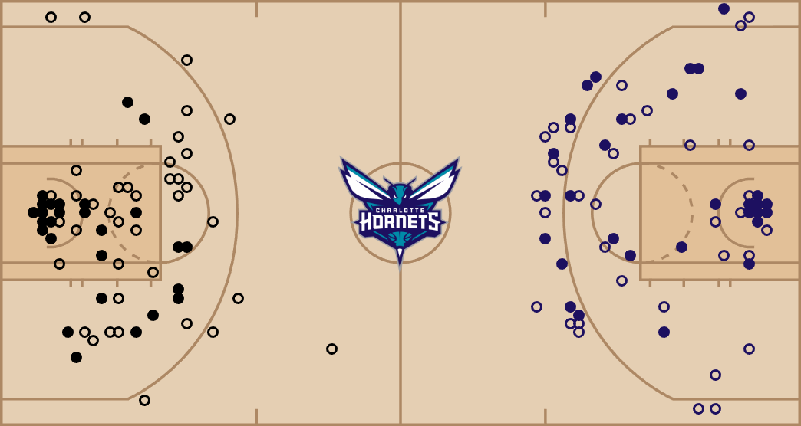
The Last of its Kind?
February 5, 2016
Charlotte, North Carolina
Miami Heat beat the Charlotte Hornets 98-95
The last time an NBA team WITHOUT a 3-point shot
https://www.espn.com/nba/game/_/gameId/401360616
Notes:
Miami only attempted 8 3-pointers. The deepest 3 was a shot at the buzzer at the end of the 1st quarter. So, only 7 real 3-point shots. The league-wide average for 2016 was 24/game. Miami ranked 28th in the league only averaging 18/game.

Slide 4
The Time Before…
Ended in the summer of 1979
The NBA was dominated by biggest players
Valued high-probability shots close to basket

Slide 5

Daryl Morey
(Previous) General Manager for Houston Rockets
Analytics consulting background
Believed in the power of statistics
Built a winning franchise using analytics to select players
https://www.houstonchronicle.com/texas-sports-nation/rockets/article/daryl-morey-rockets-mike-dantoni-nba-q-a-gm-15170415.php

Slide 6


Bill James
Billy Beane
https://www.simonandschuster.com/authors/Bill-James/698143
https://www.sfchronicle.com/athletics/article/Moneyball-at-20-Inside-Billy-Beane-s-legacy-11958848.php

Slide 7
Bill James
Baseball writer
Baseball statistician
Foremost proponent for advanced baseball statistics- SABRmetrics

Slide 8
Billy Beane
General Manager of the Oakland Athletics
Used the ideas of Bill James
Oakland was 27th lowest payroll in MLB
Built a winning franchise by spotlighting statistics over star power
Was the inspiration for “Moneyball”
Book by James Lewis
Movie starring Brad Pitt

Slide 9
Efficiency is the name of the game
3-pointer worth 50% more than a 2-pointer (basic math)
Score more points with fewer shots

Slide 10
3-Point Shooters, Comparison
*3-pointers made x 3P%

Slide 11
What Changed?

Slide 12
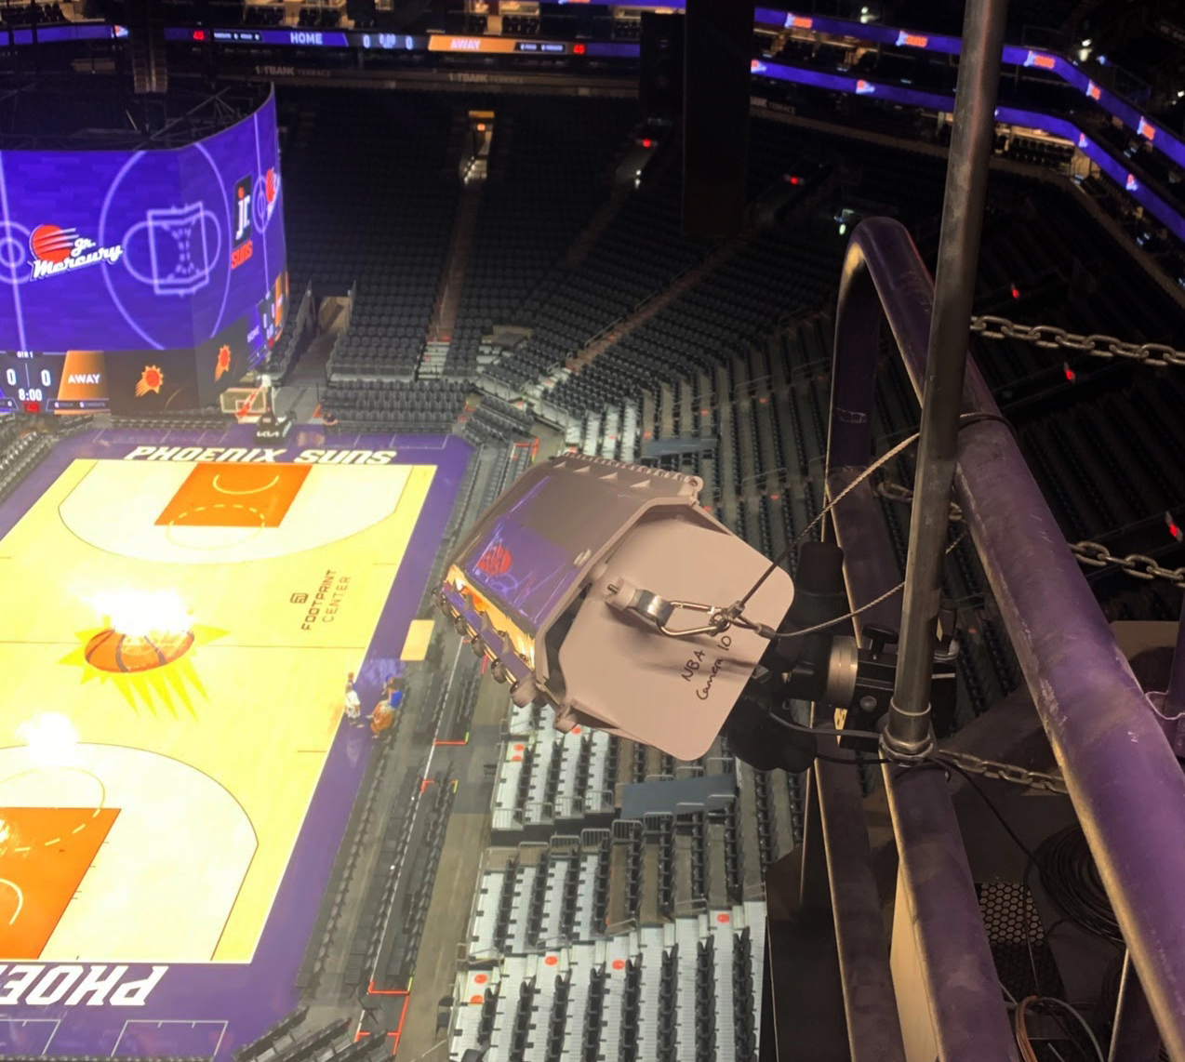
The NBA is Watching…
NBA installed tracking cameras in 2013
Data is used to make data-driven decisions
Create tools like the heatmap
https://fivethirtyeight.com/features/the-new-technology-that-may-upend-how-we-watch-basketball/

Slide 13
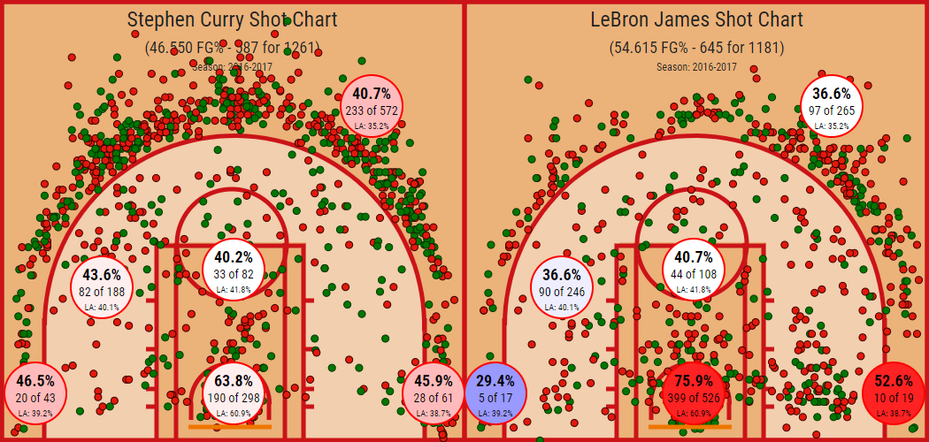
The Heatmap
http://nbasavant.com/apps/compare.php

Slide 14
Conclusion
Be dynamic
Collect data where possible
Make data-driven decisions

