Slide 1
Paste DHL logo here
DHL EXPRESS · AMKAD FINANCE
AR Reporting Transformation Project
Internship Close-Out · Jean Kadadihi · DHL Express AMKAD Finance

Slide 2
OVERVIEW
The Mission
Move AMKAD AR reporting away from manual Excel processes toward a centralized, automated reporting ecosystem.
• Historical SAP data collection & standardization across countries
• Centralized AR database strategy
• Power BI executive dashboards
• Automated HTML executive reports (Office Scripts + Power Automate)
• Power Query ingestion automation
• Future SQL / Data Factory integration
“Leading the technical side of an AMKAD AR reporting transformation — functioning as a Finance Analytics & Automation Developer rather than a typical intern.”
AMKAD AR Reporting Transformation · Internship Close-Out
2

Slide 3
ROADMAP
Five Phases of the Transformation
1
2
3
4
5
SAP Data Collection
Historical AR extracts
Open items data
Country standardization
Centralized Database
Shared AR database
Cross-country reporting
Eliminate manual Excel
Power BI Development
Executive KPIs
Customer & aging views
Replace monthly Excel
HTML Dashboard Automation
Office Scripts + Power Automate
Fully automated pipeline
Deepest technical work
SQL / Data Factory
Data Factory access granted
Centralized SQL layer
Future integration
AMKAD AR Reporting Transformation · Internship Close-Out
3

Slide 4
PHASE 1 & 2
Foundations: SAP Data & Database Strategy
Phase 1 — Historical SAP Data Collection
• Downloaded historical AR extracts & open items data
• Worked through SAP variants across countries
• Standardized country-level reporting formats
• Collaborated with Jose Pablo Cuevas, Sandra Garcia, Javier Leiva & country teams
• Built the historical dataset underpinning all later automation
Phase 2 — Centralized AR Database
• Strategy to upload AR files into a shared database
• Goal: centralized reporting across all countries
• Eliminate repetitive manual Excel processing
• Recurring governance meetings with Sandra (“Data Base & PBIs AMKAD”)
• Foundation for the SQL / Data Factory phase that followed
AMKAD AR Reporting Transformation · Internship Close-Out
4

Slide 5
PHASE 3
Power BI Development
A documented implementation plan, aimed at replacing the existing monthly Excel report.
• Executive Dashboard
– Total AR, Overdue %, GT60 %, GT90 %
• Customer View
– Customer-level AR performance
– Top risk customers
• Aging Analysis
– Aging buckets & distribution analytics
• Future Enhancements
– Database connectivity
– Sales integration & DSO calculations
– Leadership-ready reporting
AMKAD AR Reporting Transformation · Internship Close-Out
5

Slide 6
PHASE 4
HTML Dashboard Automation — The Pipeline
The most technically complex piece of the project: a fully automated, self-refreshing reporting chain.
SOURCE
Daily Excel File
Uploaded to SharePoint each day
LOAD
Power Query
Always finds the latest file
CALCULATE
Office Script
MTD calculations, KPIs, tables
OUTPUT
JSON Result
Structured data for the flow
ASSEMBLE
Power Automate
Injects data into the template
DELIVER
HTML Dashboard
Emailed automatically
Runs on a schedule with no manual intervention — already distributing “Weekly Automated Report” emails in production.
AMKAD AR Reporting Transformation · Internship Close-Out
6

Slide 7
SIGNATURE TECHNICAL WIN
Solving the “Monthly Snapshot” Problem
The single most important concept in the reporting logic.
The problem:
The AR source file contains multiple historical months and multiple daily snapshots per month, stretching back to 2024. Summing every row for a month meant a month's figures were counted 20+ times over.
The fix:
Keep only the latest valid snapshot for each month — a two-pass algorithm that detects the true point-in-time extract and discards every earlier daily copy.
Result: a Month-to-Date view that finance can actually trust.
REAL IMPACT — BEFORE vs. AFTER
June figures, before fix:
€924,030,792
June figures, after fix:
€45,423,420
~20× overstatement, caught and corrected
AMKAD AR Reporting Transformation · Internship Close-Out
7

Slide 8
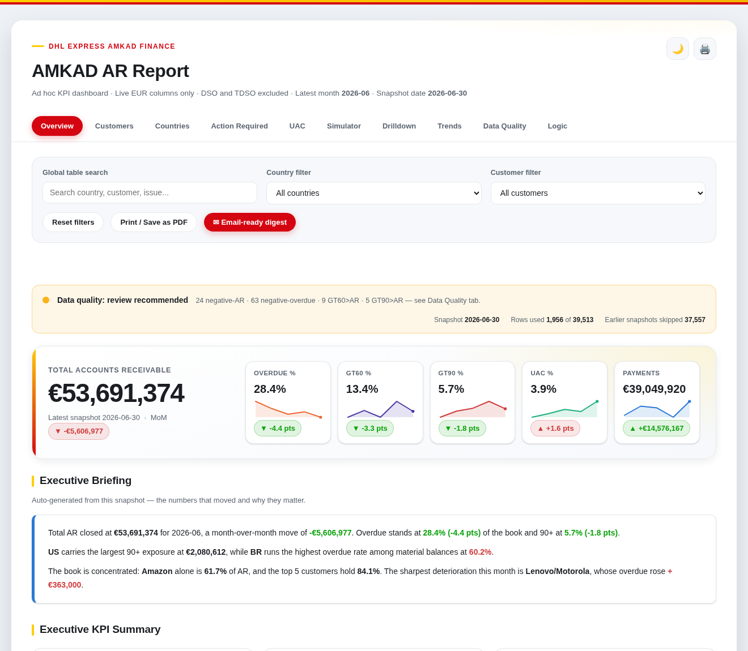
THE DELIVERABLE
Executive Overview Dashboard
Auto-generated narrative briefing, live KPIs, and a data-quality confidence banner.
Live render of the deployed HTML report, current AMKAD data.
AMKAD AR Reporting Transformation · Internship Close-Out
8

Slide 9
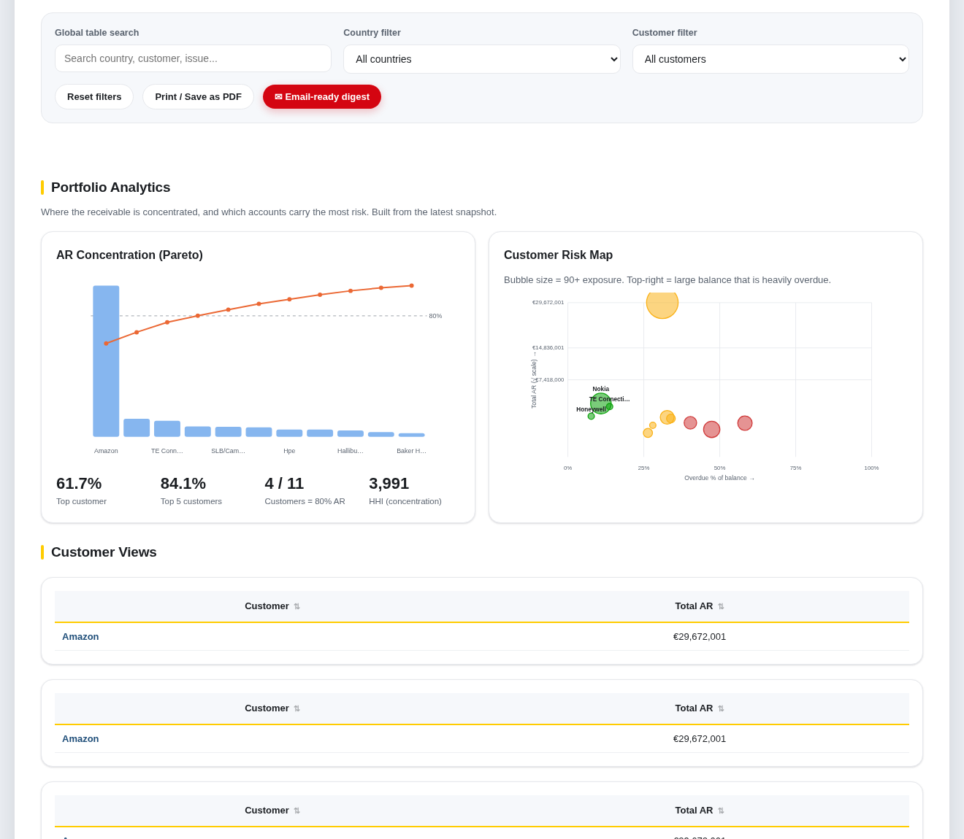
THE DELIVERABLE
Portfolio Analytics
AR concentration (Pareto/HHI) and a customer risk map — insights nobody had visibility into before.
Live render of the deployed HTML report, current AMKAD data.
AMKAD AR Reporting Transformation · Internship Close-Out
9

Slide 10
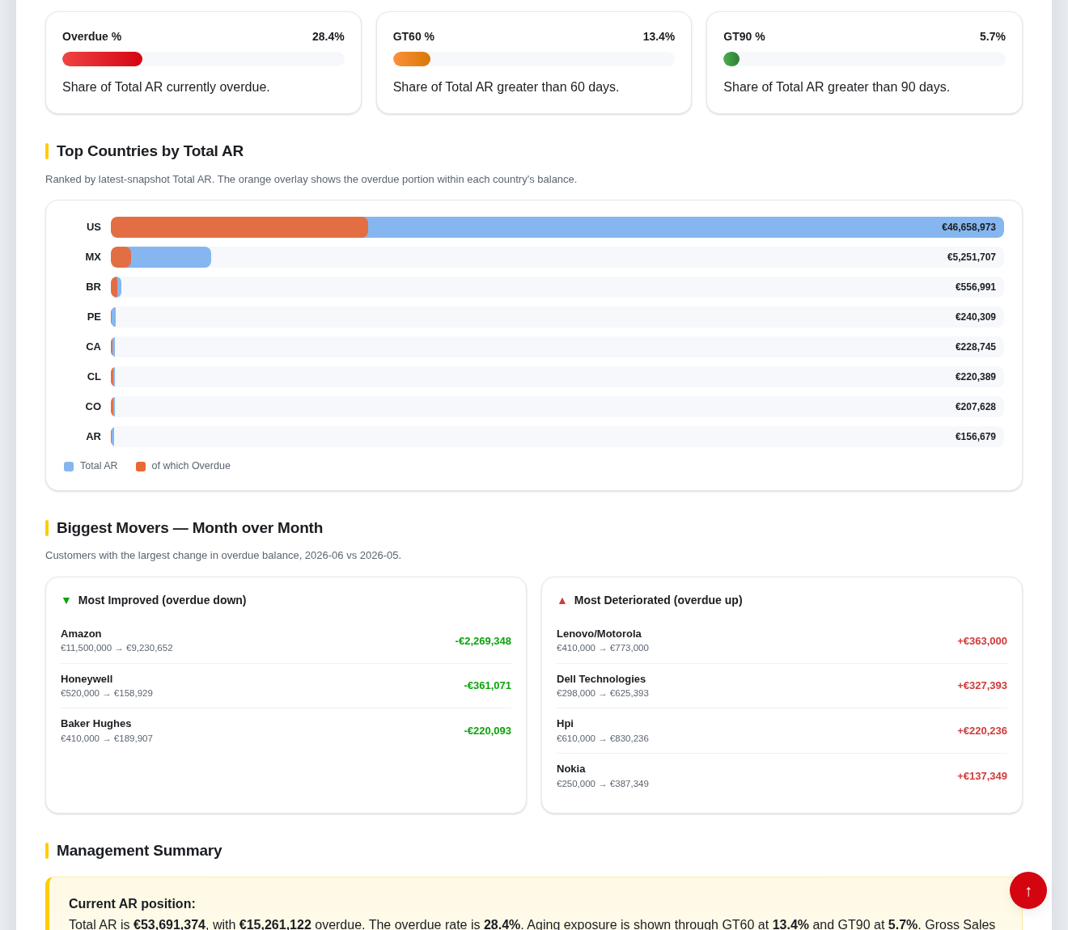
THE DELIVERABLE
Biggest Movers
Automatically ranks the customers most improved and most deteriorated, month over month.
Live render of the deployed HTML report, current AMKAD data.
AMKAD AR Reporting Transformation · Internship Close-Out
10

Slide 11
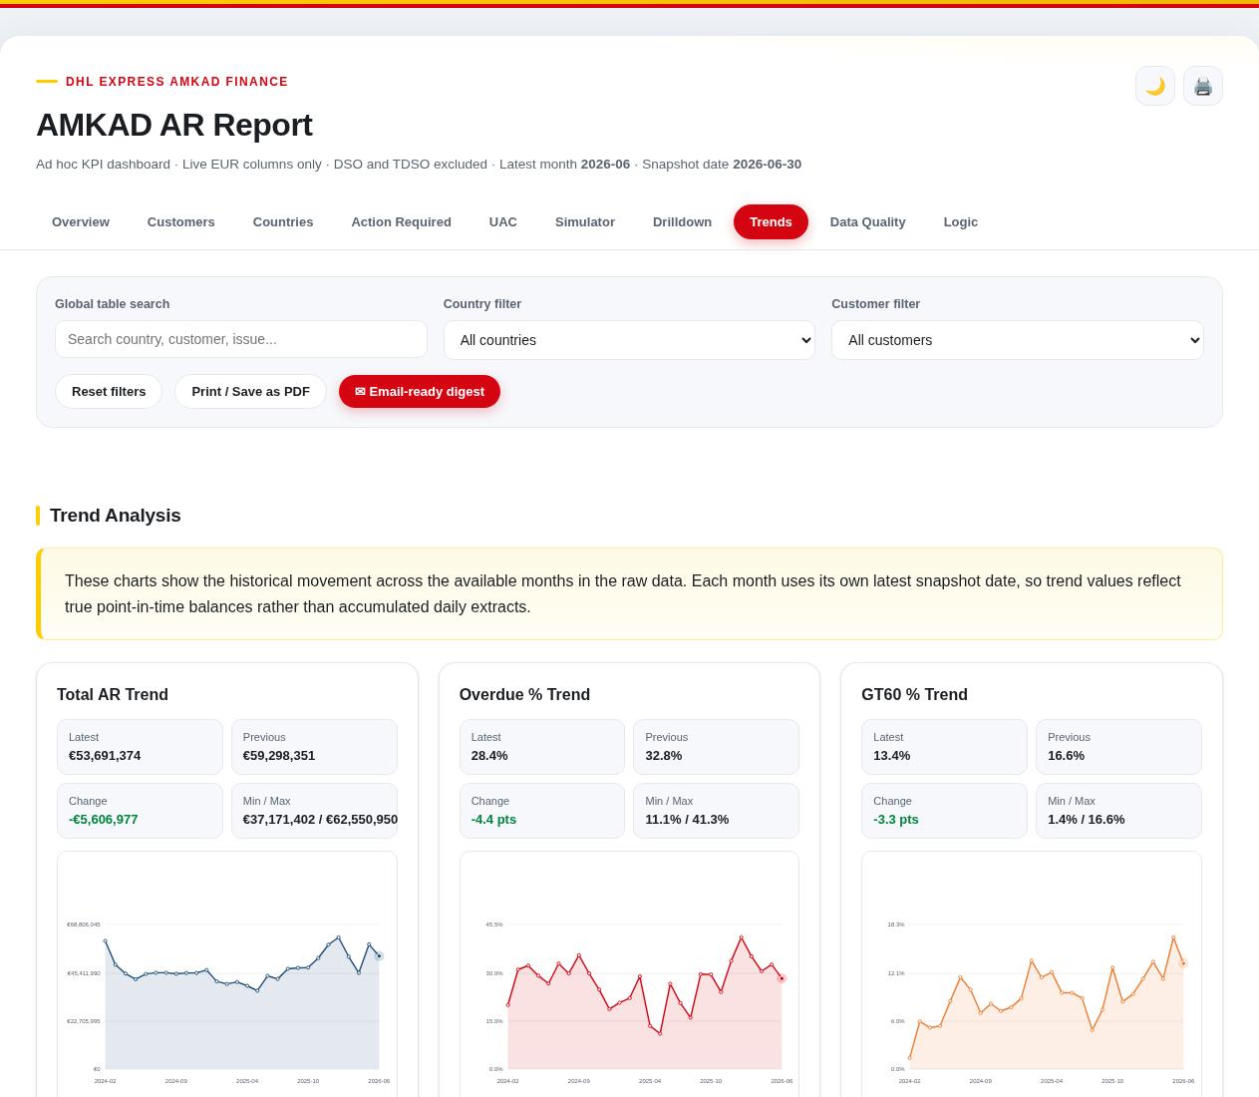
THE DELIVERABLE
Trend Analysis
Interactive, hover-enabled trend charts across 2+ years of point-in-time snapshots.
Live render of the deployed HTML report, current AMKAD data.
AMKAD AR Reporting Transformation · Internship Close-Out
11

Slide 12
GOVERNANCE
Data Trust & Reliability
A dashboard is only as good as the numbers behind it — built to fail loudly, never silently.
• Confidence banner
– Every report surfaces rows used vs. skipped, and any structural anomalies
• Snapshot audit trail
– Shows exactly which date was chosen for every month, fully auditable
• Automated refresh reliability
– A dedicated trigger flow guarantees the source file refreshes before the report runs
• Freshness safeguards
– Designed to fail visibly rather than silently ship stale numbers
AMKAD AR Reporting Transformation · Internship Close-Out
12

Slide 13
PHASE 5 — LOOKING AHEAD
SQL & Data Factory Integration
• Requested and received Data Factory access under Finance O2C reporting functions
• Reviewed SQL environments and centralization strategies
• Groundwork laid for moving from file-based automation to a true data platform
• Positions the next phase of this project for scale across AMKAD and beyond
AMKAD AR Reporting Transformation · Internship Close-Out
13

Slide 14
MILESTONE
Houston Working Session
Power BI
• Validated May numbers
• Reviewed charts & graphs
• Gross Sales review
• DSO logic review
SAP & Reporting
• SAP download process improvements
• HTML automation development
• Forecasting work
• SQL environment review
Process Exposure
• Collections process exposure
• AMKAD overview
• Mexico SPR presentation observed
AMKAD AR Reporting Transformation · Internship Close-Out
14

Slide 15
IN PRODUCTION
Live Automation & Operational Exposure
• Weekly Automated Reports
– Already distributing production reports on a recurring schedule — development has moved to real usage
• Statement of Account (SOA) shadowing
– Shadowed Taralynn Haag on SOA workflows, invoice reconciliation, and Power BI usage in customer account reviews
• Recurring governance
– Regular Power BI plan review sessions with Sandra kept the project aligned with business needs
AMKAD AR Reporting Transformation · Internship Close-Out
15

Slide 16
HONEST RETROSPECTIVE
Challenges Faced
• Diagnosing the multi-snapshot inflation bug — required building a diagnostic audit, not just guessing
• A month showing zero data (April) — traced to source-level gaps, not the automation itself
• Platform limits: Office Scripts cannot trigger a Power Query refresh — required a workaround flow design
• Power Automate silently stripping HTML on save — learned to always redeploy the full file, never a fragment
• Getting data-refresh timing right with no native “wait until ready” mechanism
• Standardizing AR business logic (Total AR, Overdue, GT60/90, DSO/TDSO) consistently across countries
AMKAD AR Reporting Transformation · Internship Close-Out
16

Slide 17
IMPACT
Value Added
~20×
Reporting distortion found and corrected
100%
Manual monthly Excel process automated
2+ yrs
Historical AR data standardized
Live
Weekly automated reports in production
• Surfaced a real concentration risk invisible before: top customer ≈ 62% of AR, HHI ≈ 3,990
• Replaced a fully manual monthly reporting cycle with a self-refreshing automated pipeline
• Unlocked the path to SQL / Data Factory centralization for the next phase
AMKAD AR Reporting Transformation · Internship Close-Out
17

Slide 18
HANDOVER
What I'm Leaving Behind
• Maintenance guide, in three formats
– Markdown (versioned in the repo), Word document, and a shareable web page
• A documented Power BI implementation plan
– KPIs, customer view, aging analysis, and a future-enhancements roadmap
• A standardized historical SAP dataset
– The foundation for all reporting going forward
• A running, self-refreshing automation
– Already in production, distributing weekly reports
• Data Factory access under Finance O2C
– A clear on-ramp to full SQL integration for my successor
AMKAD AR Reporting Transformation · Internship Close-Out
18

Slide 19
Paste DHL logo here
Thank You
This internship took me from reading SAP extracts to designing a self-refreshing automated reporting platform — and taught me to build things that are still trustworthy after I'm gone.
Questions & discussion

