Slide 1
Syntax-based MT Evaluation with
Expected Dependency Pair Match
  Jeremy G. Kahn
  Mari Ostendorf
  UW (SSLI Lab)
  Brian Roark
  OHSU

Slide 2
Overview
Expected Dependency Pair Match
Straightforward intuition
Uses syntactic and lexical information
Does well* at predicting HTER
No:
  Synonym or paraphrase tables
  Dev-set tuning (much)
  Fuzzy approximations (except in the parser)

Slide 3
Building EDPM: the F measure
F-measure is intuitively appealing
  Hard to game
  Bag-of-words has easy intuition.
  Multiple references? Match vs. any ref bag
What's in the bag?
  Words?
  Word-sequences → n-grams

Slide 4
Building DPM:
Outsourcing adjacency
Why insist on adjacency? Ne ... pas skip-n-gram is perfectly good
  But which non-adjacent n-grams?
“If only we had a tool for deciding which words in a sentence were related!”
With dependency parse, we can F-measure
  syntactically-local n-grams [Liu and Gildea]
  Labeled dep-head links [Roark et al. SParseval]
Salutary side effect: heads “overcounted”

Slide 5
Building EDPM: partial match
Don't have to use whole link.
  We have n outbound links (dependent→link→)
  We have n-1 inbound links (→link→head)
  (also n unigrams, n-1 bigrams)
Prev. work with LFG dependencies [Owczarzak et al.] found that partial-link was better vs. human judgments
Note: still a single F-measure (all 4 subclasses have different signatures)

Slide 6
Building EDPM:
Mistrusting the parse
Parses are hidden, even on reference
Use n-best lists on reference and hypothesis
Use weighted counts (based on parser probabilities)
Mistrust parser probabilities (flatten with γ)
  γ=0: uniform distribution, γ=1: no change

Slide 7
EDPM: to review
Free parameters:
  Which graph fragments?
    Unigrams, bigrams, etc
    head+inbound link
    dependent+outbound link
    dependent+link+head
    dependent+head [no link!]
  Number of n-best parses to include
  γ parse confidence trustworthiness parameter

Slide 8
Implementation
Dependency forest extraction
  Charniak parser in n-best mode
  Head-finding table [tweaked with semantic heads]
  Arc-labels from lowest-over-highest constituents
The rest is in Perl

Slide 9
Experiments [Chinese MTC]
Set up experiments against MTC judgments
  Similar to Owczarzak 2007 experiments
Key results in r correlation vs fluency+adequacy:
  Full-link-alone F-measure ≈ BLEU-4, TER
  Improved by using partial rather than full links
  Using 1- and 2-grams ≈ inbound and outbound word+link (≫ BLEU and TER)
  Including 1g, 2g, inbound, outbound better still
  small jump from 1- to 50-best
  γ = 0.25 is good setting.

Slide 10
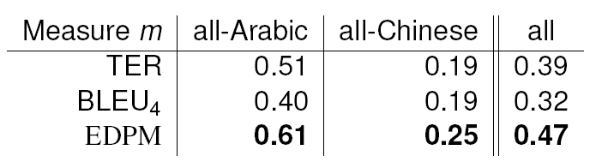
Experiments [GALE 2.5]
Compared EDPM measures (same settings) to TER, BLEU-4 on docs, sentences of GALE 2.5
  Correlations between Δ(score) & ΔHTER

Slide 11
Discussion and Future Work [1]
Internal weight tuning?
  Weight relative contribution of 1g, 2g, out-bound & inbound links.
  Introduces only 3 free parameters; no need for additional parsing when tuning.
Very different strategy from (e.g.) METEOR and TER. Combination approaches seem fertile
Question: cross-correlation among metrics?

Slide 12
Discussion and Future work [2]
Defers to [expensive!] parser for syntactic info
  Better labeling? Better parser
  New target language? New parser
  More candidates? Longer n-best lists
Cherry & Quirk (2008) discriminative parsing
  vs. a better [Viterbi] parser?
L. Huang's [2008] packed forests
  Better than longer n-best lists?
Directly get dependency parse?
  We really want dist. of likely heads, arcs for each word

Slide 13
Thank you!
Conversations and comments from:
My co-authors, Mari Ostendorf and Brian Roark
Two anonymous reviewers
Kevin Knight, Kevin Duh, Matt Snover, Michel Galley
GALE team-members and Karolina Owczarzak

Slide 14
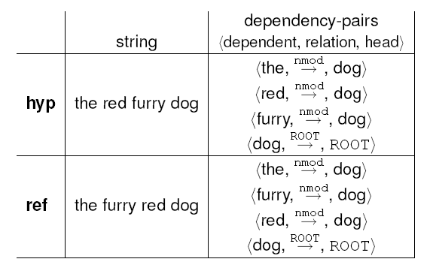
Sparseval example [1]

Slide 15
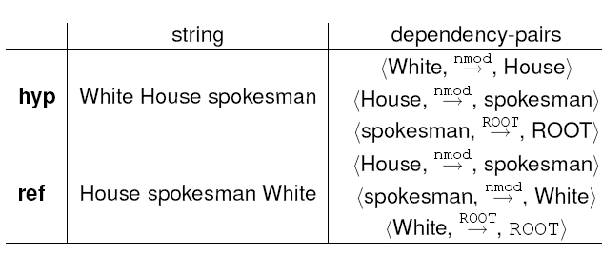
Sparseval example [2]

Slide 16
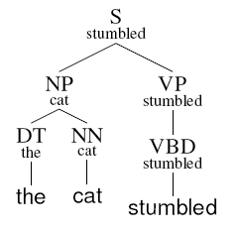

Extracting dependency trees
Charniak PCFG with WSJ default training
Head-finding with modified Charniak rules
Arc-labels are Gov/MaxProj

Slide 17
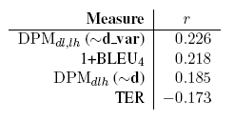
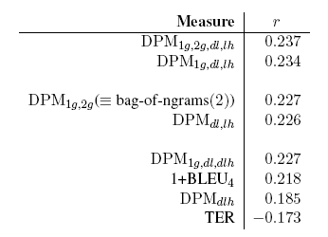
Correlation improvements [MTC]

Slide 18
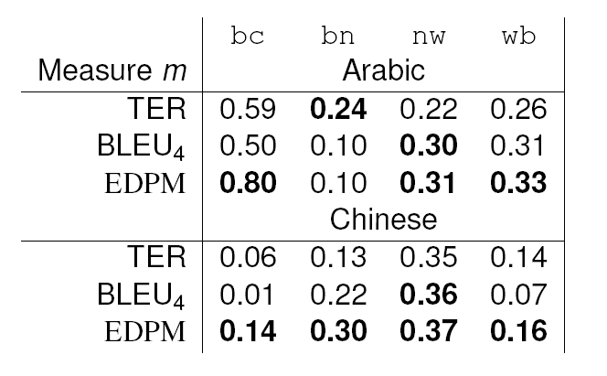
GALE 2.5 by-genre document correlations with HTER

