Slide 1

SOUTH ASIAN UNIVERSITY
SAU CSE
Department Website
Project idea and progress presentation
A clearer website for students
and department visitors
CURRENT STAGE
HTML and CSS homepage
Next: PHP and MySQL
01 / 11
Notes:
Good morning everyone. Our project is a website for the Department of Computer Science and Engineering at South Asian University. Today I will present the homepage that we have built and our plan to make the website dynamic.

Slide 2
SOUTH ASIAN UNIVERSITY
Problem Statement
01
Finding department information
Visitors need clear routes to programmes, research and notices.
02
Updating the current prototype
Changing a notice currently requires editing the HTML code.
03
Proposed solution
An admin panel will allow authorised staff to update database content.
02 / 11
Notes:
Students and visitors need an easy way to find department information. Our project focuses on clearer organisation and easier content updates. In the current prototype, we must edit HTML to change a notice. We plan to solve that with an admin panel. We are not claiming that the existing official website has no backend.

Slide 3
SOUTH ASIAN UNIVERSITY
Objectives
01
Make information easier to find
Use clear sections, navigation and useful links.
02
Support different screen sizes
Use CSS Flexbox and a mobile media query.
03
Make content easier to maintain
Connect the website to a database in the next phase.
03 / 11
Notes:
Our objectives are to create an easy-to-use homepage, organise the main department sections, support different screen sizes and later connect the website to a database. These are project goals, and backend work is still pending.

Slide 4
SOUTH ASIAN UNIVERSITY
Scope of the Project
In scope
Outside the scope
Department homepage
Programme and faculty pages
Research, notices and events
Admin panel and database
Admission processing
Online payments
Attendance and exam results
Full university management
Current delivery covers the homepage. Other pages and the backend remain planned.
04 / 11
Notes:
The project covers department information and content management. We have built only the homepage so far. The full plan includes separate content pages and an administration panel. Admissions processing, payments and examination management are outside our scope.

Slide 5
SOUTH ASIAN UNIVERSITY
Features and Functional Requirements
Available now
Planned next
Section navigation and quick links
Programme and research cards
Sample notices
Links to official resources
Administrator login
Add, edit and delete content
Database content on pages
Search and contact enquiries
05 / 11
Notes:
The current homepage has navigation links, programme cards, research information, sample notices and links to official resources. Planned functions include administrator login and the ability to add, edit or delete content. The notices shown today are examples, not live announcements.

Slide 6
SOUTH ASIAN UNIVERSITY
Technology Stack
CURRENT HOMEPAGE
HTML5
Structure, headings and links
CSS3
Colours, spacing and responsive layouts
PLANNED DYNAMIC WEBSITE
PHP
Server logic and login
MySQL
Content storage
06 / 11
Notes:
HTML gives the website its structure. CSS controls the colours, spacing and layout. Flexbox places elements side by side. A media query stacks the layout on smaller screens. We do not use Bootstrap or JavaScript in the current homepage. PHP and MySQL are planned for the dynamic stage.

Slide 7
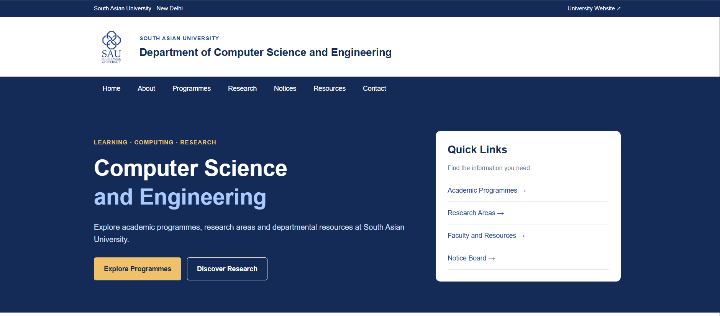
SOUTH ASIAN UNIVERSITY
Homepage Design
University branding, section navigation and quick links
07 / 11
Notes:
This is our actual homepage screenshot. It shows the SAU logo, the department name, navigation and quick links. These links move visitors to sections of the page. The screenshot shows the desktop layout. Source: user-supplied Screenshot 2026-10-25 215313.png and index(3).html.

Slide 8
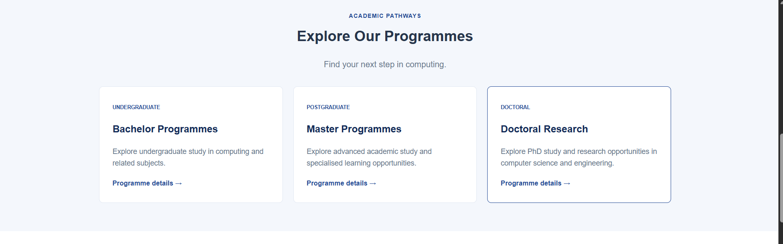
SOUTH ASIAN UNIVERSITY
Academic Programmes
Three study categories with links to official programme information
08 / 11
Notes:
The programme section groups study options into undergraduate, postgraduate and doctoral categories. CSS Flexbox arranges the cards in a row. The CSS contains a media query to stack them on smaller screens. The links currently open the official department page. Source: user-supplied Screenshot 2026-10-25 215328.png and style(2).css.

Slide 9
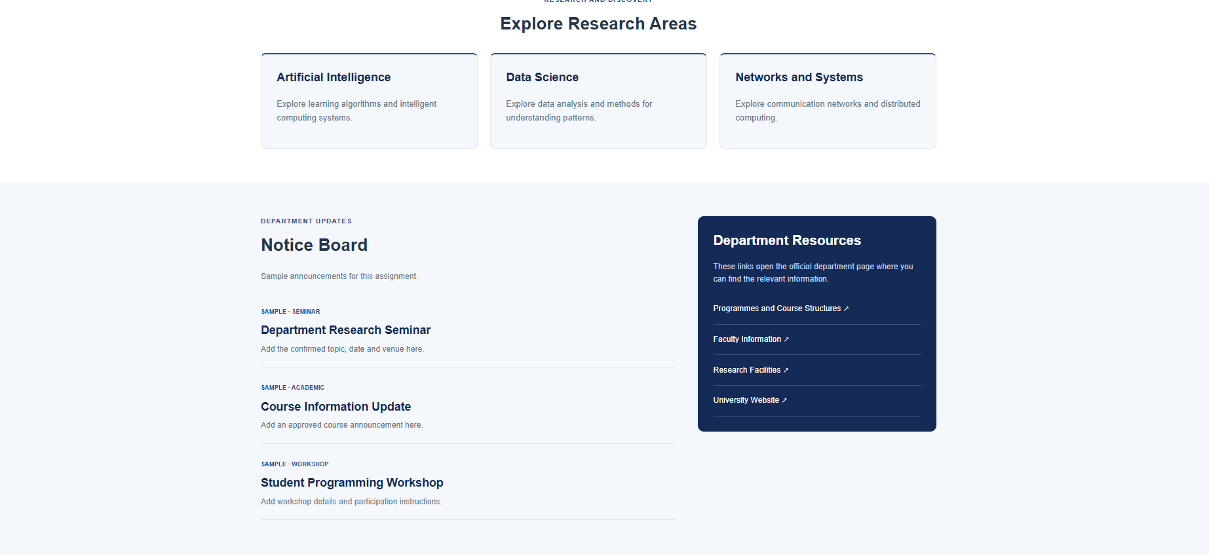
SOUTH ASIAN UNIVERSITY
Research and Notice Board
Sample notices are static. Database updates remain planned.
09 / 11
Notes:
This screenshot shows research areas, sample announcements and the resources panel. All content is currently written in HTML. The notice board is demonstration content. We plan to fetch published notices from MySQL after adding PHP. Source: user-supplied Screenshot 2026-10-25 215350.png.

Slide 10
SOUTH ASIAN UNIVERSITY
Remaining Timeline
Proposed four-week plan after this progress presentation
WEEK 01
Content pages and database design
Complete page content and define MySQL tables.
WEEK 02
Backend connection and login
Connect PHP to MySQL and build administrator login.
WEEK 03
Dynamic content management
Add content editing, search and enquiry storage.
WEEK 04
Testing and final demonstration
Check layouts, links and security. Prepare the final demo.
10 / 11
Notes:
This is a proposed four-week plan starting after the progress presentation. We will adjust it to the deadline given by our teacher. First we will finish content pages and design the database. Then we will build the admin login and content management. Finally, we will test and prepare the final demonstration.

Slide 11
SOUTH ASIAN UNIVERSITY
Conclusion
Homepage completed
HTML and CSS provide the current interface.
Dynamic development comes next
PHP and MySQL will support content updates.
Thank you. Questions are welcome.
11 / 11
Notes:
To conclude, our current deliverable is an HTML and CSS homepage. It provides a clear starting point for department information. Our next task is to develop the backend so an administrator can update content without editing HTML. Thank you. I am happy to answer your questions.

