Slide 1
Musicianship
and
Mandarin Chinese Tone Pronunciation
Jason Kao

Slide 2
What is the impact of musical exposure and musical ability (independent variable) on the ability to pronounce tones in Mandarin (dependent variable)?

Slide 3
Why conduct this study?
Every language makes use of pitch to convey information about speaker stance, tonality, and emotion. However, in a class of languages known as tone languages, words assume different meanings depending on the lexical tones in which they are spoken.
Notes:
Given the importance of, very intriguing to study the relationship.

Slide 4
Tone Production Index (TPI)
-- Dependent Variable --

Slide 5
PITCH CONTOUR ANALYSIS
Quantifying the ability to pronounce Mandarin tones

Slide 6
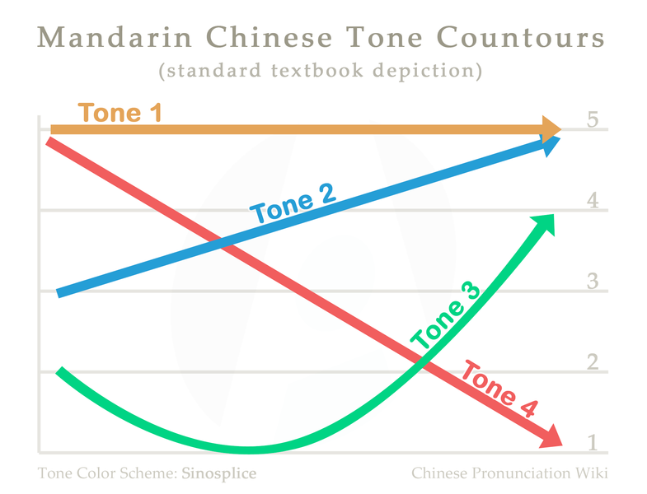

Slide 7
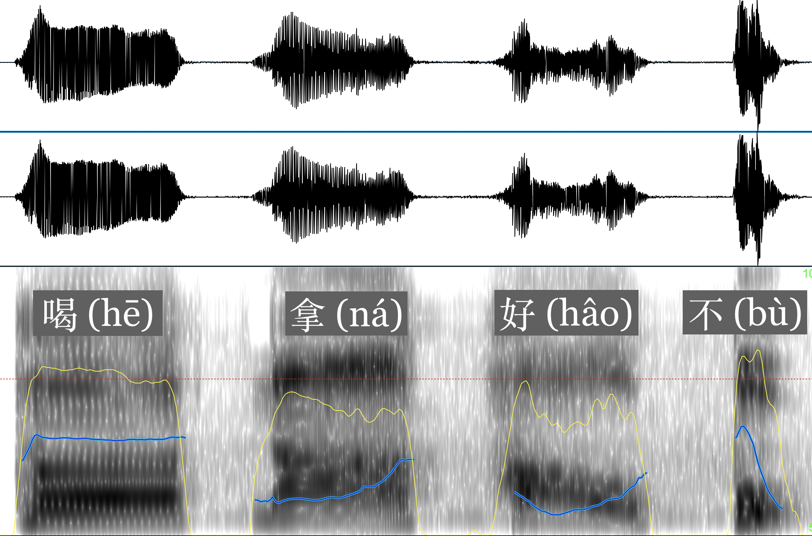

Slide 8
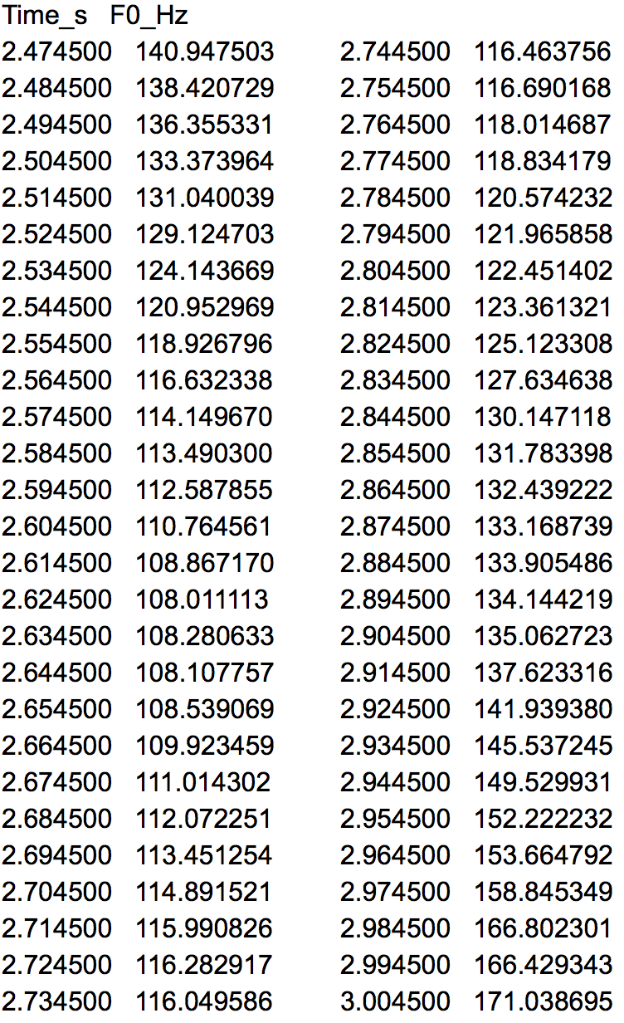
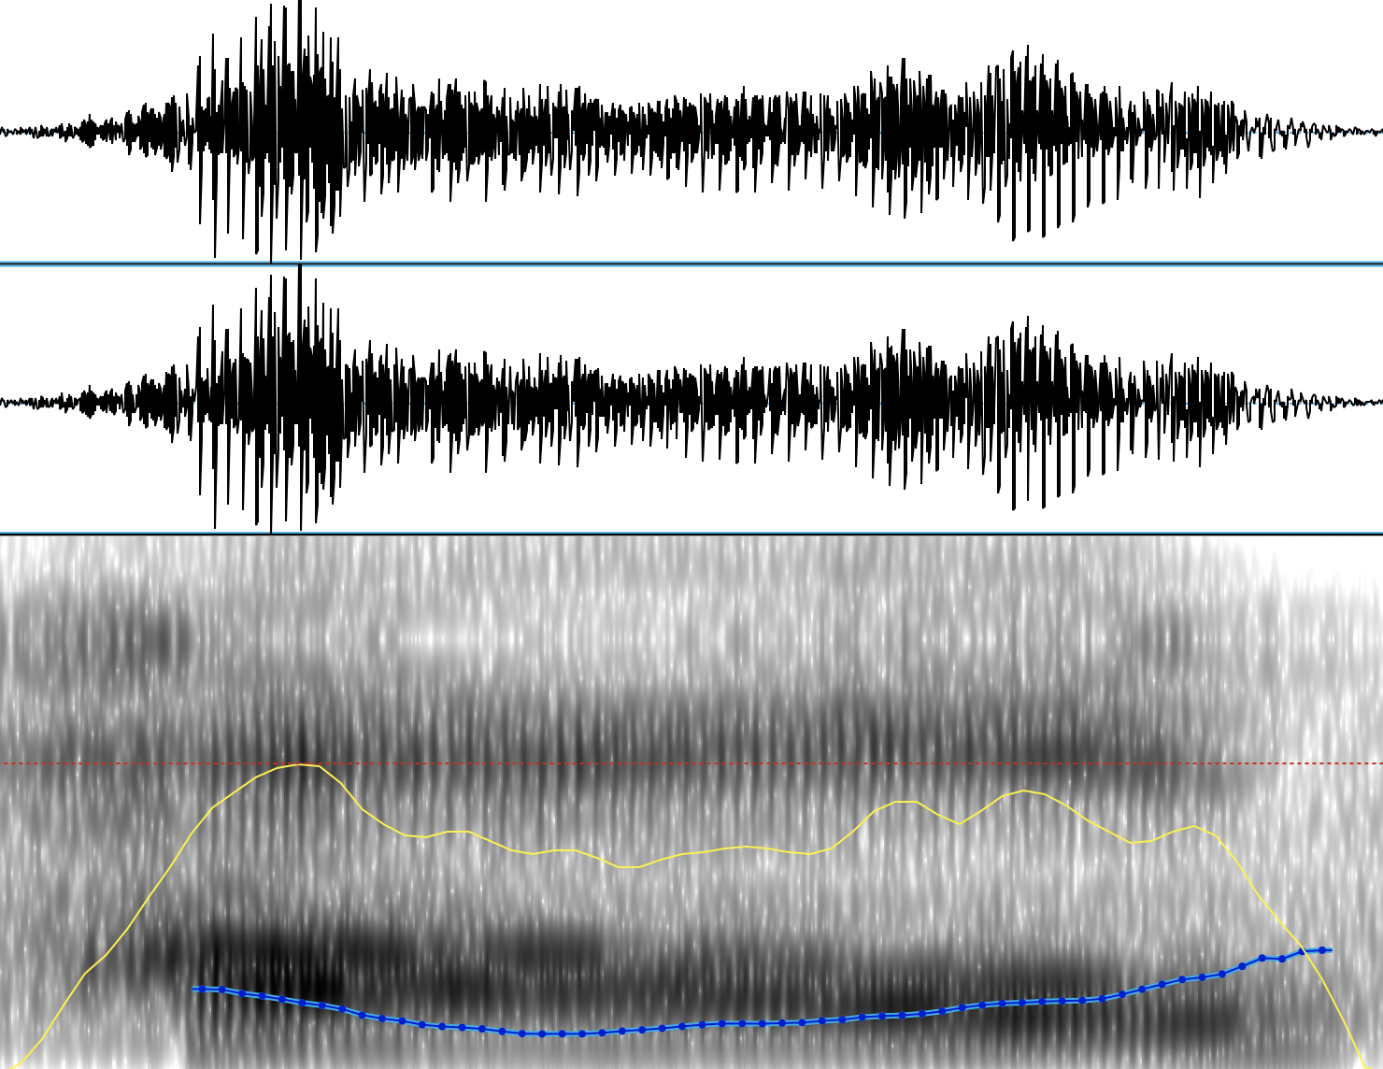
好 (hǎo)

Slide 9
Normalize and Approximate

Slide 10
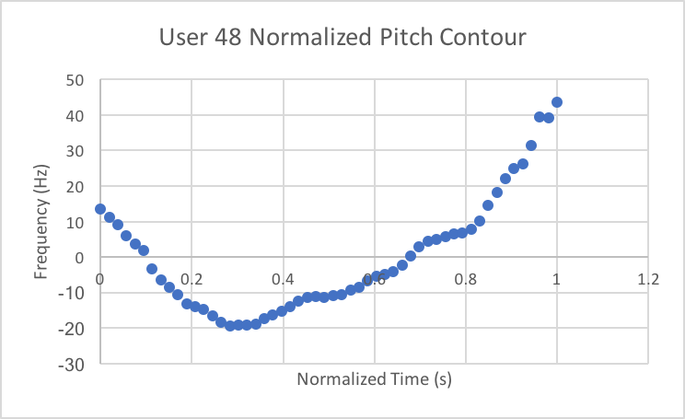
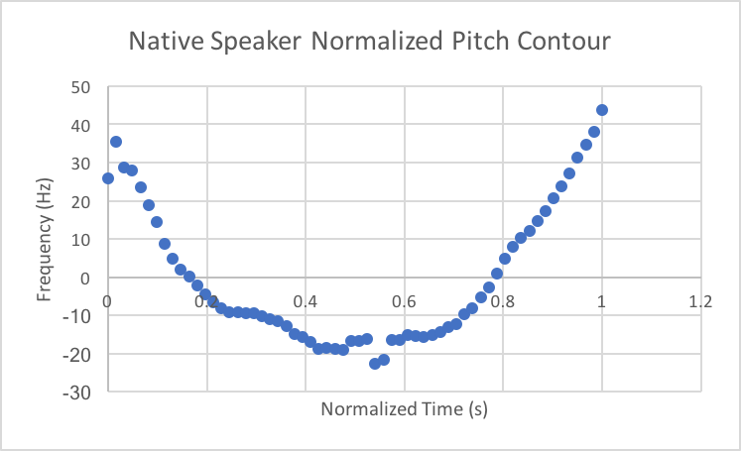
Normalize

Slide 11
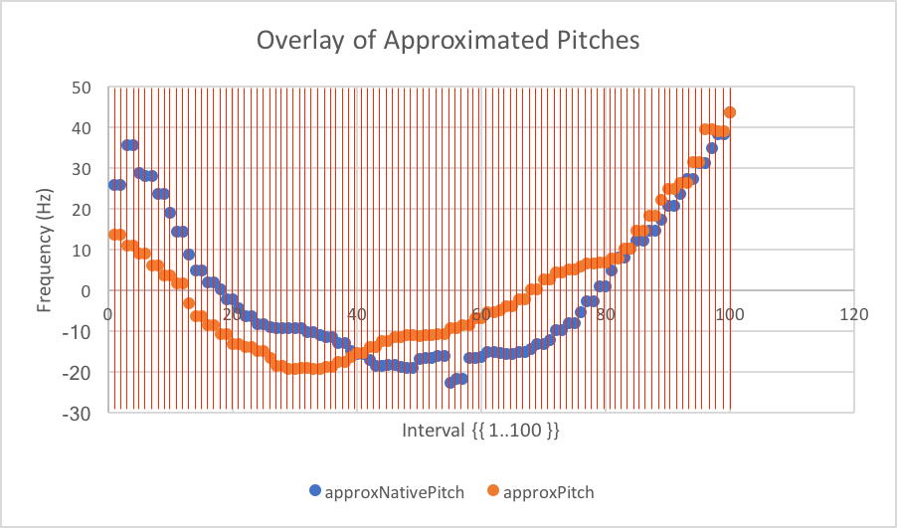
2. Approximate (p, q)

Slide 12
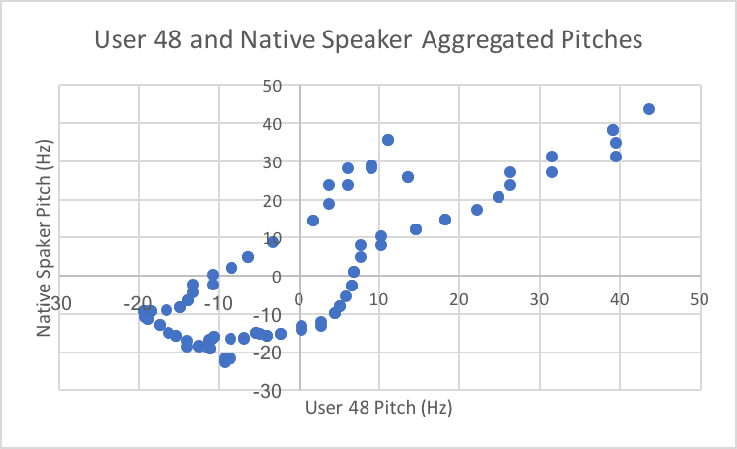
q-axis
p-axis

Slide 13
Explanatory Variables

Slide 14
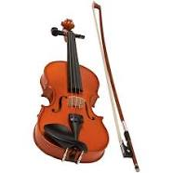
How long have you played a musical instrument? | discrete, in years
Do you play a musical instrument that requires fine tuning? | binary
How long do you practice per week? | interval
How often do you listen to music? | interval
Are you involved in any professional groups? | binary
Are any of your family members musicians? | categorical: no, yes—amateur, yes—professional
Profile of Music Perception Skills (PROMS) - melody subtest | discrete
PROMS tuning subtest | discrete
PROMS pitch subtest | discrete

Slide 15
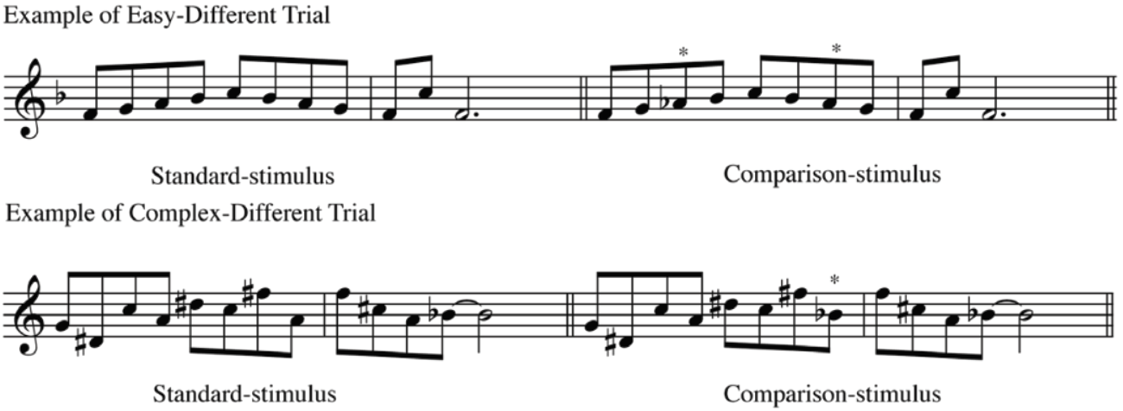
PROMS: standard stimulus vs. comparison stimulus
example melody trial

Slide 16
DATA ANALYSIS

Slide 17
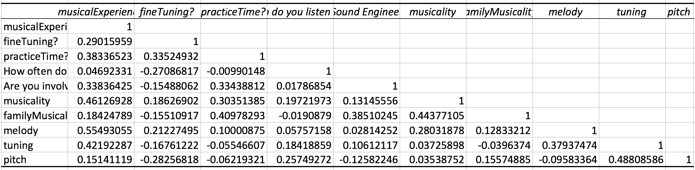
#1: Correlation Matrix

Slide 18
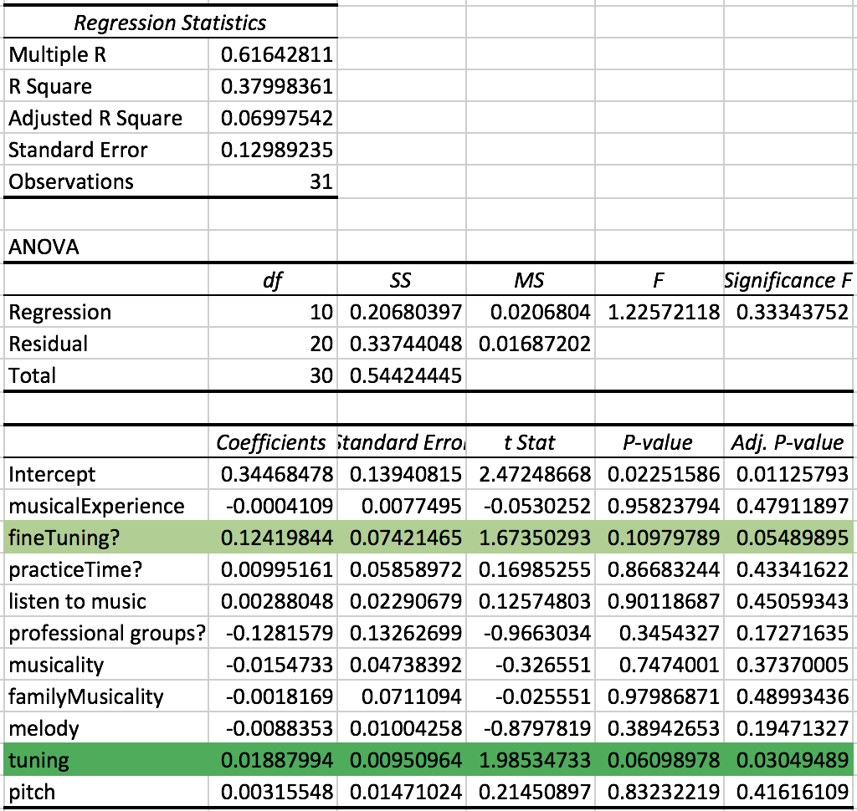
#2: Initial Regression

Slide 19
TPI = 0.34468 + -0.00041(Years of Musical Experience) + 0.1242(Plays Fined Tuned Instrument?) + 0.00995(Hours of Practice per Week) + 0.00288(Daily Exposure to Music) + -0.12816(Involved in Professional Group?) + -0.01547(Musical Status) + -0.00182(Family Musical Status) + -0.00884(PROMS Melody Subtest) + 0.01888(PROMS Tuning Subtest) + 0.00316(PROMS Pitch Subtest)

Slide 20
Significance F = 0.33344
Notes:
There is a 0.33344 chance that all regression parameters are equal to 0. Such a high F means the regression equation does not have validity in fitting the data.

Slide 21
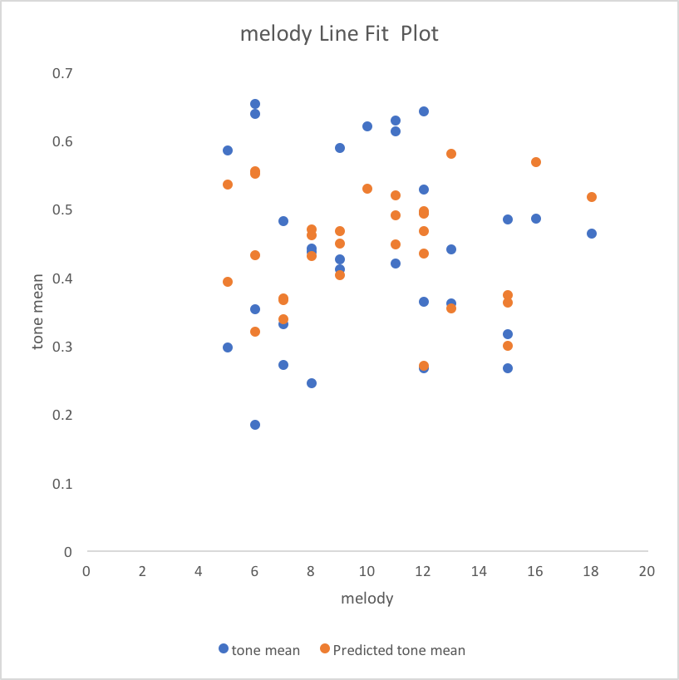
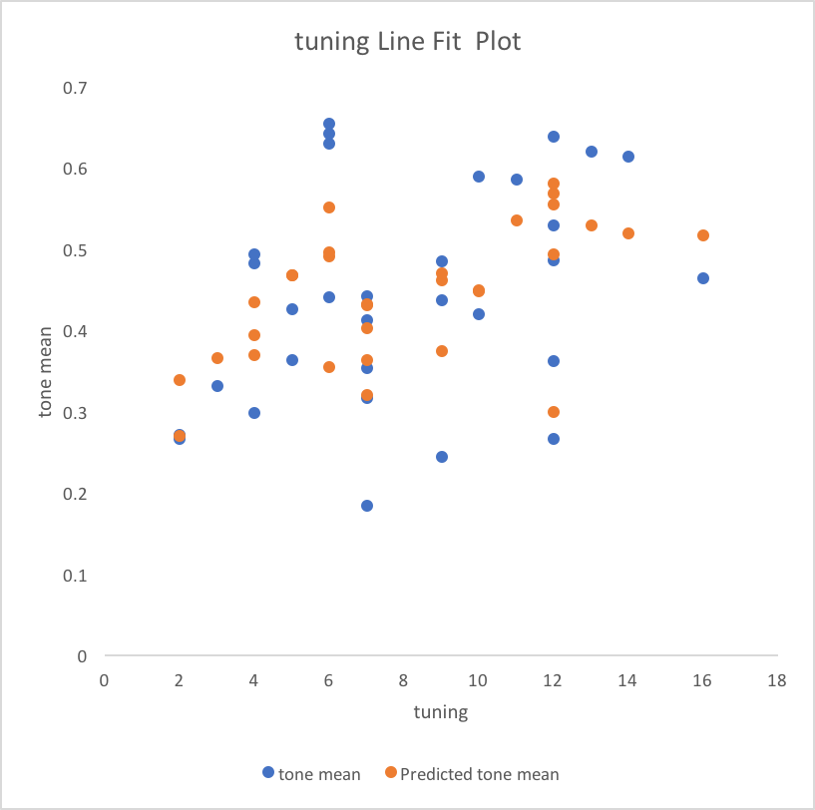
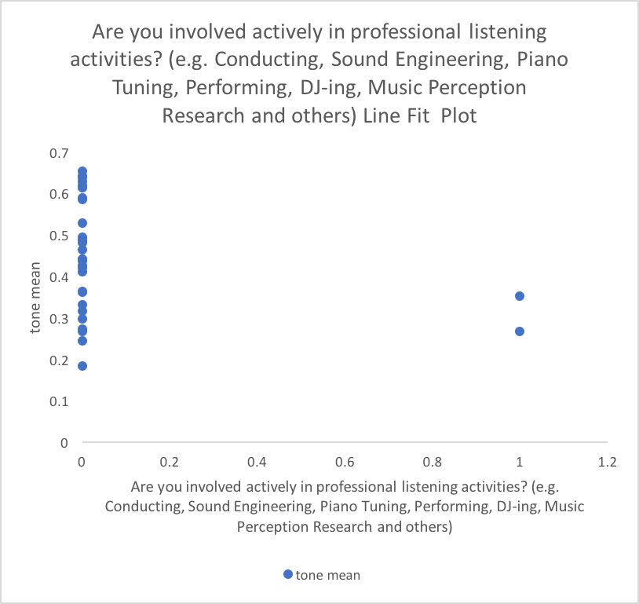
#3: Down selecting- professional Involvement?, fineTuning?, melody, and pitch
1
2

Slide 22
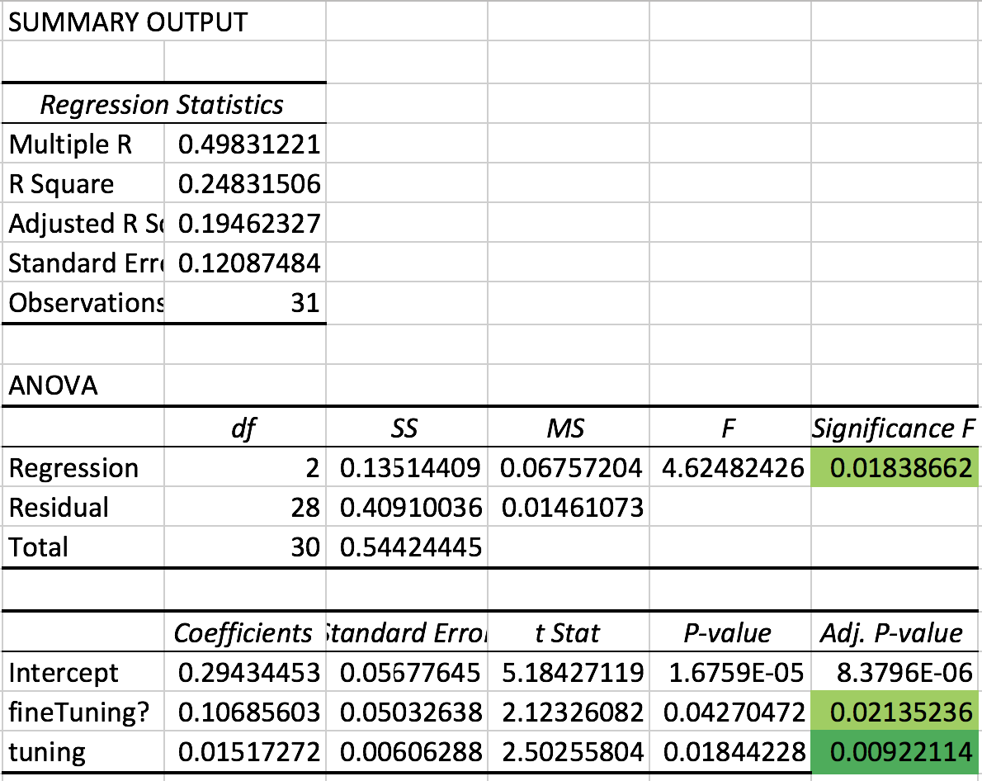
#4 Down selecting for a better fit

Slide 23
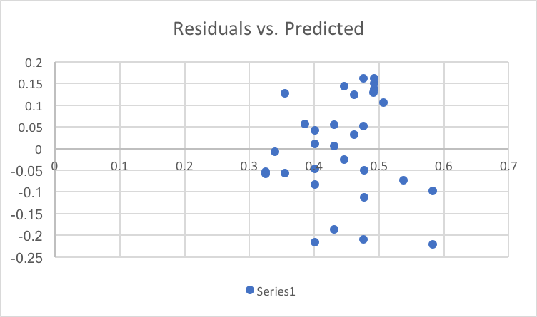
#5: Residuals

Slide 24
#6: F-test for Regression
null hypothesis: all regression coefficients are zero
alternative hypothesis: β_{k} ≠ 0 for at least one value k.
F = 0.01839
On a 95% significance level, there is strong statistical evidence that the fit of the intercept-only model is significantly reduced compared to the fit of my model.
Notes:
There is a 0.01839 chance that all regression parameters are equal to 0. Such a low F means the regression equation does have some validity in fitting the data.

Slide 25
#7: The Equation
TPI = 0.29434 + 0.10686(playsFineTunedInstrument?) + 0.015172(PROMS Tuning Subset)

Slide 26
So what does this mean?
People who play instruments that require fine tuning are significantly better at pronouncing Mandarin tones than people who do not.
Your ability to pronounce Mandarin tones increases with musical aptitude in tuning.

Slide 27
Limitations of this study
recording & PROMS environments were not controlled
voluntary bias, usually musicians/confident participants
response bias in some of the questions (not listening to music is uncool)
small sample size (31) because of length of PROMS most likely was the reason for very few significant variables
lack of prior research in creating a model for tone

Slide 28
Extensions of this study
incorporating music into the Mandarin curriculum (e.g. listening, producing)
Initial results show a trend, but more rigorous analysis is necessary.

