Slide 1
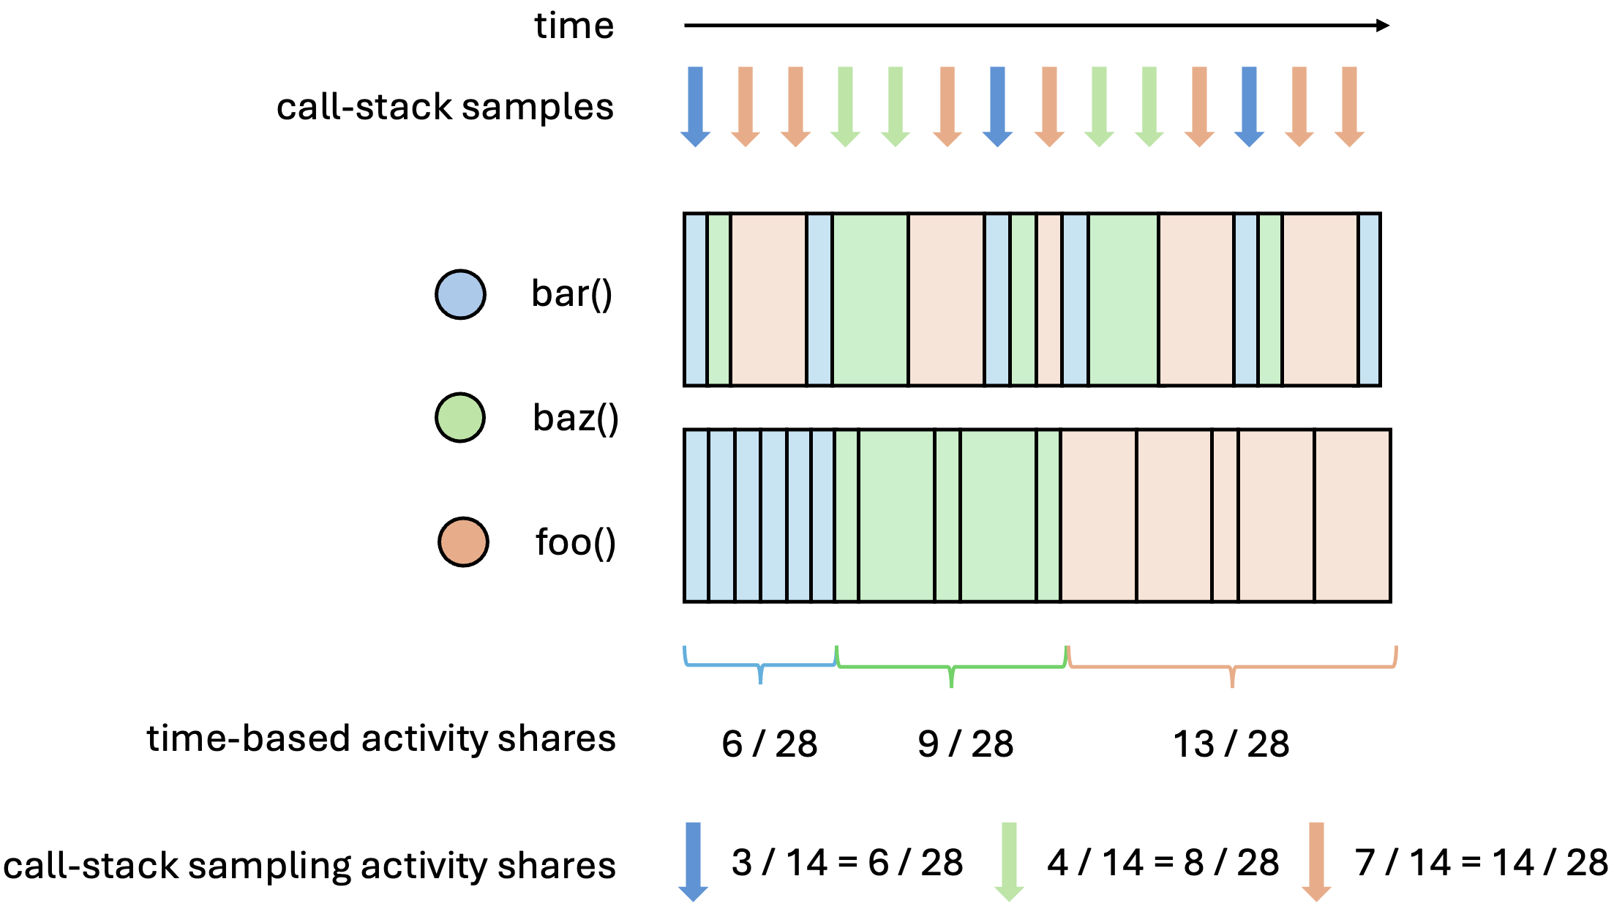
start foo()
end foo()
execution time-markers
start bar()
end bar()
start baz()
end baz()
time-markers share estimations
call-stack sampling share estimations

