Slide 1
Ad-Supported Service
Service Without Ad
Goal & Scope
Goal & Scope
Inventory
Inventory
LCA
GHG Emissions Assessment
Ad GHG Emissions
GHG Emissions Assessment

Slide 2
Define the Scenarios
Run Scenario
&
Monitor User Device
User SIDE
1) kWh / Scenario
2) GB / Scenario

Slide 3
% Users
40
30
20
10
0
5
10
15
20
# of Email Sent / day

Slide 4
% Users
40
30
20
10
0
2
5
7
10
12
15
17
20
# of Email Sent / day

Slide 5
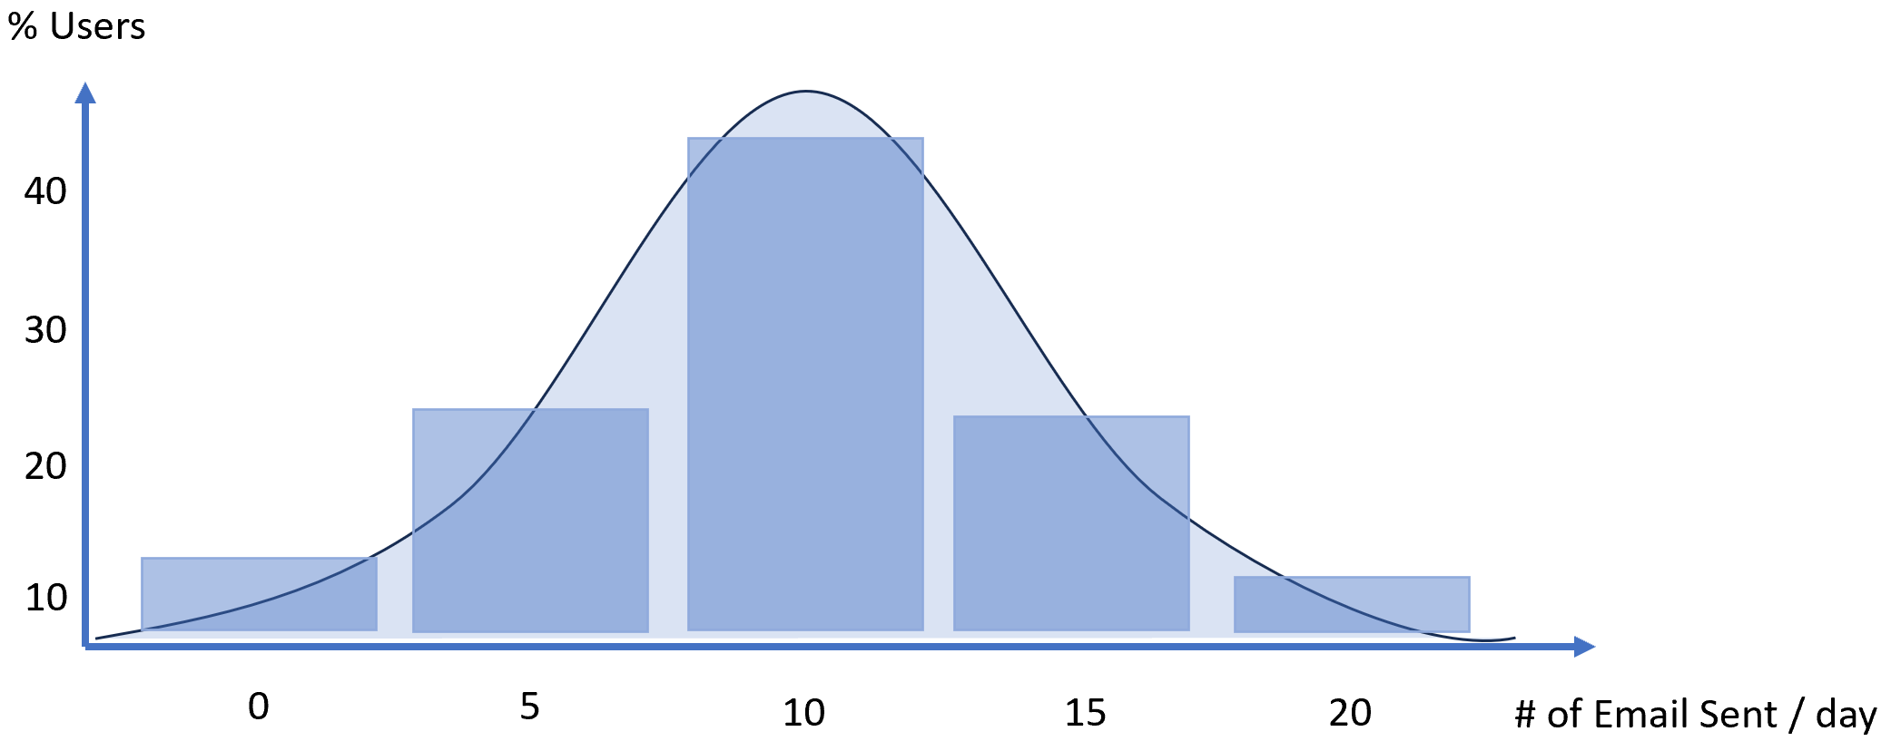
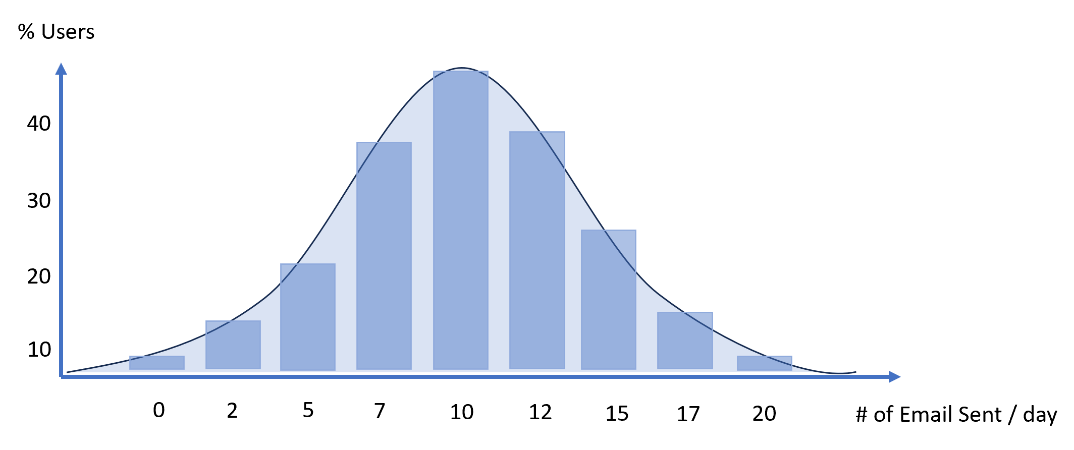

Slide 6
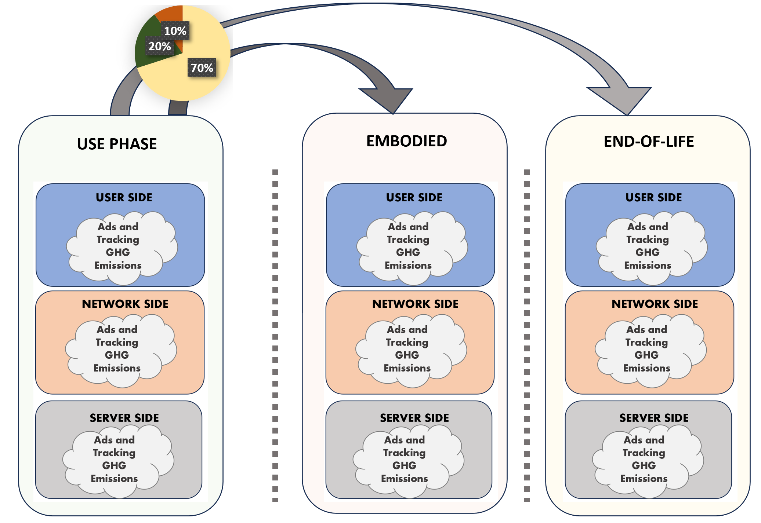
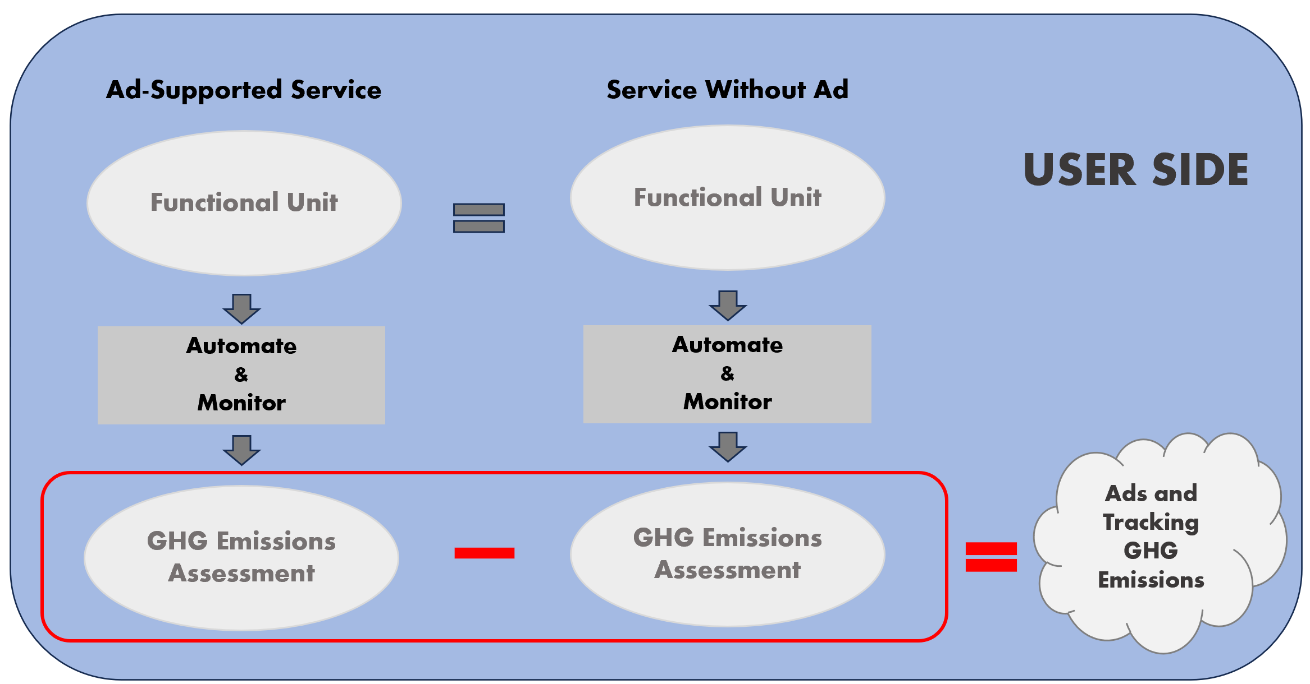
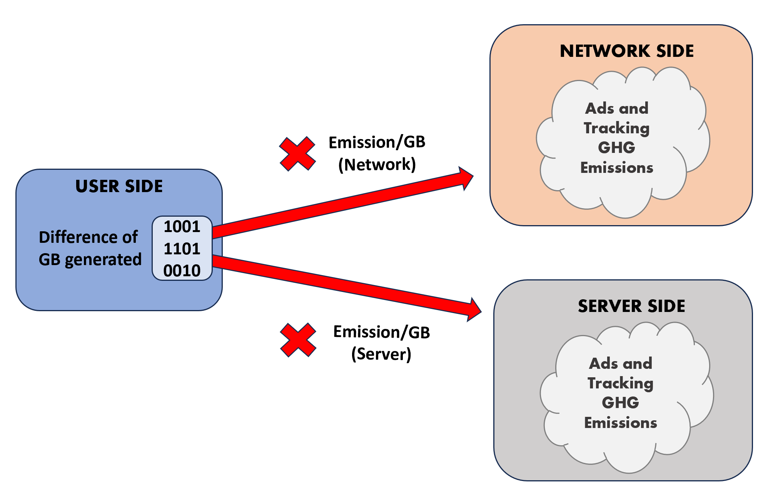
1: Assess User Side
2: Derive Network & Server Sides
3: Derive Embodied & E-o-L

Slide 7
Ad-Supported Service
Service Without Ad
Functional Unit
Functional Unit
USER SIDE
Automate
&
Monitor
Automate
&
Monitor
Ads and Tracking GHG Emissions
GHG Emissions Assessment
GHG Emissions Assessment

Slide 8
Implementation A
Implementation B
Functional Unit
Functional Unit
Functional Unit
Functional Unit
Functional Unit
Functional Unit
Functional Unit
Functional Unit
USER SIDE
Automate
&
Monitor
Automate
&
Monitor
Integrate over user behaviour distribution
Ads and Tracking GHG Emissions
GHG Emissions Assessment
GHG Emissions Assessment

Slide 9
Ad-Supported Service
Service Without Ad
Functional Unit
Functional Unit
LCA
LCA
Ads and Tracking GHG Emissions
GHG Emissions Assessment
GHG Emissions Assessment

Slide 10
NETWORK SIDE
Ads and Tracking GHG Emissions
Emission/GB (Network)
USER SIDE
Difference of GB generated
1001
1101
0010
SERVER SIDE
Emission/GB (Server)
Ads and Tracking GHG Emissions

Slide 11
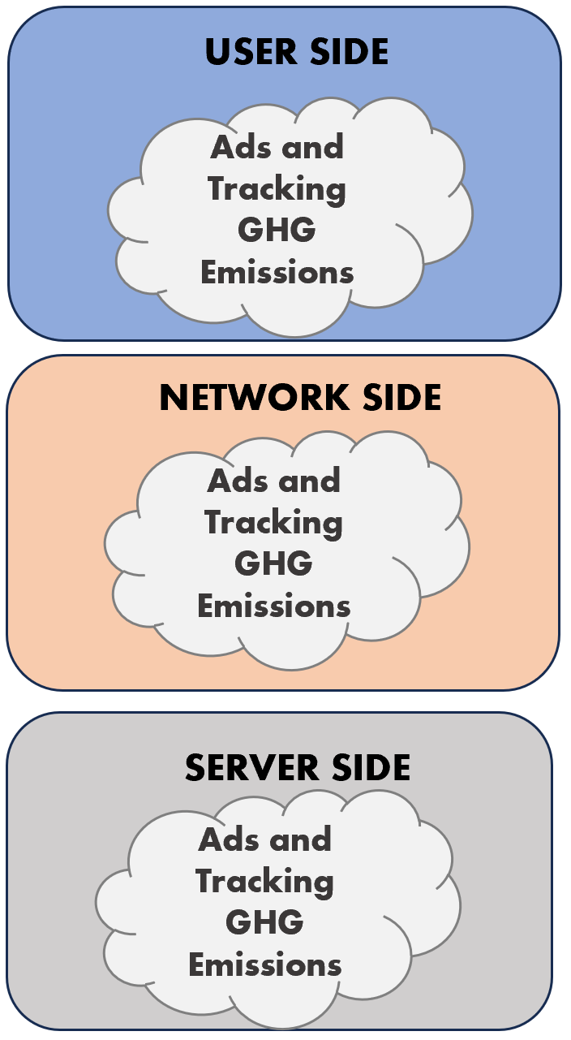
USE PHASE
EMBODIED
END-OF-LIFE

Slide 12




Slide 13
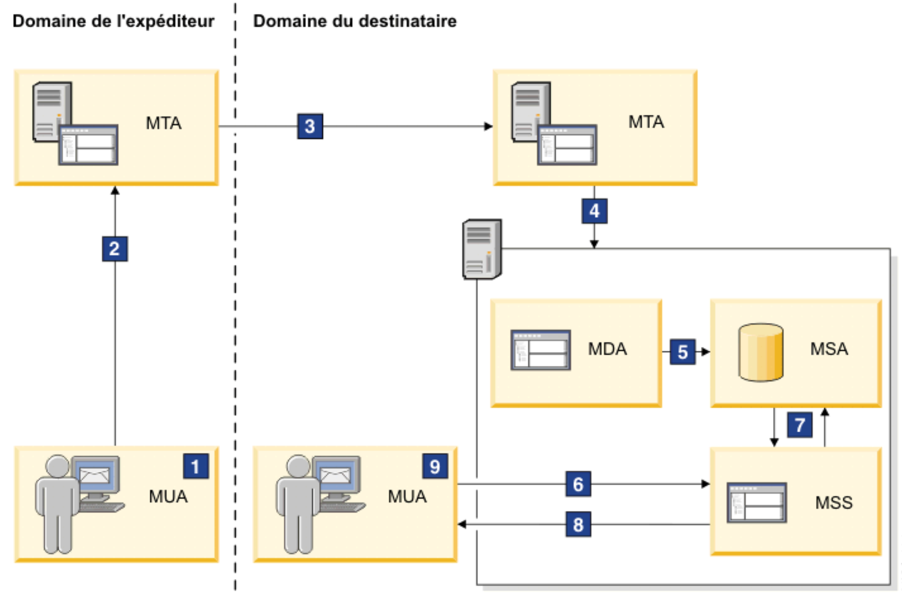
INTERNET

Slide 14




Sender’s Domain
Recipient’s Domain
MTA
MTA
Provider’s Private Network
INTERNET
MDA
MSA
INTERNET
MSS
MUA
MUA
INTERNET

Slide 15


Sender’s Domain
Recipient’s Domain
MTA
MTA
Provider’s Private Network
INTERNET
MDA
Provider’s Private Network
MUA
MUA
MSA
BROWSER
INTERNET
MSS
Provider’s Private Network
BROWSER
INTERNET

Slide 16




User Side
Network Side
Server Side

Slide 17
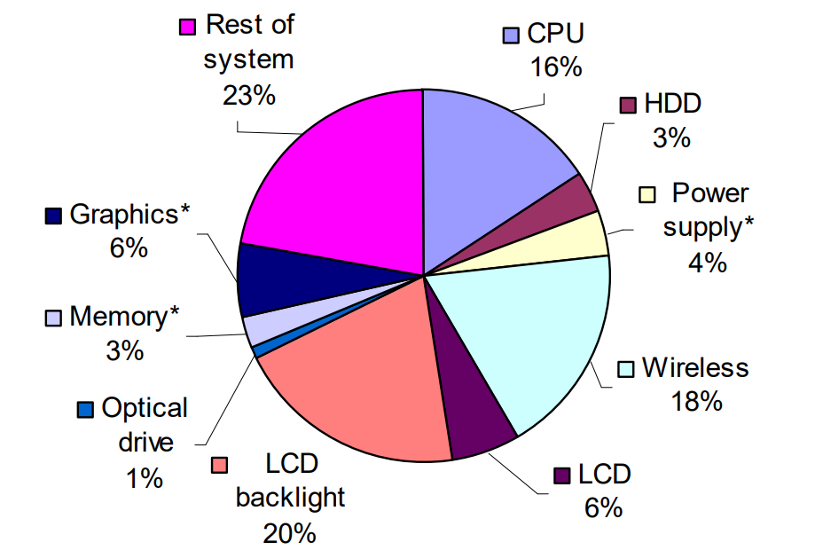

Slide 18
 | Log In | Soft | Heavy
Time | 5 | 5 | 5
Email Sent | 0 | 1 | 5
Email Read | 0 | 1 | 5
Email Answered | 0 | 0 | 5

