Slide 1
Predicting the Optimal Location of a Craft Brewery in Austin, TX Joel Blakeney

Slide 2
Craft Brewery Project - objectives
Project Background
Target Audience
In Austin, TX there are a large number of craft breweries especially in the last 10 years
A high number of these breweries appear to be located in certain areas of the city
I wanted to find out what motivated a craft brewery to open in one area of the city compared to another city area
The goal of the project is to collect data regarding the operational breweries and neighborhoods around the breweries.
The data will be analyzed to find a cause why a craft brewery opens in one part of town versus another part.
The obvious audience would be anyone interested in opening a craft brewery
However, this data would be relevant to any individual interested in opening a similar service industry related business
It would also be valuable to people interested in specific city data

Slide 3
Data was acquired from web scraping and FourSquare API
Relevant information about each of the Austin, TX zip codes was scraped from the web
Used BeautifulSoup with the LXML scraper
Several of the feature selected(per zip code):
Cost of Living
Median_Income
Population
# of wharehouse for rent/lease
The number of craft breweries and location was extracted using the FourSquare API.
All breweries with a range of 25km of Austin, TX were selected.
Brewery location data was cleaned and formatted with zip code information
Data was cleaned and merged in to one dataframe

Slide 4
Folium map of craft brewery locations in Austin, TX
Craft breweries in Austin, TX were selected via the Foursquare API. The blue circles represent the locations of the breweries by zip code.

Slide 5
Initial investigation between the features was done by Seaborn pairplot
The initial data analysis was done via Seaborn pairplot comparing – brewery count by zip code, Population of zip code, Cost of Living, and Median_Income of Zip code.
The pairplot does not reveal any strong correlations.

Slide 6
Investigated correlation between brewery counts and other features
Scatter plot comparing the population per zip code and the number of breweries(counts) in that zip code.
Scatter plot comparing the Cost of Living per zip code and the number of breweries(counts) in that zip code.
Neither feature strongly correlates with the number of breweries!

Slide 7
Linear correlation between breweries and wharehouse
Barchart showing the number of breweries and available wharehouse in the same zip code
Linear correlation between the number of available wharehouse in a zip code and the number of breweries
Counts
Zip codes

Slide 8
Implement a linear regression model to predict the location of next craft brewery
The model was trained and tested on the number of breweries and the number of wharehouse due to the linear relationship between the two.
The model is difficult to fit due to the available quantity of data(the number of craft breweries was not sufficient to fully form a machine learning model).
Scatter plot of test model values when only the brewery counts were used to predict the available number of wharehouse.
This can be seen by observed the relative error in the model – calculated with all features included and only the brewery count.
 | Mean Absolute Error | Mean squared error | Root Mean squared error
All Features | 5.860 | 51.377 | 7.168
Brewery count only | 3.263 | 21.52 | 4.639
Another validation is the analysis of the coefficients of the model.
The brewery count has by
Far the most influence on
The model.

Slide 9
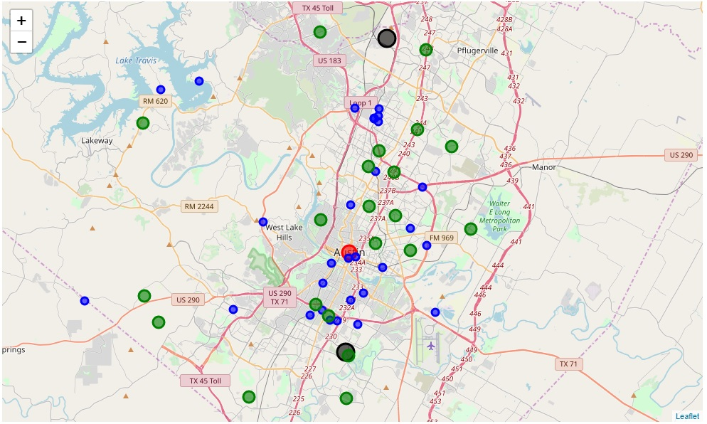
Folium Map of predicted new craft brewery in Austin, TX
Map of Austin, TX:
Craft breweries – blue circles
Available wharehouses – green circles
Predicted location of next craft brewery – black circles
The linear regression model predicts a maximum number of available wharehouse. The dataframe was filtered by wharehouse number and any zip code exceeding the maximum number was considered a good fit for a craft brewery. The potential zip codes are shown in the black circles in the map.

