Slide 1

Digital Image Processing
Image Enhancement (Spatial Filtering 2)

Slide 2

Contents
In this lecture we will look at more spatial filtering techniques
Spatial filtering refresher
Sharpening filters
1st derivative filters
2nd derivative filters
Combining filtering techniques

Slide 3
Spatial Filtering Refresher
Origin
x
a
b
c
r
s
t
d
e
f
*
u
v
w
g
h
i
x
y
z
Original Image Pixels
Filter
Simple 3*3 Neighbourhood
e
3*3 Filter
e_{processed} = v*e + r*a + s*b + t*c + u*d + w*f + x*g + y*h + z*i
y
Image f (x, y)
The above is repeated for every pixel in the original image to generate the smoothed image

Slide 4
Sharpening Spatial Filters
Previously we have looked at smoothing filters which remove fine detail
Sharpening spatial filters seek to highlight fine detail
Remove blurring from images
Highlight edges
Sharpening filters are based on spatial differentiation

Slide 5
Sharpening Spatial Filters
highlight fine detail in an image or to enhance detail that has been blurred, either in error or as a natural effect of a particular method of image acquisition.
Averaging is like Integration
Sharpening is like Differentiation

Slide 6
Sharpening Spatial Filters
first derivative
second derivative
Notes:
First Derivative: Rate of change of gray-level values

Slide 7
Sharpening Spatial Filters: first derivative
must be zero in flat segments (areas of constant gray-level values)
must be non-zero at the onset of a gray-level step or ramp
must be nonzero along ramps.
Notes:
First Derivative: Rate of change of gray-level values. It can help identify edges or transitions between different objects or regions. The criteria for a good definition of the first derivative are as follows:
Must Be Zero in Flat Segments (Areas of Constant Gray-Level Values): In areas where the intensity or gray-level values are constant (flat regions), the rate of change is zero because there is no change in value. Therefore, the first derivative should be zero in these regions.
Must Be Non-Zero at the Onset of a Gray-Level Step or Ramp: When there is a sudden change or step in gray-level values (such as the boundary between two objects), the first derivative should be non-zero at the beginning of this step to indicate the abrupt change.
Must Be Non-Zero Along Ramps: Along a ramp, which is a region with a constant slope or gradual change in gray-level values, the first derivative should also be non-zero to reflect the gradual transition.

Slide 8
Sharpening Spatial Filters: second derivative
must be zero in flat areas
must be non zero at the onset and end of a gray-level step or ramp
must be zero along ramps of constant slope.
Notes:
Second Derivative: It provides information about the curvature or smoothness of intensity changes. It can be used to detect corners or sharp changes in curvature within an image or signal. The criteria for a good definition of the second derivative are as follows:
Must Be Zero in Flat Areas: Similar to the first derivative, in flat regions where the gray-level values are constant, the second derivative should be zero because there is no change in curvature.
Must Be Non-Zero at the Onset and End of a Gray-Level Step or Ramp: At the beginning and end of a step or ramp in gray-level values, the second derivative should be non-zero to indicate the change in curvature.
Must Be Zero Along Ramps of Constant Slope: In regions with a constant slope or gradual change in intensity (ramps), the curvature remains constant, so the second derivative should be zero along these ramps.

Slide 9
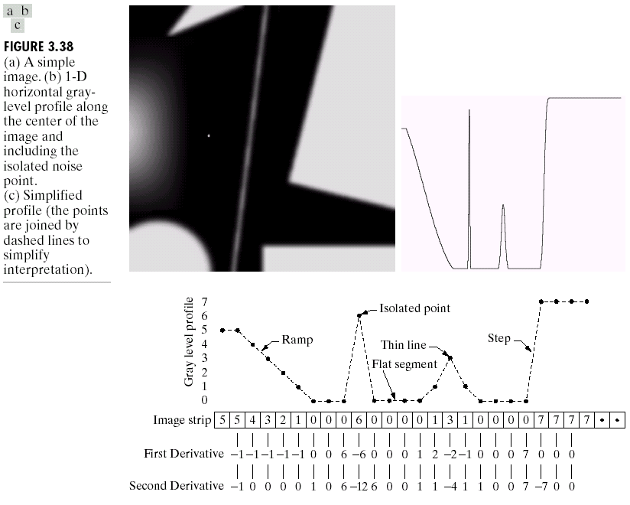
Spatial Differentiation
Differentiation measures the rate of change of a function
Let’s consider a simple 1 dimensional example

Slide 10
Spatial Differentiation
A
B

Slide 11
1st Derivative
The formula for the 1st derivative of a function is as follows:
It’s just the difference between subsequent values and measures the rate of change of the function

Slide 12
1st Derivative (cont…)
5 | 5 | 4 | 3 | 2 | 1 | 0 | 0 | 0 | 6 | 0 | 0 | 0 | 0 | 1 | 3 | 1 | 0 | 0 | 0 | 0 | 7 | 7 | 7 | 7
 | 0 | -1 | -1 | -1 | -1 | 0 | 0 | 6 | -6 | 0 | 0 | 0 | 1 | 2 | -2 | -1 | 0 | 0 | 0 | 7 | 0 | 0 | 0

Slide 13
2nd Derivative
The formula for the 2nd derivative of a function is as follows:
Simply takes into account the values both before and after the current value
The derivative is centred at the middle of the filter.

Slide 14
2nd Derivative (cont…)
5 | 5 | 4 | 3 | 2 | 1 | 0 | 0 | 0 | 6 | 0 | 0 | 0 | 0 | 1 | 3 | 1 | 0 | 0 | 0 | 0 | 7 | 7 | 7 | 7
 | -1 | 0 | 0 | 0 | 0 | 1 | 0 | 6 | -12 | 6 | 0 | 0 | 1 | 1 | -4 | 1 | 1 | 0 | 0 | 7 | -7 | 0 | 0

Slide 15
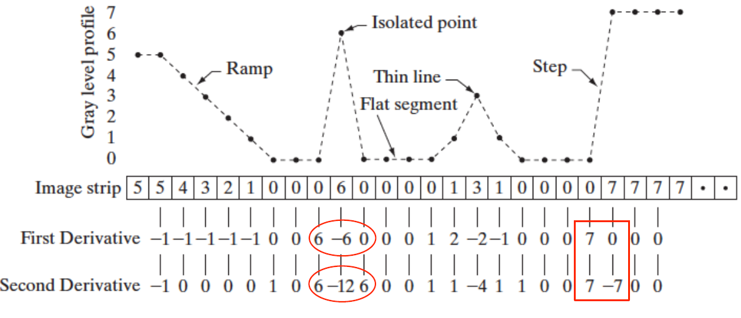
Combined 1st and 2nd derivative

Slide 16
First vs Second order derivatives
Ramp: the first-order derivative is nonzero along the entire ramp, while the second-order derivative is nonzero only at the onset and end of the ramp.
– Because edges in an image resemble this type of transition, we conclude that first-order derivatives produce “ thick” edges and second-order derivatives, much finer ones.
Isolated noise point: Here, the response at and around the point is much stronger for the second- than for the first-order derivative.
– A second-order derivative is much more aggressive than a first-order derivative in enhancing sharp changes.

Slide 17
First vs Second order derivatives
Grey-level step/Ramp: the response of the two derivatives is the same at the gray-level step
– in most cases when the transition into a step is not from zero, the second derivative will be weaker
– the second derivative has a transition from positive back to negative. In an image, this shows as a thin double line.

Slide 18
Summary
1. First-order derivatives generally produce thicker edges in an image.
2. Second-order derivatives have a stronger response to fine details, such as thin lines and isolated points.
3. First order derivatives generally have a stronger response to a gray-level step.
4. Second-order derivatives produce a double response at step changes in gray level.
We also note of second-order derivatives that, for similar changes in gray-level values in an image, their response is stronger to a line than to a step, and to a point than to a line.
First and second order derivatives can be used in combination

Slide 19

Using Second Derivatives For Image Enhancement
The 2nd derivative is more useful for image enhancement than the 1st derivative
Stronger response to fine detail
Simpler implementation
We will come back to the 1st order derivative later on
Notes:
The second derivative is known to provide a stronger response to fine details and edges within an image. This makes it a valuable tool for enhancing these intricate features.
The second derivative might be simpler from an implementation perspective

Slide 20

Using Second Derivatives For Image Enhancement
The first sharpening filter we will look at is the Laplacian
Isotropic
One of the simplest sharpening filters
We will look at a digital implementation
Notes:
Laplacian equally enhances edges and features regardless of their orientation.
The Laplacian filter is considered one of the simpler methods for sharpening images.
Implementing the Laplacian filter for image sharpening in a digital context.

Slide 21

The Laplacian transformation
Premise: we are interested in isotropic filters, whose response is independent of the direction of the discontinuities in the image to which the filter is applied.
In other words, isotropic filters are rotation invariant, in the sense that rotating the image and then applying the filter gives the same result as applying the filter to the image first and then rotating the result.

Slide 22
The Laplacian transformation
The Laplacian is defined as follows:
where the partial 1st order derivative in the x direction is defined as follows:
and in the y direction as follows:

Slide 23
The Laplacian (cont…)
So, the Laplacian can be given as follows:
We can easily build a filter based on this
0
1
0
1
-4
1
0
1
0

Slide 24
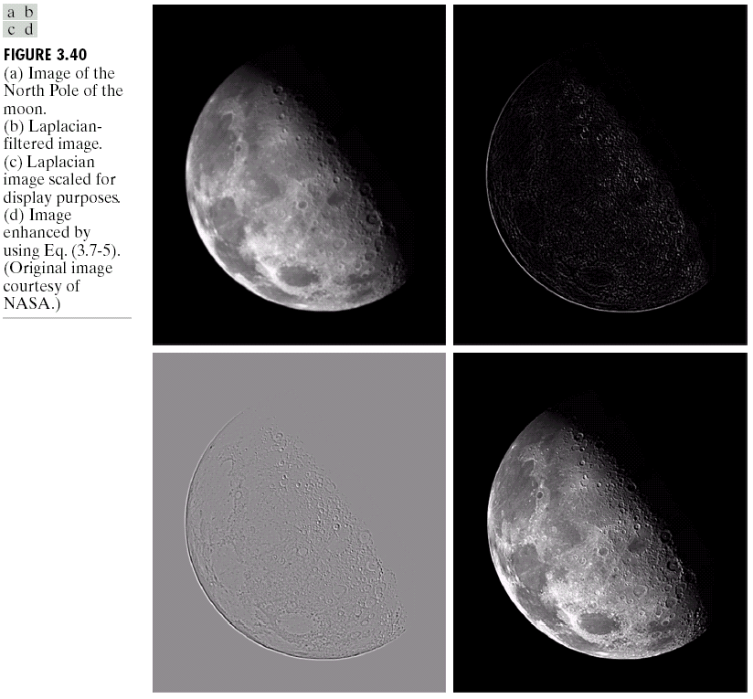
The Laplacian (cont…)
Applying the Laplacian to an image we get a new image that highlights edges and other discontinuities
Original Image
Laplacian Filtered Image
Laplacian Filtered Image Scaled for Display

Slide 25
But That Is Not Very Enhanced!
The result of a Laplacian filtering is not an enhanced image
We have to do more work in order to get our final image
Subtract the Laplacian result from the original image to generate our final sharpened enhanced image
Laplacian Filtered Image Scaled for Display

Slide 26
Laplacian Image Enhancement
-
=
Original Image
Laplacian Filtered Image
Sharpened Image
In the final sharpened image edges and fine detail are much more obvious

Slide 27
Laplacian Image Enhancement

Slide 28
Simplified Image Enhancement
The entire enhancement can be combined into a single filtering operation

Slide 29
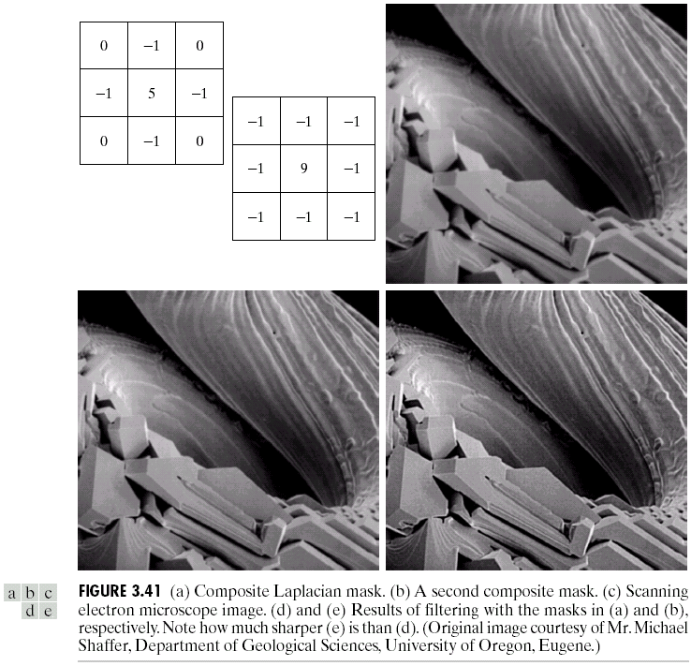
Simplified Image Enhancement (cont…)
This gives us a new filter which does the whole job for us in one step
0
-1
0
-1
5
-1
0
-1
0

Slide 30
Simplified Image Enhancement (cont…)

Slide 31
Variants On The Simple Laplacian
There are lots of slightly different versions of the Laplacian that can be used:
0
1
0
1
1
1
Simple Laplacian
Variant of Laplacian
1
-4
1
1
-8
1
0
1
0
1
1
1
-1
-1
-1
-1
9
-1
-1
-1
-1

Slide 32
Variants On The Simple Laplacian

Slide 33
1st Derivative Filtering
Implementing 1st derivative filters is difficult in practice
For a function f(x, y) the gradient of f at coordinates (x, y) is given as the column vector:

Slide 34
1st Derivative Filtering (cont…)
The magnitude of this vector is given by:
For practical reasons this can be simplified as:

Slide 35
Definition of 1st Derivatives
Recall that:
– any definition we use for a first derivative (1) must be zero in flat segments (areas of constant gray-level values); (2) must be non-zero at the onset of a gray-level step or ramp; and (3) must be nonzero along ramps.
– Similarly, any definition of a second derivative (1) must be zero in flat areas; (2) must be non zero at the onset and end of a gray-level step or ramp; and (3) must be zero along ramps of constant slope.

Slide 36
1st Derivative Filtering (cont…)
There is some debate as to how best to calculate these gradients but we will use:
i.e., Normal->Roberts->Prewitts->Sobel
which is based on these coordinates
z₁
z₂
z₃
z₄
z₅
z₆
z₇
z₈
z₉

Slide 37
Sobel Operators
Based on the previous equations we can derive the Sobel Operators
To filter an image it is filtered using both operators the results of which are added together
-1
-2
-1
-1
0
1
0
0
0
-2
0
2
1
2
1
-1
0
1

Slide 38
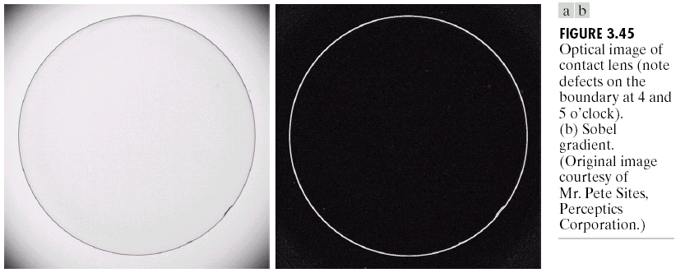
Sobel Example
Sobel filters are typically used for edge detection
An image of a contact lens which is enhanced in order to make defects (at four and five o’clock in the image) more obvious

Slide 39
1st & 2nd Derivatives
Comparing the 1st and 2nd derivatives we can conclude the following:
1st order derivatives generally produce thicker edges
2nd order derivatives have a stronger response to fine detail e.g. thin lines
1st order derivatives have stronger response to grey level step
2nd order derivatives produce a double response at step changes in grey level

Slide 40
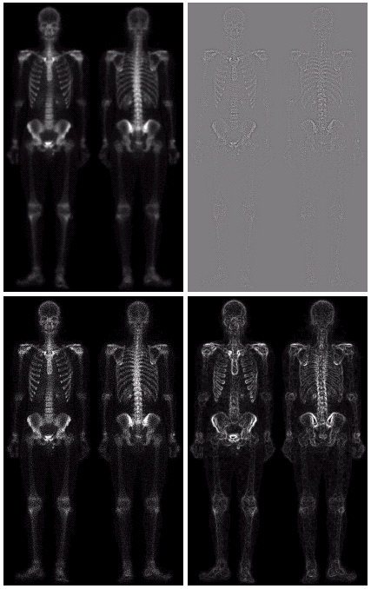
Combining Spatial Enhancement Methods
Successful image enhancement is typically not achieved using a single operation
Rather we combine a range of techniques in order to achieve a final result
This example will focus on enhancing the bone scan to the right

Slide 41
Combining Spatial Enhancement Methods (cont…)
(a)
Laplacian filter of bone scan (a)
(b)
Sharpened version of bone scan achieved by subtracting (a) and (b)
(c)
Sobel filter of bone scan (a)
(d)

Slide 42
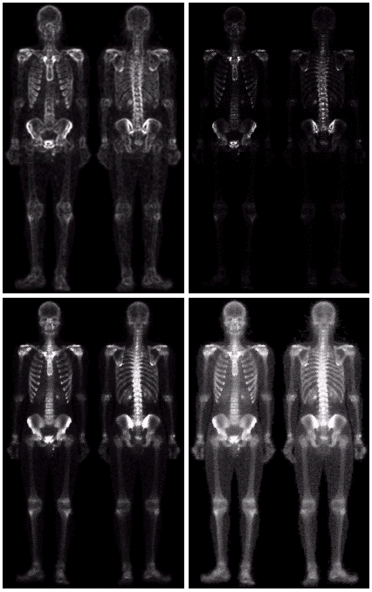
Combining Spatial Enhancement Methods (cont…)
Result of applying a power-law trans. to (g)
(h)
Sharpened image which is sum of (a) and (f)
(g)
The product of (c) and (e) which will be used as a mask
(f)
(e)
Image (d) smoothed with a 5*5 averaging filter

Slide 43
Combining Spatial Enhancement Methods (cont…)
Compare the original and final images

Slide 44
Summary
In this lecture we looked at:
Sharpening filters
1st derivative filters
2nd derivative filters
Combining filtering techniques

