Slide 1
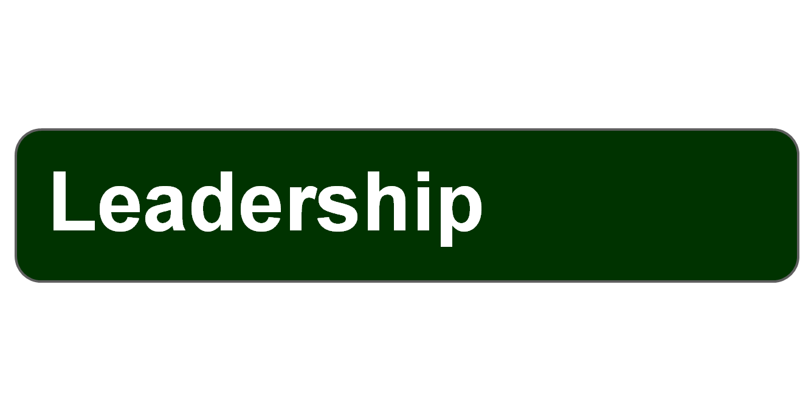
© 2007 Prentice Hall, Inc.
All rights reserved.

Slide 2
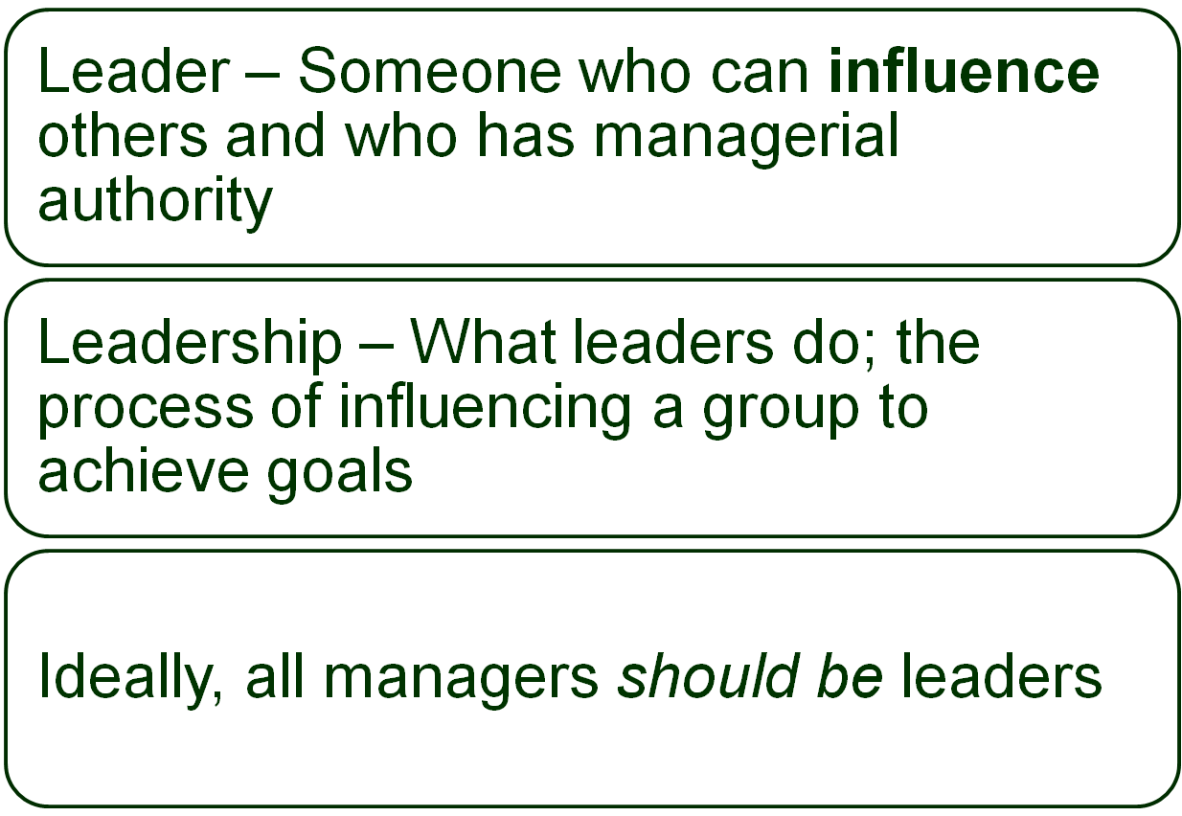
© 2007 Prentice Hall, Inc. All rights reserved.
17–<number>

Slide 3

© 2007 Prentice Hall, Inc. All rights reserved.
17–<number>

Slide 4
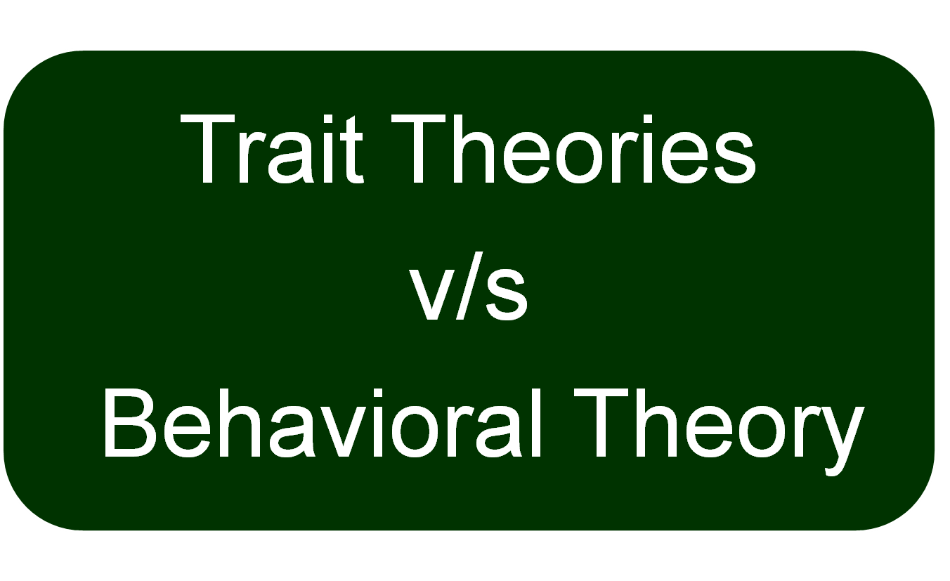
© 2007 Prentice Hall, Inc. All rights reserved.
17–<number>

Slide 5
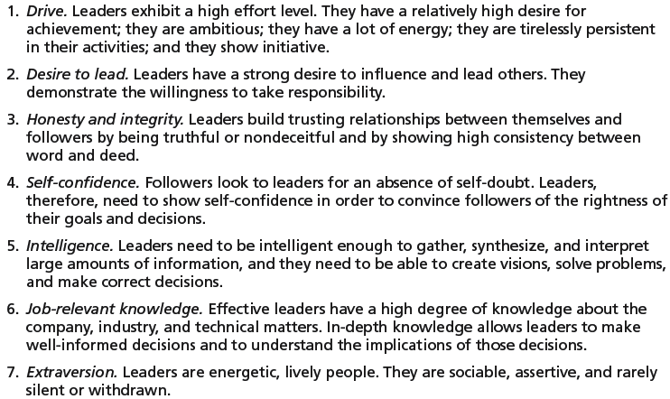
Exhibit 17–1 Seven Traits Associated with Leadership
Source: S. A. Kirkpatrick and E. A. Locke, “Leadership: Do Traits Really Matter?” Academy of Management Executive, May 1991, pp. 48–60; T. A. Judge, J. E. Bono, R. llies, and M. W. Gerhardt, “Personality and Leadership: A Qualitative and Quantitative Review,” Journal of Applied Psychology, August 2002, pp. 765–780.
© 2007 Prentice Hall, Inc. All rights reserved.
17–<number>

Slide 6
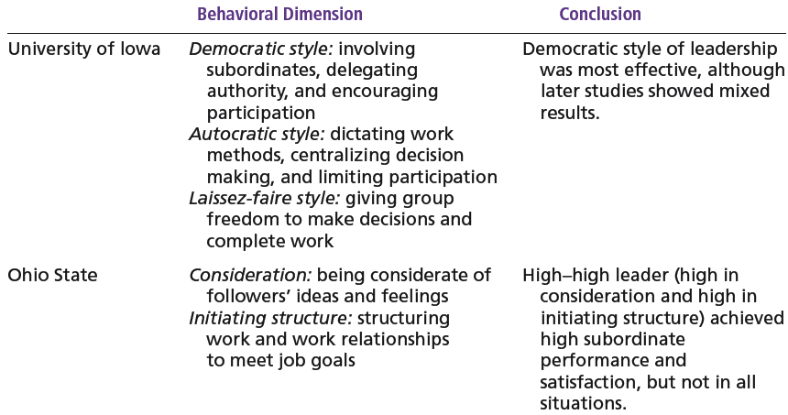
Exhibit 17–2 Behavioral Theories of Leadership
© 2007 Prentice Hall, Inc. All rights reserved.
17–<number>

Slide 7
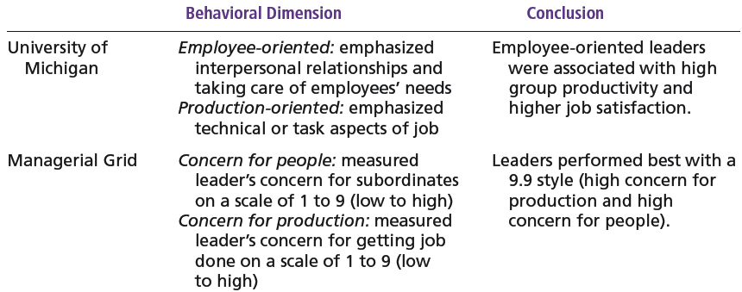
Exhibit 17–2 (cont’d) Behavioral Theories of Leadership
© 2007 Prentice Hall, Inc. All rights reserved.
17–<number>

Slide 8
The Managerial Grid
Managerial Grid
  Appraises leadership styles using two dimensions:
    Concern for people
    Concern for production
  Places managerial styles in five categories:
    Impoverished management
    Task management
    Middle-of-the-road management
    Country club management
    Team management
© 2007 Prentice Hall, Inc. All rights reserved.
17–<number>

Slide 9
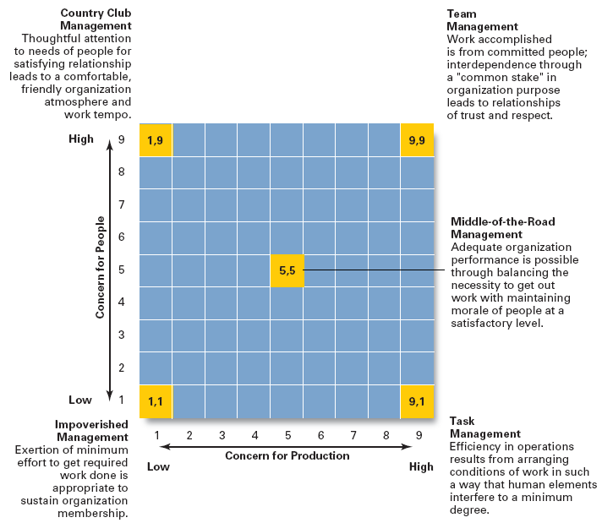
Exhibit 17–3
The
Managerial
Grid
Source: Reprinted by permission of Harvard Business Review. An exhibit from “Breakthrough in Organization Development” by Robert R. Blake, Jane S. Mouton, Louis B. Barnes, and Larry E. Greiner, November–December 1964, p. 136. Copyright © 1964 by the President and Fellows of Harvard College. All rights reserved.
© 2007 Prentice Hall, Inc. All rights reserved.
17–<number>

Slide 10
Transactional Leadership
  Leaders who guide or motivate their followers in the direction of established goals by clarifying role and task requirements.
Transformational Leadership
  Leaders who inspire followers to transcend their own self-interests for the good of the organization by clarifying role and task requirements.
  Leaders who also are capable of having a profound and extraordinary effect on their followers.
© 2007 Prentice Hall, Inc. All rights reserved.
17–<number>

Slide 11
Charismatic Leadership
  An enthusiastic, self-confident leader whose personality and actions influence people to behave in certain ways.
Visionary Leadership
  A leader who creates and articulates a realistic, credible, and attractive vision of the future that improves upon the present situation.
© 2007 Prentice Hall, Inc. All rights reserved.
17–<number>

Slide 12
Ethical Leadership
Ethics are part of leadership when leaders attempt to:
  Foster moral virtue through changes in attitudes and behaviors.
  Promote ethical behavior by exhibiting their personal traits of honesty and integrity.
© 2007 Prentice Hall, Inc. All rights reserved.
17–<number>

Slide 13
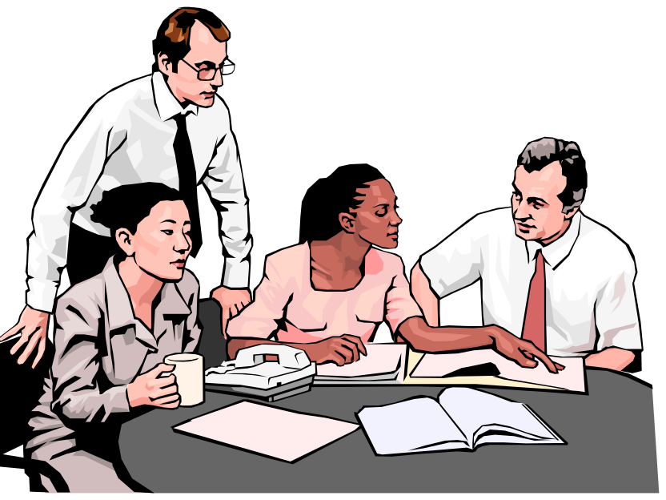
Cross-Cultural Leadership
Universal Elements of Effective Leadership
  Vision
  Foresight
  Providing encouragement
  Trustworthiness
  Dynamism
  Positiveness
  Proactiveness
© 2007 Prentice Hall, Inc. All rights reserved.
17–<number>

Slide 14
Gender Differences and Leadership
Research Findings
  Males and females use different styles:
    Women tend to adopt a more democratic or participative style unless in a male-dominated job.
    Women tend to use transformational leadership.
    Men tend to use transactional leadership.
© 2007 Prentice Hall, Inc. All rights reserved.
17–<number>

