Slide 1
PowerPoint Presentation by Charlie Cook
Copyright © 2005 Prentice Hall, Inc.
All rights reserved.

Slide 2
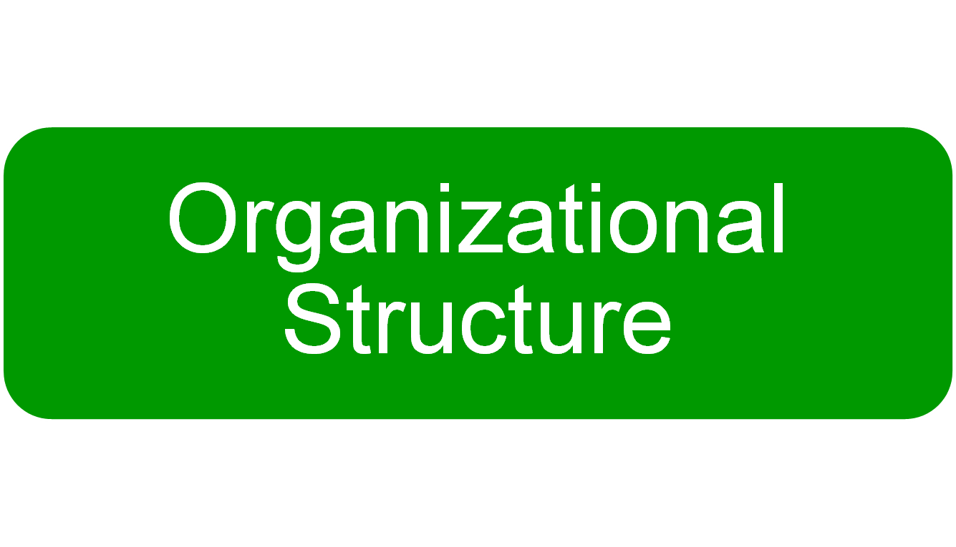
Copyright © 2005 Prentice Hall, Inc. All rights reserved.
10–<number>

Slide 3

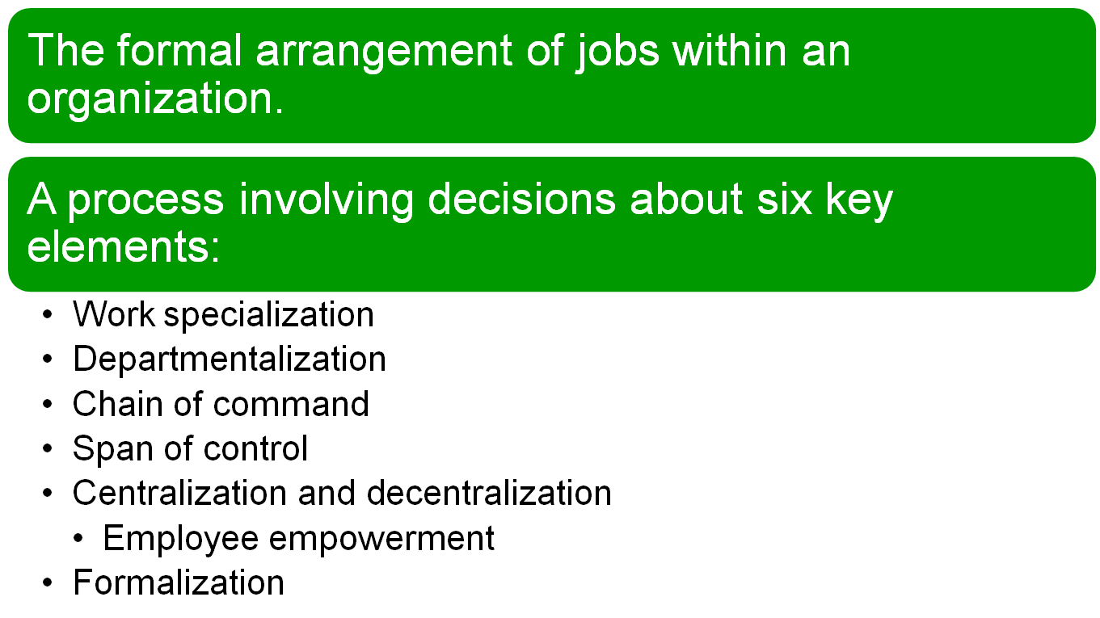
Copyright © 2005 Prentice Hall, Inc. All rights reserved.
10–<number>

Slide 4
Mechanistic Organization
  A rigid and tightly controlled structure
    High specialization
    Rigid departmentalization
    Narrow spans of control
    High formalization
    Limited information network (downward)
    Low decision participation
Organic Organization
  Highly flexible and adaptable structure
    Non-standardized jobs
    Fluid team-based structure
    Little direct supervision
    Minimal formal rules
    Open communication network
    Empowered employees
Copyright © 2005 Prentice Hall, Inc. All rights reserved.
10–<number>

Slide 5

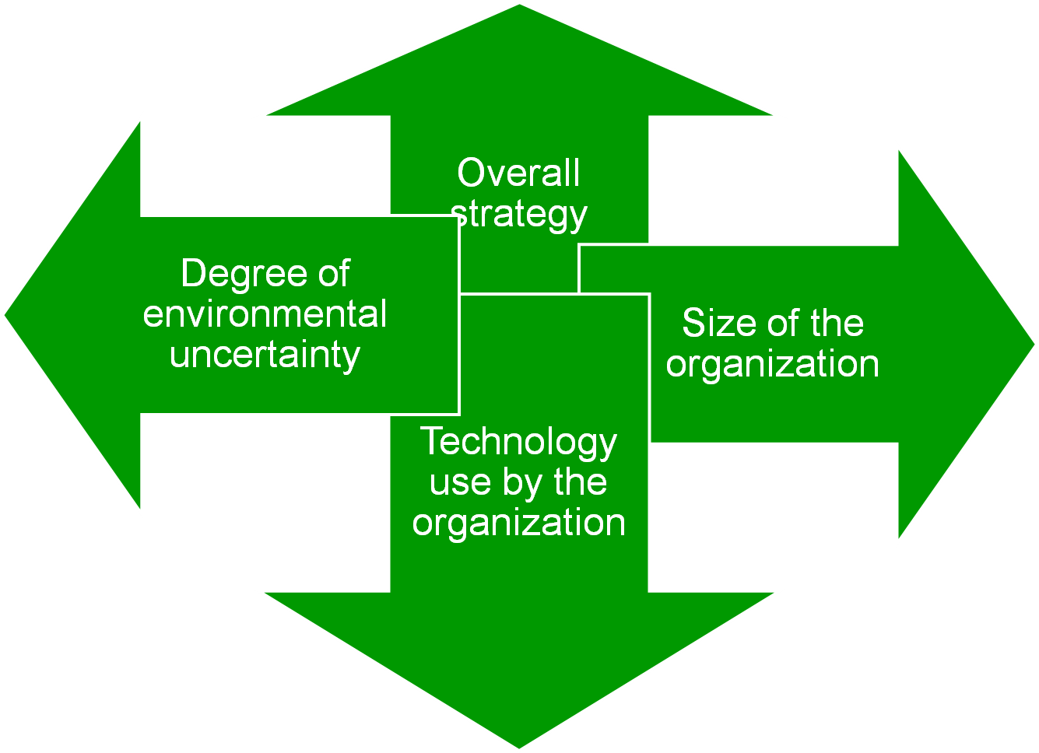
Copyright © 2005 Prentice Hall, Inc. All rights reserved.
10–<number>

Slide 6
Structural Contingency Factors (cont’d)
Strategy
  Innovation & Differentiation
  Cost minimization
  Technology and Structure
  Routine technology = mechanistic organizations
  Non-routine technology = organic organizations
Copyright © 2005 Prentice Hall, Inc. All rights reserved.
10–<number>

Slide 7

  Simple structure
  Functional structure
  Divisional structure
Copyright © 2005 Prentice Hall, Inc. All rights reserved.
10–<number>

Slide 8

Copyright © 2005 Prentice Hall, Inc. All rights reserved.
10–<number>

Slide 9

  Team structures
    The entire organization is made up of work groups or self-managed teams of empowered employees.
  Matrix and project structures
    Specialists for different functional departments are assigned to work on projects led by project managers.
    Matrix participants have two managers.
  Project structures
    Employees work continuously on projects; moving on to another project as each project is completed
Copyright © 2005 Prentice Hall, Inc. All rights reserved.
10–<number>

Slide 10
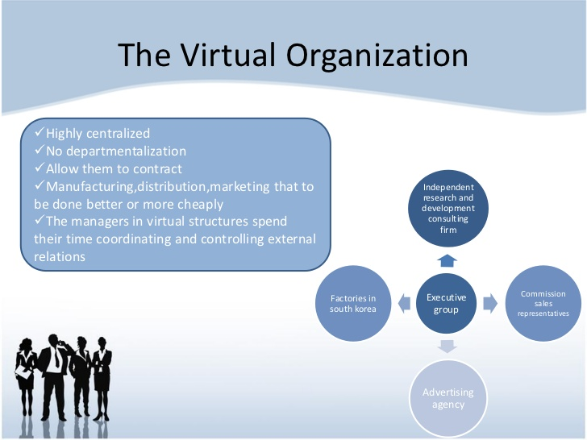
Removing Boundaries
Virtual Organization
  An organization that consists of a small core of full-time employees and that temporarily hires specialists to work on opportunities that arise.
Copyright © 2005 Prentice Hall, Inc. All rights reserved.
10–<number>

Slide 11
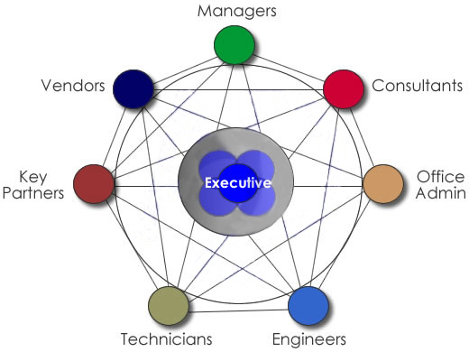
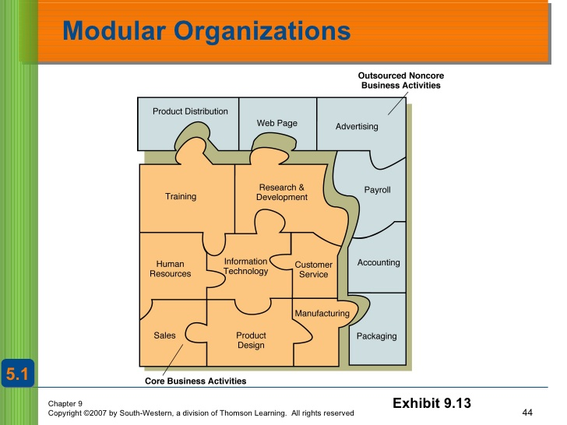
Network Organization
  A small core organization that
  outsources its major business
  functions (e.g., manufacturing)
  in order to concentrate what it does
  best.
Modular Organization
  A manufacturing organization
  that uses outside suppliers to
  provide product components
  for its final assembly operations.
10–<number>

