Slide 1
Emotions
Prepared By:
Muhammad Behroz khan
Lecturer Psychology
(PhD Scholar)

Slide 2
Emotions
An emotion is a subjective state of being that we often describe as our feelings.
The words emotion and mood are sometimes used interchangeably, but psychologists use these words to refer to two different things.
Typically, the word emotion indicates a subjective, affective state that is relatively intense and that occurs in response to something we experience (Figure 10.20).
Emotions are often thought to be consciously experienced and intentional.

Slide 3
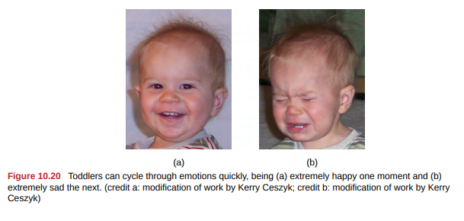

Slide 4
Mood, on the other hand, refers to a prolonged, less intense, affective state that does not occur in response to something we experience.
Mood states may not be consciously recognized and do not carry the intentionality that is associated with emotion.
For example, we can be at the heights of joy, we might feel angry when we are betrayed, fear when we are threatened, and surprised when something unexpected happens.

Slide 5
Theories Of Emotion
Our emotional states are combinations of physiological arousal, psychological appraisal, and subjective experiences.
Together, these are known as the components of emotion.
These appraisals are learned by our experiences, backgrounds, and cultures.
Therefore, different people may have different emotional experiences even when faced with similar circumstances.
Over time, several different theories of emotion have been proposed to explain how the various components of emotion interact with one another.

Slide 6
James-Lange Theory
The James-Lange theory of emotion states that emotions arise from physiological arousal.
Sympathetic nervous system prepare our body for fight or flight response when threatened.
For example, If you were to encounter some threat in your environment, like a venomous snake in your backyard, your sympathetic nervous system would initiate significant physiological arousal, which would make your heart race and increase your respiration rate.
According to the James-Lange theory of emotion, you would only experience a feeling of fear after this physiological arousal had taken place.

Slide 7
Cannon Bard Theory of Emotions
According to this view, physiological arousal and emotional experience occur simultaneously, yet independently.
So, when you see the venomous snake, you feel fear at exactly the same time that your sympathetic nervous system initiate significant physiological response.
This emotional reaction would be separate and independent of the physiological arousal, even though they co-occur.
Schachter-Singer Two Factor Theory of Emotion
The Schachter-Singer two-factor theory of emotion is another variation on theories of emotions that takes into account both physiological arousal and the emotional experience.

Slide 8
According to this theory, emotions are composed of two factors: physiological and cognitive.
In other words, physiological arousal is interpreted in context to produce the emotional experience.
In revisiting our example involving the venomous snake in your backyard, the two-factor theory maintains that the snake elicits sympathetic nervous system activation that is labelled as fear given the context, and our experience is that of fear.

Slide 9
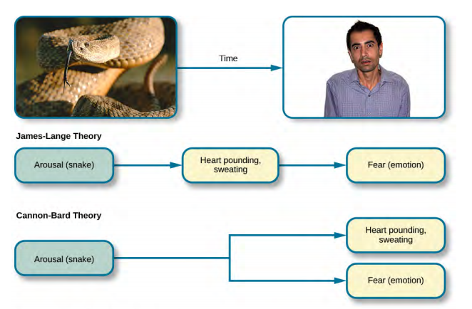

Slide 10
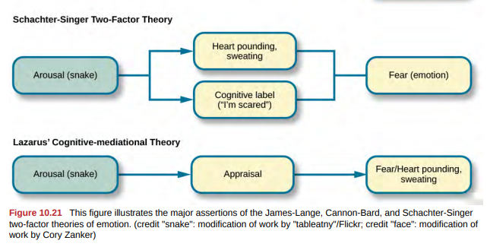

Slide 11
Cognitive Mediational Theory
The relationship between our experiencing of emotions and our cognitive processing of them, and the order in which these occur, remains a topic of research and debate.
Lazarus (1991) developed the cognitive-mediational theory that asserts our emotions are determined by our appraisal of the stimulus.
This appraisal mediates between the stimulus and the emotional response, and it is immediate and often unconscious.
In contrast to the Schachter-Singer model, the appraisal precedes a cognitive label.

Slide 12
Two other prominent views arise from the work of Robert Zajonc and Joseph LeDoux.
Zajonc asserted that some emotions occur separately from our cognitive interpretation of them, such as feeling fear in response to an unexpected loud sound.
He also believed in what we might casually refer to as a gut feeling—that we can experience an instantaneous and unexplainable like or dislike for someone or something.
LeDoux also views some emotions as requiring no cognition: some emotions completely bypass contextual interpretation.
His research into the neuroscience of emotion has demonstrated the amygdala’s primary role in fear.

Slide 13
The Biology of Emotions
The limbic system, which is the area of the brain involved in emotion and memory.
The limbic system includes the hypothalamus, thalamus, amygdala, and the hippocampus.
The hypothalamus plays a role in the activation of the sympathetic nervous system that is a part of any given emotional reaction.
The thalamus serves as a sensory relay center whose neurons project to both the amygdala and the higher cortical regions for further processing.
The amygdala plays a role in processing emotional information and sending that information on to cortical structures.

Slide 14
The hippocampus integrates emotional experience with cognition.
The amygdala is composed of various subnuclei, including the basolateral complex and the central nucleus (Figure 10.23).
The basolateral complex has strong connections with a variety of sensory areas of the brain.
It is critical for classical conditioning and for attaching emotional value to learning processes and memory.
The central nucleus plays a role in attention, and it has connections with the hypothalamus and various brainstem areas to regulate the autonomic nervous and endocrine systems’ activity

Slide 15
Human research also suggests a relationship between the amygdala and psychological disorders of mood or anxiety.
Changes in amygdala structure and function have been demonstrated in adolescents who are either at-risk or have been diagnosed with various mood and/or anxiety disorders.

Slide 16
Recognition of Emotions
Our ability to recognize and produce facial expressions of emotion appears to be universal.
In fact, even congenitally blind individuals produce the same facial expression of emotions, despite they never have the opportunity to observe these facial displays of emotion in other people.
This would seem to suggest that the pattern of activity in facial muscles involved in generating emotional expressions is universal, and indeed, this idea was suggested in the late 19th century in Charles Darwin’s book The Expression of Emotions in Man and Animals (1872).
In fact, there is substantial evidence for seven universal emotions that are each associated with distinct facial expressions. These include: happiness, surprise, sadness, fright, disgust, contempt, and anger.

Slide 17
