Slide 1
Hiding or dead?
A comparison of the effects of dome-shaped selectivity and differential removal of fast-growing fish
SAFS Quantitative Seminar
June 5, 2009
Ian Taylor, UW/NMFS
Rick Methot, NMFS
Note: copyrighted images used in original talk have been removed for posting to web.

Slide 2
Outline
More advice on bias correction
Overview of growth morphs
Interaction between dome-shaped selectivity and growth morphs
A way out?

Slide 3
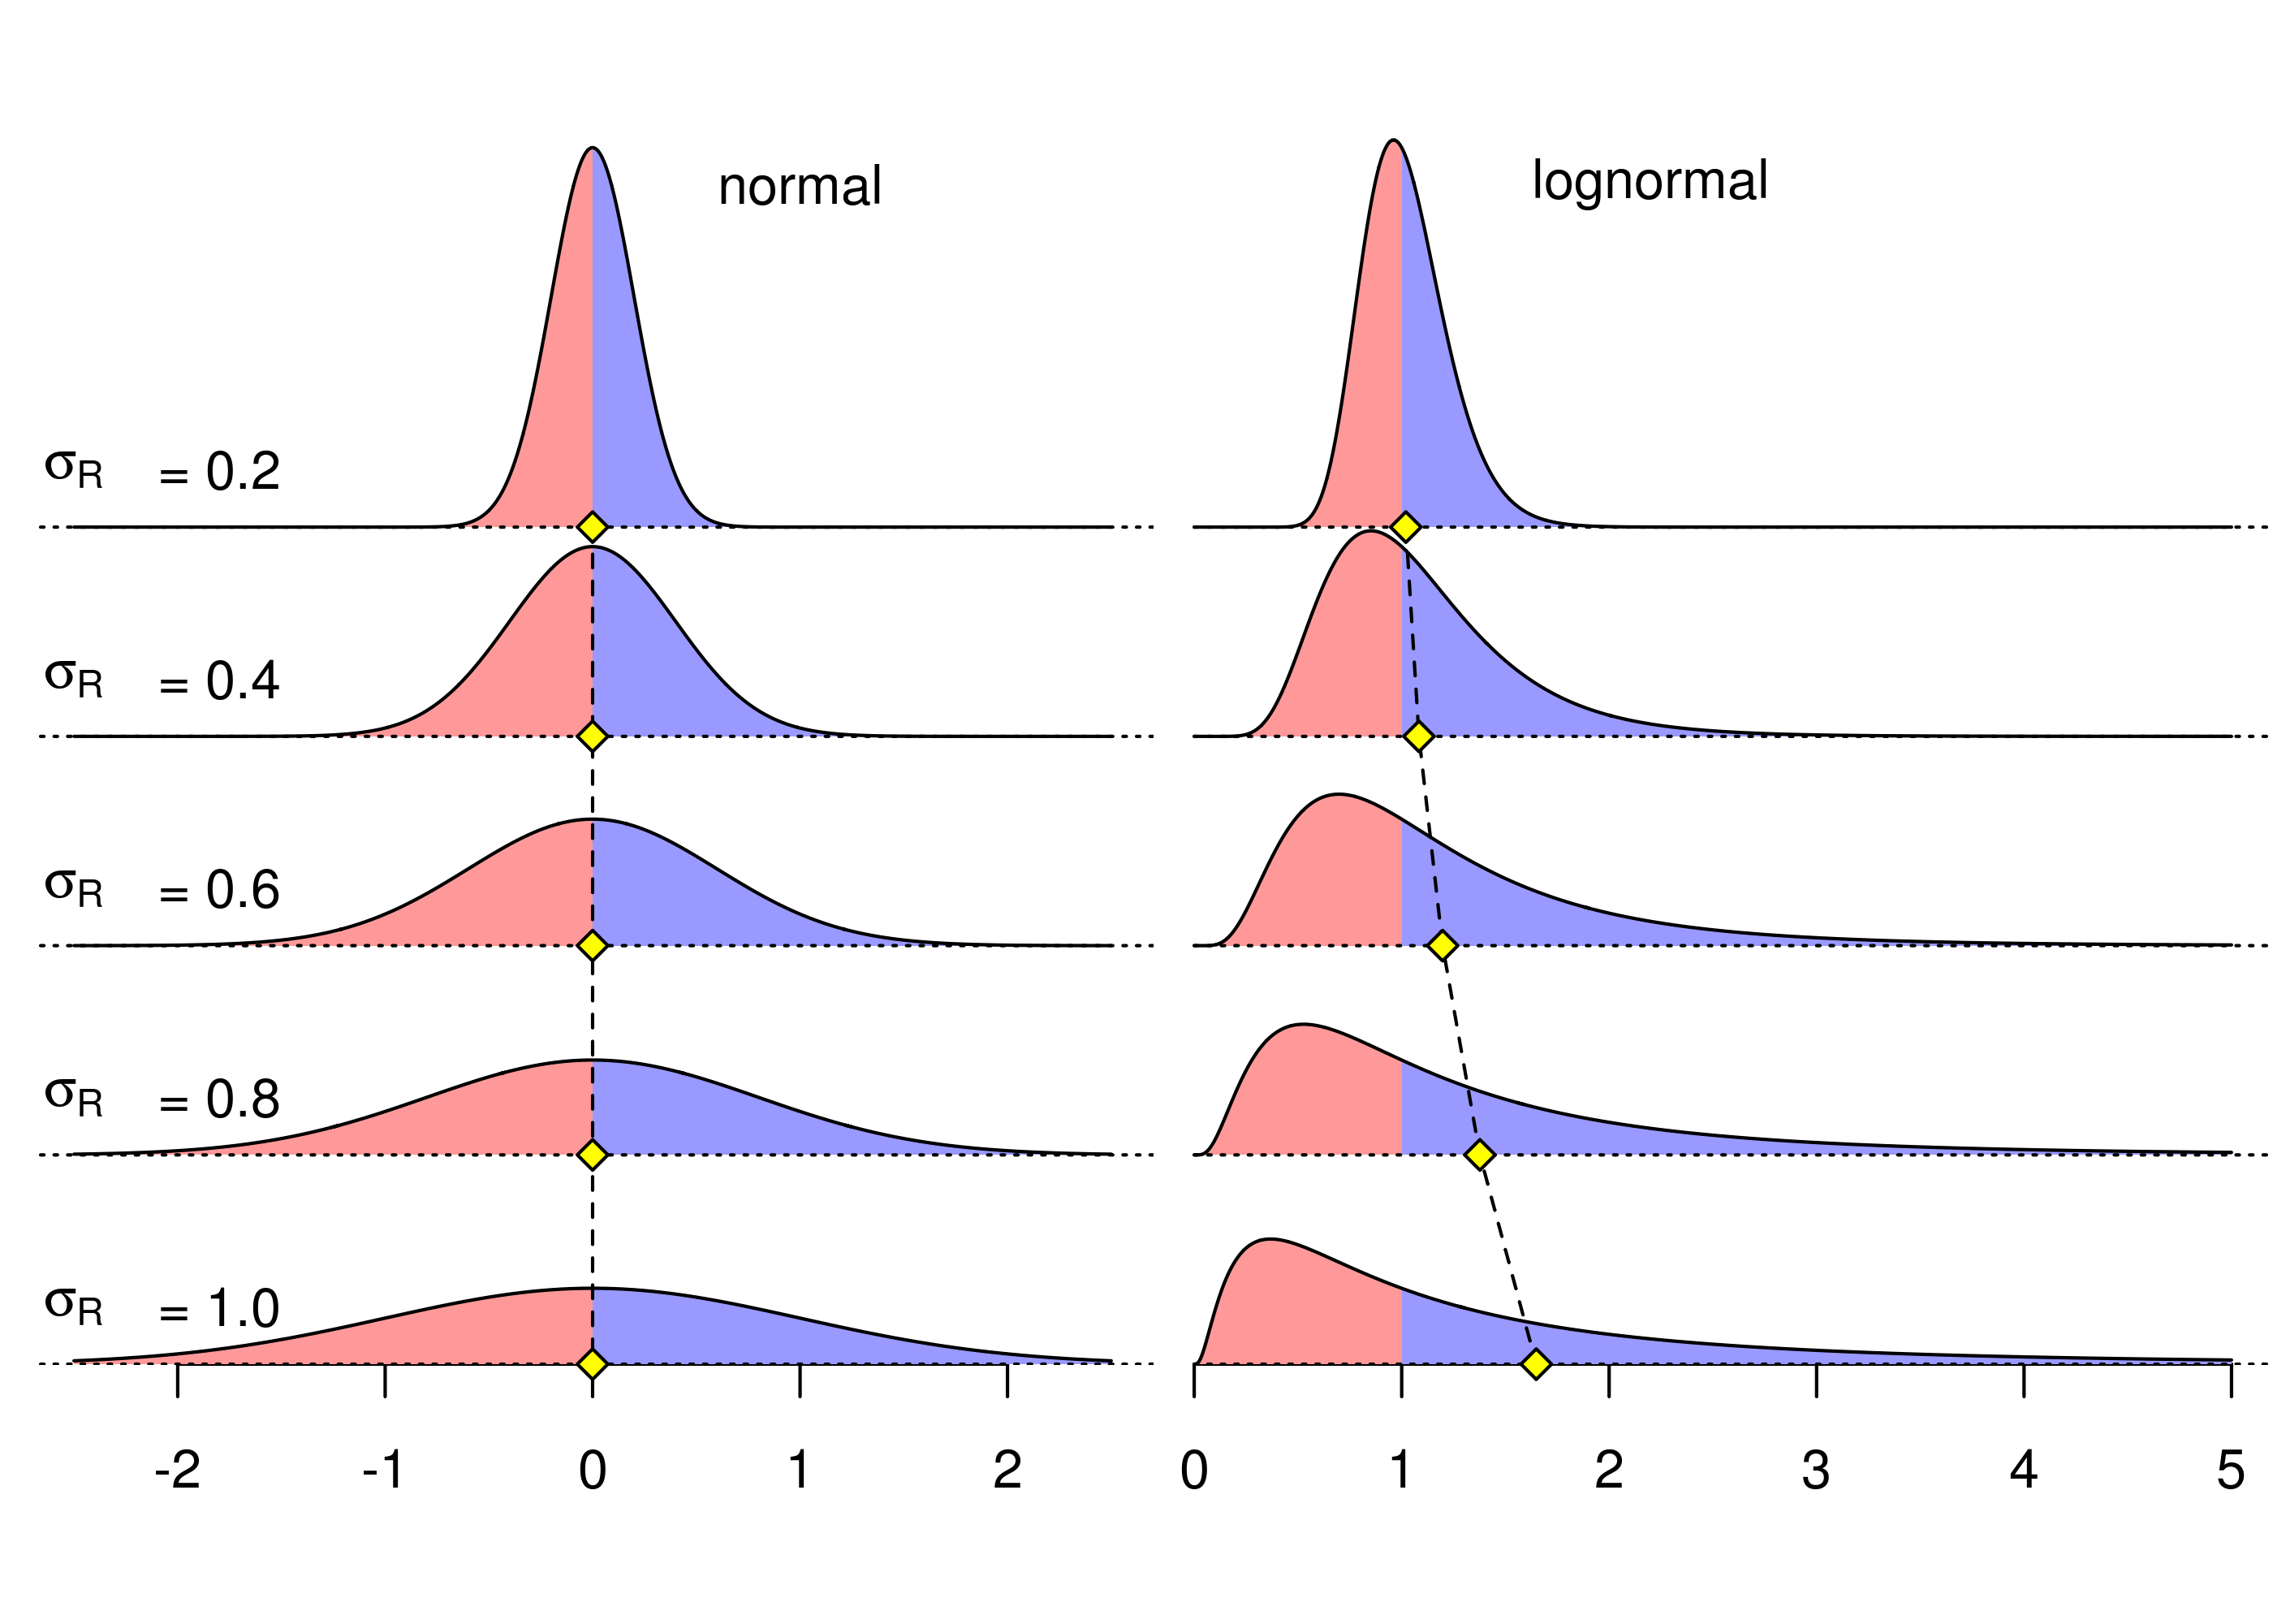
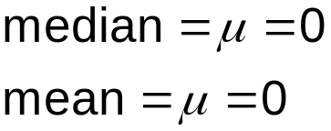
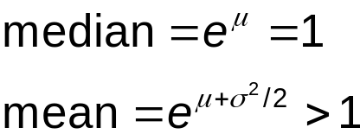
Mean vs. median in lognormal

Slide 4
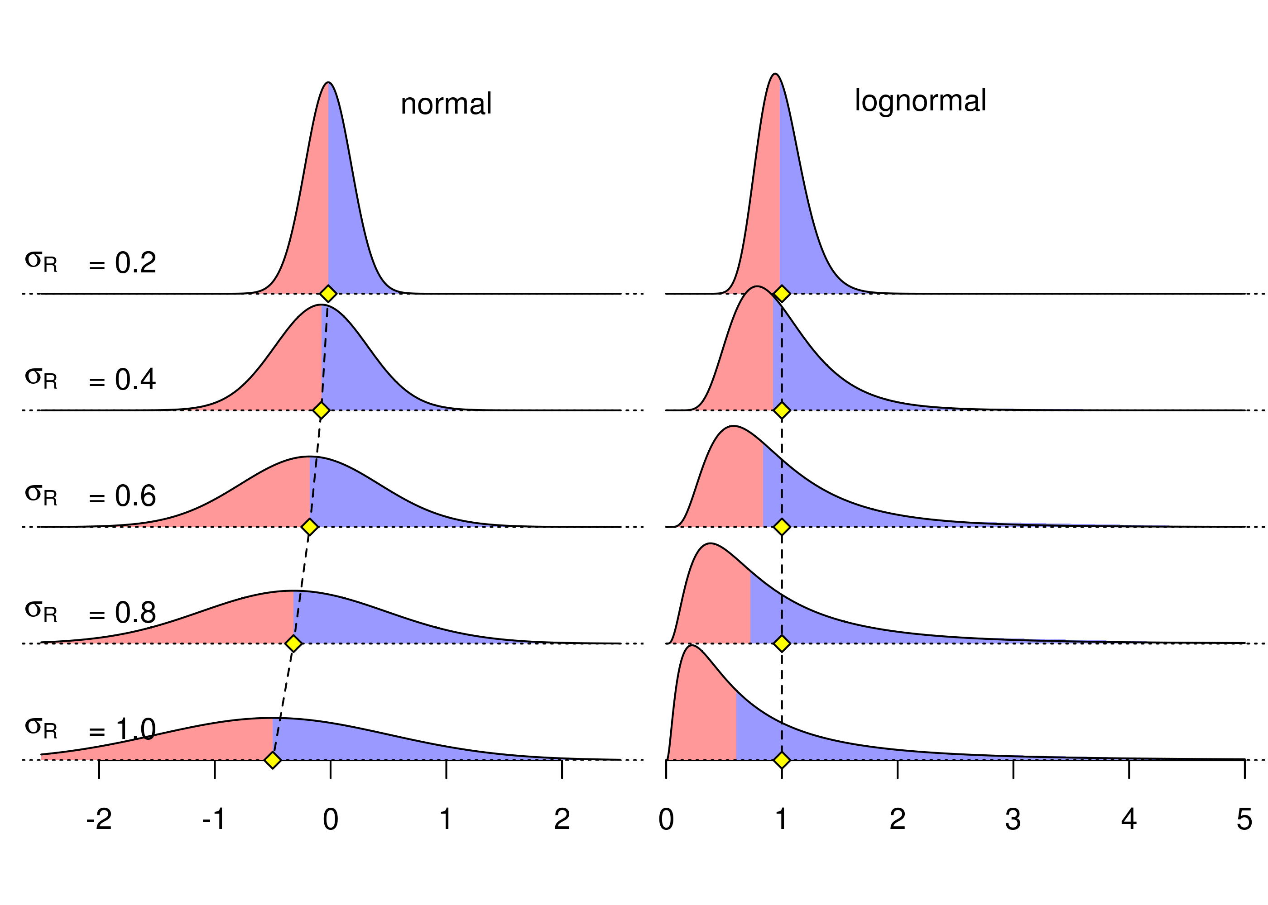
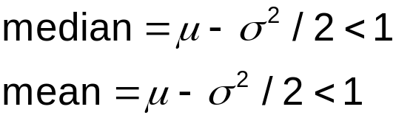
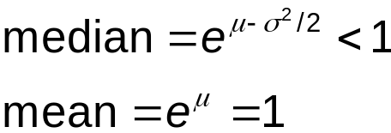
Mean vs. median in lognormal

Slide 5
Bias correction
Mean recruitments is best measure of contribution to population
Mean should be unbiased, so correction is made:
NewRecruits*=
mfexp(-biasadj(y)*SR_parm(3)*SR_parm(3)*0.5);
where SR_parm(3) = σ_{R}
Rick showed that correction should be based on true variability in recruitment deviations, not σ_{R}
Q: how do you calculate biasadj(y)?

Slide 6
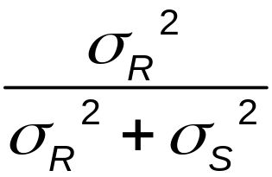
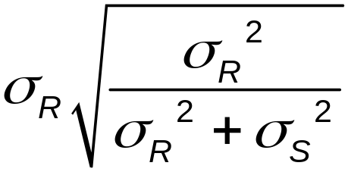

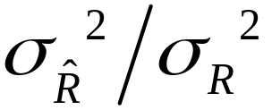
General method
Rick showed that if data is rec. dev. survey with
s.e. = σ_{S}, then bias adj. frac. =
In this case, the root mean squared error
(rmse = ) of estimated rec. devs. =
Solving gives bias adj frac. =

Slide 7
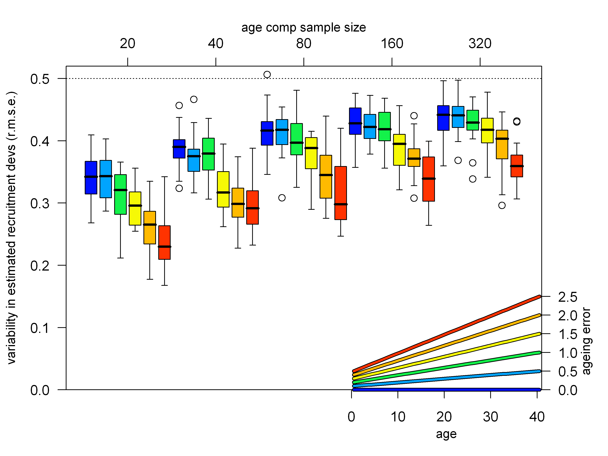
Model with only age comps

Slide 8
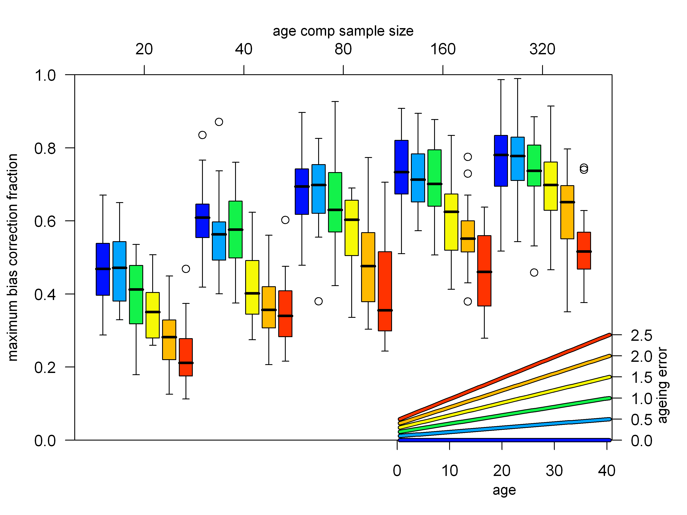
Model with only age comps

Slide 9
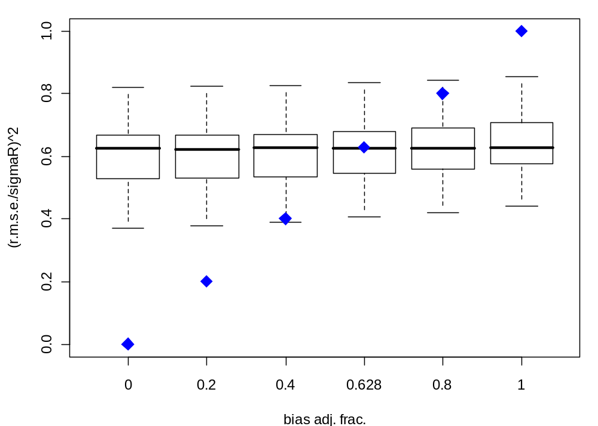
Estimating bias correction for full model
Set bias adj. frac. to and other values

Slide 10
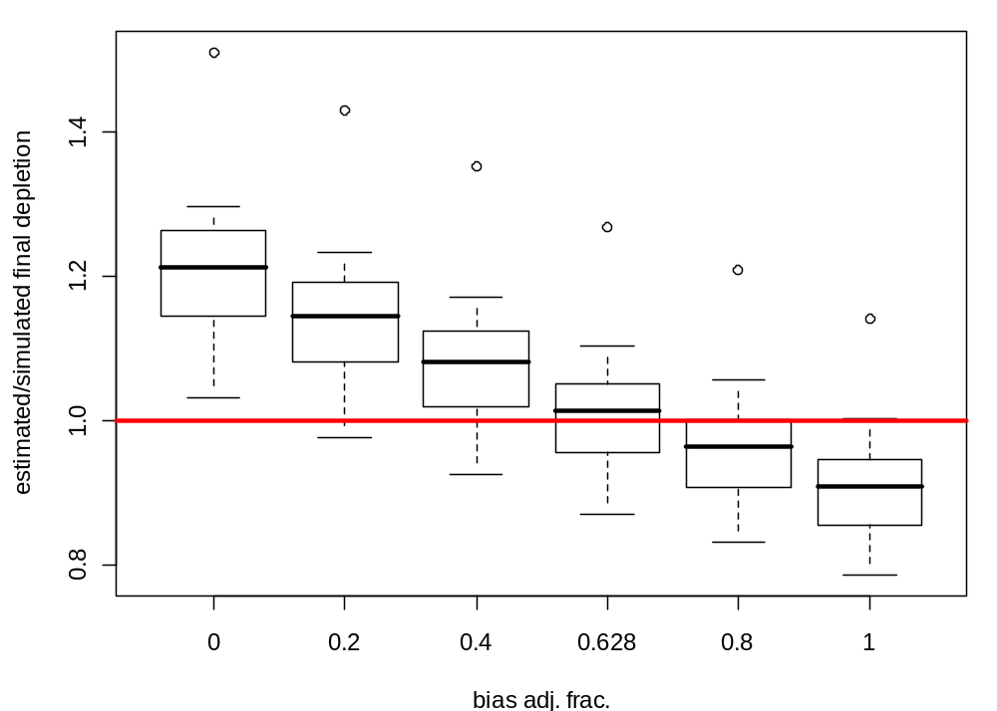
Estimating bias correction for full model
Set bias adj. frac. to and other values
correct value gives unbiased result (pretty close)

Slide 11
Outline
More advice on bias correction
Overview of growth morphs
Interaction between dome-shaped selectivity and growth morphs
A way out?

Slide 12
Growth morphs
Allows for size specific processes (e.g. selectivity) to influence the length at age distribution
Each cohort is comprised of several growth morphs
Each growth morph has its own von Bertalanffy growth parameters and variation of length-at-age

Slide 13
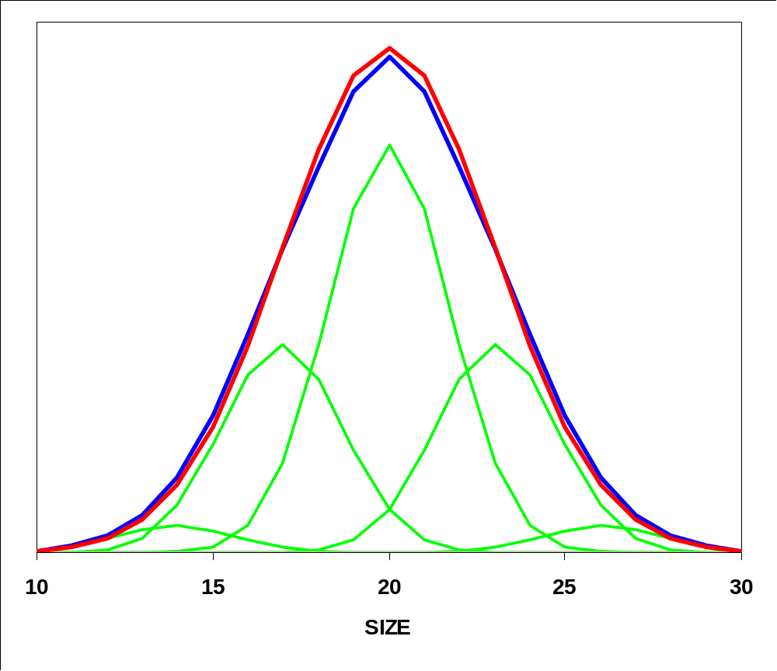
Partitioning a Normal Distribution
Select number of morphs:
1, 3, or 5
Set ratio of within to between morph variability, i.e. 1.0
Notes:
In Synthesis 2, the user has full flexibility in assigning the number of morphs, their gender and their characteristics relative to morph #1.
One option though, is to take a very structured approach to this assignment of morphs.
Blue line is a normal distribution
Green lines are 5, equally-spaced normal distributions which sum to the red line and provide a quite adequate approximation to the blue normal distribution

Slide 14
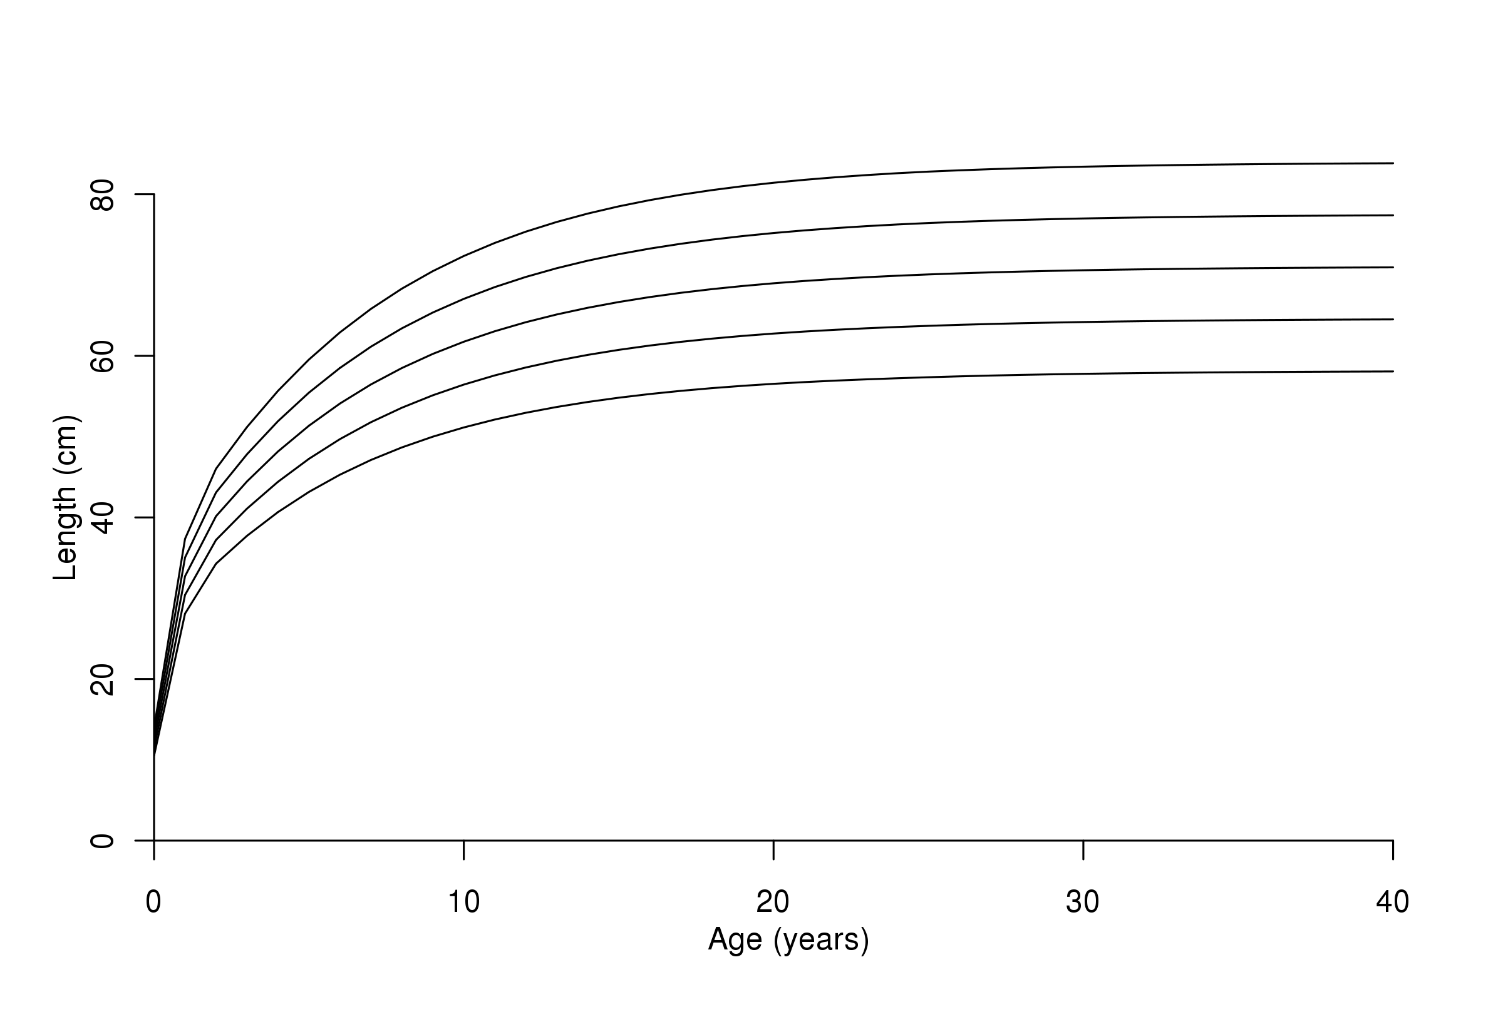
Separate trajectories for each morph

Slide 15
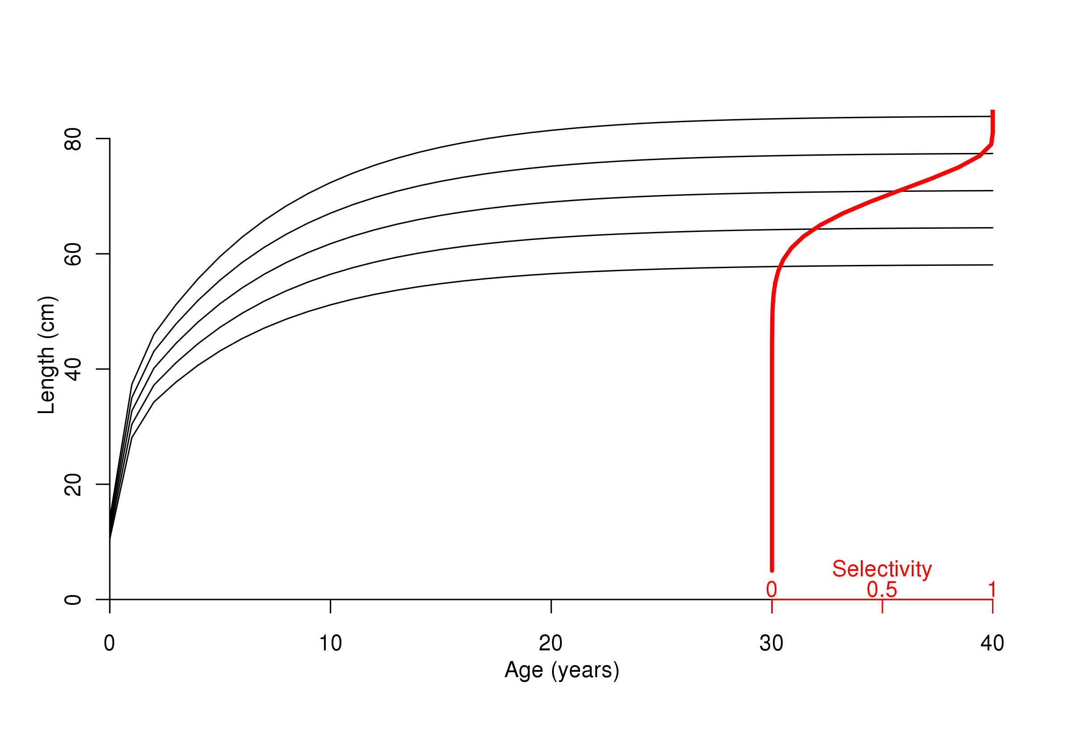
Separate trajectories for each morph

Slide 16
Easy inclusion in models
#_SS-V3.02B;_01/15/09;_Stock_Synthesis_by_Richard_Methot
1 #_N_Growth_Patterns
5 #_N_Morphs_Within_GrowthPattern
1 #_Morph_between/within_stdev_ratio (no read if N_morphs=1)
-1 1 1 1 1 #vector_Morphdist_(-1_in_first_val_gives_normal_approx)

Slide 17
Easy inclusion in models
#_SS-V3.02B;_01/15/09;_Stock_Synthesis_by_Richard_Methot
1 #_N_Growth_Patterns
5 #_N_Morphs_Within_GrowthPattern
1 #_Morph_between/within_stdev_ratio (no read if N_morphs=1)
0.031 0.237 0.464 0.237 0.031 #vector_Morphdist
_(-1_in_first_val_gives_normal_approx)
Stock Synthesis v.3 produces annotated Control.SS_New file

Slide 18
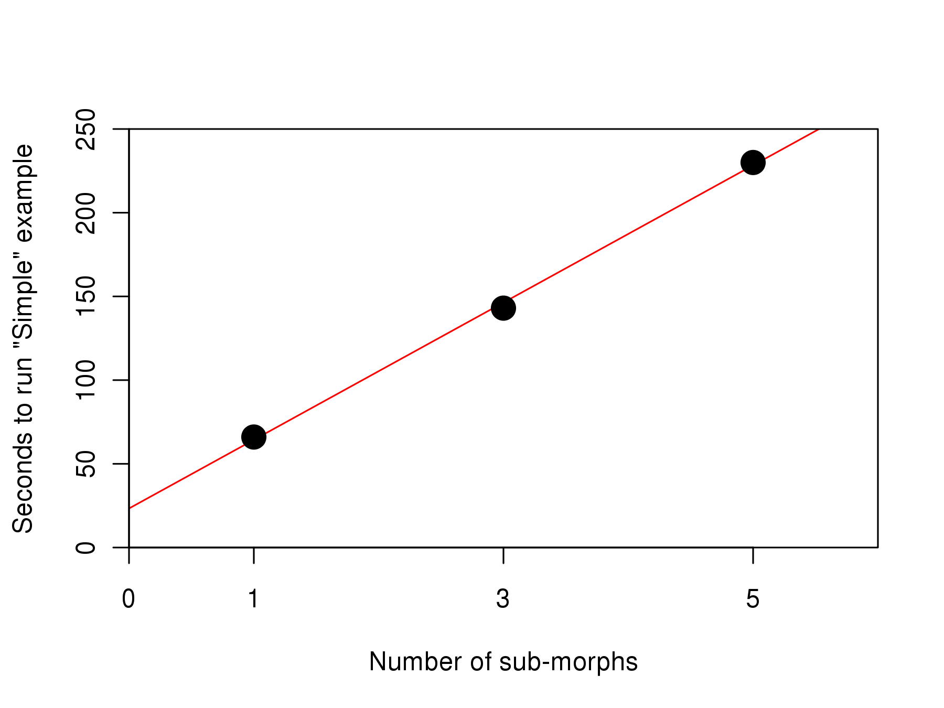
No free lunch

Slide 19
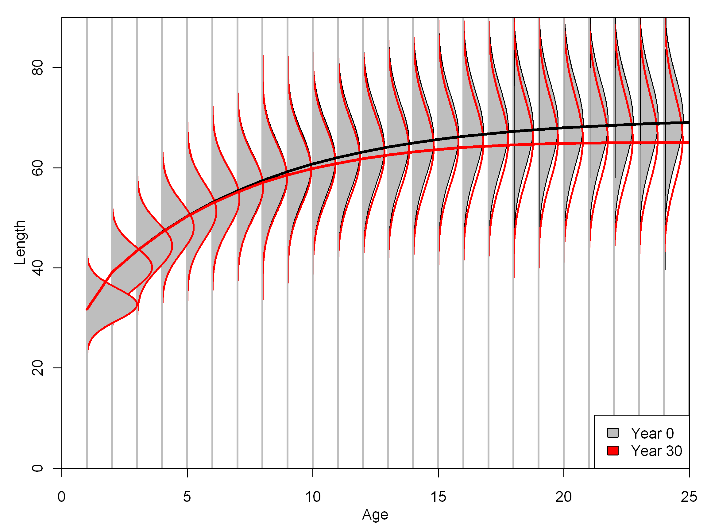
Shifted distribution of length at age due to differential removal of morphs

Slide 20
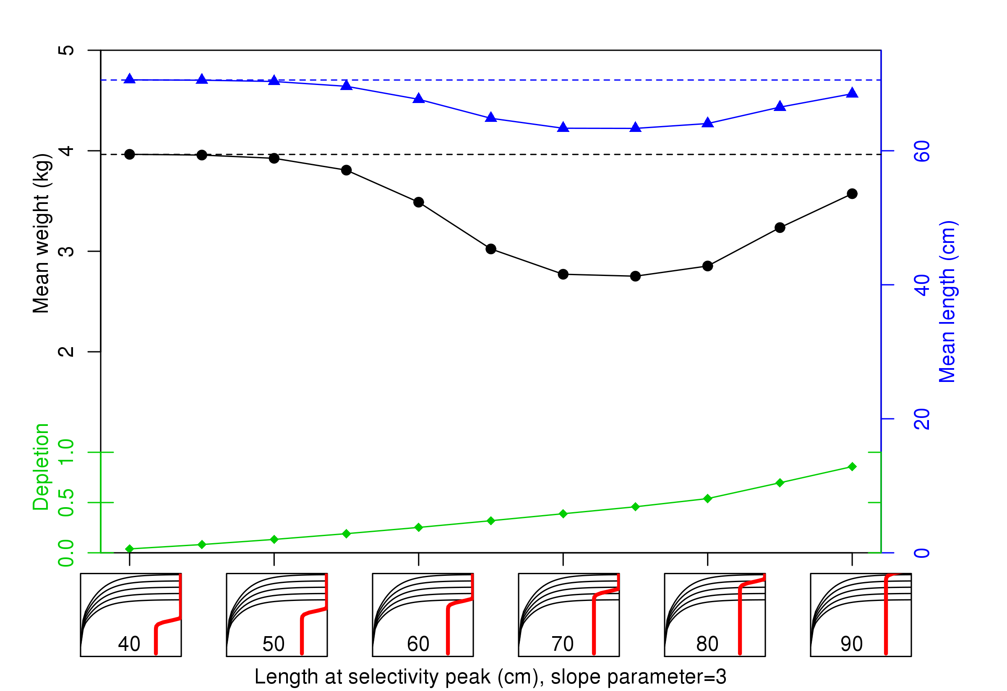
Impact of changing selectivity (age=30)

Slide 21
Outline
More advice on bias correction
Overview of growth morphs
Interaction between dome-shaped selectivity and growth morphs
A way out?

Slide 22
Simulation study
Projected population in SSv3 for 30 years with random recruitment deviations.
Depleted to between 15%-60% of initial biomass
Generated bootstrap datasets for CPUE, age and length compositions.
Estimated growth, R0, steepness, selectivity,
and annual recruitment
16 scenarios for match/mismatch of simulation and estimation of each combination of
  morphs (1 or 5 per gender)
  selectivity (dome-shaped or asymptotic)

Slide 23
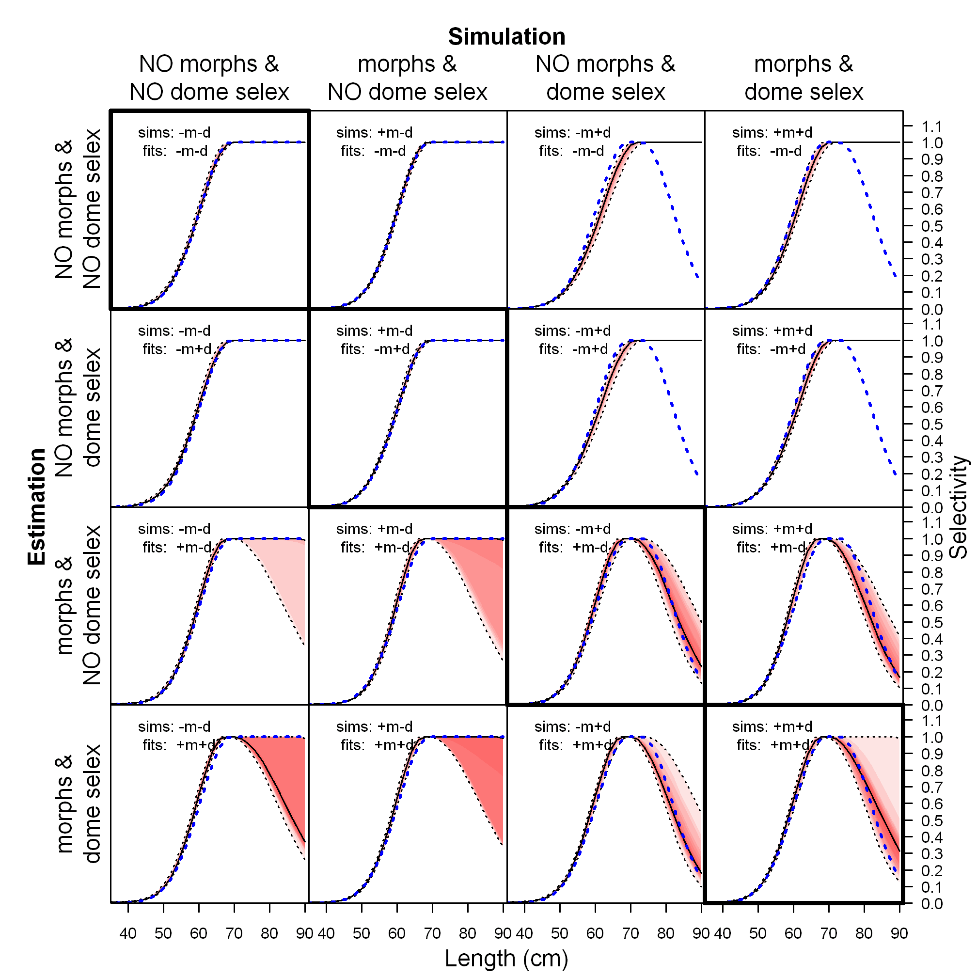
Simulated and estimated selectivity

Slide 24
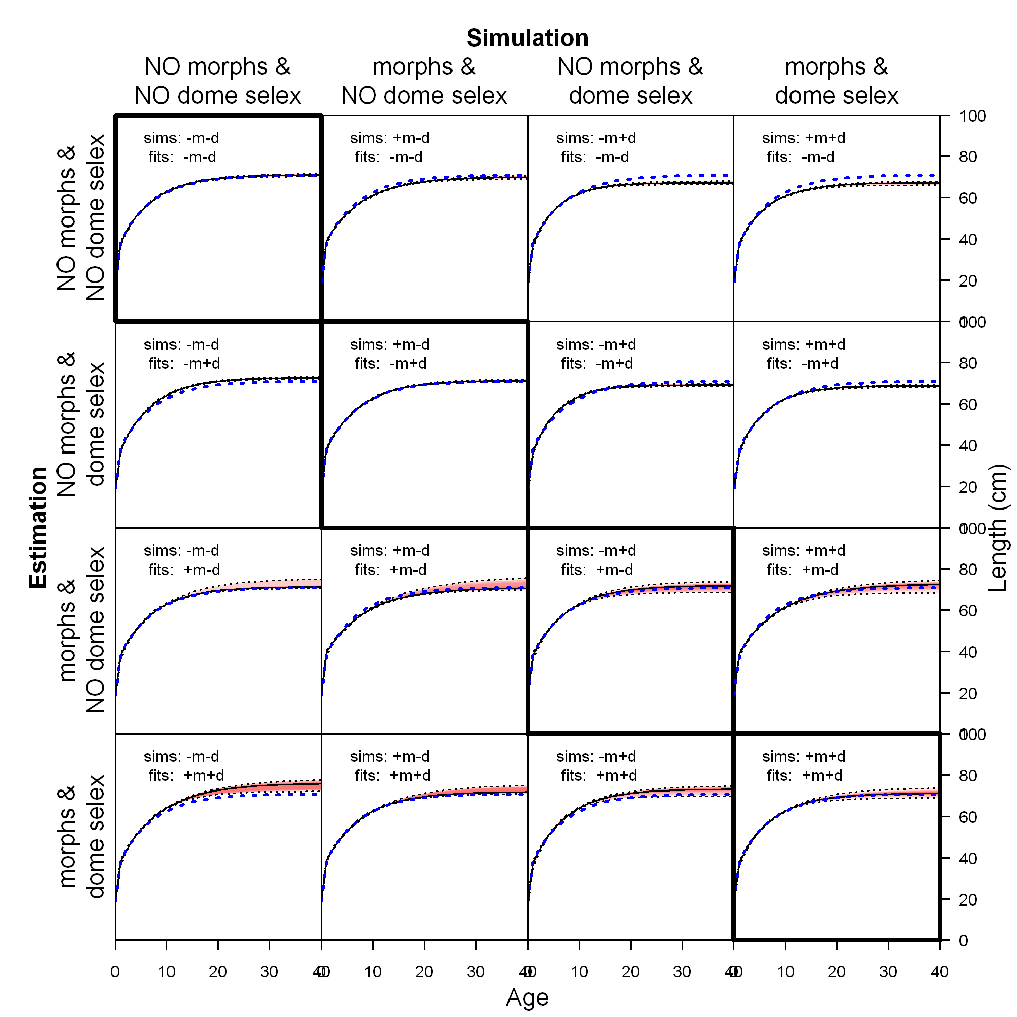
Simulated and estimated growth

Slide 25
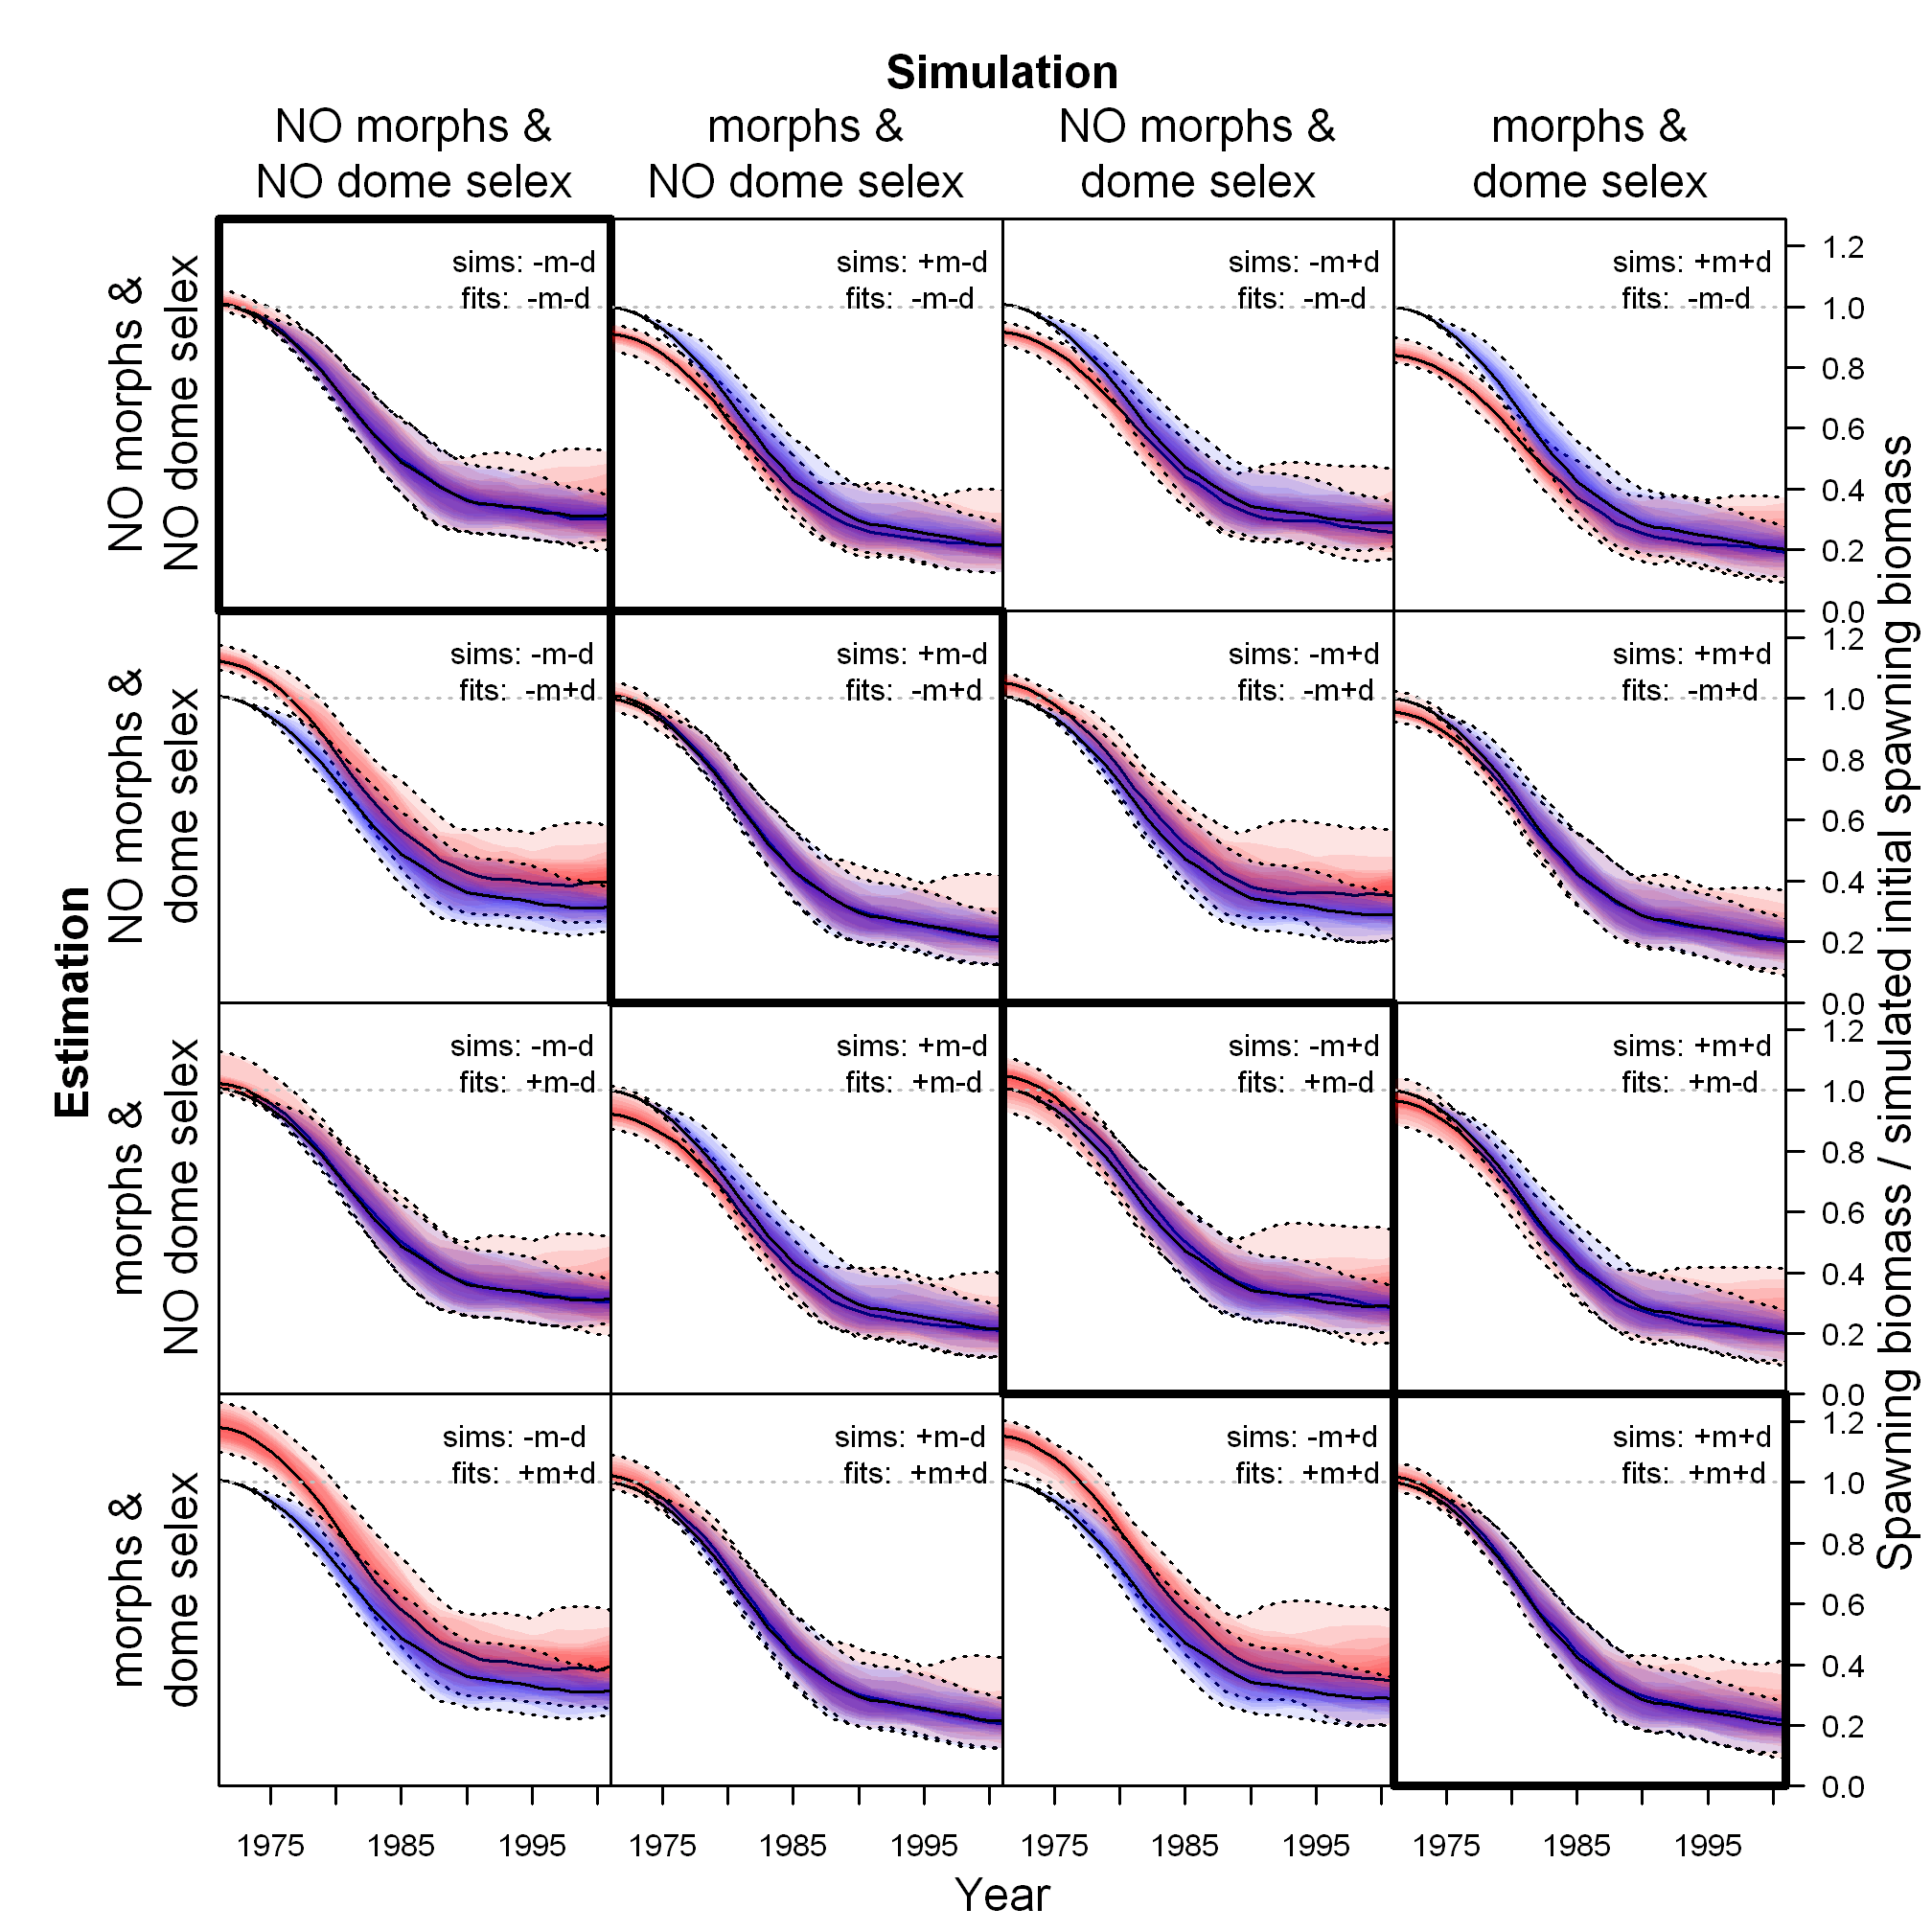
Simulated and estimated spawn. bio.

Slide 26
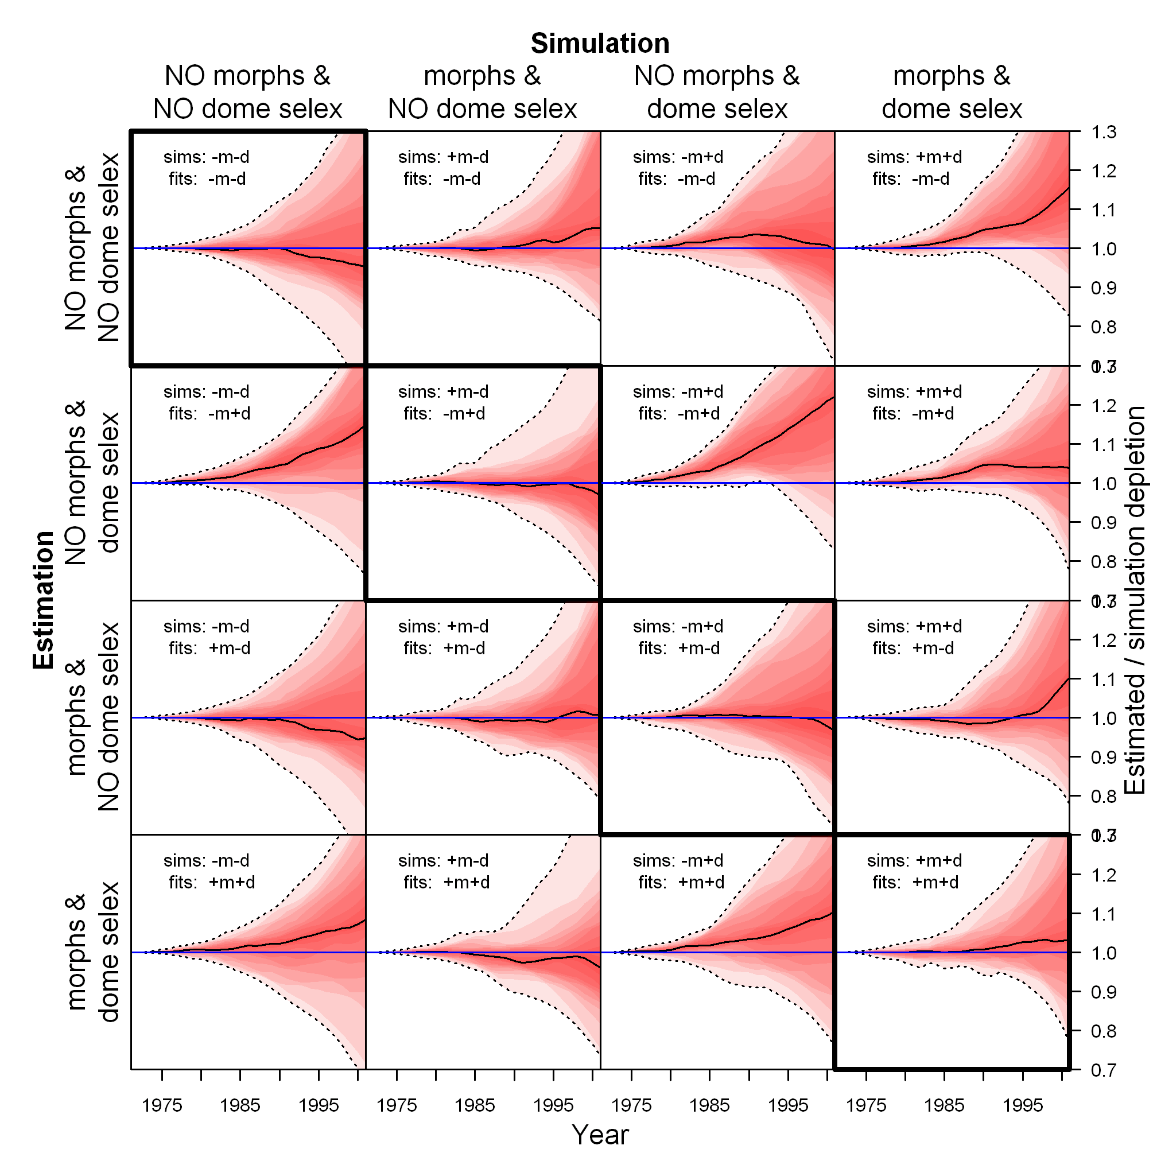
Estimated / simulated depletion

Slide 27
Outline
More advice on bias correction
Overview of growth morphs
Interaction between dome-shaped selectivity and growth morphs
A way out?

Slide 28
Parameter trends: a way out?
Negative value for the Use_Block input causes SS to create a parameter time trend
requires 3 parameters
base parameter is the value for the adjusted parameter
in year = start year
for subsequent years, the 3 parameters define a normal distribution of change over time:
  P1: parameter value for year = end year. Either as logistic offset from base P (if Use_Block=-1), or as direct usage (if Use_Block=-2)
  P2: inflection year; if HI value for the base parameter is >1.1, then use as year, else use as fraction of range styr – endyr
  P3: width of change (units of std.dev. of years)
Source: User Manual for Stock Synthesis v.3.03a, pg. 91

Slide 29
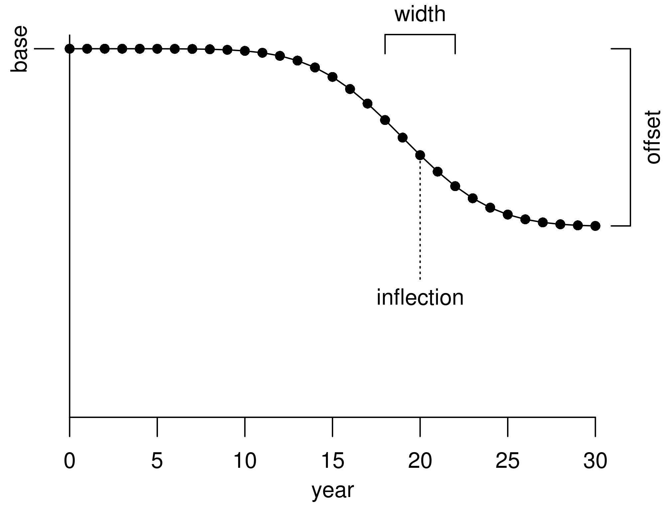
Parameter trends: a way out?

Slide 30
Parameter trends: a way out?
Use parameter trends for descending limb of dome-shaped selectivity
If dome-ness is increasing, that suggests that either big fish are hiding increasingly well,...
...or dead and gone

Slide 31
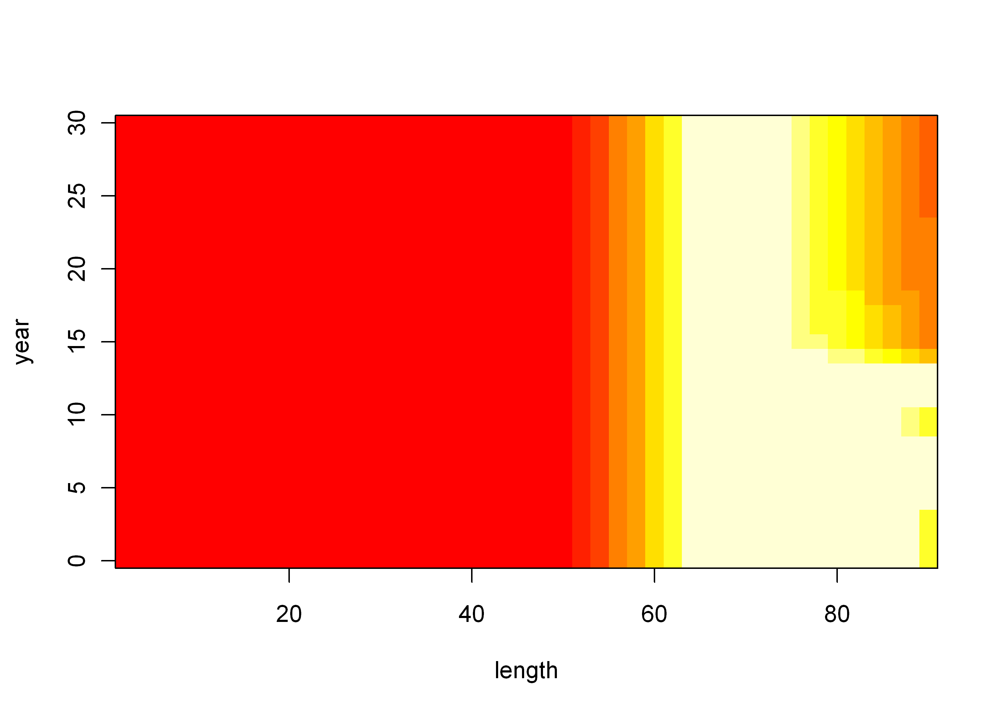
Increasing dome-ness (average)

Slide 32
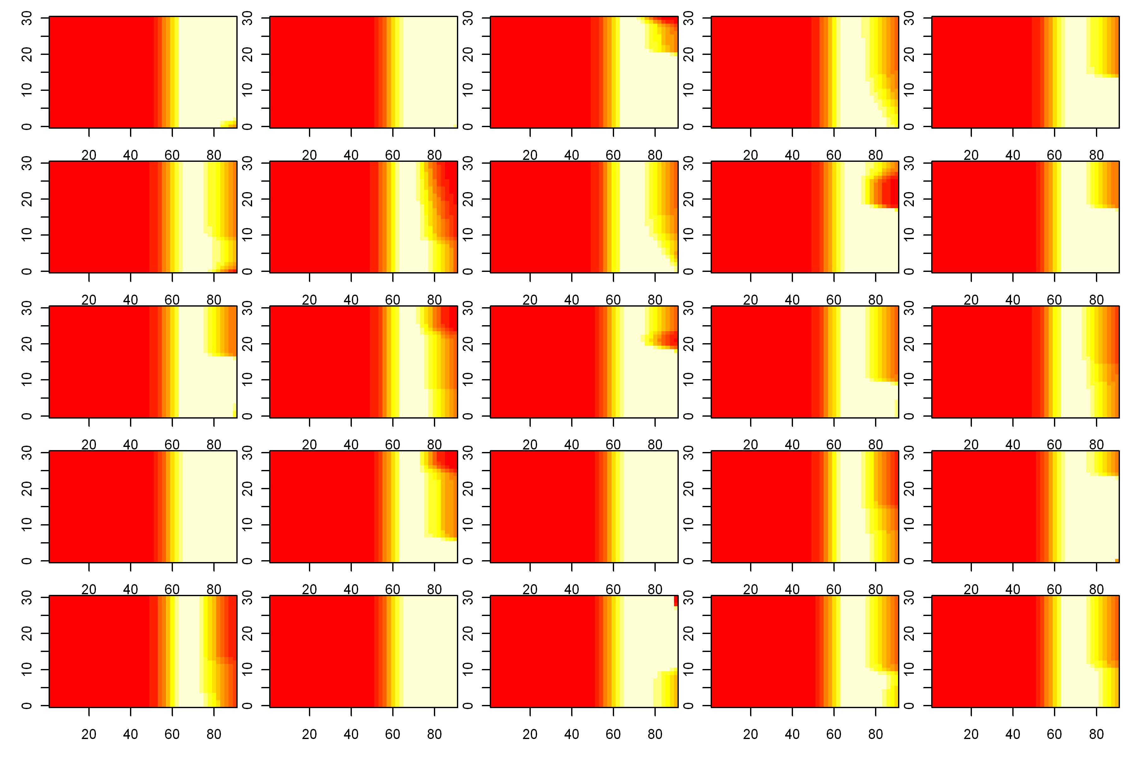
Increasing dome-ness (multiple runs)

Slide 33
Conclusions
We should all start using the maximum bias adjustment feature
Morphs are worth implementing
  at minimum to see impact on results
If dome-shaped selectivity is estimated, be aware of possible confounding with morphs
Look for trends in dome-ness

Slide 34
Thank you.

Slide 35
Extra slides

Slide 36
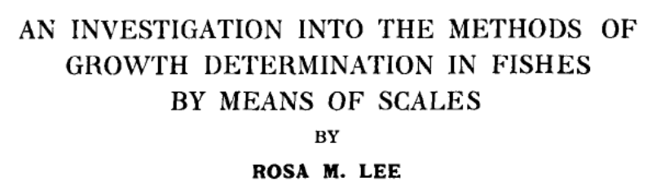
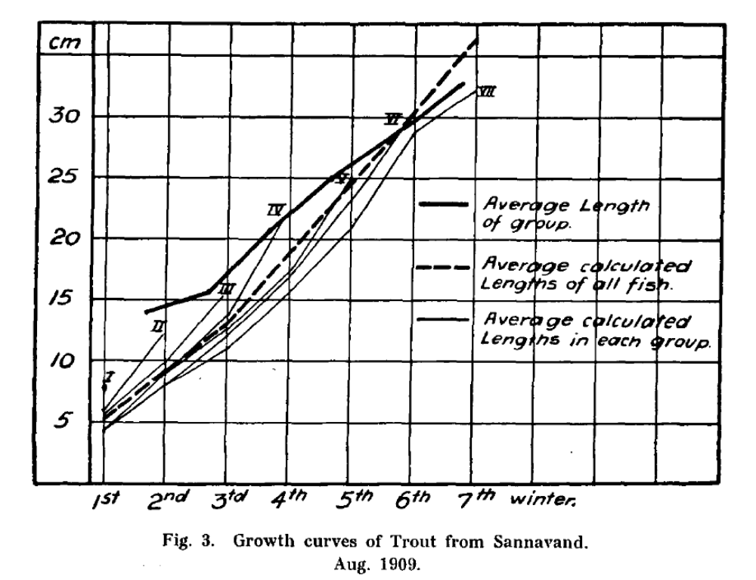
1912

Slide 37
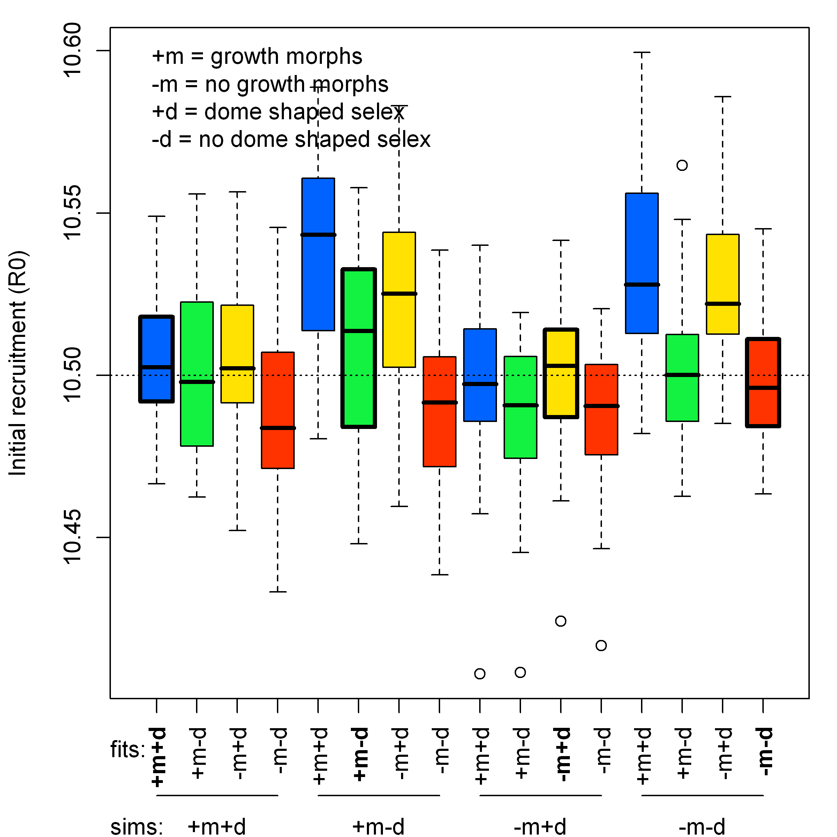

Slide 38
