Slide 1
Genetic Algorithms for AI using Ruby Warrior
James McLellan
Notes:
Hi, my name is James McLellan and I’ll be speaking to you for the next hour about genetic algorithms, and specifically three different approaches to using genetic algorithms for game AI

Slide 2
Definitions
What are Genetic Algorithms?
  An evolutionary algorithm which generates each individual from some encoded form known as a "chromosome" or "genome".
  Useful for multidimensional optimisation problems in which the chromosome can encode the values for the different variables being optimised.
    Source: Dictionary.com
What is AI?
What is RubyWarrior?
Notes:
What are Genetic Algorithms?
Wikipedia defines a Genetic Algorithm as “a search heuristic that mimics the process of natural evolution.”
However, a genetic algorithm does not need to solve only search problems. As a result, I like the Dictionary.com definition a little better:
“An evolutionary algorithm which generates each individual from some encoded form known as a "chromosome" or "genome".”
What this means is that a genetic algorithm is a method that is composed of other methods. These methods are all loosely coupled with one another so that they can easily be replaced with other, similar methods.

Slide 3
Definitions
What are Genetic Algorithms?
  An evolutionary algorithm which generates each individual from some encoded form known as a "chromosome" or "genome".
  Useful for multidimensional optimisation problems in which the chromosome can encode the values for the different variables being optimised.
    Source: Dictionary.com
What is AI?
What is RubyWarrior?
Notes:
The reason why we would want to do this at all is in the second part of the definition. Genertic algorithms are:
“Useful for multidimensional optimisation problems in which the chromosome can encode the values for the different variables being optimised.”
What this means is that you can use a genetic algorithm help you to find the best combination of methods to solve your problem set.
Using some classic academic examples of genetic algorithms (which are sorting examples) you have an unknown data set: which is the quickest way to sort it?
Using a genetic algorithm paradigm you would set up different sorting methods (bubble sort, replacement sort, tree sort) as competing genes. These genes would be tested against part of your data set and graded on criteria you determine: speed, correctness. This would help you identify the best gene to work on your data, and the second best.

Slide 4
Definitions
What are Genetic Algorithms?
  An evolutionary algorithm which generates each individual from some encoded form known as a "chromosome" or "genome".
  Useful for multidimensional optimisation problems in which the chromosome can encode the values for the different variables being optimised.
    Source: Dictionary.com
What is AI?
  What is the AI problem domain for games?
  What are the challenges that a genetic algorithm can help solve?
What is RubyWarrior?
Notes:
What is AI?
Hopefully you already know that AI is artificial intelligence and what that is. Almost any game requires some form of AI to make decisions on behalf of the automatic player.
With that in mind, the questions become more:
What problem domains can genetic algorithms be applied to?

Slide 5
Definitions
What is AI?
  What is the AI problem domain for games?
    Pathing
    Seek Valuable Objects
    Avoid Dangerous Objects
    Manage Resources
      In a game: health
  What are the challenges that a genetic algorithm can help solve?
    Provide organic, not scripted, solutions
      This handles more problem classes, and
      Ultimately, there are fewer lines of code to maintain
    Examples
      When to shoot (and where to shoot)
      When to slash (and where to slash)
      When to flee (and where to flee to, and for how long)
What is RubyWarrior?
Notes:
In most games, the problems that someone develops an AI to solve are:
Pathing - figuring out how to get from one point on the map to another
Seeking and Avoidance - finding things you want, avoiding dangers
and Managing Resources, which in many games is health points.
Many games resolve this problem simply with per-level scripts, sometimes supplemented with a library of more general scripts.
The problem with per-level scripts are that they are very narrowly focused, and a change to the level could break the script. And, most likely the script will have to be re-written for every level.
This is where genetic algorithms can help improve performance.

Slide 6
Definitions
What is RubyWarrior?
  Game written in Ruby for learning Ruby and artificial intelligence.
Notes:
Lastly, before moving on to the detail, “What is Ruby Warrior”.
The Ruby Warrior website itself provides a great definition. It’s a “game written in Ruby for learning Ruby and artificial intelligence.”
However, for this study Ruby Warrior is more than that.

Slide 7
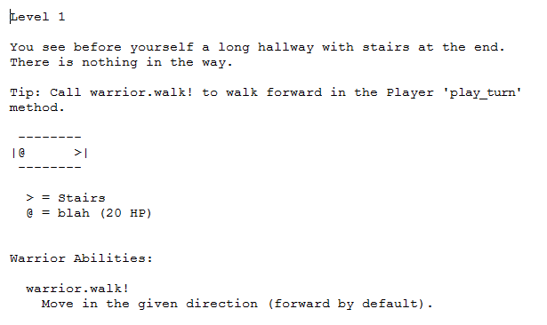
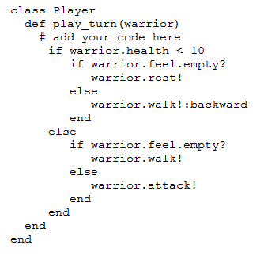
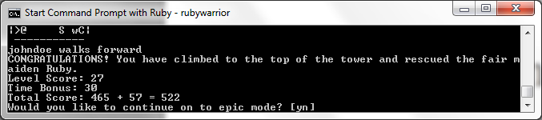
Definitions
What is RubyWarrior?
  A classic old-school tower crawl.
  A pre-built framework for writing and testing AI models
  A pre-existing framework to evaluate the performance of AI models in an organic environment.
Notes:
If you’re an older gamer, RubyWarrior is a fun, old-school dungeon (tower) crawl.
It is a framework for writing and testing AI models. You don’t need to write unit classes, map classes, enemy classes, or anything else. Levels can be customized using some very simple per-level Ruby files.
Finally, Ruby Warrior is a pre-built framework for evaluating your AIs.
Every level is given three score categories: accomplishments on the level, time taken, and a bonus for completing all available accomplishments.
There is a fourth metric, survival. This is implied, but it is also very important.
In short, Ruby Warrior is a sandbox that makes testing an AI solution much easier.

Slide 8

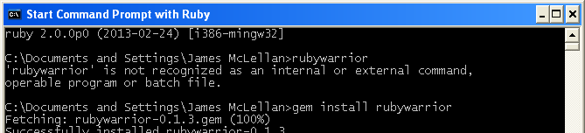
Getting Started
Download Ruby
http://www.ruby-lang.org/en/downloads/
Download Rubywarrior
Notes:
To get started, if you want to follow along. You will need to first download Ruby.
You can do this at the URL shown here.
After downloading and installing ruby, you will need to install rubywarrior. You can do this from the ruby command line by running the command “gem install rubywarrior”

Slide 9
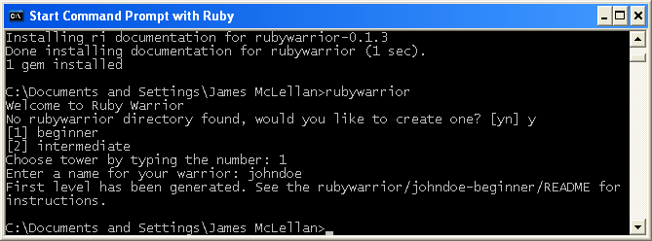
Getting Started
Try it out by hand a little to get the hang of it
Notes:
If you are following along, you might want to take a second to get yourself acquainted with the ruby warrior sandbox.
Type “rubywarrior” to get started and create a profile. A level description and a stub of ruby code, where your AI will be written will be automatically generated for you.

Slide 10
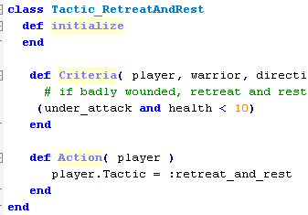
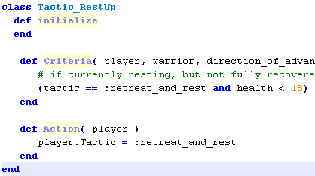
A Very Brief Introduction to GA
C
G
A
T
T
G
C
A
A
C
T
C
T
G
C
A
C
A
Genetic algorithms encode methods as “genes”
Strings or trees of gene methods are tested in the problem set
Successfully tested gene method combinations are mixed into the next generation attempt to improve the solution
Notes:
Before we go any further, I wanted to explain a few concepts about genetic algorithms that don’t seem (to me) to be very intuitive.
When discussing genes, a gene is an alternate name given to a method. A method can be a very simple operation, or a very complex one. The goal in either case is that the method can exist independently.
You will hear the term “individual” in a “population”. An individual is a particular instance of a particular combination of genes. An individual is what is being evaluated by whatever test procedure has been created.
“Fitness” is the result of that evaluation.
“Selection”, “breeding”, and “mutation” are parameters by which the next generation of the solution is created, using the best fit answers from the current population.

Slide 11
Overall Development Plan
Manually construct a first pass library of methods (genes) that could accomplish the goal task
  Goal task: complete all 9 levels of “beginner” mode
  Alt task #1: maximize score
  Alt task #2: minimize number of genes
Construct a mechanism to automatically arrange, run, and evaluate alternate combinations of genes.
Select satisfactory genes as starting point for a second pass aimed at maximizing score.
Notes:
For this exercise I needed to first decide on some goals: questions that I wanted to answer.
In this case those questions were: How can I maximize my score? and How can I minimize the complexity of my AI software?
I had one criteria that any solution had to meet. Namely, that any solution provided could complete all nine levels of the rubywarrior “beginner” mode.
I decided that the best way to start developing genes to test was to first manually code a way through all nine levels. While doing this, I would pay attention to packaging particular actions. These would become my initial pool of genes to test.
Then, I’d need to create a framework to automatically arrange genes into chromosomes, run rubywarrior to test the solution, and then evaluate the run for it’s success.
After my first run, I then planned to select the best genes and try a second pass to further improve score or minimize the number of required genes.

Slide 12
Overall Development Plan
Fitness function
  First fitness function based on final completed level
  (x = last level finished)
  Second fitness function based on final completed level and final score
  (x = last level finished, y = final score)
  Third fitness function based on gene length (x = last level finish, y = gene length)
true (x = 9)
δ(x) =
false (x < 9)
true (x = 9 && y >> 0)
δ(x,y) =
false (x < 9 || y !>> 0)
true (x = 9 && y << y-max)
δ(x,y) =
false (x < 9 || y !<< y-max)
Notes:
Restated more formally, my fitness functions per generation were, first to complete all nine levels, and then secondarily to either maximize score or minimize complexity.

Slide 13
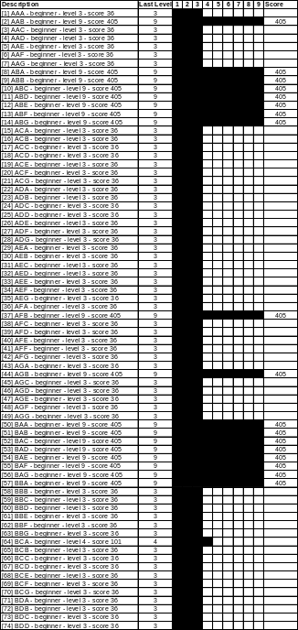
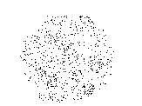
Overall Development Plan
Three approaches considered:
  Semi manual approach, static environment
    Complex methods for genes
  Fully automatic approach, static environment
    Extremely simple methods for genes
  Best of above, dynamic environment
Notes:
There are a few different approaches to applying genetic algorithms.
The one I was most comfortable with, and wanted to test first is a semi manual approach. In this case the library of genes is all hand written (not computer written). The computer will then create test candidates from these genes and evaluate them.
Secondly, I wanted to try a completely computer-driven approach, where my gene library was composed of the smallest class of functions possible for controlling my AI.
Finally, I wanted to try the better of the above two in a dynamic environment to validate that a solution built using genetic algorithms didn’t focus on a local best fit, but instead provided a good generic answer.

Slide 14
Manual Pass
Manual pass through nine levels
  Pay attention to parts of script that could be packaged as genes
  Should have a starting point that provides at least one “correct” answer
Notes:
For my first test, I would create the library of genes myself and use this library to have the computer construct individuals and populations.
It was necessary, then, to first develop this library of genes.
To do this, I manually developed my first set of scripts to get through the nine sample “beginner” levels of rubywarrior.
I’m not certain it is necessary to start from a known “good” initial condition, but since this is my first time applying genetic algorithms to AI, I wanted to have confidence in what I was doing.
An alternative approach might be to splice together very simple and basic actions, and evolve up; instead of building a complex action, then cutting it into nore simple pieces.
I will demonstrate the alternative approach later in this presentation.

Slide 15
Manual Pass
The Earliest Chromosome
Retreat and Rest
Criteria: health < 10
Action: retreat and rest
Advance
Criteria: always true
Action: advance
Note: the “advance” default behavior was kept in all later trials, and is not shown
Notes:
On the right is the first draft of the first two genes, stitched together as an individual.
It is an if-else, which probably seems far too simple. However, if else applies exclusivity and priority: the first condition to execute will be the only condition to execute.
So, even with something as primitive as if-else blocks you can begin to organized specialized functionality, which are what the genes are.

Slide 16
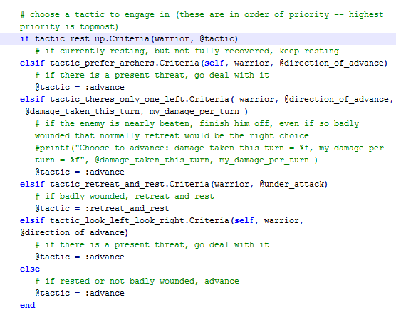
Manual Pass
Later Chromosomes
Rest Up
Criteria: had retreated and health < 18
Action: keep resting
“Look Left, Look Right”
Criteria: relative threat in one direction > relative threat in other direction
Action: turn around
Prefer Archers
Criteria: relative threat (from archers) in one direction > relative threat in other direction
Action: turn around
Advance
Criteria: always true
Action: advance
“There’s Only One Left”
Criteria: only one enemy still visible, plus “I Can Take ‘Em” calculated without an allowance for retreat to safety
Action: advance
Retreat and Rest
Criteria: health < 10
Action: retreat and rest
Notes:
This becomes more obvious, I hope, as you add more genes.
Criteria moved into the gene interface (which is shown on the right in a still-sloppy fashion that is not using a common signature).
In this example, you can see that if the Ruby Warrior has been hurt badly enough to retreat and rest, he is directed to rest until fully healed.
There is an optimization here in “There’s Only One Left” to maximize time score by taking a risk and trying to complete the level when, otherwise, wounds would dictate that the Ruby Warrior should rest.
These manually written genes are named and organized memetically, by the thought process they represent. In my opinion, this made it easier to understand what function a particular gene was intended to have.
Genes do not have to be organized strictly as strings. They can be organized as trees, at least; and I’m certain there are other structure possibilities.
I have chosen strings for their easiness to implement.

Slide 17

Manual Pass
Order Matters
Prefer Archers
Criteria: relative threat (from archers) in one direction > relative threat in other direction
Action: turn around
Not a good idea
Rest Up
Criteria: had retreated and health < 18
Action: keep resting
“There’s Only One Left”
Criteria: only one enemy still visible, plus “I Can Take ‘Em” calculated without an allowance for retreat to safety
Action: advance
Retreat and Rest
Criteria: health < 10
Action: retreat and rest
Notes:
During testing it became obvious, and I suppose to some it was already obvious that the order of genes can matter. Since the outcome of the evaluation is taking some action, preferring one action over another -- such as advancing through the level without fully resting -- can result in Natural Selection taking hold (failure).

Slide 18
Building the Genes
Genes for Ruby Warrior, Easy Level
Retreat and Rest
Criteria: health < 10
Action: retreat and rest
“I Can Take ‘Em”
Criteria: evaluation that remaining, known, enemies can be beat without resting
Action: advance
“I’ll Be Fully Healed on the Next Level”
Criteria: not under attack and enough health remaining to take a single, surprise shot from an unseen unit.
Action: advance
Rest Up
Criteria: had retreated and health < 18
Action: keep resting
“There’s Only One Left”
Criteria: only one enemy still visible, plus “I Can Take ‘Em” calculated without an allowance for retreat to safety
Action: advance
“Look Left, Look Right”
Criteria: relative threat in one direction > relative threat in other direction
Action: turn around
Advance
Criteria: always true
Action: advance
Prefer Archers
Criteria: relative threat (from archers) in one direction > relative threat in other direction
Action: turn around
Notes:
This is part of the gene library I wrote to get myself through the first nine “easy” levels of Ruby Warrior.
Each gene has a common Criteria method that returns true and an action that occurs as a result of the Criteria.
You’ll notice that the genes on the left are primitive and the genes on the right look more nuanced. As you start to apply genes, I think you will find spots where a new gene will optimize some particular issue.
Similarly, I hope you’ll notice that this level of abstraction allows me to call my genes by some meme that helps communicate to me what the thought process involved is. “I’ll be fully healed on the next level” hopefully communicates that this method involves ignoring any impulse to rest; taking a measured risk that the end of the level (and full health) is just a little further away.

Slide 19
Building the Genes
Developed a library of “gene” methods
  All implemented a common interface, so that they could be easily swapped
    bool Criteria()
      returned ‘true’ if this gene felt it could be used
      returned ‘false’ if this gene felt it could not be used
    void Action()
      triggered the desired response
  Naming was based on memes, which helped keep it clear what the gene was intended to do
Notes:
To summarize, from a software mechanics point of view.
You will need to build a library of “genes”. Genes are software methods that partially or fully implement your solution.
Genes must share a common interface, so that you can easily replace them and swap them without changing software. When evaluating genes, you’ll want to be able to string genes together and evaluate them automatically.

Slide 20
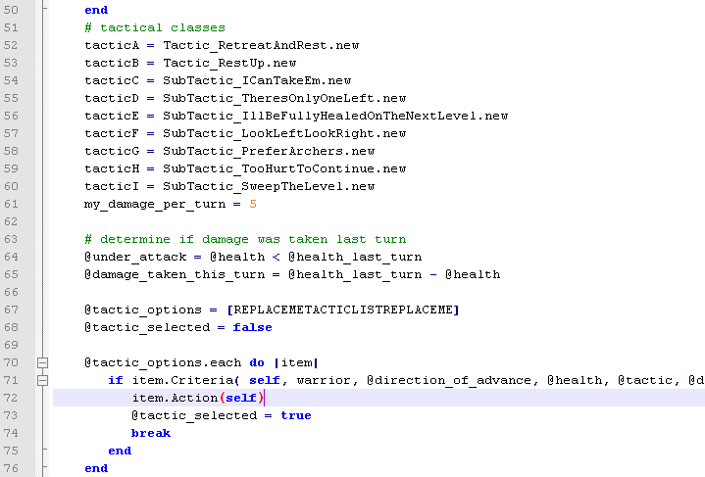
Building the Population
Gene definitions at top
Ordered list of genes
Run each item in order
Criteria
Action
Notes:
This is a sample of the boilerplate ruby AI I used to stitch together gene methods.
The method (gene) definitions are located at the top.
An ordered list of genes is next. In this image, you see the list is filled with a tag that can be replaced automatically, so that multiple chromosomes can be generated from the same template.
Next is the main loop that will only execute the first gene which has passing criteria. Until that condition is reached, each gene is evaluated for it’s activation criteria; and, if the conditions are met, the associated action is executed.

Slide 21
Building the Population
Diagram
  Circles: functions/conditionals
  Squares: actions/terminal conditions
...
Notes:
Diagramatically, this is what each population looks like.
Each gene is a combined conditional and terminal action, only to be taken if the conditional is true. Otherwise, the next conditional gene is evaluated.

Slide 22
Automatically Arranging and Evaluating Population
Write a common interface
Write a framework that will jumble genes and run test
Write a framework to collate results with the chromosome jumble
Notes:
The library of genes is now built.
What is next is to write a framework to construct a large population of candidate solutions, automatically evaluate those solutions, and present the results.
We’ve mentioned before, the first part of this is structural: write the gene methods using a common interface, so that they are interchangeable.
Next, we need to write a framework that will jumble the genes into individuals and evaluate each individual by running it through RubyWarrior’s beginner levels.
And finally, we’ll need that same framework to evaluate the results and recommend the individuals for promotion into the next generation.

Slide 23
Automatically Arranging and Evaluating Population
Write a common interface
  Criteria
    returns true if criteria for gene is met, false otherwise
  Action
    commands a specific action
Notes:
The interface has been touched on before. It is a combination of a boolean method for evaluation and a void method that will execute the desired action.

Slide 24
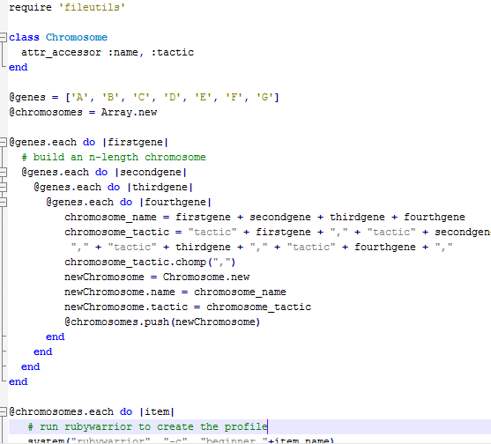
Automatically Building and Evaluating Population
Write a common interface
Write a framework that will jumble genes and run test
  Vary length
  Vary genes and gene order
Notes:
The jumble application will create individuals from the gene library and place them on a stack for evaluation.

Slide 25
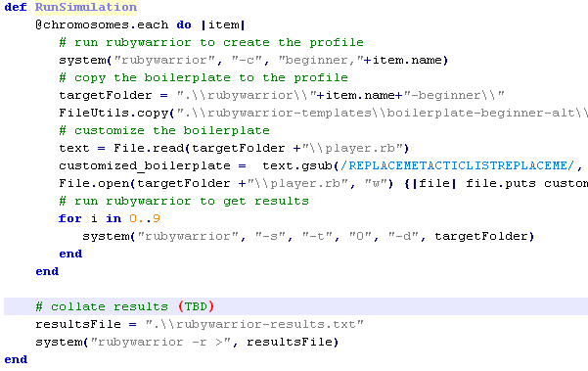
Automatically Building and Evaluating Population
Write a common interface
Write a framework that will jumble genes and run test
  Run the simulation
  Record results
Notes:
The jumble application will also write the gene individual as a player into RubyWarrior.
The individual will then be passed through the nine beginner levels of RubyWarrior.
Score and highest level completed will be recorded for evaluation.

Slide 26
Automatically Building and Evaluating Population
Write a framework that will jumble genes and run test
  Needed to make a small change to Rubywarrior
    Added a “-c” command line parameter that would construct a new player automatically.
    Added a “-r” command line parameter that would send scores to a text file for evaluation.
    Modified the no user input flag to remove some lingering user prompts.
Notes:
There were a few very small structural changes that had to be made to RubyWarrior to facilitate the automatic testing.
The RubyWarrior source is written in ruby and installed to your gems folder when you install ruby warrior. These changes were made to “config.rb”, “runner.rb”, and “game.rb”.
A create player flag was added to automatically generate a player from the command line, so that our jumble app could more easily write individual players.
A reporting flag was added to get the results.
And the no user input behavior was modified to remove some user inputs that remained even if the flag was on.

Slide 27
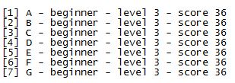
Automatically Building and Evaluating Population
Write a common interface
Write a framework that will jumble chromosomes and run test
Write a framework to collate results with the chromosome jumble
Notes:
In the end, this is what the results would look like for a first pass through jumbling and evaluation.
Each individual is a single gene long, and did not meet the fitness criteria of completing the game.
To help me build confidence in my answers, my first evaluation of results was manual.

Slide 28
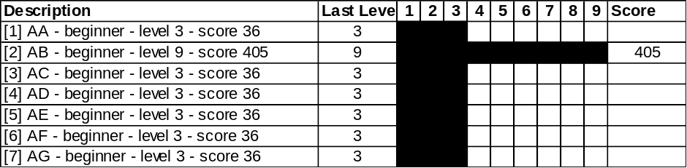
Automatically Building and Evaluating Population
Write a framework to collate results with the chromosome jumble
  Piped character selection (which shows name and score) to a text file
  Processed text file in Excel for ease-of-browsing
  Looked at:
    Successfully completing all 9 levels
    Final score
    Chromosome length
Notes:
To manually evaluate the results, I piperd the results into a text file and loaded it into Microsoft Excel.
I concentrated on seeing if a particular individual met my fitness criteria of completing all nine levels, and then I looked at my other criteria of maximum score and simplicity.

Slide 29
Automatically Building and Evaluating Population
Fitness function
  First pass fitness function based on final completed level
  (x = last level finished)

true (x = 9)
δ(x) =
false (x < 9)
Notes:
The very first population was a single gene long and produced no individuals that could pass all nine beginner levels.
To my surprise, my second population (which was two genes long), produced two individuals that could pass the beginner mode of RubyWarrior.
These two individuals, then, also were my best fit for my simplicity goal.

Slide 30
Automatically Building and Evaluating Population
Fitness function
  Second pass fitness function based on final completed level and final score
  (x = last level finished,
  y = final score)

true (x = 9 && y > 405)
δ(x,y) =
false (x < 9 || y <= 405)
Notes:
My third, fourth, and fifth populations were of increasing complexity and produced more individuals that met the initial criteria of completing the game.
Now I focused on my score criteria, using the score achieved by the simple genes as a threshold.

Slide 31
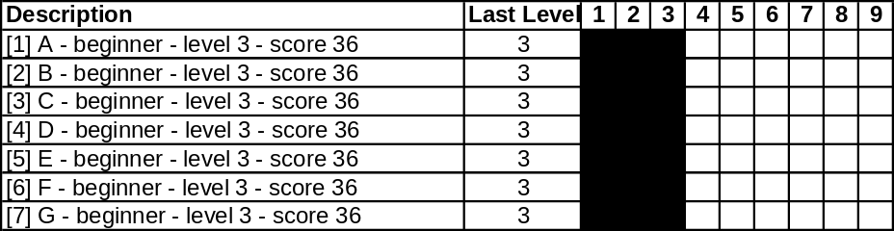
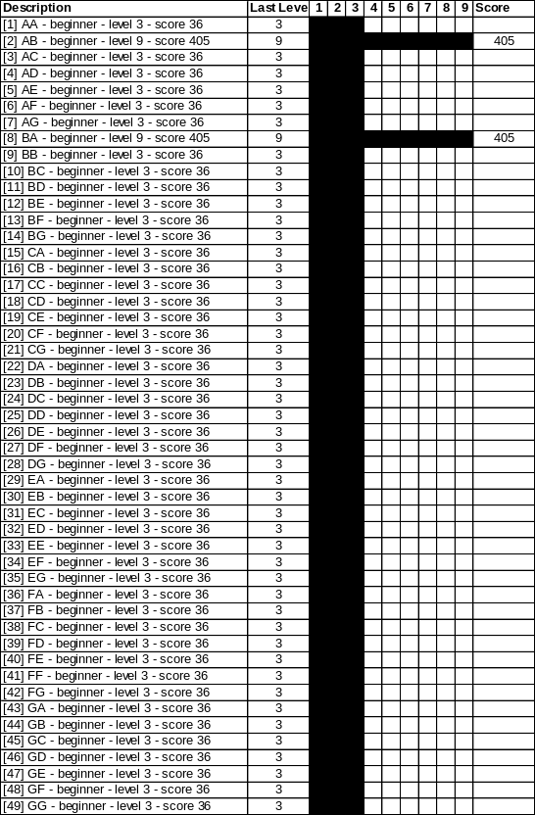
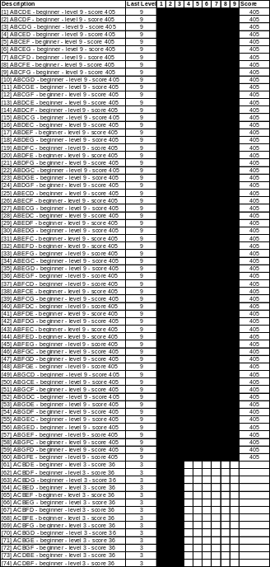
Results: First Automatic Pass
One gene
No success
Two genes
2 combinations succeed, meeting simplest chromosome alternate goal
Three genes
Several successes; start paying attention to score
Notes:
These are an example of the first, second and third population.
You’ll barely be able to see score, but you can see how the number of solutions that could beat the beginner levels does begin to grow.
You can also see that level three is a very difficult-to-cross hurdle. This might be useful for level design. For me it was useful in understanding my criteria when doing a completely automated approach to solving this problem later.

Slide 32
Results: First Automatic Pass
4 and 5 gene results not shown
  Improved number of successes completing nine levels
  No improvement in score
Notes:
The four and five gene populations are too large to display.
However, it is enough to say that there was no improvement in score from the basic two genes.

Slide 33
Results: Winners
Oddly enough, neither of these alone was a winner. They had to exist in combination.
  “Rest up” regulated the “rest” action, and made it more useful.
  Relied on default (no-gene) impulse to advance.
Notes:
These were the two winning genes, both of which focused on managing the health resource and relied on the default walk/attack impulse to advance.
I was also surprised that these two genes, which perform similar functions needed to both be present in order to work.
This brings to mind when doing selection that if you are too quick to cull particular methods, you might miss out on a combination that is necessary for effect.

Slide 34
Conclusions: First Automatic Pass
Selection
  Game could be beat with just two genes
  Score didn’t improve with “score enhancing” optimization genes
    Need to reconsider those genes
      Look at defects in those particular test cases
      Add genes that address those defects
        “Too Hurt To Continue” and “Sweep the Level”
Real-world process applicability
  How often do “score enhancing” genes not work?
Notes:
I learned a lot of lessons from this first pass:
First, I learned that the seven method solution I had written by hand could be simplified to two methods.
I also learned that my “score enhancing” genes were not providing any score improvement. I would need to either reconsider these genes, or abandon them entirely in favor of new ideas.
This brings to mind a thought that genetic algorithms could be used in a process model environment to help identify parts of a process that are intended to improve performance, but also do not.

Slide 35
Selection and Second Pass
Selection would involve removing unsuccessful genes from consideration
  Kept other genes, to see if anything interesting might turn up
    A 9-gene, 5-chromosome simulation takes about 12 hours to run on a 2.53GHz i5 CPU
Ran samples of what had appeared to be promising combinations to find out what went wrong.
Notes:
My next pass using my manually created genes, the second of three, would involve removing some of the unsuccessful genes from consideration.
Some genes, that I thought were still promising, I kept in this second pass in hopes they would combine with some helper to produce a better result.
However, such a choice is computationally expensive: a library of nine genes, running from 1 to 5 genes long per individual took 12 hours to run as a simulation on a 2.5 GHz CPU.
While the simulation was running, I hand-ran particular individuals through RubyWarrior to help me understand why a particular method that I thought would improve score was not working as I had hoped.

Slide 36
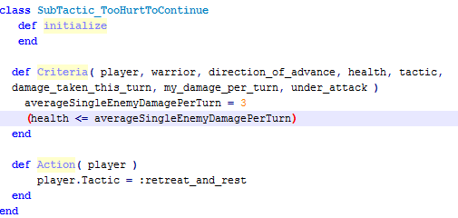
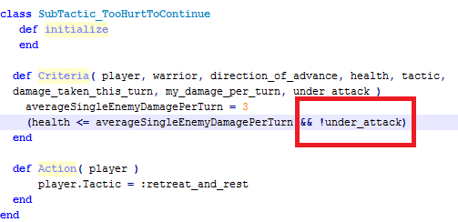
Troubleshooting Genes
Second pass genes improved final score very modestly (420 vs. 405)
One of the two “score enhancing” genes did not work at all: chromosomes possessing it did not make it to the final level
Ran the level for that gene to find out what didn’t work
Notes:
The results of the second pass was a disappointingly modest gain in total score.
Manually inspecting combinations that I thought should work better involved taking that particular player and replaying the RubyWarrior levels slowly to identify the behavior I had expected to see, and what I got instead. This did lead to fixing problems with some genes as intended.
In this case, I am not using the full potential of genetic algorithms to solve my general problems. This is, as compared to the fully automatic approach later, still a very hands-on way of doing things.

Slide 37
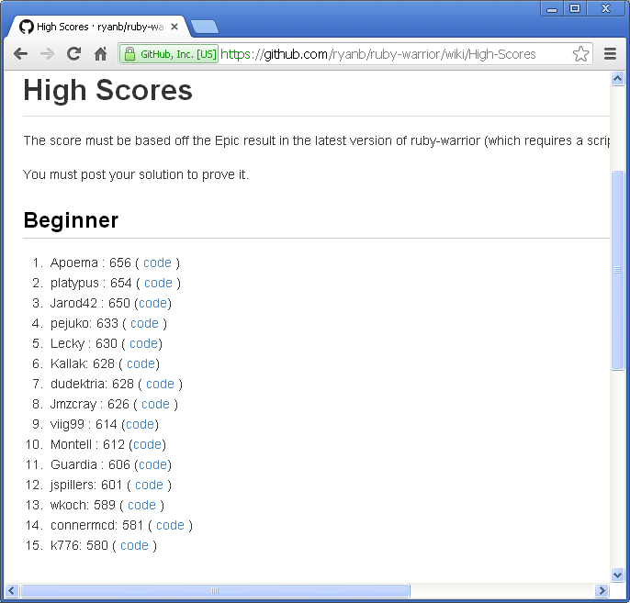
Third Pass Results
Peak Score of 465
  Bottom “top fifteen” high score is 580
Notes:
Fixes to genes produced a better score gain of 10% (45 points).
However, my computer generated AIs were still not among the top tier players of RubyWarrior.
At this point, it was time to try a different approach to applying genetic algorithms to my gaming problem.

Slide 38
Alternate Approach: Fully Automatic Selection, Reproduction (with random starting pool)
Alternatively
  Replace complex genes with the simplest genes possible: conditionals and actions
  Relax the restrictive early criteria of passing all nine levels
  Add an automatic inheritance model
Notes:
This is the more fully automated approach to using genetic algorithms.
In this case, I created genes that were very primitive and composed all of the “atomic” RubyWarrior functions: looking, feeling, walking, attacking, resting, rescuing.
I also learned from my manual pass that the criteria to beat all nine levels was very restrictive. If I did not relax my criteria, it is possibly that I would not produce any improvement from generation to generation.
Lastly, I updated my infrastructure to automatically read the results, apply the fitness functions, and produce the next generation from the most fit of the previous generation.

Slide 39
Alt Approach Comparison
More complex genes
  9 “meme” genes
Simpler genes
  2 conditionals
      feel, walk
    2 modifiers
      forward backward
    7 objects
      archer, sludge, thick sludge, wizard, wall, nothing
    more modifiers
      health and amount of it
  5 actions
      walk, rest, pivot, attack, shoot
    2 modifiers
      forward backward
Notes:
This approach puts a great deal more faith in the computer.
In my first approach I had a library of nine genes that represented particular partial solutions I proposed to my problem. These were more thoughtful.
The fully automatic approach removed me from consideration. Genes were the conditionals, their modifiers, their objects, and the possible actions.

Slide 40
Alt Approach Comparison
Smaller search space
  N = 9⁽⁵⁾ = 59,049
Entire search space covered
Fewer generations
Larger search space
  N > 38⁽⁵⁾ > 79,235,168
Only some of search space will be covered
More generations
Notes:
There is an advantage to the more primitive combination of genes.
My search space with my manual library was only roughly 59 thousand possible solutions, and was limited by bugs I introduced as the programmer.
By contrast, the primitive gene approach would cover a much larger search space of 79 million possible solutions.
However, because the search space is so much larger, the resolution will also be poorer: my manual solution population of 59,000 took 12 hours to evaluate; a 79 million solution population would be impossible to evaluate in a reasonable amount of time.
The only way, then, to evaluate the larger solution space is to randomize the possible answers. This is a scattered approach that leaves gaps, as shown in the image below; where, by contrast, the more complex gene approach allowed me to evaluate every possible solution.
For selection to work, I would need more selection opportunities and more generations.

Slide 41
Alt Approach Comparison
Structural Differences
Ordered
Fully Random
...
x
...
Notes:
This fully random approach also created some structural differences in how individuals were laid out.
A random approach allows for both nested conditionals and also for dead-ends that terminate prematurely.

Slide 42
Alt Approach Comparison
Fitness function
  First pass fitness function based on final completed level
  (x = last level finished, y = score)

true (x = x-max || y = y-max)
δ(x) =
false (x < x-max && y < y-max)
Notes:
The manual pass showed that requiring the completion of all nine beginner levels was too stringent a requirement, so the fitness criteria have been relaxed to select whatever individuals proceed furthest or obtain the highest score.

Slide 43
Alt Approach Comparison
First Pass
  N = 19,607
  n = 30,000
  Best level = 9
  Best score = 405
Second Pass
  n = 19,607
  Best level = 9
  Best score = 420
First Pass (alt)
  N > 79,235,168
  n = 3,700
  Best level = 2
  Best score = 10
  δ = 259
Second Pass (gen 2-30)
  n ~ 3,500
  Best level = 2
  Best score = 10
Notes:
Every ten generations took about 10 hours to simulate.
I decided to stop simulation at 30 generations, which was roughly triple the processing time of the manually prepared population and compare the results.
I was very disappointed to find that the randomly generated populations did not succeed. No population at all passed the second level.
After a little while, the explanation became obvious:

Slide 44
Alt Approach Lessons Learned
Irreducible Complexity
  2:38^3 (1:25,000) chance of hitting the triplet required to pass level two
    #1 If (feel.nothing?) walk! else attack!
    #2 If (feel.enemy?) attack! else walk!
      Level 3 chance 6:38^6
        if (hurt) rest! elseif (feel.nothing?) walk! else attack!
  No intermediate steps available to use as selection criteria
    Without hurdles that can be crossed, selection can not function as an amplifier of “good” behavior
  Randomly traversing a field may take longer to hit a hard-to-hit result than iterating through
Notes:
The problem with this use case (and possibly others) is that there are two and only two combinations that will produce a solution that will pass this second level gateway.
A rich pool of 38 genes only madeit more unlikely that the combination would be hit by chance.
This particular combination can not be simplified and remain functional.
Score is incremented only when a level completes. Being unable to progress in satisfying fitness functions removes the ability to select and amplify desireable intermediate behavior.
Finally, and especially true for a very unlikely combination, random traversal around a search space can take much longer than an iterative method. After running roughly four times as long as it would have taken an iterative method to find the combination with certainty, there was still a 3% chance of a random traversal missing it entirely; and in this case that is what happened.

Slide 45
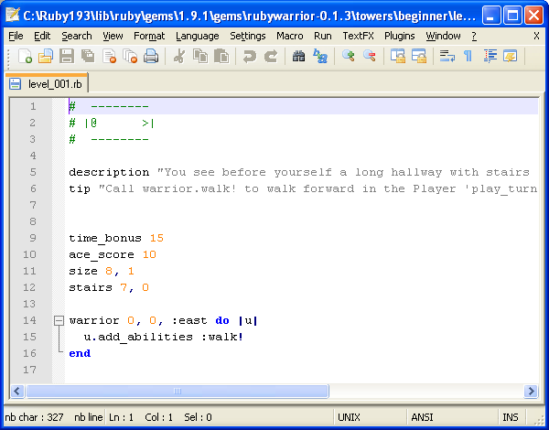
Dynamic Environments
Level files are simple ruby scripts
  Create multiple copies of the beginner towers folder and select one before a run
Notes:
Finally, it is possible using RubyWarrior to make the test environment change.
This allows you to prove that your AI solution hasn’t settled on a solution that is too level specific.

Slide 46
Moving From Ruby to Your App
Copy the gene methods that are important
Change the hooks to your method calls
Extend RubyWarrior to sandbox your AI before new elements of game are finished
Notes:
To take the results of a session and use it elsewhere is just a matter of copying your gene methods (which should be small and portable) to your target app.
And the reverse is also true: if your target app is adding new features, but they are not yet complete; depending on the feature it may be possible to extend RubyWarrior and develop the AI in parallel with the feature infrastructure.

Slide 47
Applicability in Game AI
Accurate level of difficulty that accurately reflects the capability of the AI, not extra resources
Special purpose AI “heroes” that are very capable in some scenarios, but not all. Without any need for special abilities.
Notes:
In the first semi-manual run, it was possible to quickly construct three differently capable solutions to the game that reuse the same underlying methods.
This makes it possible to generate a genuinely unique character without any need for tuning terms or tweaks of any other kind.

Slide 48
Applicability Outside Game AI
Process improvement
  If a business process or other process can be simulated, this methodology could be used to identify parts of the process that add no value or do not fit all use cases.
Notes:
This exercise also taught me how this same technique of genetic algorithms can be used for real world process optimization.
If you don’t mind, take: for example, an assemblyman. He (or she) receives work orders from email, checks out his tools from property management, drives to the shop in a separate building, collects the required parts; if required parts are missing, he drives back to the office to issue put the parts on order. While at the shop, which isn’t air conditioned, he takes frequent breaks outside for some air.
Depending on your use case: many small orders, few large orders, or something in the middle, there are different variables to simulate and experiment with. You could run such a process optimization experiment on your computer instead and save the expense of doing the same thing with trial setups and training until you have identified some certain improvements.s

Slide 49
Risks of Using Genetic Algorithms
Your Best Solution Isn’t Necessarily “The” Best Solution
  Tendency to stick with a solution that works
    Could have been happy with a 2-gene score of 405
Keep thinking of new genes that might improve how the problem is solved
  Need to set goals for “improvement” genes to meet or beat
  Sometimes a particular method needs several helper methods that are junk until a certain length is reached.

Slide 50
Risks of Using Genetic Algorithms
Need a framework to identify remaining inefficiencies and how to focus on them
  This study manually inspected and fixed problems
  Simulate those genes in a small scale, to make sure they work

