Slide 1
FilterBoost:
Regression and Classification on Large Datasets
Joseph K. Bradley¹ and Robert E. Schapire²
¹Carnegie Mellon University
²Princeton University

Slide 2
Typical Framework for Boosting
Batch Framework
Dataset
Final Hypothesis
Booster
The booster must always have access to the entire dataset!
Sampled i.i.d. from target distribution D

Slide 3
Motivation for a New Framework
Batch boosters must always have access to the entire dataset!
This limits their applications: e.g. Classify all websites on the WWW (i.e. very large dataset)
  Batch boosters must either use a small subset of the data or use lots of time and space.
This limits their efficiency: Each round requires computation on entire dataset.
Ideas: 1) Use a data stream instead of a dataset, and 2) Train on new subsets of data each round.

Slide 4
Alternate Framework: Filtering
Data Oracle
Stores tiny fraction of data!
Final Hypothesis
~D
Booster
Boost for 1000 rounds → only store ~1/1000 of data at a time.
Note: Original boosting algorithm [Schapire ’90] was for filtering.

Slide 5
Main Results
FilterBoost, a novel boosting-by-filtering algorithm
Provable guarantees
  Fewer assumptions than previous work
  Better or equivalent bounds
Applicable to both classification and conditional probability estimation
Good empirical performance

Slide 6
Batch Boosting to Filtering
Batch Algorithm
Given: fixed dataset S
For t = 1,…,T,
Choose distribution D_{t} over S
Choose hypothesis h_{t}
Estimate error of h_{t} with D_{t}, S
Give h_{t} weight α_{t}
Output: final hypothesis
sign[ H(x) = Σ_{t} α_{t} h_{t}(x) ]
Gives higher weights to misclassified examples
D_{t} forces the booster to learn to correctly classify “harder” examples on later rounds.

Slide 7
Batch Boosting to Filtering
Batch Algorithm
Given: fixed dataset S
For t = 1,…,T,
Choose distribution D_{t} over S
Choose hypothesis h_{t}
Estimate error of h_{t} with D_{t}, S
Give h_{t} weight α_{t}
Output: final hypothesis
sign[ H(x) = Σ_{t} α_{t} h_{t}(x) ]
In Filtering, no dataset S!
We need to think about D_{t} in a different way.

Slide 8
Batch Boosting to Filtering
Filter
accept
Data Oracle
~D
~D_{t}
Key idea:
Simulate D_{t} using Filter mechanism (rejection sampling)
reject

Slide 9
FilterBoost: Main Algorithm
Given: Oracle
For t = 1,…,T,
Filter_{t} gives access to D_{t}
Draw example set from Filter
  Choose hypothesis h_{t}
Draw new example set from Filter
  Estimate error of h_{t}
Give h_{t} weight α_{t}
Output: final hypothesis
sign[ H(x) = Σ_{t} α_{t} h_{t}(x) ]
Data Oracle
Filter₁
Estimate error of weak hypothesis
Weak Learner
Weak Hypothesis
h₁
Predict sign[ H(x) =
α₁
+ …
]

Slide 10
The Filter
Filter
accept
Data Oracle
~D
~D_{t}
Recall:
We want to simulate D_{t} using rejection sampling, where D_{t} gives high weight to badly misclassified examples.
reject

Slide 11
The Filter
Filter
accept
Data Oracle
~D
~D_{t}
Label = +1
Booster predicts -1
High weight
High probability
of being accepted
Label = -1
Booster predicts -1
Low weight
Low probability
of being accepted
reject

Slide 12
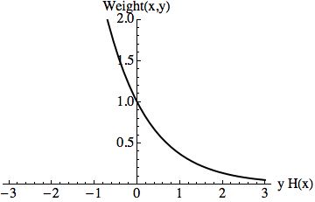
The Filter
What should D_{t} be?
D_{t} must give high weight to misclassified examples.
Idea: Filter accepts (x,y) with probability proportional to the error of the booster’s prediction H(x) w.r.t. y.
AdaBoost [Freund & Schapire ’97]
Exponential weights put too much weight on a few examples.
Can’t be used for filtering!

Slide 13
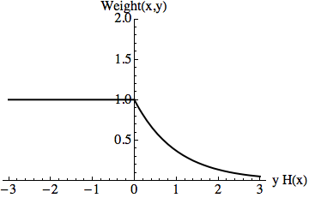
The Filter
What should D_{t} be?
D_{t} must give high weight to misclassified examples.
Idea: Filter accepts (x,y) with probability proportional to the error of the booster’s prediction H(x) w.r.t. y.
MadaBoost [Domingo & Watanabe ’00]
Truncated exponential weights work for filtering

Slide 14
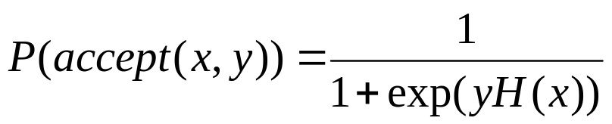
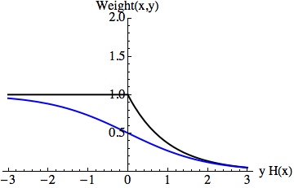
The Filter
FilterBoost is based on a variant of AdaBoost for logistic regression [Collins, Schapire & Singer, ’02]
Minimizes logistic loss → leads to logistic weights:
MadaBoost
FilterBoost

Slide 15
FilterBoost: Analysis
Step 1
Given: Oracle
For t = 1,…,T,
Filter_{t} gives access to D_{t}
Draw example set from Filter
  Choose hypothesis h_{t}
Draw new example set from Filter
  Estimate error of h_{t}
Give h_{t} weight α_{t}
Output: final hypothesis
sign[ H(x) = Σ_{t} α_{t} h_{t}(x) ]
How long does the filter take to produce an example?
Step 2:
How many boosting rounds are needed?
Step 3:
How can we estimate weak hypotheses’ errors?

Slide 16
FilterBoost: Analysis
Step 1:
Given: Oracle
For t = 1,…,T,
Filter_{t} gives access to D_{t}
Draw example set from Filter
  Choose hypothesis h_{t}
Draw new example set from Filter
  Estimate error of h_{t}
Give h_{t} weight α_{t}
Output: final hypothesis
sign[ H(x) = Σ_{t} α_{t} h_{t}(x) ]
How long does the filter take to produce an example?
If the filter takes too long, H(x) is accurate enough.

Slide 17
FilterBoost: Analysis
Step 1:
Given: Oracle
For t = 1,…,T,
Filter_{t} gives access to D_{t}
Draw example set from Filter
  Choose hypothesis h_{t}
Draw new example set from Filter
  Estimate error of h_{t}
Give h_{t} weight α_{t}
Output: final hypothesis
sign[ H(x) = Σ_{t} α_{t} h_{t}(x) ]
If the filter takes too long, H(x) is accurate enough.
Step 2:
How many boosting rounds are needed?
If weak hypotheses have errors bounded away from ½, we make “significant progress” each round.

Slide 18
FilterBoost: Analysis
Step 1:
Given: Oracle
For t = 1,…,T,
Filter_{t} gives access to D_{t}
Draw example set from Filter
  Choose hypothesis h_{t}
Draw new example set from Filter
  Estimate error of h_{t}
Give h_{t} weight α_{t}
Output: final hypothesis
sign[ H(x) = Σ_{t} α_{t} h_{t}(x) ]
If the filter takes too long, H(x) is accurate enough.
Step 2:
We make “significant progress” each round.
Step 3:
How can we estimate weak hypotheses’ errors?
We use adaptive sampling [Watanabe ’00]

Slide 19
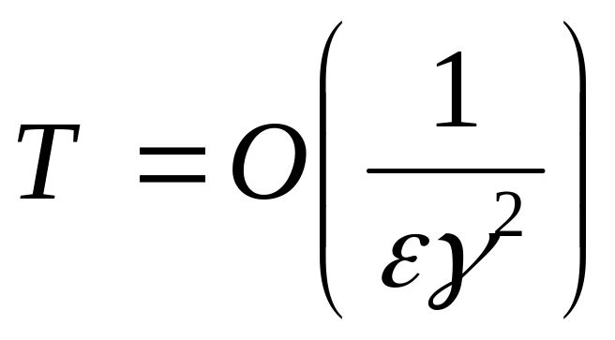
FilterBoost: Analysis
Theorem:
Assume weak hypotheses have
edges (1/2 – error) at least γ > 0.
Let ε = target error rate.
FilterBoost produces a final hypothesis H(x) with error ≤ ε within T rounds where

Slide 20
Previous Work vs. FilterBoost
 | Assume edges decreasing? | Need a priori bound γ? | Can use infinite weak hypothesis spaces? | # rounds
MadaBoost [Domingo & Watanabe ’00] | Y | N | Y | 1/ε
[Bshouty & Gavinsky ’02] | N | Y | Y | log(1/ε)
AdaFlat [Gavinsky ’03] | N | N | Y | 1/ε²
GiniBoost [Hatano ’06] | N | N | N | 1/ε
FilterBoost | N | N | Y | 1/ε

Slide 21
FilterBoost’s Versatility
FilterBoost is based on logistic regression.
It may be directly applied to
conditional probability estimation.
FilterBoost may use
confidence-rated predictions
(real-valued weak hypotheses).

Slide 22
Experiments
Tested FilterBoost against other batch and filtering boosters:
MadaBoost, AdaBoost, Logistic AdaBoost
Synthetic and real data
Tested: classification and conditional probability estimation

Slide 23
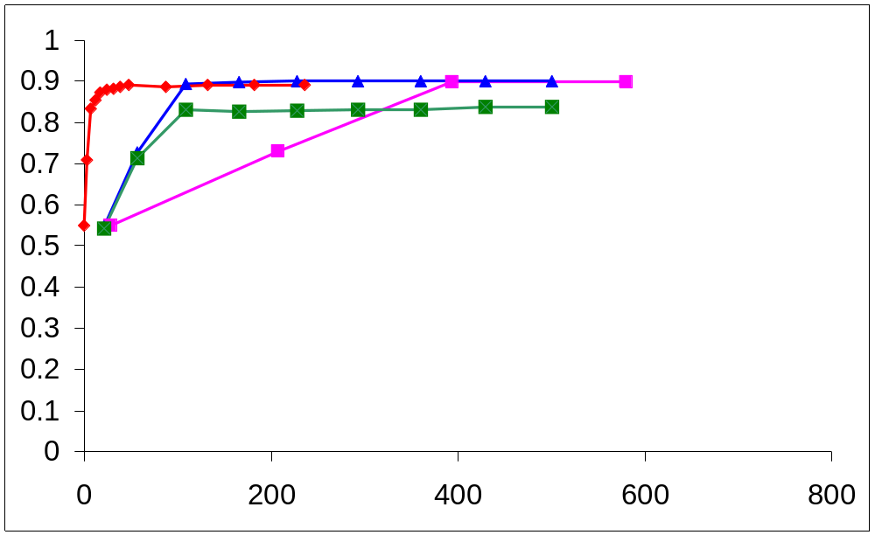
Experiments:
Classification
Noisy majority vote data, WL = decision stumps, 500,000 exs
AdaBoost
AdaBoost w/ resampling
Test accuracy
FilterBoost
achieves optimal accuracy fastest
AdaBoost w/ confidence-rated predictions
Time (sec)

Slide 24
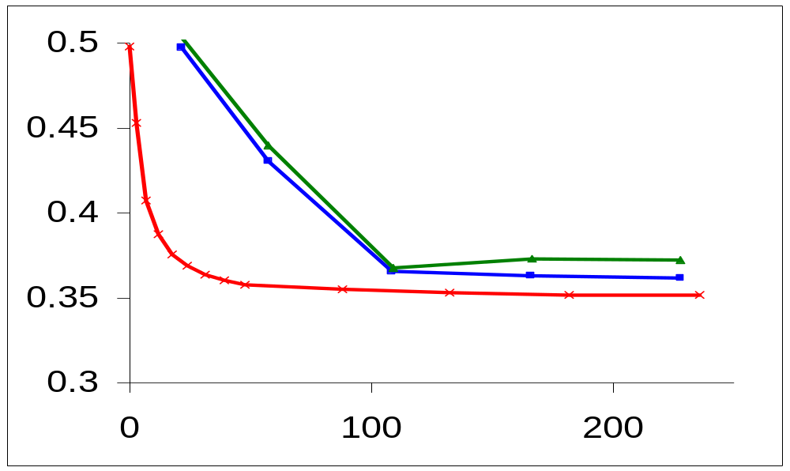
Experiments:
Conditional Probability Estimation
Noisy majority vote data, WL = decision stumps, 500,000 exs
FilterBoost
AdaBoost (confidence-rated)
AdaBoost (resampling)
RMSE
Time (sec)

Slide 25
Summary
FilterBoost is applicable to learning with large datasets
Fewer assumptions and better bounds than previous work
Validated empirically in classification and conditional probability estimation, and appears much faster than batch boosting without sacrificing accuracy

