Slide 1


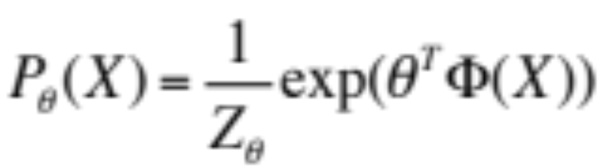


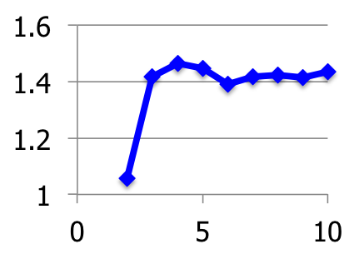
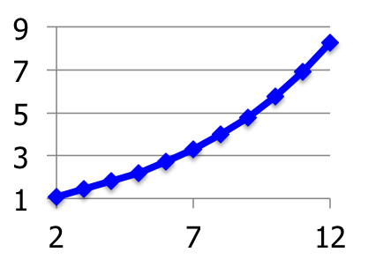
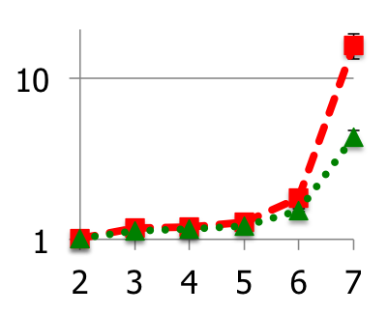
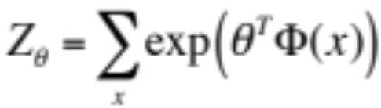
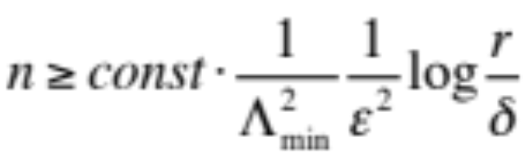
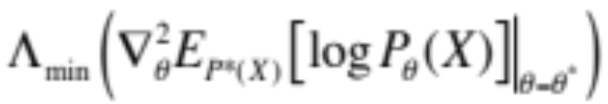
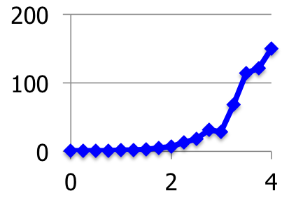
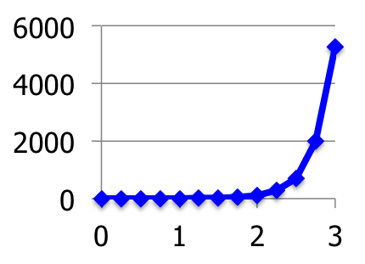
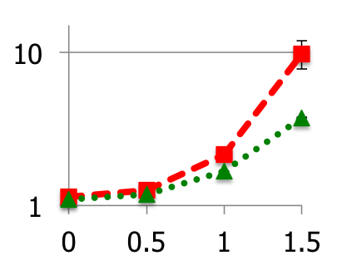
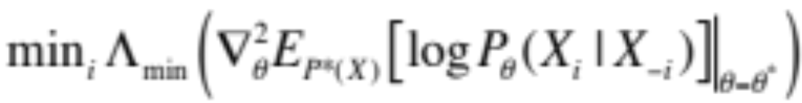
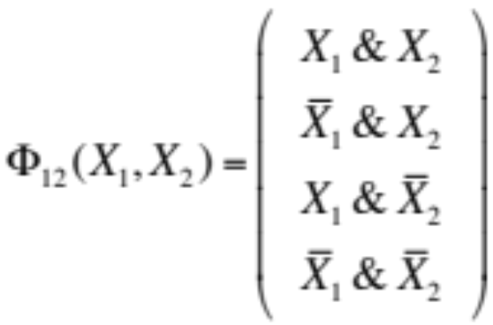
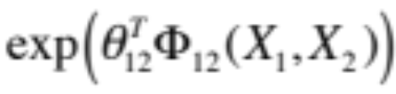

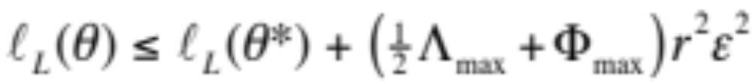
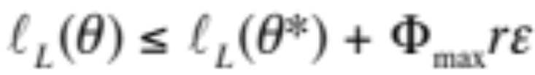
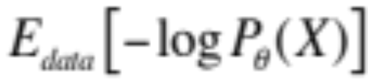

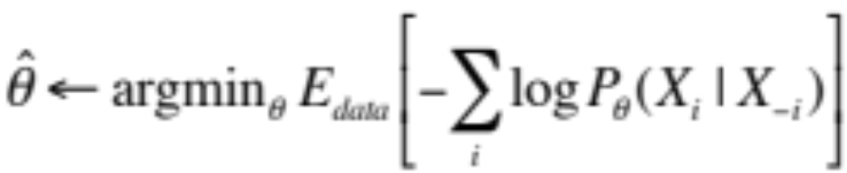
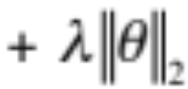
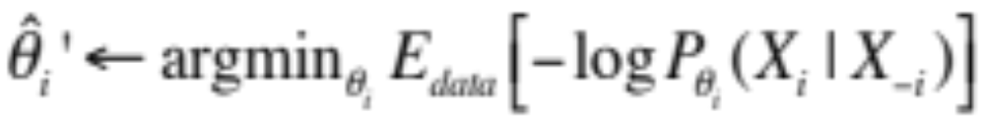
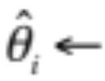

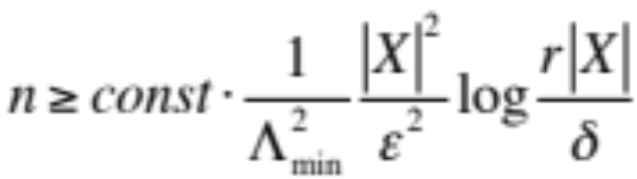
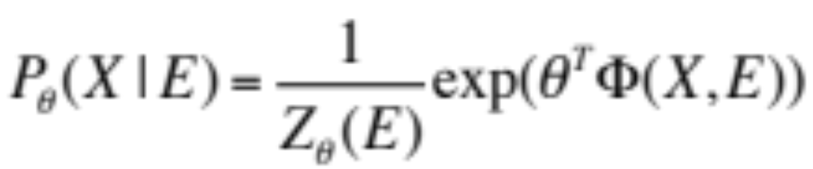
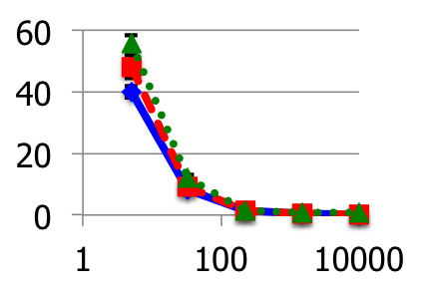
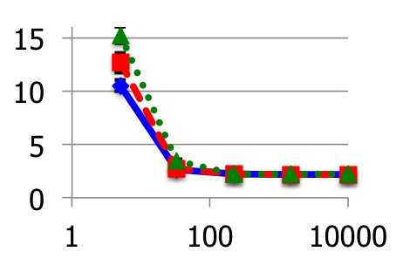

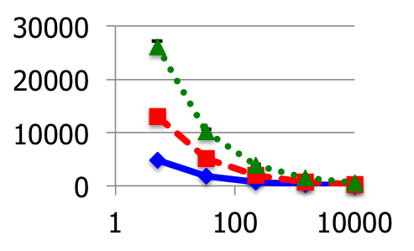
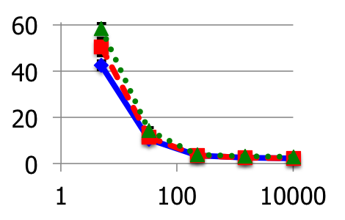
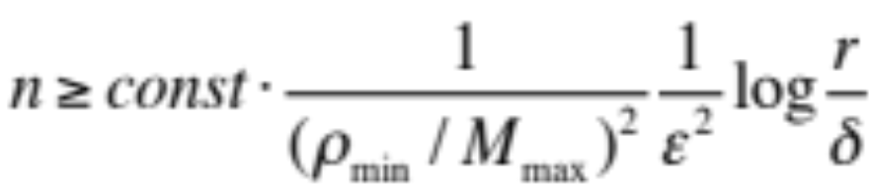
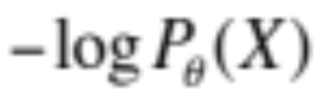
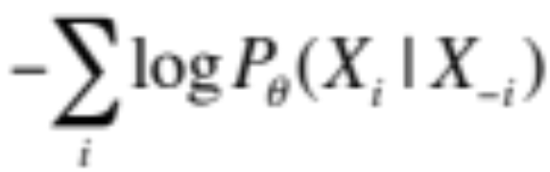
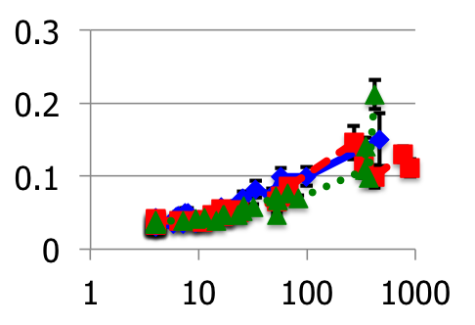

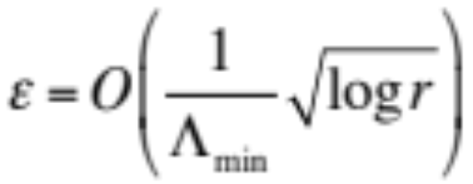

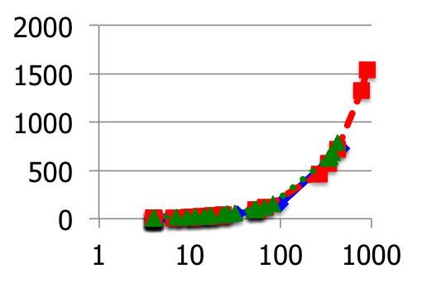


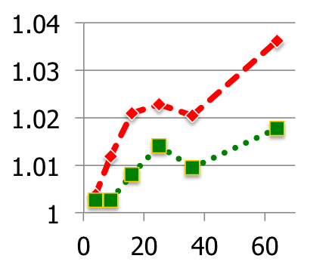
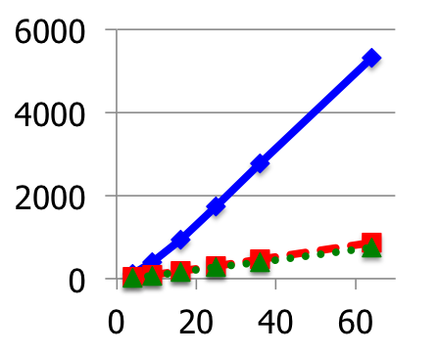
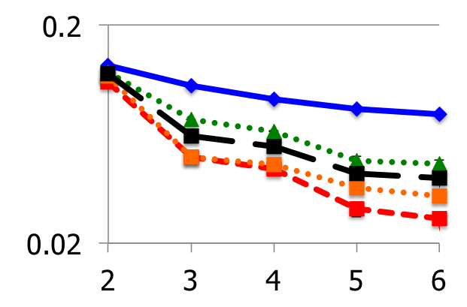


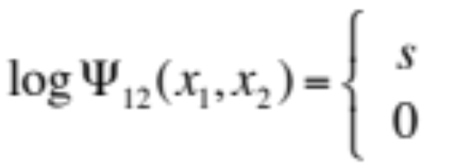

Sample Complexity of Composite Likelihood
Joseph K. Bradley & Carlos Guestrin
PAC-learning parameters for general MRFs & CRFs
via practical methods: pseudolikelihood & structured composite likelihood.
Background
Sample Complexity Bounds
Λ_{min} for Various Models
Markov Random Fields (MRFs)
Bound on Parameter Error: MLE, MPLE
How do the bounds vary w.r.t. model properties?
Model distribution P(X) over random variables X
Theorem
MLE or MPLE using L1 or L2 regularization
achieve avg. per-parameter error
with probability ≥ 1-δ
using n i.i.d. samples from P_{θ*}(X):
Plotted: Ratio (Λ_{min} for MLE) / (Λ_{min} for other method)
as a log-linear MRF:
Chains
Stars
Grids
# parameters (length of θ)
Model diameter is not important.
MPLE is worse for high-degree nodes.
MPLE is worse for big grids.
Requires inference.
➔ Provably hard for general MRFs.
Features
MPLE
MPLE
Parameters
Probability of failure
better
Λ_{min} ratio
combs
Avg. per-parameter error
Λ_{min} ratio
MPLE
Λ_{min} ratio
Example MRF: the health of a grad student
X₄: losing hair?
Λ_{min} for MLE: min eigenvalue of Hessian of loss at θ*:
Model size |Y|
(Fixed factor strength)
Model size |Y|
(Fixed factor strength)
Grid width
(Fixed factor strength)
X₂: bags under eyes?
X₁: deadline?
Λ_{min} for MPLE: min_{i} [ min eigval of Hessian of loss component i at θ* ]:
MPLE
MPLE
MPLE
factor
X₃: sick?
Λ_{min} ratio
Λ_{min} ratio
Λ_{min} ratio
combs
X₅: overeating?
Bound on Log Loss
Factor strength
(Fixed |Y|=8)
Factor strength
(Fixed |Y|=8)
Factor strength
(Fixed |Y|=8)
Binary X:
Theorem
If the parameter estimation error ε is small,
then the log loss converges quadratically in ε:
else the log loss converges linearly in ε:
MPLE is worse for strong factors.
Combs (Structured MCLE) improve upon MPLE.
Example query:
All plots are for associative factors. (Random factors behave similarly.)
= P( deadline | bags under eyes, losing hair )
Max feature magnitude
Structured Composite Likelihood
Maximum Likelihood Estimation (MLE)
Joint vs. Disjoint Optimization
Composite Likelihood (MCLE)
Given data: n i.i.d. samples from
L2 regularization is more common. Our analysis applies to L1 & L2.
Joint MPLE:
Minimize objective:
Y_{i}
MLE: Estimate P(Y) all at once
Loss
Regularization
Disjoint
MPLE:
Pro: Data parallel
Con: Worse bound (extra factors |X|)
MPLE: Estimate P(Y_{i}|Y_{-i}) separately
Gold Standard: MLE is (optimally) statistically efficient.
Theorem
Sample Complexity Bound for Disjoint MPLE:
Avg of from separate estimates
Something in between?
→ Estimate a larger component, but keep inference tractable.
Composite Likelihood (MCLE):
Estimate P(Y_{Ai}|Y_{-Ai}) separately, Y_{Ai} in Y.
(Lindsay, 1988)
MLE Algorithm
Iterate:
Compute gradient.
Step along gradient.
Hard to compute (inference).
Can we learn without
intractable inference?
Y_{Ai}
Conditional Random Fields (CRFs)
Tightness of Bounds
Choosing MCLE components Y_{Ai}:
Larger is better.
Keep inference tractable.
Use model structure.
E.g., model with:
Weak horizontal factors
Strong vertical factors
→ Good choice: vertical combs
Model conditional distribution P(X|E) over random variables X,
Parameter estimation error
≤ f(sample size)
(looser bound)
Log loss
≤ f(param estimation error)
(tighter bound)
Chain.
|X|=4.
Random factors.
given variables E:
MLE
Pro: Model X, not E.
➔ Inference exponential only in |X|, not in |E|.
Con: Z depends on E!
L1 param error
Log (base e) loss
MPLE
MLE objective:
MPLE-disjoint
Bound on Parameter Error: MCLE
(Lafferty et al., 2001)
Compute Z(e) for every training example!
L1 param
error bound
Log loss bound,
given params
Theorem
Intuition:
ρ_{min}/M_{max} = Average Λ_{min}
(over multiple components estimating each parameter)
Maximum Pseudolikelihood (MPLE)
Training set size
Training set size
ρ_{min} = min_{j} [ sum over components Ai which estimate θ_{j} of
[ min eigval of Hessian of at θ* ].
MLE loss:
Hard to compute → replace it!
Predictive Power of Bounds
Pseudolikelihood (MPLE) loss:
M_{max} = max_{j} [ number of components Ai which estimate θ_{j} ].
(Besag, 1975)
Is the bound still useful (predictive)?
L1 param error
MPLE: One bad estimator
P(X_{i}|X_{-i}) can give bad results.
MCLE: The effect of a bad estimator P(X_{Ai}|X_{-Ai}) can be averaged out by other good estimators.
Intuition: Approximate distribution as product of local conditionals.
Yes! Actual error vs. bound:
Different constants
Similar behavior
Nearly independent of r
Pro: No intractable inference required
Pro: Consistent estimator
Con: Less statistically efficient than MLE
Con: No PAC bounds
X₂: bags under eyes?
X₁: deadline?
Learning Test
Chains.
Random factors.
10,000 train exs.
MLE (similar results for MPLE)
r=5
L1 param error bound
MPLE
MLE
Grid.
Associative factors (fixed strength).
10,000 training samples.
r=11
better
Training time (sec)
combs
Related Work
r=23
1/Λ_{min}
Log loss ratio (other/MLE)
combs
MPLE
Ravikumar et al. (2010)
PAC bounds for regression Y_{i} ~ X with Ising factors.
Our theory is largely derived from this work.
Liang and Jordan (2008)
Asymptotic bounds for pseudolikelihood, composite likelihood.
Our finite sample bounds are of the same order.
Abbeel et al. (2006)
Grid size |X|
Grid size |X|
Only previous method for PAC-learning high-treewidth discrete MRFs.
  (Low-degree factor graphs over discrete X.)
Main idea (their “canonical parameterization”):
  Re-write P(X) as a ratio of many small factors P( X_{Ci} | X_{-Ci} ).
    Fine print: Each factor is instantiated 2^{|Ci|} times using a reference assignment.
  Estimate each small factor P( X_{Ci} | X_{-Ci} ) from data.
Combs (MCLE) lower sample complexity--without increasing computation!
Learning with approximate inference
No previous PAC-style bounds for general MRFs, CRFs.
c.f.: Hinton (2002), Koller & Friedman (2009), Wainwright (2006)
Averaging MCLE Components
Best: Component structure matches model structure.
Grid with strong vertical (associative) factors.
Experimental Setup
Theorem
If the canonical parameterization uses the factorization of P(X),
it is equivalent to MPLE with disjoint optimization.
Λ_{min}
MLE
Combs - vertical
Average: Reasonable choice without prior knowledge of θ*.
Structures
Grids
Learning
→ Computing MPLE directly is faster.
→ Our analysis covers their learning method.
better
MPLE
Combs - both
Worst: Component structure does not match model structure.
Chains
Stars
10 runs with separate datasets
Optimized with conjugate gradient
  MLE on big grids: stochastic gradient with Gibbs sampling
Future Work
Grid width
Combs - horizontal
Factors
X₁
Random:
factor strength
Theoretical understanding of how Λ_{min} varies with model properties.
Choosing MCLE structure on natural graphs.
Parallel learning: Lowering sample complexity of disjoint optimization via limited communication.
Comparing with MLE using approximate inference.
Acknowledgements
X₂
Associative:
if
Thanks to John Lafferty, Geoff Gordon, and our reviewers for helpful feedback.
Funded by NSF Career IIS-0644225, ONR YIP N00014-08-1- 0752, and ARO MURI W911NF0810242.
otherwise

