Slide 1

Enhanced LLM-based Retrieval-Augmented QA System for Educational Content
Presented By: Jaykumar Chaudhary (2022DC04341)
BITS Examiner: Jayalakshmi Natarajan ma’am
Cybage Examiner: Mr. Rakesh Sharma
Supervisor/Mentor: Mr. Lalkar Eknath Chhadawelkar

Slide 2
PROBLEM STATEMENT
Overwhelming Volume of Educational Content Students face vast amounts of PDFs, handouts, and notes—often spanning hundreds of pages—making navigation difficult.
Difficulty in Locating Accurate, Contextual Answers Searching for reliable, well-contextualized responses is slow and frustrating, especially with unstructured academic material.
Limitations of Keyword-Based Search Existing tools rarely combine retrieval with explanation, reducing their usefulness for deeper academic understanding.
Lack of Retrieval-Driven Learning Support Existing tools rarely combine retrieval with explanation, reducing their usefulness for deeper academic understanding.

Slide 3
OBJECTIVES & GOALS
1. Build a scalable semantic QA system for processing multi-format academic documents (PDF, DOCX) with structure preservation.
2. Integrate modular LLM backends (Gemini, Groq, Ollama) for flexible cloud and local inference.
3. Ensure trustworthy answers via provenance metadata and fact-preserving linguistic polishing.
4. Design advanced retrieval strategies with semantic embeddings, context expansion, and metadata filtering.
5. Enable summarization & prompt-driven Q/A generation for study and assessment use cases.
6. Evaluate using RAGAS metrics and multi-model benchmarking for performance and accuracy.

Slide 4
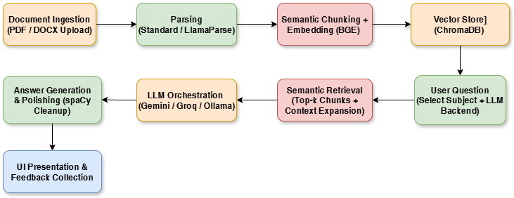
ENHANCED QA PIPELINE
Ingestion & Parsing – Academic PDFs/DOCX files are uploaded with subject tags and optionally parsed using LlamaParse for advanced extraction of tables, equations, and structured markdown. Semantic Processing – Content is chunked, embedded with BGE, and stored in ChromaDB for efficient, subject-wise semantic retrieval. Answer Generation – User selects a subject and LLM backend (Gemini, Groq, Ollama); relevant chunks are retrieved, answers generated, and polished for clarity. UI & Feedback Loop – Results and optional context are shown in the frontend, with user feedback driving continuous system improvement.

Slide 5
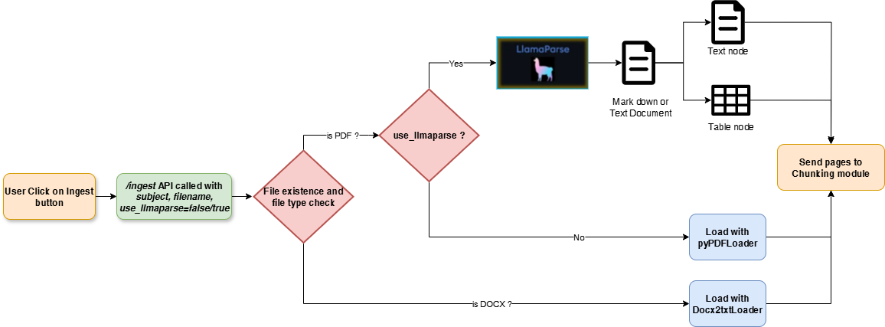
STANDARD & LLAMAPARSE-BASED PARSING
Standard Parsing
Uses PyPDFLoader and Docx2txtLoader for quick, lightweight text extraction from PDFs and DOCX files.
Best suited for simple documents without complex layouts, tables, or equations.
LlamaParse Parsing
Leverages an LLM-powered parser for tables, equations, structured markdown, and complex layouts.
Ideal for preserving document structure, enabling richer semantic chunking and improved retrieval accuracy.

Slide 6
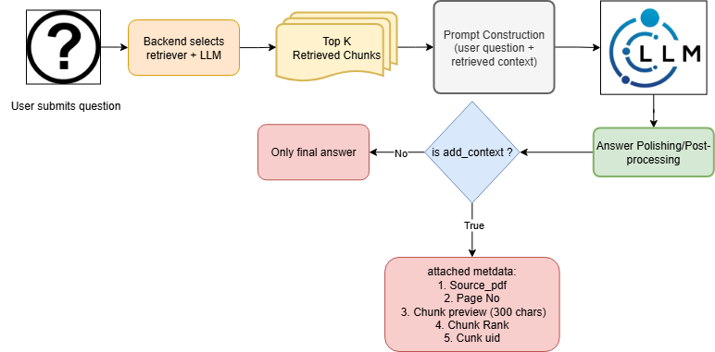
ADD CONTEXT – PROVENANCE & TRANSPARENCY
When enabled, the system retrieves the top-5 most relevant passages using semantic embeddings and cosine similarity, optionally expanding context for completeness, and returns them alongside the final answer. Each passage includes source file, page number, preview snippet, rank, and unique ID for complete traceability. Enhances trustworthiness by allowing users to verify the answer directly against the retrieved context.

Slide 7
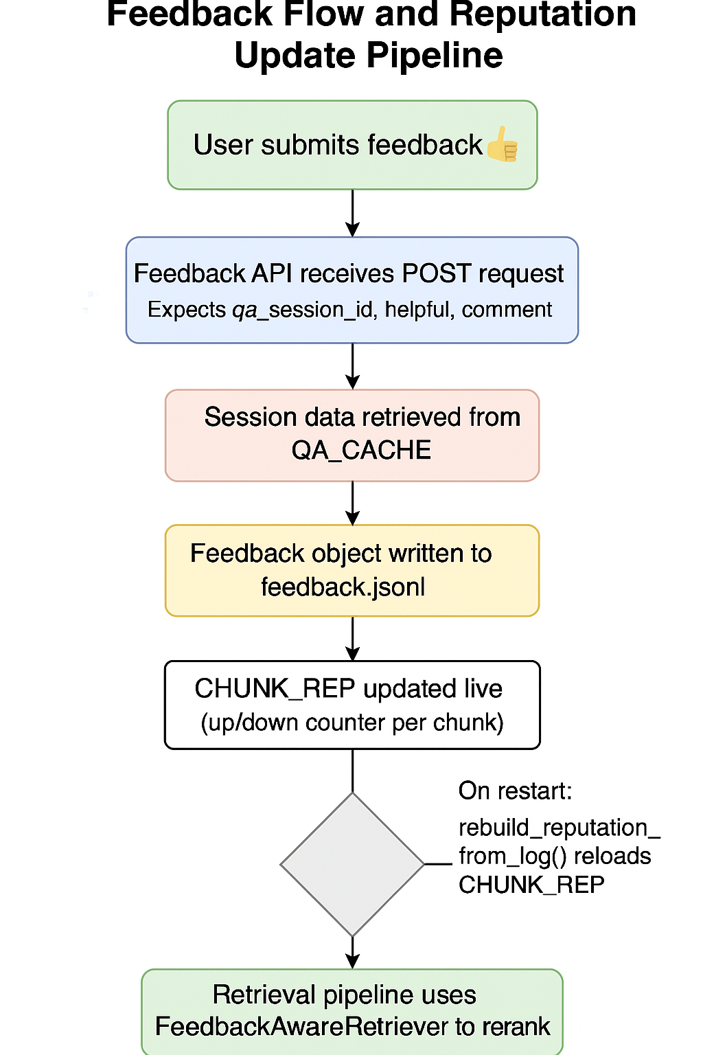

FEEDBACK-AWARE RETRIEVAL & RE-RANKING
1. User Feedback Stored – Every thumbs-up/down (and comment) is saved in a log file called feedback.jsonl, along with the chunk’s unique ID.
2. Live Scoreboard (CHUNK_REP) – This file updates an in-memory dictionary (CHUNK_REP) that keeps a running score of each chunk’s reputation.
3. Reranking with Feedback – When answering questions, the retriever ues CHUNK_REP to push helpful chunks higher and unhelpful chunks lower.
4. Recovery on Restart – If the system restarts, it reloads CHUNK_REP by reading feedback.jsonl, so past feedback still affects future answers.
Thank You !

Slide 8
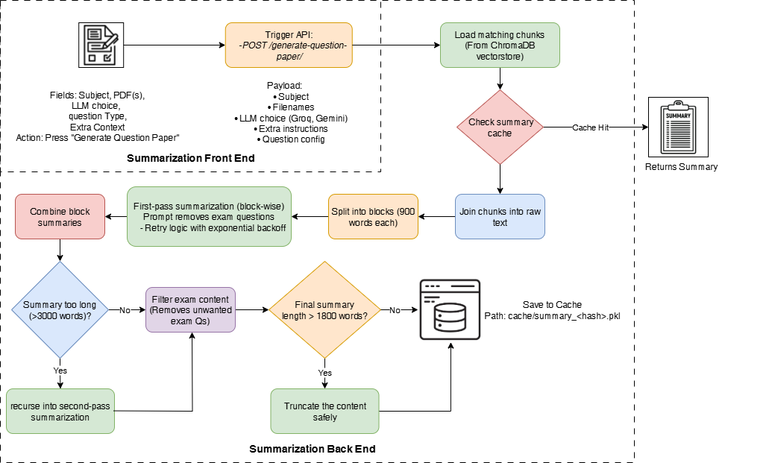
Summarization Pipeline with Smart Caching
1. Chunk Retrieval – Relevant chunks are fetched from ChromaDB using selected filenames and subject metadata.
2. Cache-First Execution – A unique SHA-256 key is generated per request (subject + files + LLM + extra context). If a cached summary exists (.pkl file), it’s loaded instantly to save LLM cost.
3. Block-Wise Summarization – Retrieved chunks are joined, split into ~900-word blocks, and each block is summarized individually with instructions to keep key concepts and remove exam questions.
4. Second-Pass Recursion – Block summaries are combined; if the result is too long (>3000 words), it is re-summarized to compress further while preserving meaning.
5. Token-Safe Final Output – Summaries are compressed to ≤1800 words to fit downstream question generation constraints, then saved to cache for future reuse.

Slide 9
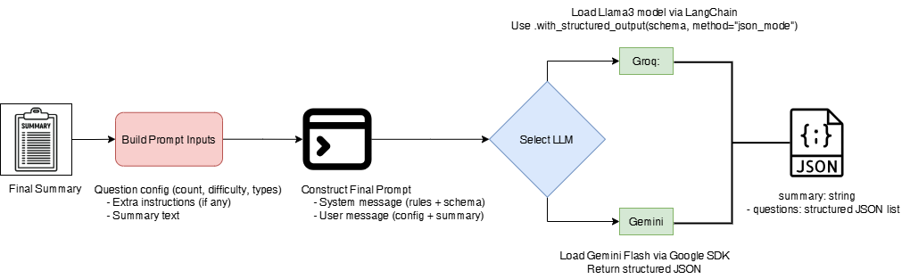
Question Paper Generation (Prompt + LLM)
1. Prompt Construction – The summarized content, question type distribution, difficulty level, and optional extra context are combined into a structured prompt for the LLM.
2. LLM-Specific Execution – Based on the selected backend (Groq or Gemini), the system invokes the model with strict JSON schema enforcement to ensure clean, structured output.
3. Validated Output – The generated set of MCQs, descriptive, and short-answer questions is returned in a ready-to-use JSON format, ensuring completeness and consistency.

Slide 10
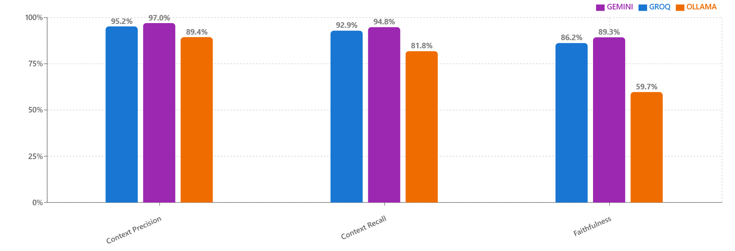
RAGAS EVALUATION – RETRIEVAL METRICS
Context Precision Gemini (97.0%) > Groq (95.2%) > Ollama (89.4) — Higher precision means fewer irrelevant chunks reach the LLM, reducing noise and hallucination risk. Ollama includes slightly more off-topic context.
Context Recall Gemini (94.8%) > Groq (92.9%) > Ollama (81.8%) — Higher recall ensures the LLM has nearly all needed facts. Ollama’s lower recall risks omitting key context, leading to incomplete answers.
Faithfulness Gemini (89.3%) > Groq (86.2%) > Ollama (59.7%) — Higher faithfulness means answers closely follow retrieved facts. Ollama’s low score signals more unsupported or hallucinated content.

Slide 11
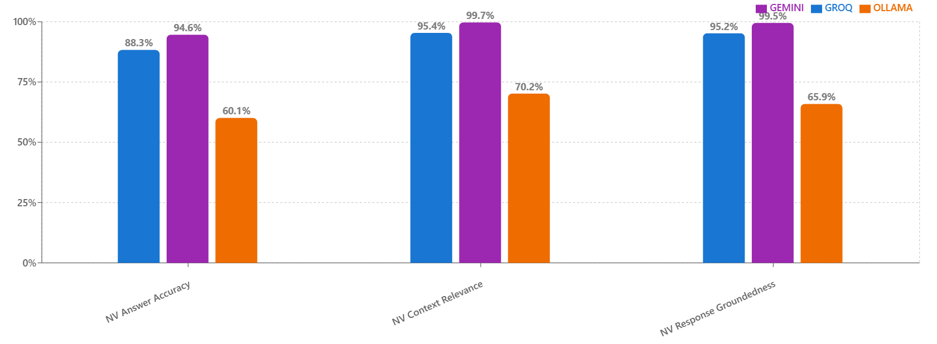
RAGAS EVALUATION – NVIDIA METRICS
NV Answer Accuracy Gemini (94.6%) > Groq (88.3%) > Ollama (60.1%) — Measures how closely answers match the reference. Higher values indicate stronger factual correctness.
NV Context Relevance Gemini (99.7%) > Groq (95.4%) > Ollama (70.2%) — Reflects how well retrieved context aligns with the question, ensuring responses are based on the most relevant material.
NV Response Groundedness Gemini (99.5%) > Groq (95.2%) > Ollama (65.9%) — Captures the degree to which answers are supported by retrieved evidence, reducing the chance of unsupported claims.

Slide 12
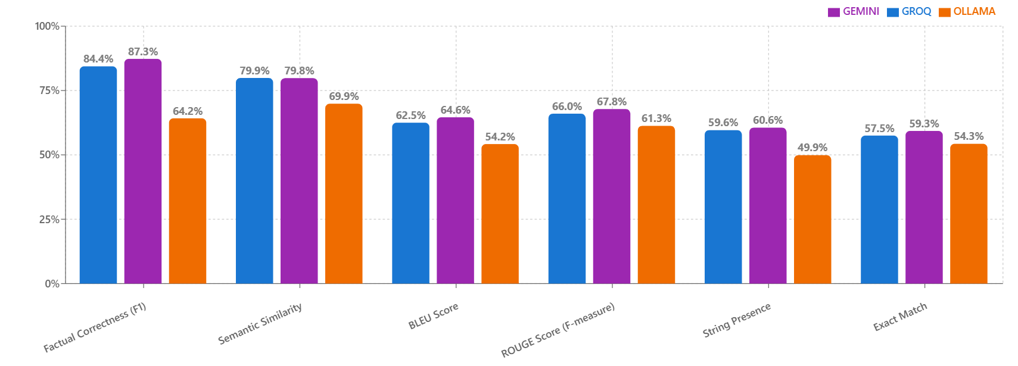
RAGAS EVALUATION – LANGUAGE METRICS
Factual Correctness (F1) Gemini (87.3%) and Groq (84.4%) show high claim-level accuracy, with Gemini slightly ahead. Higher scores mean responses are more factually aligned with the question.
Semantic Similarity Groq (79.9%) and Gemini (79.8%) produce answers semantically close to references. Measures meaning match, even when wording differs.
BLEU Score Gemini (64.6%) > Groq (62.5%) > Ollama (54.2%) — Higher BLEU indicates closer wording to the reference, useful for tasks needing standardized phrasing.
ROUGE Score (F-measure) Gemini (67.8%) and Groq (66.0%) capture most reference content; higher values mean fewer missing elements in multi-part answers.(Did we cover all pieces ?)
String Presence Gemini (60.6%) ≈ Groq (59.6%) > Ollama (49.9%) — Tracks how often exact key terms appear in responses.
Exact Match Gemini (59.3%) > Groq (57.5%) > Ollama (54.3%) — Measures fully identical answers to reference text, important for strict matching tasks.

Slide 13
Recommendations & Future Work
1. Domain-Specific Fine-Tuning – Fine-tune LLMs on curated academic datasets to improve terminology alignment, factual accuracy, and reduce hallucinations.
2. Enhanced Multi-hop Reasoning – Link multiple chunks across sections for complex queries, using LlamaParse’s hierarchical parsing for broader context.
3. Citation-Enriched Responses – Add inline citations with source page/section references, improving trust and enabling quick verification.
4. Adaptive Question Generation – Personalize question difficulty, type, and topic focus to suit learner profilesfor more engaging tutoring.
5. Visual & Mathematical Content Support – Integrate OCR for diagrams and MathML/LaTeX parsing to handle figure-based and formula-driven queries.

Slide 14
Thank You !

