Slide 1
Big Picture L1
Design Aspects
In Embedded Systems

Slide 2
Outline for Today’s Lecture
Embedded CPUs, caches, memory systems

Slide 3
Readings
Chapters 2, 3
  CPUs, Interrupts

Slide 4
Challenges in embedded system design
How much hardware do we need?
  How big is the CPU? Memory?
How do we meet our deadlines?
  Faster hardware or cleverer software?
How do we minimize power?
  Turn off unnecessary logic? Reduce memory accesses?

Slide 5
Design goals
Performance.
  Overall speed, deadlines.
Functionality and user interface.
Manufacturing cost.
Power consumption.
Other requirements (physical size, etc.)

Slide 6
Levels of abstraction
requirements
specification
architecture
component
design
system
integration

Slide 7
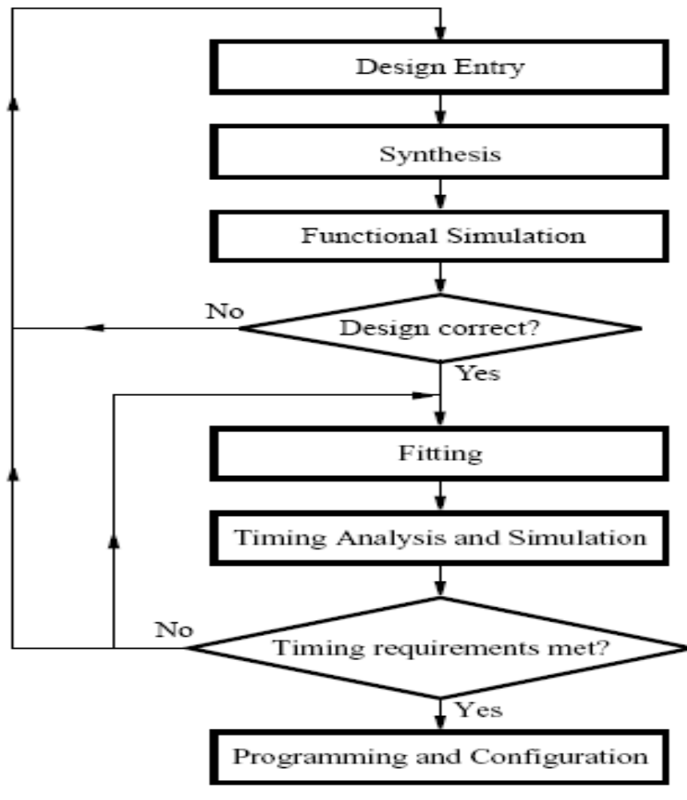
Typical CAD design flow:

Slide 8
Designing hardware and software components
Must spend time architecting the system before you start coding.
  Some components are ready-made, some can be modified from existing designs, others must be designed from scratch.
  Example: SOPC for Hardware design and Nios 2 IDE for Software Design.

Slide 9
JTAG - TESTING
JTAG - Joint Test Action Group: IEEE 1149.1 standard entitled: Standard Test Access Port and Boundary-Scan Architecture for test access ports used for testing printed circuit boards (and chips) using boundary scan.
Currently used also for programming embedded devices.
  Most FPGAs and PLDs are programmed via a JTAG port.
JTAG ports commonly available in ICs
  Boundary scan, scan chains, mbist, logic bist connected
  Chips chained together with Jtag signals and connected to main JTAG interface on PCB

Slide 10
RISC vs Superscalar
RISC pipeline executes one instruction per clock cycle (usually).
  For example, ARM, MIPS, PowerPC, etc
Superscalar machines execute multiple instructions per clock cycle.
  Faster execution.
  More variability in execution times.
  More expensive CPU.
  Requires a lot of hardware.
    n² instruction unit hardware for n-instruction parallelism.
  For example, Intel X86.

Slide 11
Order of execution
In-order:
  Machine stops issuing instructions when the next instruction can’t be dispatched.
Out-of-order:
  Machine will change order of instructions to keep dispatching.
  Substantially faster but also more complex.
  Can be still in-order completion to avoid issues with precise exceptions, etc

Slide 12
VLIW architectures
Very long instruction word (VLIW) processing provides significant parallelism.
Rely on compilers to identify parallelism.
VLIW requires considerably more sophisticated compiler technology than traditional architectures---must be able to extract parallelism to keep the instruction pipelines full.
VLIW is popular for various embedded designs
  EPIC = Explicitly parallel instruction computing.
    Used in Intel/HP Merced (IA-64) machine.

Slide 13
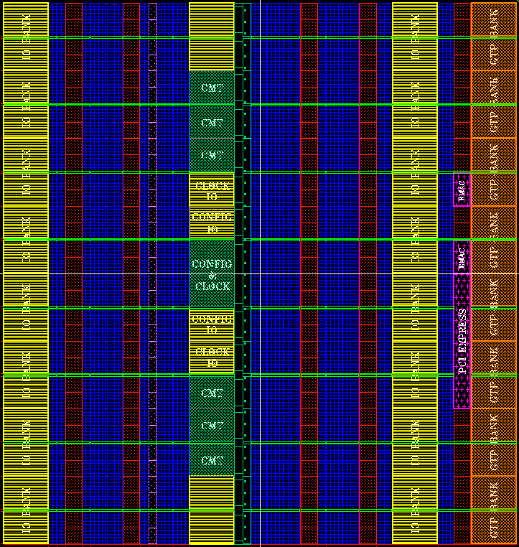
Difference between microcontrollers, microprocessors and FPGA systems
FPGA systems often contain CPUs in softcore (synthesized) or hardcore (part of die) format but can also contain logic blocks for other hardware, e.g., state machines, etc
Microcontrollers are more limited in functionality and often do not include support for virtual memory and caches
  Up to 50MHz
Microprocessors are more performance capable and have typically virtual memory support
  From 50MHz to GHz
Soft core
Discrete
PHY
Tx
Rx
Tx
Rx
Hard core with built-in Transceivers

Slide 14
Another perspective: PLDs, FPGAs, ASICs, Structured ASICs
Programmable logic devices (PLDs) provide low/medium density logic.
Field-programmable gate arrays (FPGAs) provide more logic and multi-level logic.
Application-specific integrated circuits (ASICs) are manufactured for a single purpose.
Structured ASICs (see of gates wired together) are in between FPGAs and ASIC – manufactured for single purpose but manufacturing cheaper than ASIC since customization is often through metal layers (less mask costs)

Slide 15
Memory system
CPU fetches data, instructions from a memory hierarchy:
DRAM/Flash
Main
memory
SRAM
SRAM
CPU
L2
cache
L1
cache
Some systems also include TLB/MMU to provide a cache during address translation and access control checks

Slide 16
Memory device organization (e.g., SRAM block)
n address lines
w data lines
Memory array
Word-line
n
r
Memory cell
c
Bit-line
w

Slide 17
Cache Organization
Virtual Address:
31 9 8 5 4 2 1 0
Tag
Bank
Word
Byte
16
Banks
Cache Bank
8 words
CAM
Tags
Matchline
Data
SRAM
32
lines
MUX
Data

Slide 18

Virtual Memory Organization Example

Slide 19
Programming model in Processors
Assembly language
  One-to-one with machine instructions (more or less).
  Labels provide names for addresses (usually in first column).
  Pseudo-ops: constants, define storage, define address
Programming model: registers visible to the programmer.
  For example ARM has 32 registers
  Some registers are not visibible: system registers

Slide 20
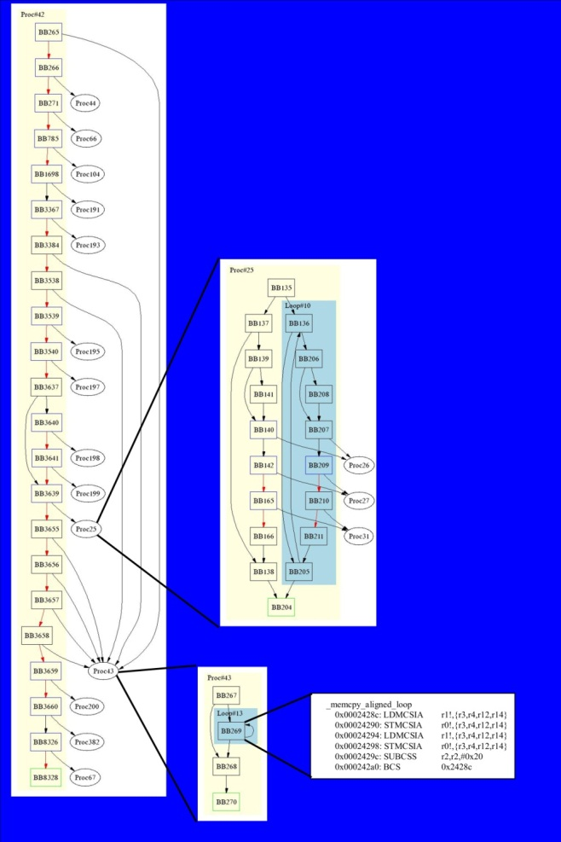
Visualizing Software
Control Flow Graph
Procedures
Loops
Basic Blocks
Instructions
Copyright BlueRISC 2007

