Slide 1
Lab 0: Familiarization with Equipment and Software
Notes:
Lab 0 should have there is lab, printer, monitor resources. What softeares are rquired, how do they install, links etc how to start
Steps:
· Take out the DE1 SOC board and connect it to a power supply using the power adapter supplied. Press the red button to turn on the board. You should see a startup sequence.
· Next, you must plan on installing the software on your PC. Your lab PC's already have all the software installed so you need to do this only on your personal machines. Install the Quartus II Prime Lite edition 15.1, Altera Monitor Program 15.1. If you have any previous version of Quartus 2 or NIOS II on your PC, please uninstall them before beginning.

Slide 2
Objectives
Familiarization with:
DE1-SoC board
CAD Tools and Development Software
Software installation

Slide 3
DE1-SoC board
State of the art System-on-Chip (SoC) FPGA development platform by Altera
Combines Cyclone V FPGA with latest dual core ARM Cortex A9 Hard Processor System (HPS)
Provides Reconfigurability paired with high performance
Features multitude of connectivity options for diverse applications

Slide 4
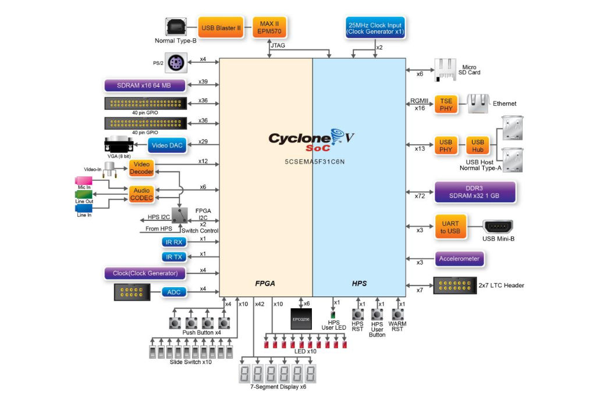
DE1-SoC board Block Diagram

Slide 5
DE1-SoC board specifications
Altera Cyclone® V SE 5CSEMA5F31C6N device with 85k Programmable Logic Elements (PLEs)
800MHz Dual-core ARM Cortex-A9 MPCore processor with 1GB of DDR3 SDRAM
24-bit VGA DAC for image and video processing applications
5 User Keys, 10 User switches, 11 User LEDs, Six 7-segment displays

Slide 6
CAD Tools and Development Software
Quartus Prime Development Suite (Version 16.0)
Qsys system integration tool
Nios II Software Build Tools for Eclipse
ModelSim starter edition
Altera Monitor Program (Version 16.0)

Slide 7
Quartus Prime Development Suite (Version 16.0)
Electronic Design Automation (EDA) Development Suite
Includes all the tools required for design entry, synthesis, verification and simulation for Altera FPGAs
Qsys - next generation System On a Programmable Chip (SOPC) builder tool
Provides drag and drop style interface to implement your design
Automatically generates HDL for the design
Nios II Software Build Tools for Eclipse
IDE for development of programs on NIOS II softcore processor

Slide 8
Quartus Prime Development Suite
ModelSim Starter edition
HDL simulation environment by Mentor Graphics included with Quartus Prime
Used for functional simulation of Verilog design

Slide 9
Altera Monitor Program (Version 16.0)
IDE to develop assembly and C programs for both ARM Cortex A9 and NIOS II processor
Helps in compilation and debugging of programs

Slide 10
Software installation
The lab computers already have all the required software installed, but you may install them on your Laptops.
Quartus Prime
Register at altera.com with your school email ID
Go to the download page
Select OS (Windows and Linux only, no macOS version)
Select version 16 and direct download option
Go to ‘updates’ tab and select ‘complete download’ option
Follow installation instructions
Altera Monitor Program
Download from here for Windows, here for Linux
Follow installation instructions

Slide 11
Questions?

