Slide 1
Lab 1: Using NIOS II processor for code execution on FPGA

Slide 2
Objectives
Introduction to Altera tools
Walk through from project creation to chip configuration (Lab1-Part I)
Instructions to get started with Part II

Slide 3
Tools
Quartus Prime
FPGA development: Design, simulation, synthesis and download
QSYS
Build target QSYS system
Based on a Processor-core (NIOS II processor), you can add other peripherals (e.g. Parallel IO, Ethernet Controller, Serial Ports, etc.)
NIOS II Software Build Tools for Eclipse
Software platform for developing programs

Slide 4
Lab1 Objectives
Part I :
Display “Hello, world” in your debug console from NIOS II
Part 2 :
Implement a counter program and display the output on the LED, and the seven segment display.

Slide 5
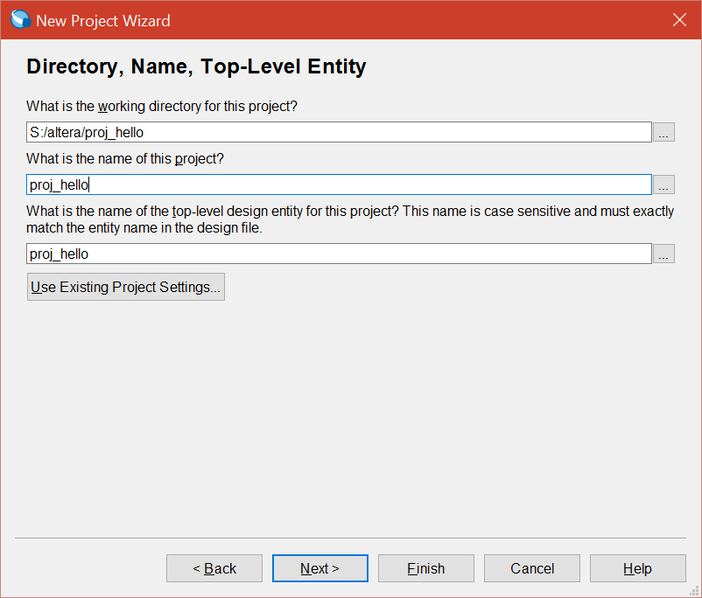
New Project Creation
Open Quartus Prime, and select file -> New Project Wizard…
Specify a working directory and name your project
NOTE: Make sure your working directory contains no white-space. (This will cause problems later when trying to compile your project from the QSYS)

Slide 6
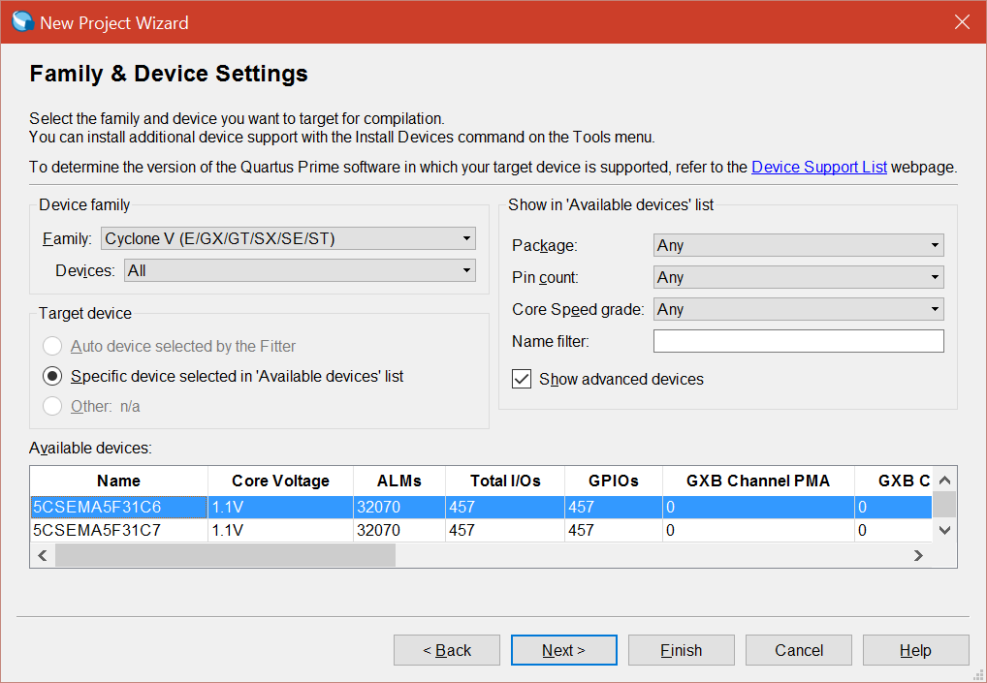
FPGA Selection
Select Cyclone V in the drop-down box labeled “family”. We will be using device 5CSEMA5F31C6.
Click finish. All necessary project parameters have been configured.

Slide 7
Using the QSYS System
SOPC Builder (System on a Programmable Chip Builder) is software made by Altera that automates connecting IP cores to create a complete system that runs on any of its various FPGA chips.
Qsys is the next-generation SOPC Builder tool powered by a new FPGA-optimized network-on-a-chip (NoC) technology.
Open Tools -> Qsys to start the system, save the system with the same name as the Top Level entity.

Slide 8
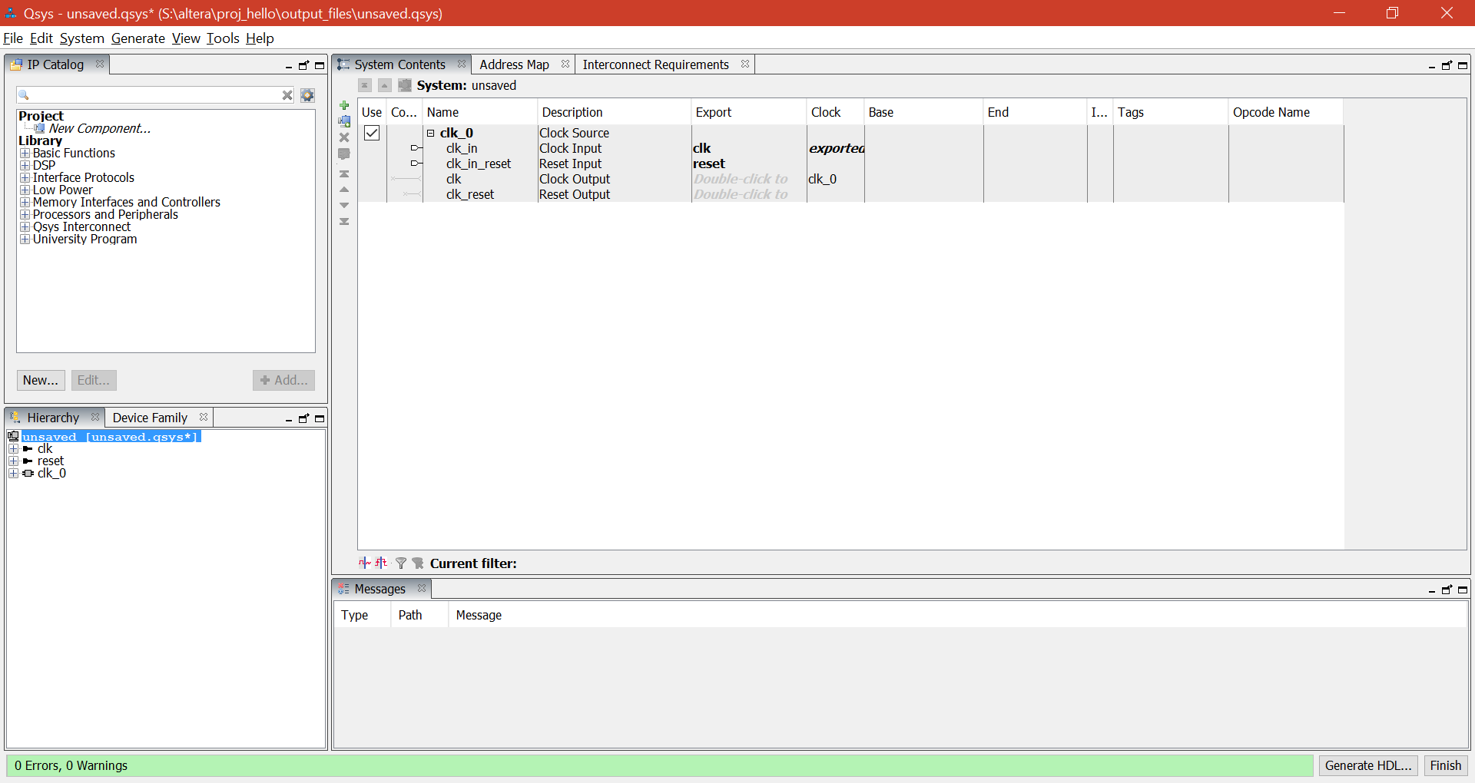
QSYS Screenshot

Slide 9
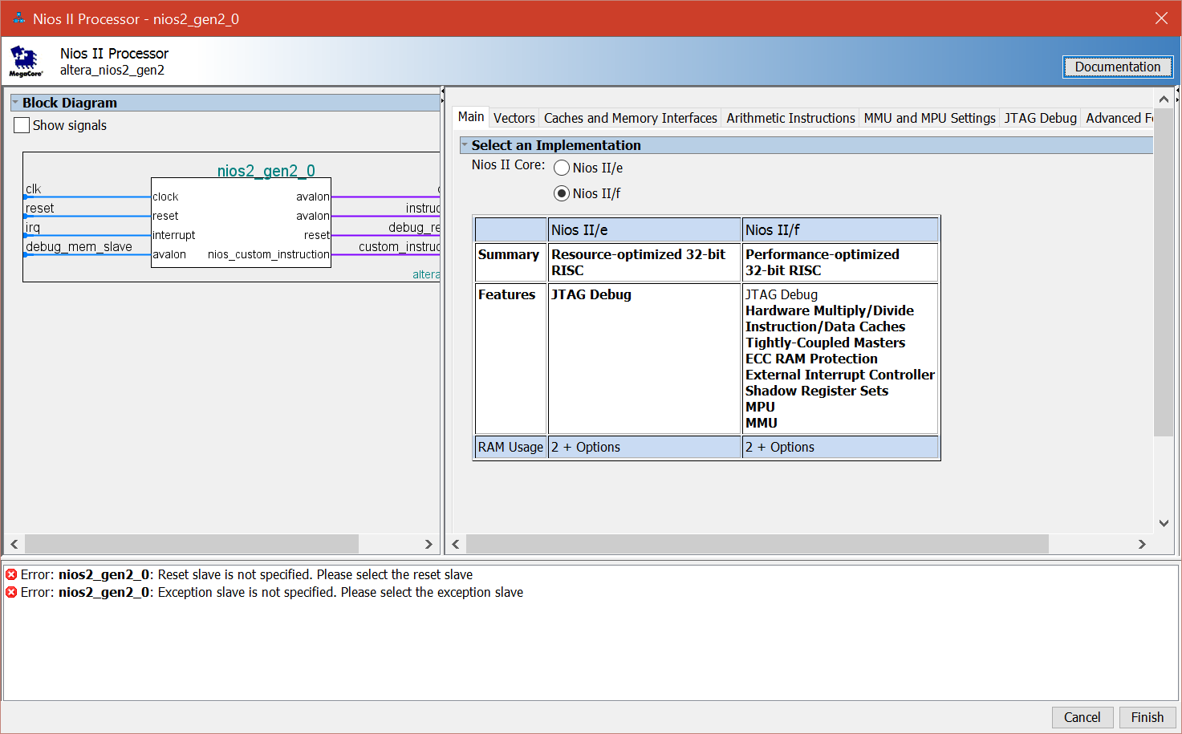
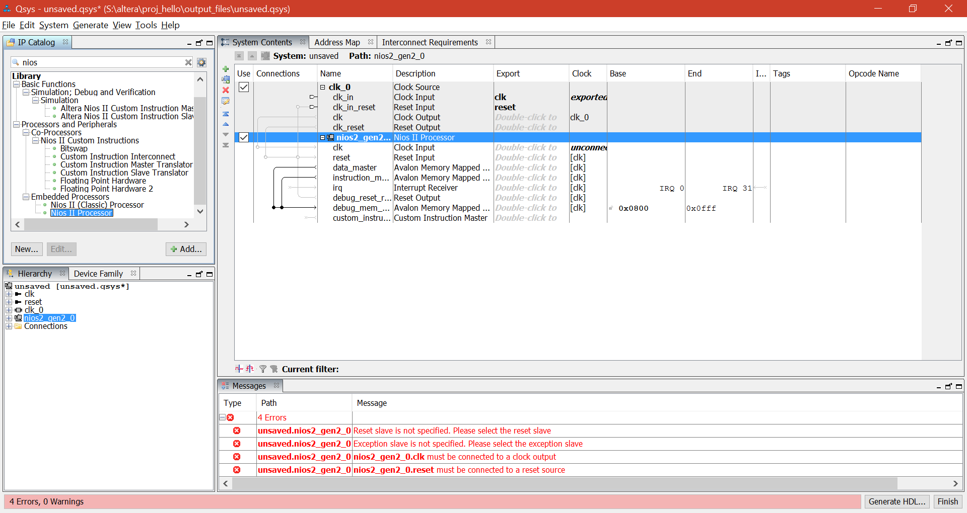
Adding NIOS II Processor

Slide 10
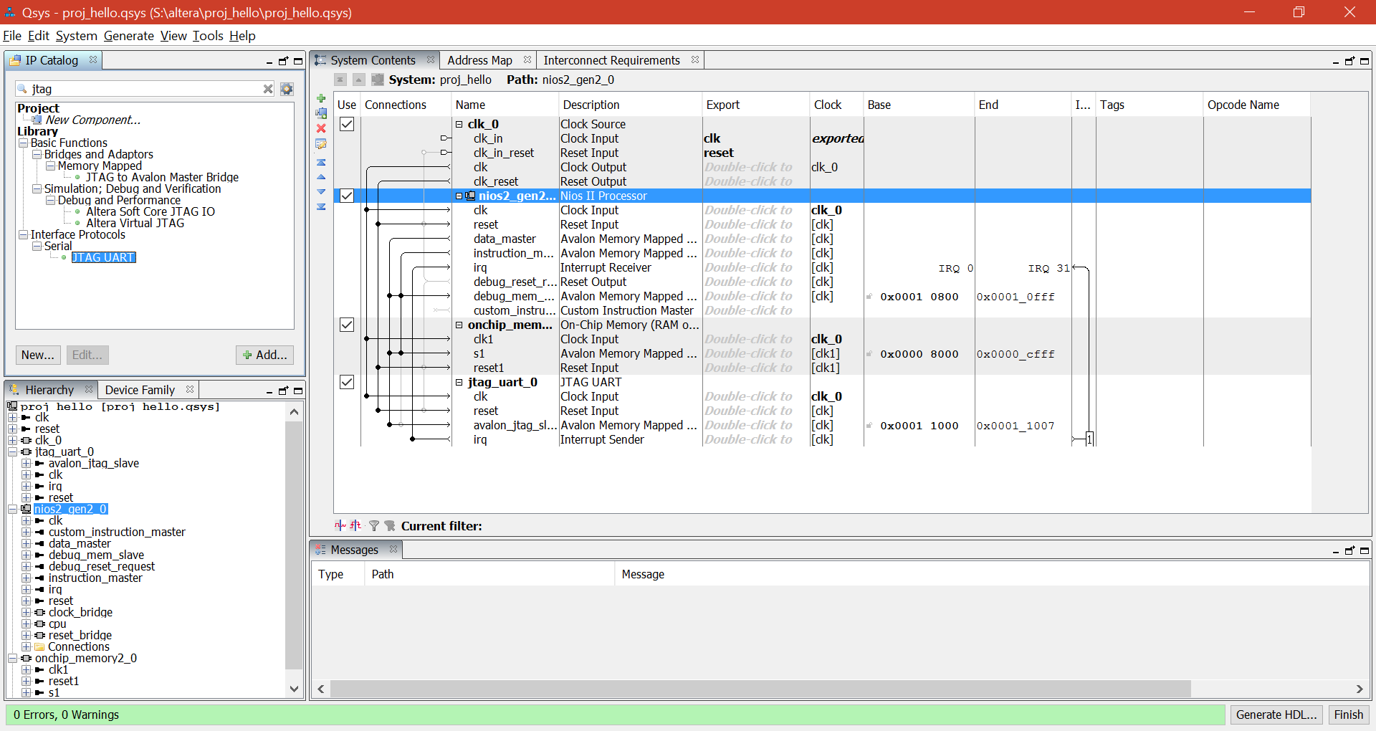
Adding JTAG UART
Next, we will be adding a JTAG UART module, found under Serial.
Notes:
JTAG provides us a way to communicate with the NIOS processor from the host computer.

Slide 11
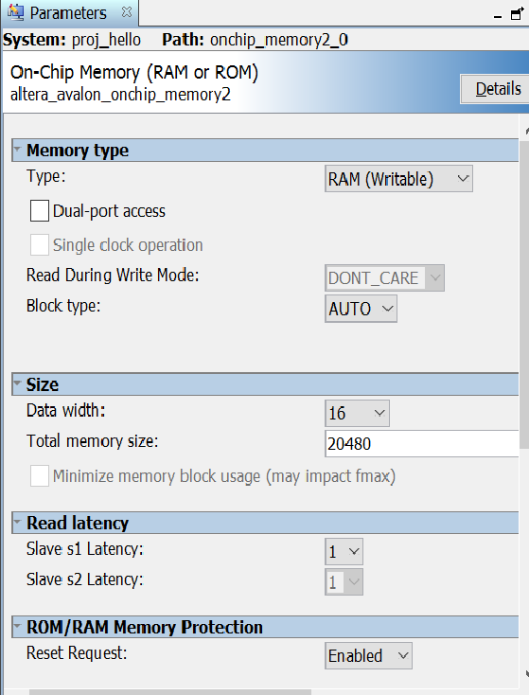
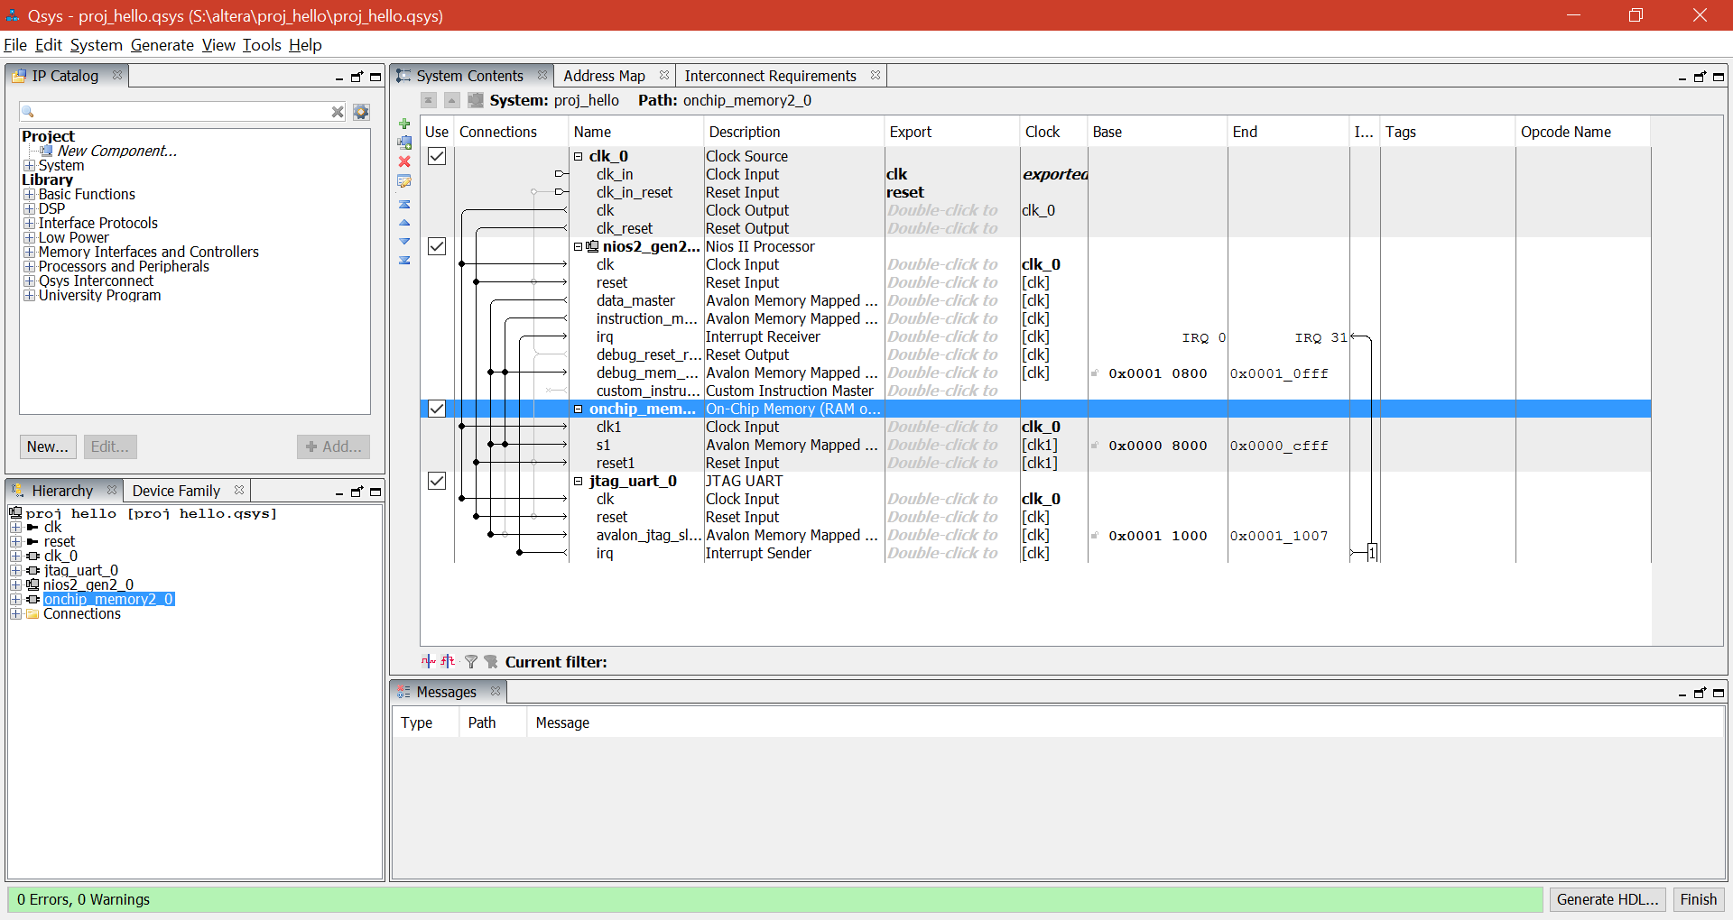
Adding On-Chip Memory
Change the memory offset: Double click cpu instance (nios2_gen2) and provide Reset Vector and Exception Vector

Slide 12
Tutorial: Programming the FPGA
Back to Quartus Prime
Add the QIP file to the project in Quartus, it contains the Verilog files generated by QSYS
Now select Processing -> start -> Start Analysis & Synthesis.
A number of warnings will appear during the check. This is normal.

Slide 13
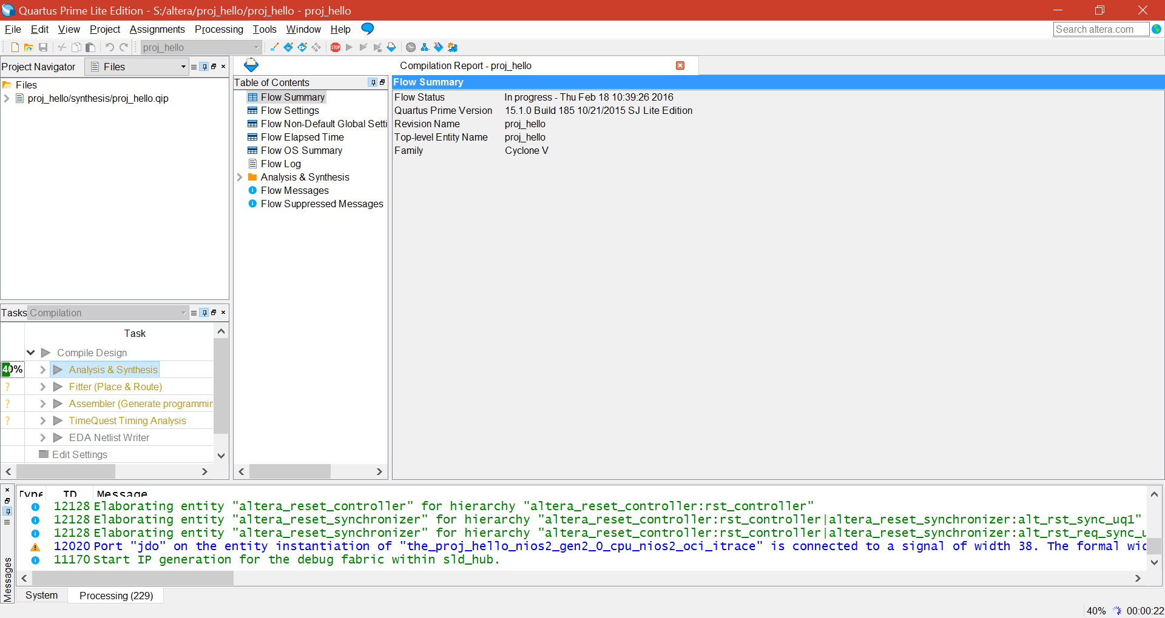
Quartus: Analysis & Synthesis

Slide 14
Assigning CLK and Reset Pins
The pins assignments can be done using Assignment Editor in Assignments -> Assignment Editor
Find the entry corresponding to the clock, assign PIN_AF14 to it. doing so will connect the clock in our design to the 50 MHz oscillator on the DE1-SoC board.
Now assign the reset input signal to any of the SW[x] pins. This will connect the reset signal to one of the switches found on the DE1-SoC board.
Now select Processing -> Start Compilation. If compilation is successful, a programming file to be written to the FPGA will be generated.

Slide 15
Programming the FPGA
Select Tools -> Programmer. Now, select Auto detect, a new dialogue box opens up, choose “5CSEMA5”, you can find two entries, Right click on the 5CSEMA5 entry, change the file to the target SOF file. Be sure that DE1 SoC is connected to the computer via the provided USB cable.
A dialogue box will open, mentioning we are using a time-limited version of the NIOS processor. Leave this box open. The FPGA has now been successfully configured!

Slide 16
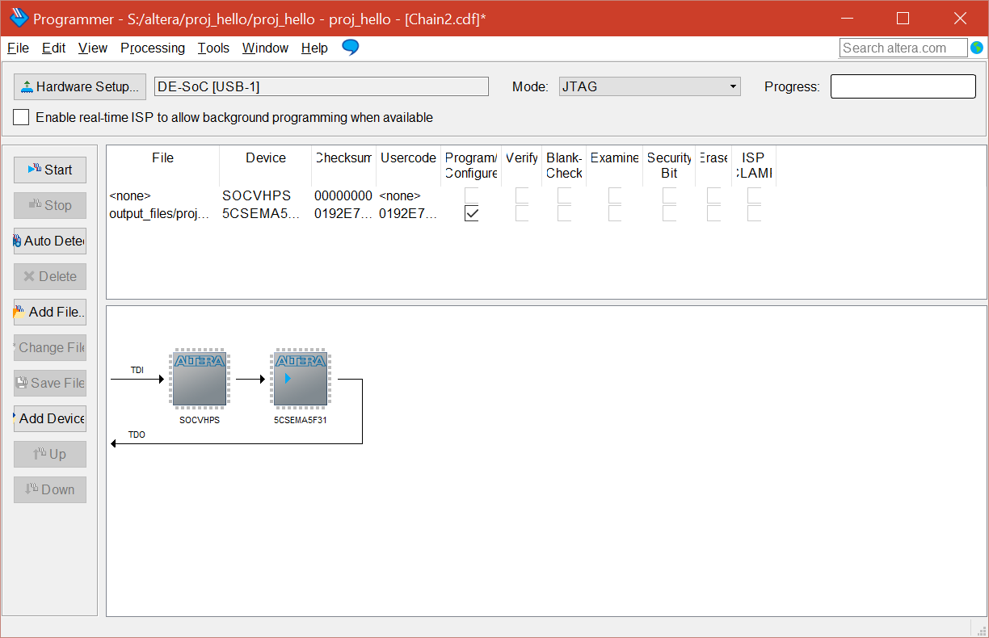
Programming the FPGA

Slide 17
Tutorial: Using the NIOS II IDE
Now that you have successfully developed an QSYS system, we will write a very simple program to run on our new processor.
Select Tools -> NIOS II Software Build Tools for Eclipse.
Create a new workspace. Make sure that there are no spaces in path directory names.

Slide 18
Tutorial: Using the NIOS II IDE
Select File -> New -> NIOS II Application and BSP from template. A new dialogue box should open.
A variety of project templates are provided as a starting point. We will be using the “Hello World Small” template.
In order to develop a NIOS project, the IDE needs a .sopcinfo file that indicates various peripherals unique to our design.

Slide 19
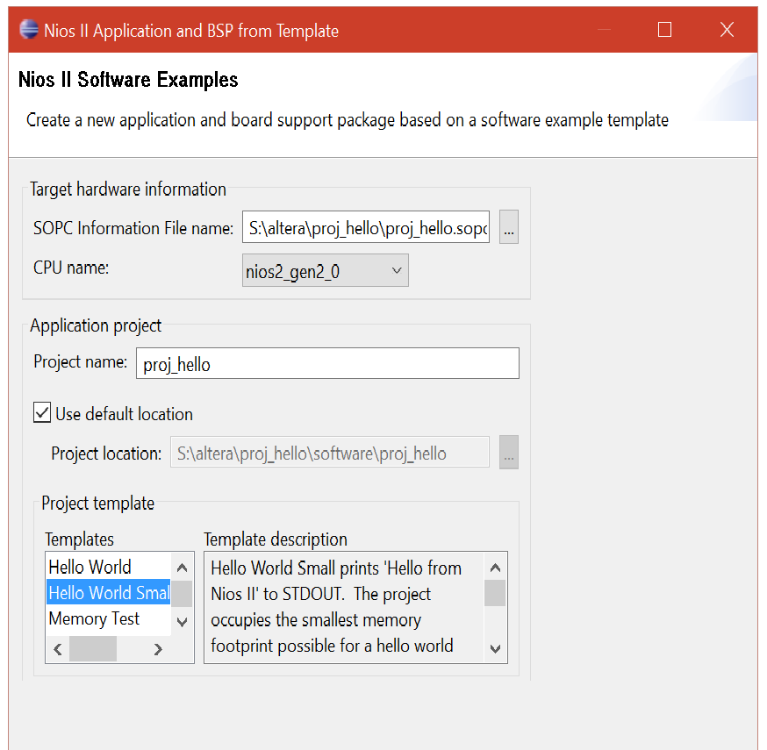
Tutorial: Using the NIOS II IDE

Slide 20
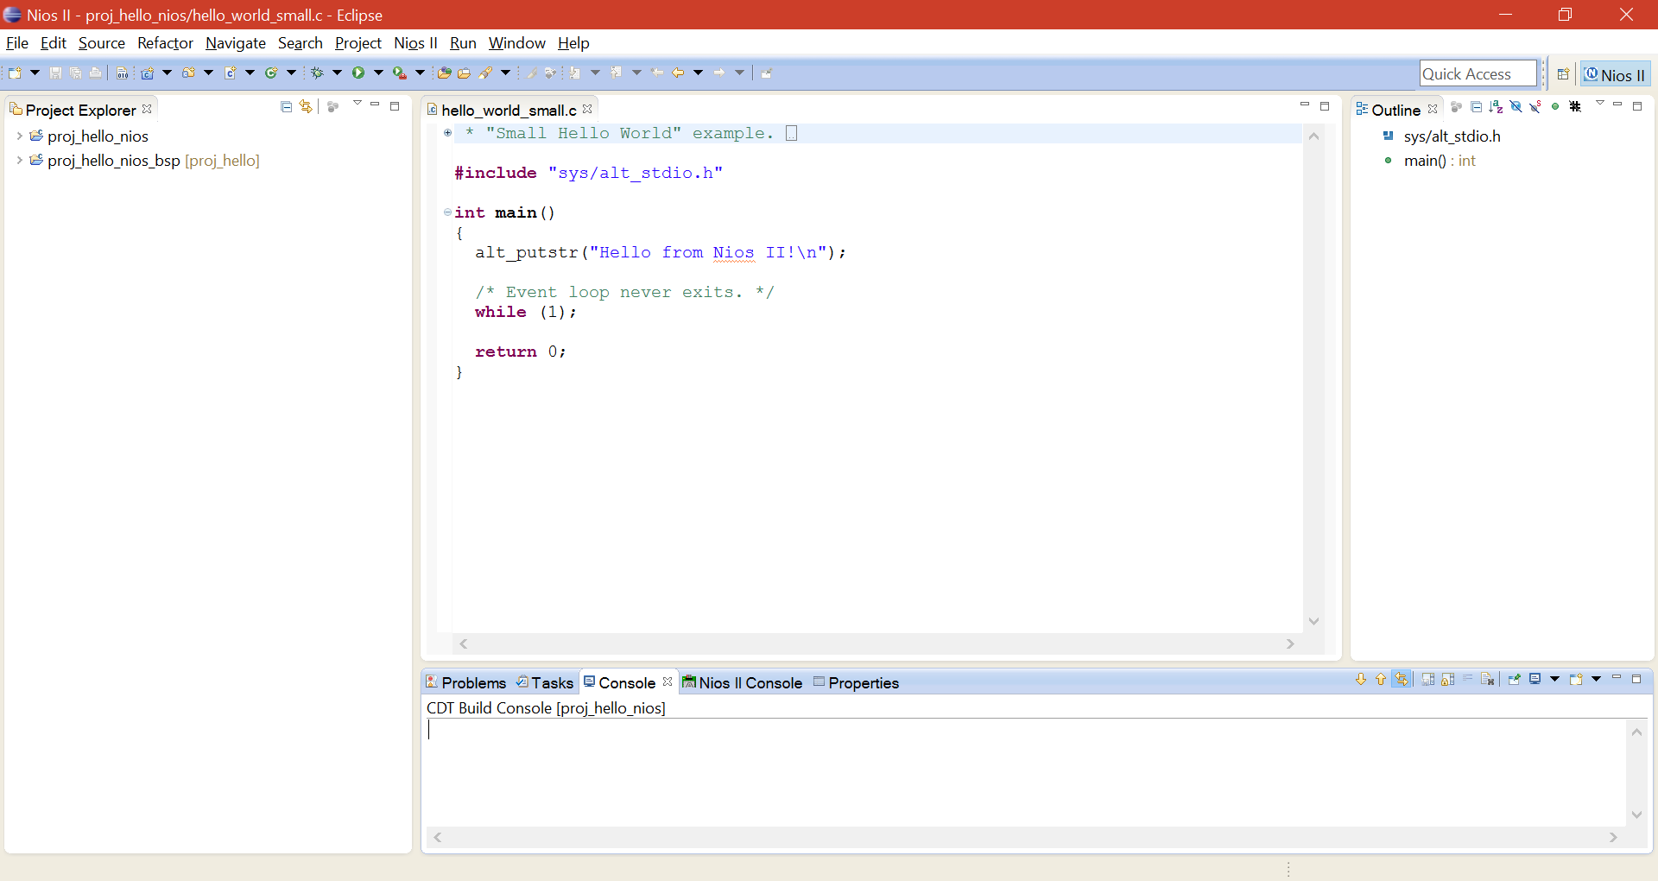
Tutorial: Using the NIOS II IDE
You should now be looking at a window like this:

Slide 21
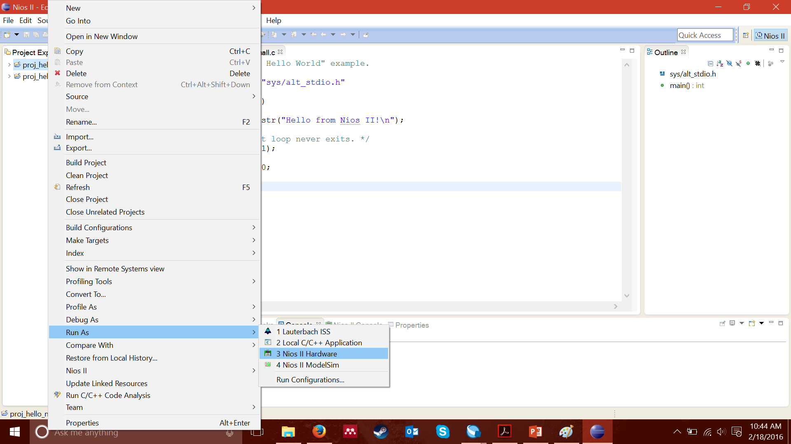
Tutorial: Using the NIOS II IDE
Under the “Project Explorer” tab, right-click on the application. This time select Run As -> NIOS II Hardware.
This option will compile and write the program to the on-chip memory we specified in QSYS.

Slide 22
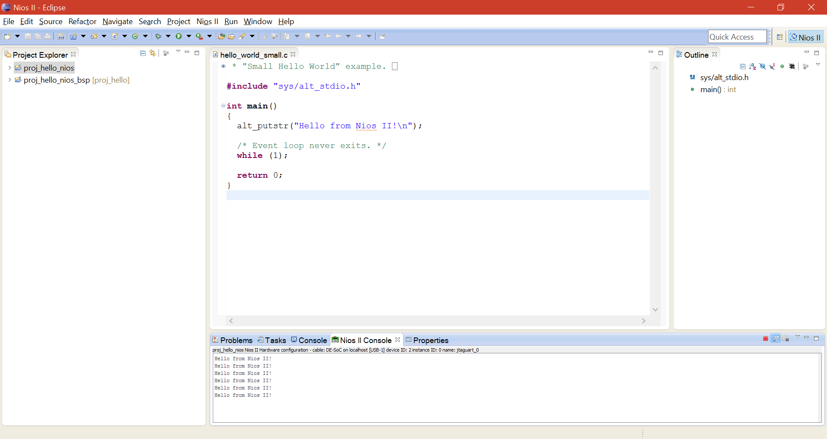
Hello From NIOS II!

Slide 23
Checkpoint: Lab1 (Part I)
A NIOS system in the Quartus Prime QSYS
Use the NIOS II IDE to run a very simple C program on the system defined in QSYS.

Slide 24
Part II
You will use external memory
You will use other devices (LED, seven segment, and hex display.)
Please read lab instructions on class website

Slide 25
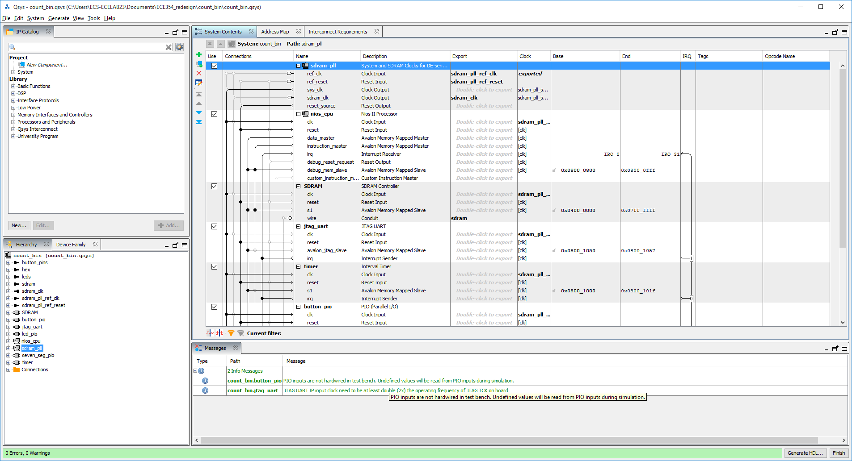
Getting Started with Part II (QSYS)
Add the SDRAM PLL to drive the system
Add the SDRAM as the program memory
Add the required PIOs and name them appropriately

Slide 26
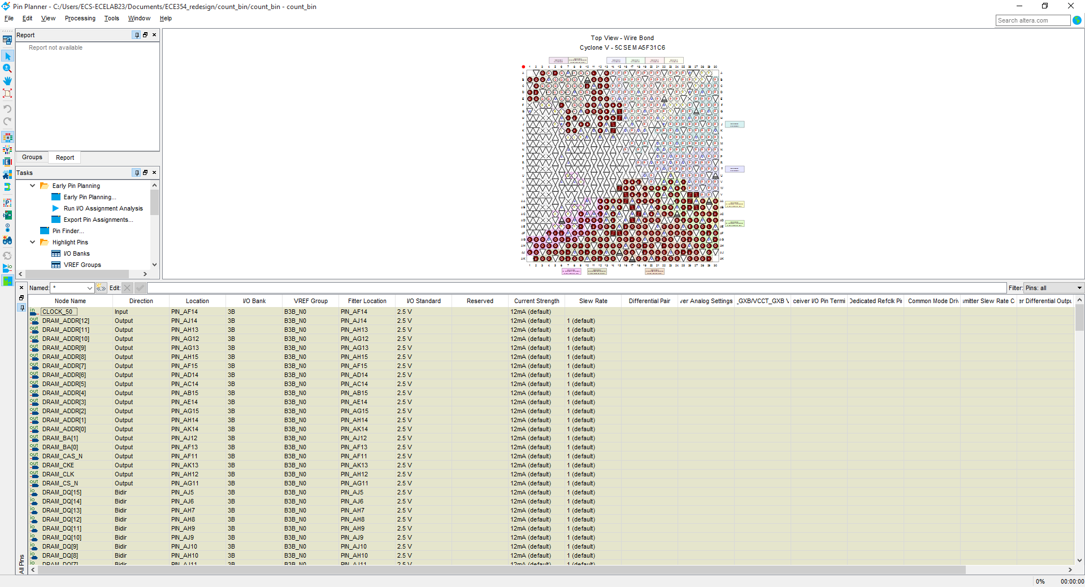
Pin assignments viewed from Pin Planner

Slide 27
Questions

