Slide 1
Lab 2
Interfacing a camera and implementing image processing algorithms with the DE1-SoC board

Slide 2
Objectives
Understand the procedure involved in interfacing peripherals to an embedded system
Understand the process of capturing image through a camera
Learn to develop C programs for the ARM hard core processor using the Altera Monitor Program
Understand basic image processing concepts
Understand how images are displayed on a monitor

Slide 3
Overview
In this lab, you shall do the following:
Interface the Terasic D5M camera module to the DE1-SoC
Capture an image using the camera module
Implement certain basic image processing algorithms in C and execute them on the ARM hard core processor
Display the processed image on a monitor with the use of a VGA controller

Slide 4
Required reading
Go through the following sections from the Altera Monitor tutorial provided on the website.
  Project creation
  Compiling and loading programs onto the board
  Executing the programs on the ARM hard core processor
Go through the D5M camera documentation
Understand the provided QSYS system (especially the video IP cores)
Go through the ‘DE1-SoC Computer System with ARM Cortex-A9’ document

Slide 5
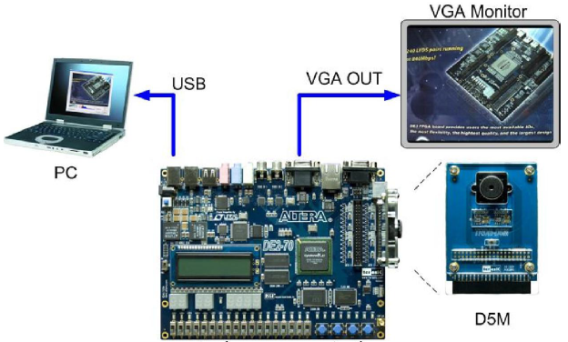
Setup
[1]
[1] TRDB_D5M_Userguide http://www.terasic.com.tw/attachment/archive/281/TRDB_D5M_UserGuide.pdf

Slide 6
To get started with the lab
Download the project content files available on the lab 2 page
Open the QSYS system file and identify the functionality of each component present
QSYS component files are present in the QSYS_IP folder
  Computer_system
  D5M_Subsystem
  VGA_Subsystem
Import the capture_image.amps present in the capture_image folder given to you into the Altera monitor Program
Software components are present under the capture_image folder
  capture_image.c

Slide 7
Components in the QSYS System
Based on Computer_System.qsys
FPGA on-chip memory, SDRAM, Interval timer, JTAG UART
The FPGA on-chip memory is used as a frame buffer that holds a single frame of video at a time, SDRAM used to store images
Parallel Input/output interface(PIO) for LED, switches, seven
segment display
D5M_Subsystem helps in transferring image data from camera to the on-chip memory
VGA_Subsystem is used for displaying the image

Slide 8
Video IP cores for image capture and display
QSYS components for image capture and display – Pixel buffer DMA controller(PBDC), on-chip FPGA SRAM, RGB resampler, Scaler
PBDC produces video data for VGA controller, uses on-chip SRAM as memory
The image stored in the pixel buffer is of resolution 320x240 with 16 bits representing the color (RGB) of each pixel
Resampler and Scaler convert the image from 320x240 resolution to 640x480
DC FIFO is used as a buffer between the Scaler and VGA controller
Use the SDRAM to store the captured images

Slide 9
Getting started with C code
Open the capture_image.amps file in Altera monitor program, compile and run it
Starter C code in the project performs the following operations
  Captures one frame of video when any key is pressed
  Displays the captured image on the monitor upon another key press
Go through the ‘DE1-SoC Computer System with ARM Cortex-A9’ document
Understand how to access the peripherals like LEDs, switches, push buttons etc. using C
Please go through the examples given in the document which might be useful for successful completion of the lab

Slide 10
Image Processing tasks
Convert the captured color image into black and white
Implement any two of the following tasks
  Add timestamp onto the image
  Counter to keep track of number of pictures taken
  Rotate, mirror, invert image
You can perform the following challenging task for extra credit
  Detect changes between two images

Slide 11
Questions

