Slide 1
Big Picture
Operating Systems in Embedded Systems

Slide 2
Readings
Wolf, Computers as Components, Chapter 6
pp. 293-352
Multiple Tasks and Multiple Processes
Pre-emptive Real-time Operating Systems
Priority-Based Scheduling
Interprocess Communication Mechanisms
Evaluating OS Performance
Power Management and Optimization for Processes
Design Example Telephone Answering Machine

Slide 3
Operating system is just another program.. a big one
The operating system controls resources:
  who gets the CPU;
  when I/O takes place;
  how much memory is allocated.
The most important resource is the CPU itself.
  CPU access controlled by the scheduler of processes.
OS needs to keep track of:
  process priorities;
  scheduling state;
  process activation record.

Slide 4
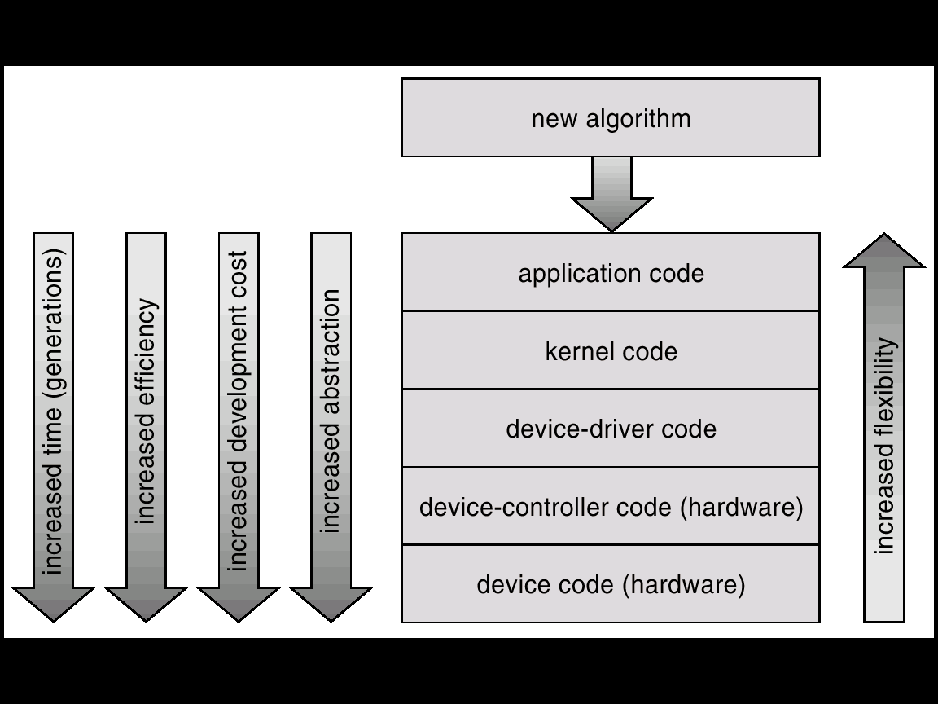
Where is the OS?

Slide 5
Process Concept
Process = a program in execution (main thing to manage)
  process execution must progress in sequential fashion.
Processes may be created:
  statically before system starts;
  dynamically during execution.

Slide 6
Process State
As a process executes, it changes state
Each process may be in one of the following states (names vary across various OS):
  new: The process is being created.
  running: Instructions are being executed.
  waiting: The process is waiting for some event to occur.
  ready: The process is waiting to be assigned to a processor.
  terminated: The process has finished execution.

Slide 7

Diagram of Process State in the OS

Slide 8
Process Control Block (PCB)
Information associated with each process in the OS, i.e., the process related data structure.
The PCB contains:
  Process state (running, waiting, …)
  Program counter (value of PC)
  Stack pointer, General purpose CPU registers
  CPU scheduling information (e.g., priority)
  Memory-management information
  Username of owner
  I/O status information
  Pointer to state queues, ..

Slide 9

Process Control Block (PCB)

Slide 10
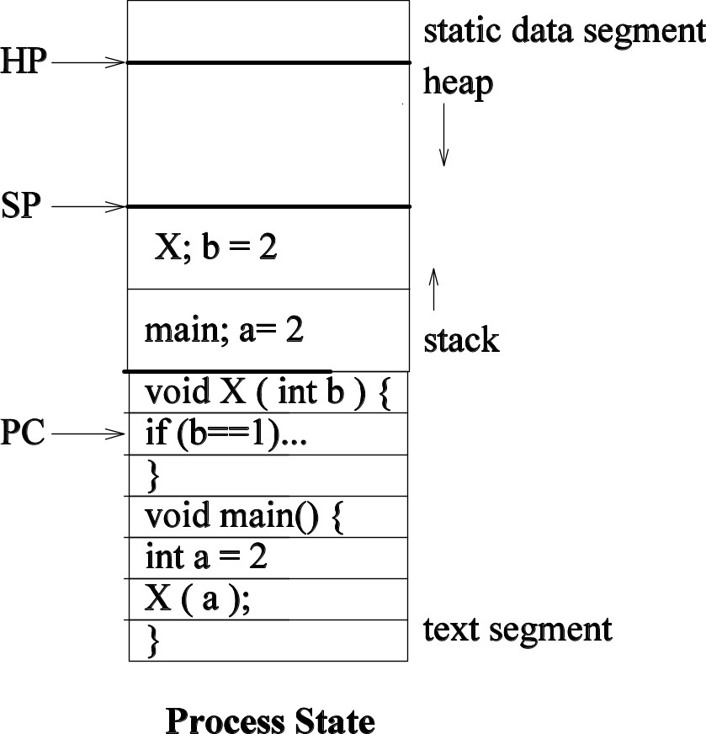
Example Process State in Memory
In memory:
What you wrote:
void X(int b){
If (b==1) ..
}
main(){
int a = 2;
X(a);
}
PC->

Slide 11

Single and Multithreaded Processes
A thread = stream of execution
Benefits?

Slide 12
Example of Memory Layout with Threads
main() {
……
fork_thread(producer);
fork_thread(consumer);
……
}
producer() {
……
}
consumer(){
…….
}

Slide 13
Embedded vs. general-purpose scheduling
Workstations try to avoid starving processes of CPU access.
  Fairness = access to CPU.
Embedded systems must meet deadlines.
  Low-priority processes may not run for a long time.
Priority Driven scheduling
  Each process has a priority.
  CPU goes to highest-priority process that is ready.

Slide 14

CPU Switch From Process to Process

Slide 15
Interprocess Communication
Interprocess communication (IPC): OS provides mechanisms so that processes can pass data.

Slide 16
IPC Styles
Shared memory:
  processes have some memory in common;
  must cooperate to avoid destroying/missing messages.
Message passing:
  processes send messages along a communication channel---no common address space.

Slide 17
Critical Regions
Critical region: section of code that cannot be interrupted by another process.
Examples:
  writing shared memory;
  accessing I/O device.

Slide 18
Shared Memory
Shared memory on a bus:
memory
CPU 1
CPU 2

Slide 19
Race Condition in Shared Memory
Problem when two CPUs try to write the same location:
  CPU 1 reads flag and sees 0.
  CPU 2 reads flag and sees 0.
  CPU 1 sets flag to one and writes location with 123.
  CPU 2 sets flag to one and overwrites location with 456.
  CPU 1 thinks value is 123 since it checked flag but it is 456!

Slide 20
Synchronization Hardware – ISA Support
E.g.,: Test and modify the content of a word atomically
  Below pseudo-code for the hardware would implement in ISA.
boolean TestAndSet(boolean &target) {
boolean rv = target;
target = true;
return rv;
}

Slide 21
Mutual Exclusion Lock with Test-and-Set
Can be used to implement a simple lock
Shared data:
boolean lock = false;
Process P_{i}
do {
while (TestAndSet(lock)) ;
critical section
lock = false;
remainder section
}
Wait here/test until/if Lock is TRUE, If it is not, set it and continue

Slide 22
Semaphores
Semaphore: OS primitive for controlling access to critical regions.
  Based on test-and-set or swap at implementation level
    Binary semaphors similar to mutex locks shown earlier conceptually
    Counting semaphors allow some # of players access to critical section
Protocol:
  Get access to semaphore.
  Perform critical region operations.
  Release semaphore.

Slide 23
Backup

Slide 24
What do you need to design a real embedded system?
You know how to interface to simple switches and lights
You know how to use memory of different types (SRAM, DRAM, EEPROM, Flash)
You know how to interface to serial I/O (UART, USB, SPI, GPIO)
You know how to interface to Ethernet/Internet
You know how to write programs and process data in C
What’s next?
  Running multiple programs
  Real-time?
  Reliability? Security? Upgradeability?
You need an Operating System!

Slide 25
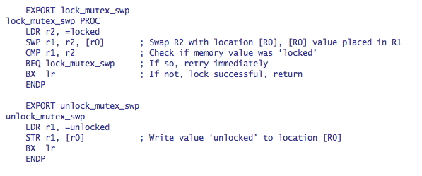
Atomic test-and-set in ARM ISA
ARM test-and-set provided by SWP: single bus operation reads memory location, tests it, writes it.
Example mutex lock implementation

