Slide 1
RLE Compression using Verilog and Verification using Functional Simulation
3/8/2017

Slide 2
Objectives
Learn to write Verilog for a custom design
Understand how to verify your design using functional simulation
Learn to write Verilog test bench for your design

Slide 3
Run Length Encoding
Takes data stream and records how many bits
are the same
Output the value of the bit and the number of
iterations of that value
ID Value
Count Value

Slide 4
Run Length Encoding (Contd..)
Input – 8 Bit data stream segments
Output – 24 Bit data
How does it work?
First bit – ID Bit (0 or 1)
Count value - 23 bits (Number of 0s or 1s)
More of same value in sequence, more data is saved
Worst Case - Interchanging data (01010101.....)

Slide 5
Illustration
0
8bit
7
1
1
1
0
0
0
0
0
Original Data Stream Segment
0
0
1
1
1
1
0
0
1bit
23bit
1
3
Encoded Data Stream Segment
0
7
1
4
0
2

Slide 6
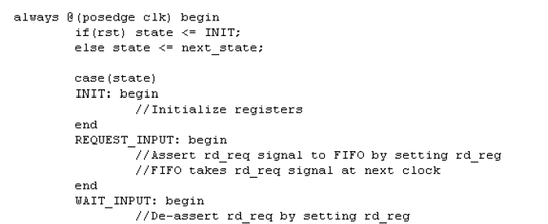
RLE Implementation
Implemented using a state machine written in Verilog (provided)
Understand the state diagram (appendix)
State transitions provided
Fill in the commented sections

Slide 7
Functional Simulation
Technique to verify the functionality of a hardware design (Design verification)
Standard procedure followed in the industry before implementing in a target device
Provide the inputs to your design and check the outputs to confirm functionality
ModelSim from Mentor Graphics is a well known tool used in the industry

Slide 8
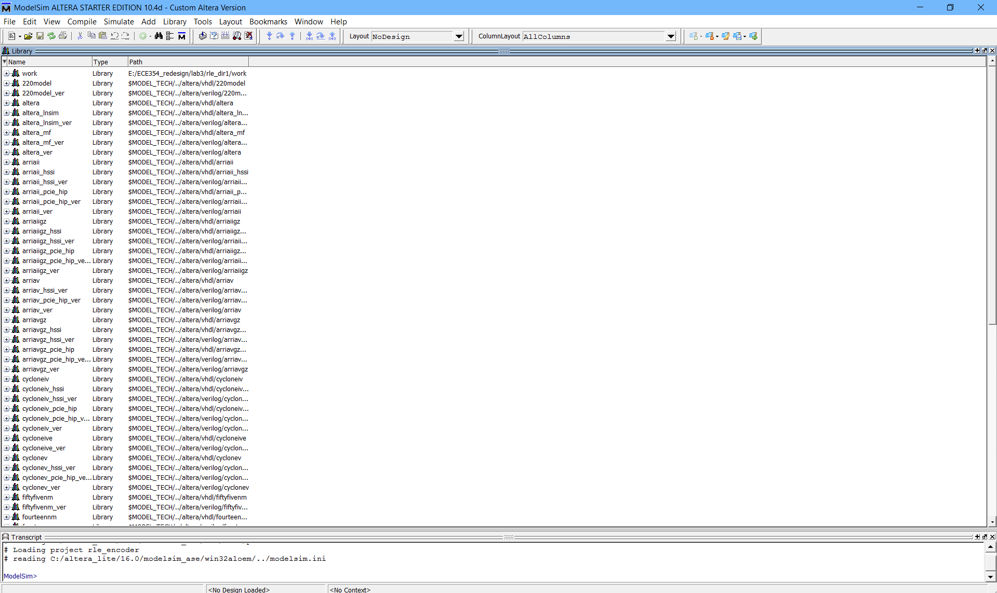
ModelSim – Functional simulation tool
Two ways to perform the design verification
Set the inputs through wave editor and observe the outputs
Design a test bench for your design

Slide 9
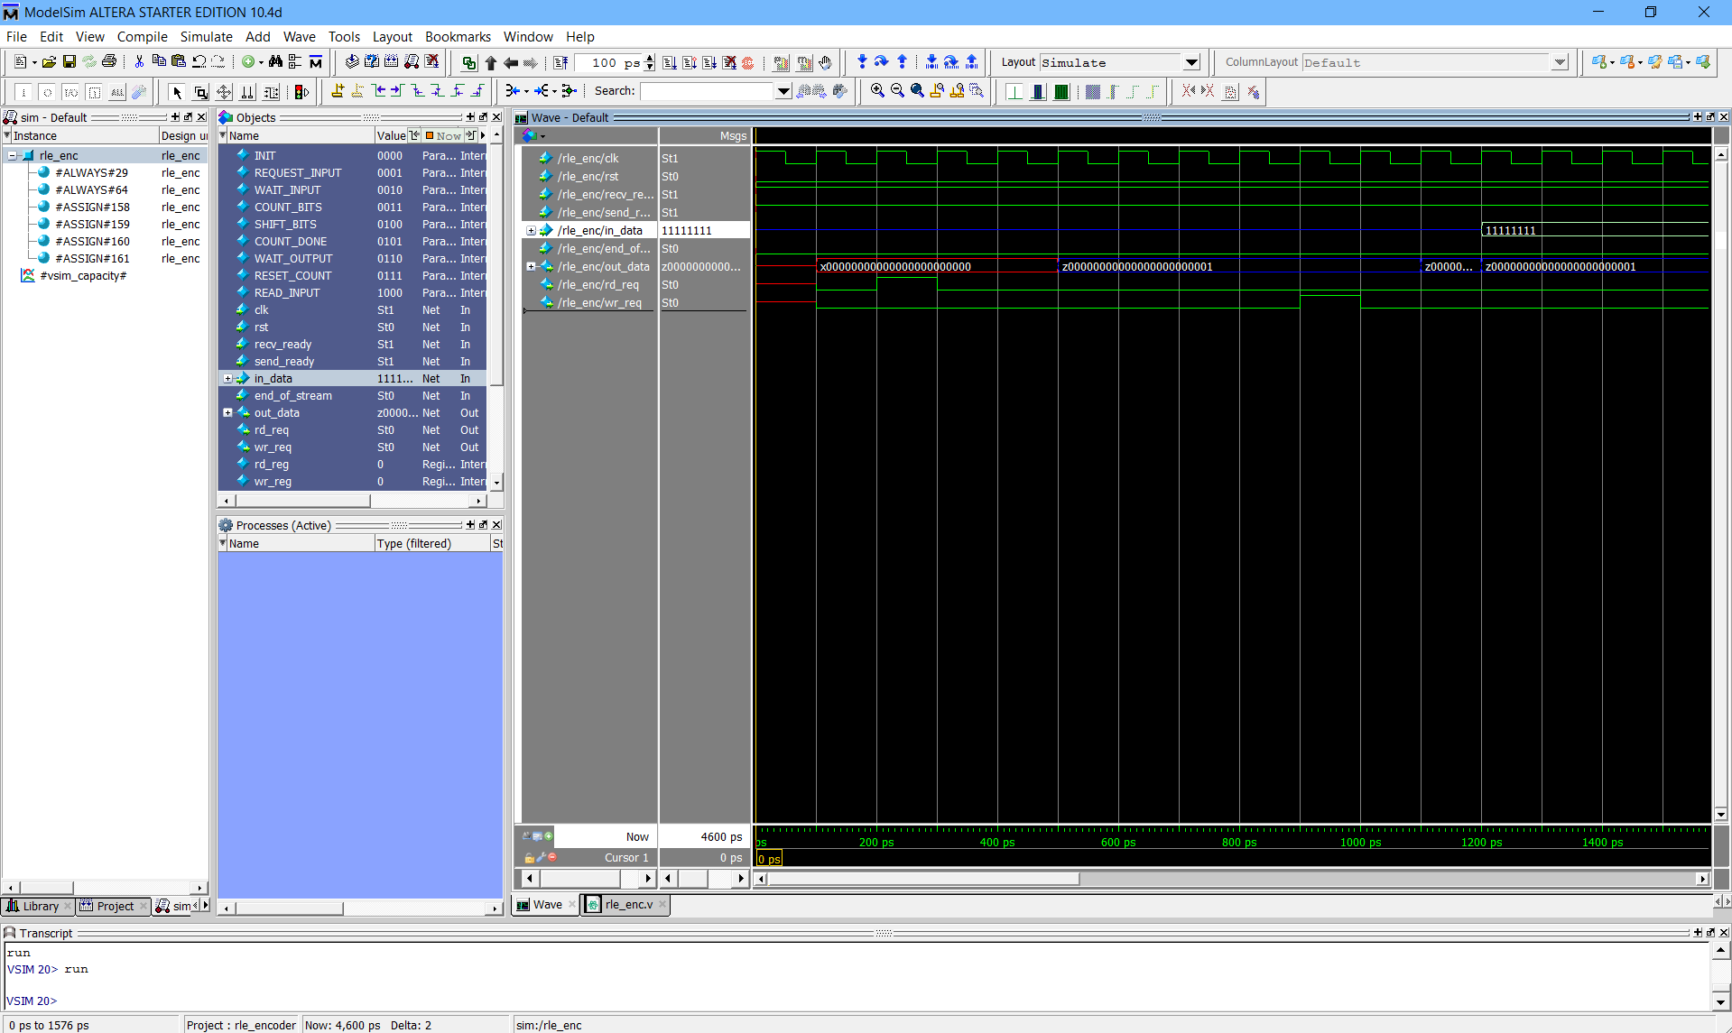
Wave Editor in ModelSim

Slide 10
Test Bench
Verilog wrapper module which does the following
Invokes the Design Under Test (DUT) - RLE
Provides the inputs to the DUT
Formats the outputs suitable for viewing
Verilog provides constructs such as procedural blocks and timing controls
Good source: https://people.ece.cornell.edu/land/courses/ece5760/Verilog/LatticeTestbenchPrimer.pdf

Slide 11
Test Bench Template
Module ‘RLE_test’
Instance ‘RLE_top’
DUT inputs
RLE Verilog netlist
module (DUT)
Procedural blocks
with test bench code
DUT outputs

Slide 12
Summary
To implement hardware for RLE
Encoding is done in Hardware (Verilog)
Functional simulation
Verify the design by providing the input stimulus and observe the output using Verilog test bench

Slide 13
Appendix
Signals and their Description

Slide 14
RLE Internal Signals
reg rd_reg
connected to rd_req;
reg wr_reg
Connected to wr_req;
reg [22:0] bit_count
Stores number of same consecutive bit in bit stream
value_type represent bit ID
reg value_type
Bit ID

Slide 15
RLE Internal Signals
reg [7:0] shift_buf
Store 8 bit segment of bit stream comes from input side FIFO
Will be shifted out to calculate number of bits
reg [3:0] shift_count
Current shift amount of shift_buf
reg new_bitstream
Indicate new bit sequence is starting
Current encoded data segment is passed to output side FIFO

Slide 16
RLE Internal Signals
reg [3:0] state
Represent State.
There are 9 states in total
reg [3:0] next_state
Represent Next state

Slide 17
RLE Interface - Input
input clk,rst
clk and reset
input recv_ready
Connected with (!fifo_empty) of input side FIFO
input send_ready
Connected with (!fifo_full) of output side FIFO
input [7:0] in_data
Input data from input side FIFO
8 bit segment of original bit stream
input end_of_stream
Indicate the end of bit stream
Request flushing out the last segment

Slide 18
RLE Interface - Output
output [23:0] out_data
Output data to output side FIFO
[23] has bit ID, [22:0] has bit counting value
output rd_req
Read request for input side FIFO
output wr_req
Write request for output side FIFO

Slide 19
INIT
bit_count = 0
shift_buf = 0
rd_reg = 0
wr_req_reg = 0
new_bitstream = 1
RESET_COUNT
bit_count = 0
end_of_stream
REQUEST_INPUT
rd_reg = 1
shift_count = 0
!recv_read
!recv_read&
end_of_stream&
bit_count != 0
WAIT_INPUT
rd_reg = 0
WAIT_OUTPUT
wr_reg = 0
send_ready
shift_count == 7
READ_INPUT
shift_buf = in_data
COUNT_DONE
wr_reg = 1
COUNT_BITS
Increase bit_count
Set/reset
new_bitstream
SHIFT_BITS
Shift sift_buf
Increase
shift_count
Lookup
new_bitstream
new_bitstream

Slide 20
RLE State in detail
INIT
Initialize registers
REQUEST_INPUT
Assert rd_req signal to FIFO by setting rd_reg
FIFO takes rd_req signal at next clock
WAIT_INPUT
1 cycle stall is needed
De-assert rd_req by setting rd_reg
READ_INPUT
FIFO provides valid data after taking rd_req
shift_buf stores 8 bit input data

Slide 21
RLE State in detail
COUNT_BITS
Count number of consecutive bits in shift_buf
If new type of bit starts, store bit ID in value_type register
If current value_type and shift_buf[0] is not matched, notify current encoding is completed and new encoding will be started
SHIFT_BITS
Right shift the shift_buf
Increase shift_count
Look up new_bitstream
COUNT_DONE
Assert wr_req by setting wr_reg
FIFO will take wr_req signal in next clock cycle

Slide 22
RLE State in detail
WAIT_OUTPUT
1 cycle stall is needed
De-assert wr_req by setting wr_reg
RESET_COUNT
Reset bit counting register after passing encoded data to output side FIFO

Slide 23
Race Condition
An Example
always @(posedge clk)
a = b;
always @(posedge clk)
b = c;
Which statement will be executed first?
Produces different simulation result from real hardware
Keeping verilog design guideline is important

Slide 24
Important Design Guideline for LAB 3
Do not mix BA and NBA in the same always block
Use BA for combinational circuit in given design
State transition
Use NBA for sequential circuit in given design
Updating registers

