Slide 1
Encapsulation
Inheritance
Polymorphism
OOP programming with Java
OOP Concepts Revisited

Slide 2
Polymorphism
Means 'having many forms'.
One example of its use is method overloading.
The same function name can be reused as long as each version has a unique signature, i.e. a different parameter list.
Functions with the same name should carry out similar processing.

Slide 3
Method signatures
Signatures consist of the function name and the type and order of its parameters.
Examples: setExam(int) getCoursework()
Note the parameter names are not included.
Any documentation/description will usually use the signature in this form.

Slide 4
Method polymorphism and constructors
Consider the constructors in the Marks class:
Marks() - has no parameters (initialises both attributes with -1, i.e. no mark recorded)
Marks(int, int) has two parameters, one for each attribute.
There are two constructors, same function name but different signatures.
Known as overloading or method polymorphism.

Slide 5
The default constructor ...
Has no parameters.
Usually initialises using default values.
Is a requirement in some situations.
It is good practice to include a default constructor.

Slide 6
Coding a default constructor
If possible, a default constructor must re-use a parameterised constructor.
Default constructor
public Marks() {
this(-1, -1);
}
public Marks(int cw, int exam) {
this.cw = cw;
this.exam = exam;
}
Parameterisedconstructor

Slide 7
Coding a default constructor - continued
Why?
code re-use
possible future changes are made in only one place.

Slide 8
Methods Overloading
&
Methods Overriding

Slide 9
Polymorphism
Method overloading and method overriding in Java is two important concepts which allows Java programmer to declare method with same name but different behavior.
Method overloading and method overriding is based on polymorphism in Java.
Polymorphism is the ability of an object to take on many forms.
The most common use of polymorphism in OOP occurs when a parent class reference is used to refer to a child class object.
Animal a =new Dog ();
Reference Type
Object Type

Slide 10
Key Points:
Static Binding -> Overloading Methods -> resolved at Compile Time
Dynamic Binding -> Overriding Methods -> resolved at Run Time

Slide 11
How to overload a Method
If you have two methods with same name in one Java class with different method signature then its called overloaded method.
Have different set of arguments to perform something based on different number of input.
Can also overload constructor in Java.
Binding of overloading method occurs during compile time and overloaded calls resolved using static binding.
To overload a Java method just changes its signature.
Just remember in order to change signature you either need to change number of argument, type of argument or order of argument in Java if they are of different types.

Slide 12
How to override a Method
In order to override a Java method, you need to create a child class which extends parent.
Overridden method in Java also shares same name as original method in Java but can only be overridden in sub class.
When you override a method in Java its signature remains exactly same.
JVM resolves correct overridden method based upon object at run-time by using dynamic binding in Java.
Can not override static, final, private methods in Java.

Slide 13
Rules of Method overriding
Method signature must be same including return type, number of method parameters, type of parameters and order of parameters.
Overriding method can not throw higher Exception than original.
Overriding method can not reduce accessibility of overridden method , means if original or overridden method is public then overriding method can not make it protected.

Slide 14
Example
class Animal{
public void move(){
System.out.println("Animals can move");
}
}
class Dog extends Animal{
public void move(){
System.out.println("Dogs can walk and run");
}
}
public class TestDog{
public static void main(String args[]){
Animal a = new Animal(); // Animal reference and object
Animal b = new Dog(); // Animal reference but Dog object
a.move();// runs the method in Animal class
b.move();//Runs the method in Dog class
}
}

Slide 15
Overloading vs. Overriding
In case of method overloading Signature of method changes while in case of method overriding it remain same.
Can overload method in one class but overriding can only be done on subclass.
You can not override static, final and private method in Java but you can overload static, final or private method in Java.
Overloaded method in Java is bonded by static binding and overridden methods are subject to dynamic binding.

Slide 16
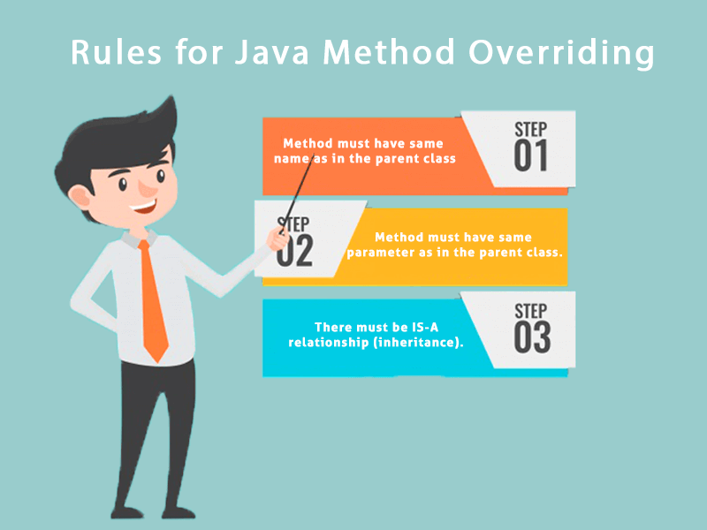
Method Overriding

Slide 17
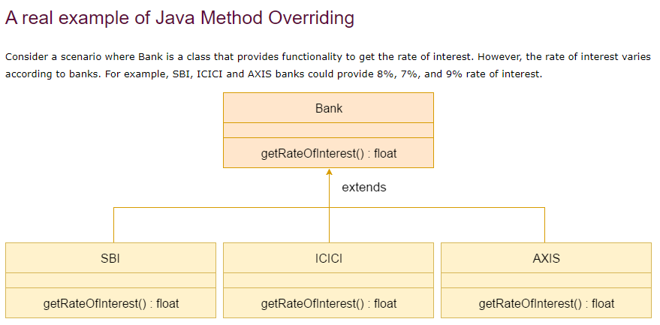

Slide 18
THANK YOU

