Slide 1
Intro to systems neuroscience.
And maybe a little biophysics.
Peter Latham
Systems Neuroscience
October 6, 2020

Slide 2
Outline
What the brain does (big picture)
How it does it, sort of (micro picture)
What you’ll get out of this course
What we want to know about the brain
Biophysics (if time)

Slide 3
1. What the brain does (big picture)
sensory input
(sounds, images, etc.)
brain
choose an action
short term sensory processing
(what’s in the world now)
construct a model
of the world
execute a motor
command

Slide 4
short term sensory processing
(what’s in the world now)
extract latent variables
attach meaning and relationships
to latent variables
construct a model
of the world
we all know what that means, but it’s incredibly hard (RL)
choose an action
move the appropriate muscles, at the right time.
execute a motor
command

Slide 5
1. What the brain does (big picture)
sensory input
(sounds, images, etc.)
brain
choose an action
short term sensory processing
(what’s in the world now)
construct a model
of the world
execute a motor
command

Slide 6
2. How it does it, sort of (micro picture)
Neurons!!!!

Slide 7
Your brain is full of neurons
dendrites (input)
soma
spike generation
1 mm
axon (output)
(1000 μm)
20 μm
mm - meter
(1000-1,000,000 μm)
Notes:
Here through “A bigger picture view of the brain” I’m telling them basic facts about neurons and networks.

Slide 8
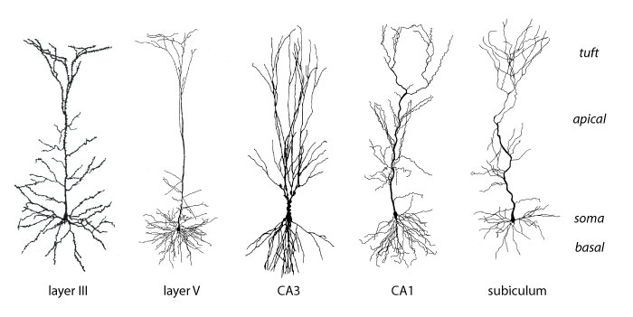
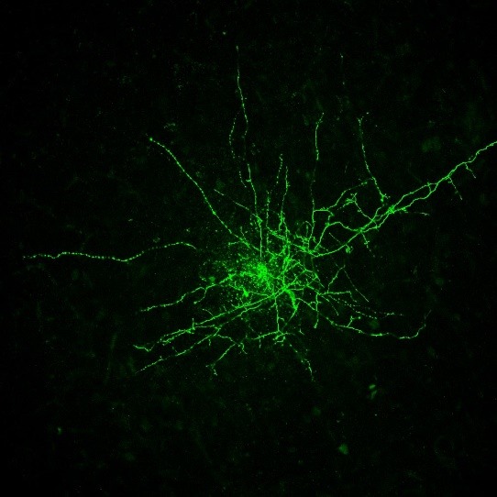
~1900 (Ramon y Cajal)
~2010 (Mandy George)
~100 μm
Notes:
Here through “A bigger picture view of the brain” I’m telling them basic facts about neurons and networks.

Slide 9
dendrites (input)
soma
spike generation
axon (output)
+20 mV
1 ms
voltage
-50 mV
time
100 ms
Notes:
Here through “A bigger picture view of the brain” I’m telling them basic facts about neurons and networks.

Slide 10
dendrites (input)
soma
spike generation
axon (wires)
+20 mV
1 ms
voltage
-50 mV
time
100 ms
Notes:
Here through “A bigger picture view of the brain” I’m telling them basic facts about neurons and networks.

Slide 12
synapse
current flow

Slide 13
+20 mV
voltage
-50 mV
time
100 ms

Slide 14
neuron i
neuron j
neuron j emits a spike:
EPSP (excitatory post-synaptic
potential)
0.5 mV
V on neuron i
t
10 ms

Slide 15
neuron i
neuron j
neuron j emits a spike:
IPSP (inhibitory post-synaptic
potential)
V on neuron i
t
10 ms
0.5 mV

Slide 16
neuron i
neuron j
neuron j emits a spike:
changes with
learning
IPSP
V on neuron i
t
amplitude ∝ w_{ij}
10 ms
0.5 mV

Slide 17
Simplest possible network equations:
~10 ms
dV_{i}
τ
=
–(V_{i} – V_{rest}) + Σ_{j} w_{ij} g_{j}(t)
subtheshold integration
dt
+20 mV
voltage
V_{thresh}
V_{rest}
time
100 ms
Notes:
update first homework

Slide 18
Simplest possible network equations:
~10 ms
dV_{i}
τ
=
–(V_{i} – V_{rest}) + Σ_{j} w_{ij} g_{j}(t)
subtheshold integration
dt
V_{i} reaches threshold (≈ -50 mV):
- a spike is emitted
- V_{i} is reset to V_{rest} (≈ -65 mV)
+20 mV
1 ms
voltage
-50 mV
-65 mV
time
100 ms
Notes:
update first homework

Slide 19
Simplest possible network equations:
~10 ms
dV_{i}
τ
=
–(V_{i} – V_{rest}) + Σ_{j} w_{ij} g_{j}(t)
subtheshold integration
dt
V_{i} reaches threshold (≈ -50 mV):
- a spike is emitted
- V_{i} is reset to V_{rest} (≈ -65 mV)
+20 mV
voltage
-50 mV
-65 mV
time
100 ms
Notes:
update first homework

Slide 20
Simplest possible network equations:
each neuron receives
about 1,000 inputs.
about 1,000 nonzero
terms in this sum.
~10 ms
dV_{i}
τ
=
–(V_{i} – V_{rest}) + Σ_{j} w_{ij} g_{j}(t)
dt
~5 ms
V_{i} reaches threshold (≈ -50 mV):
t
- a spike is emitted
- V_{i} is reset to V_{rest} (≈ -65 mV)
spike times,
neuron j
+20 mV
voltage
-50 mV
-65 mV
time
100 ms
Notes:
update first homework

Slide 21
Simplest possible network equations:
dV_{i}
τ
=
–(V_{i} – V_{rest}) + Σ_{j} w_{ij} g_{j}(t)
dt
w is 10¹¹ × 10¹¹
w is very sparse: each neuron contacts ~10³ other neurons.
w evolves in time (learning):
dw_{ij}
τ_{s}
=
F_{ij} (V_{i} ,V_{j}; global signal)
dt
>> τ
we think
spikes on neuron j
Notes:
update first homework

Slide 22
Notes:
update first homework

Slide 23
Simplest possible network equations:
dV_{i}
τ
=
–(V_{i} – V_{rest}) + Σ_{j} w_{ij} g_{j}(t)
dt
w is 10¹¹ × 10¹¹
w is very sparse: each neuron contacts ~10³ other neurons.
w evolves in time (learning):
dw_{ij}
τ_{s}
=
F_{ij} (V_{i} ,V_{j}; global signal)
dt
>> τ
we think
spikes on neuron j
Notes:
update first homework

Slide 24
your brain
~10¹¹ neurons
excitatory
neuron (80%)
~1,000 connections
~90% short range
~10% long range
Notes:
update first homework

Slide 25
your brain
~10¹¹ neurons
excitatory
neuron (80%)
inhibitory
neuron (20%)
~1,000 connections
~100% short range
Notes:
update first homework

Slide 26
What you need to remember:
When a neuron spikes, that causes a small change in the voltage of its target neurons:
- if the neuron is excitatory, the voltage goes up on
about half of its 1,000 target neurons
on the other half, nothing happens
- if the neuron is inhibitory, the voltage goes down on
about half if its 1,000 target neurons
on the other half, nothing happens
a different half every time there’s a spike!
why nothing happens is one of the biggest
mysteries in neuroscience
along with why we sleep – another huge mystery
Notes:
update first homework

Slide 27
your brain at a microscopic level
~10¹¹ neurons
excitatory
neuron (80%)
inhibitory
neuron (20%)
Notes:
update first homework

Slide 28
there is lots of structure at the macroscopic level
sensory
processing
(input)
action
selection
motor
processing
(output)
memory
Notes:
update first homework

Slide 29
there is lots of structure at the macroscopic level
lots of
visual areas
action
selection
motor
processing
(output)
auditory areas
memory
Notes:
update first homework

Slide 30
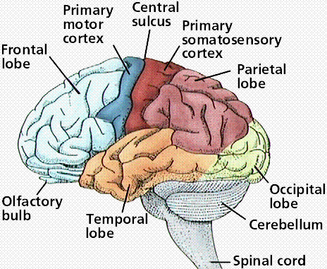
Your brain

Slide 31
Your cortex unfolded
neocortex (sensory and motor processing, cognition)
6 layers
~30 cm
~0.5 cm
subcortical structures
(emotions, reward,
homeostasis, much much
more)

Slide 32
Your cortex unfolded
1 cubic millimeter,
~10⁻³ grams

Slide 33
1 mm³ of cortex:
50,000 neurons
1000 connections/neuron
(=> 50 million connections)
4 km of axons
whole brain (2 kg):
10¹¹ neurons
10¹⁴ connections
8 million km of axons
20 watts
1 mm² of a CPU:
1 million transistors
2 connections/transistor
(=> 2 million connections)
.002 km of wire
whole CPU:
10⁹ transistors
2×10⁹ connections
2 km of wire
scaled to brain: MWs

Slide 34
1 mm³ of cortex:
50,000 neurons
1000 connections/neuron
(=> 50 million connections)
4 km of axons
whole brain (2 kg):
10¹¹ neurons
10¹⁴ connections
8 million km of axons
20 watts
1 mm² of a CPU:
1 million transistors
2 connections/transistor
(=> 2 million connections)
.002 km of wire
whole CPU:
10⁹ transistors
2×10⁹ connections
2 km of wire
scaled to brain: MW

Slide 35
1 mm³ of cortex:
50,000 neurons
1000 connections/neuron
(=> 50 million connections)
4 km of axons
whole brain (2 kg):
10¹¹ neurons
10¹⁴ connections
8 million km of axons
20 watts
1 mm² of a CPU:
1 million transistors
2 connections/transistor
(=> 2 million connections)
.002 km of wire
whole CPU:
10⁹ transistors
2×10⁹ connections
2 km of wire
scaled to brain: MWs

Slide 36
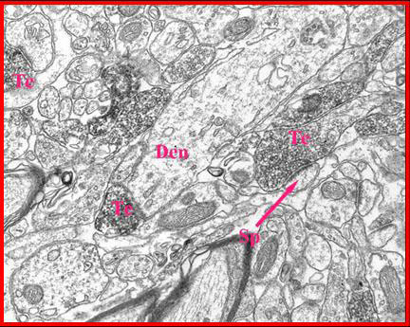
There are about 10 billion cubes of
this size in your brain!
10 microns
.01 mm
Notes:
main point: the brain is really really complicatd

Slide 37
2. How it does it, sort of (micro picture)
That was a whirlwind tour.
Things to remember:
The brain computes by passing spikes between neurons.
The weights are learned, and the brain eventually does useful stuff.
There are lots of neurons in the human brain (10¹¹).
And even more synapses (10¹⁴).

Slide 38
2. How it does it, sort of (micro picture)
For the neuroscientists, that should have been mainly review.
For the machine learners, that should have looked very familiar.
The brain is just a giant recurrent network!
To make it work, all you have to do is train it!

Slide 39
Outline
What the brain does (big picture)
How it does it, sort of (micro picture)
What you’ll get out of this course
Facts
Facts
More facts
You will be inundated with facts.
And they’ll come in the wrong order.
That’s because we have no clue how the brain works.
We don’t even know what “how the brain works” means.

Slide 40
1. What the brain does (big picture)
sensory input
(sounds, images, etc.)
brain
choose an action
short term sensory processing
(what’s in the world now)
construct a model
of the world
execute a motor
command

Slide 41
short term sensory processing
(what’s in the world now)
extract latent variables
attach meaning and relationships
to latent variables
construct a model
of the world
we all know what that means, but it’s incredibly hard (RL)
choose an action
move the appropriate muscles, at the right time.
execute a motor
command

Slide 42
short term sensory processing
(what’s in the world now)
extract latent variables
attach meaning and relationships
to latent variables
construct a model
of the world
we all know what that means, but it’s incredibly hard (RL)
choose an action
move the appropriate muscles, at the right time.
execute a motor
command

Slide 43

People
Bronze (probably) lion
Lamp post
London
Trafalgar square
…

Slide 44
Our job as neuroscientists is to figure out how the brain extracts latent variables – like you just did.
That’s a bit of a problem: we have no idea how anything could extract latent variables.
So we mainly collect facts.
We also build theories, but (until recently) they tended to describe only simple situations.

Slide 45
For instance:
We show drifting gratings and record responses in visual cortex.
Firing rates depend on the direction of the moving grating.
We can build explain that using relatively simple ideas about optimal coding.

Slide 46
For instance:
We show dots moving to the right or left (near threshold), ask animals to tell us which way they’re moving, and give them a reward if they’re correct.
Animals often exhibit near-optimal behavior.
We can build reinforcement learning models that describe this behavior very well.

Slide 47
These (and tasks like them) are insanely simple, and cannot possibly tell us how animals perform hard tasks.
Or so I claim – some would disagree.
They’re wrong.
But that’s mainly what you’ll see in this course.
Either:
just experimental facts
simple motivating theory, then experimental facts
you should be constantly asking “what does this tell us about how the brain works”!

Slide 48
That was classical theoretical neuroscience.
Recently, deep learning has changed that.

Slide 49
1. What the brain does (big picture).
sensory input
(sounds, images, etc.)
deep feedforward
networks
deep RL
brain
choose an action
short term sensory processing
(what’s in the world now)
construct a model
of the world
execute a motor
command
deep recurrent
networks
no clue

Slide 50
The modern approach:
train a deep network on some task
compare to what we see in the brain
If there’s a match, declare victory!
Jim DiCarlo and Dan Yamins made this famous, but it’s now a small cottage industry.
It’s not at all clear what we learn.
You may see some of that in the course.

Slide 51
Outline
What the brain does (big picture)
How it does it, sort of (micro picture)
What you’ll get out of this course
What we want to know about the brain

Slide 52
Presumably we want to “understand” how the brain works.
For that we need a definition of understand!
This sounds like philosophy, but it’s an important issue.
Here’s my definition:

Slide 53
We understand something with respect to a parameter if we can predict what happens when a parameter changes.
“Parameter” refers to a 1-D path through some potentially high dimensional space.
A complete understanding means we have to do this for lots of parameters.
Importantly, we have to make our prediction
Without doing massive simulations!
Without doing regression!

Slide 54
Without doing massive simulations!
Just because you know the equations doesn’t mean you understand anything.
Would you know how the brain works?
Remember, there are 100 trillion highly nonlinear equations!
dV_{i}
τ
=
– (V_{i} – V_{rest}) + Σ_{j} w_{ij} g_{j}(t) (V_{i} – E_{j})
dt
dw_{ij}
τ_{w}
=
F_{ij} (V_{i} , x_{j}; feedback signal)
dt

Slide 55
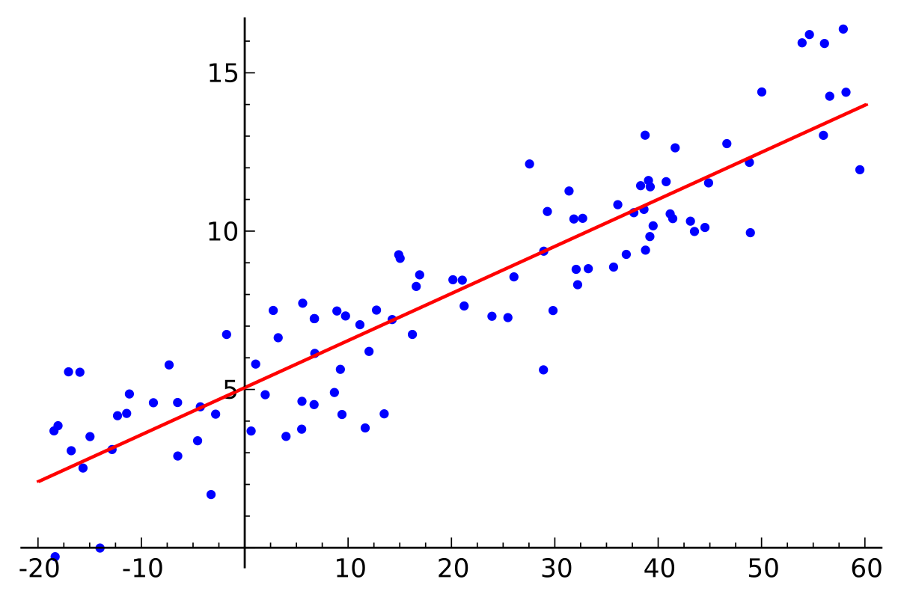
Without doing regression!
what y corresponds to this x?
Would you understand anything about the transformation from x to y?

Slide 56
Understanding things is hard!

Slide 57
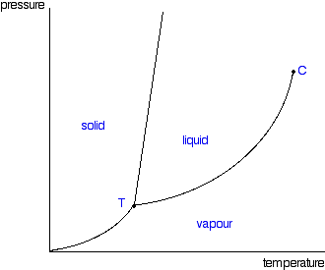
Things we understand pretty well

Slide 58
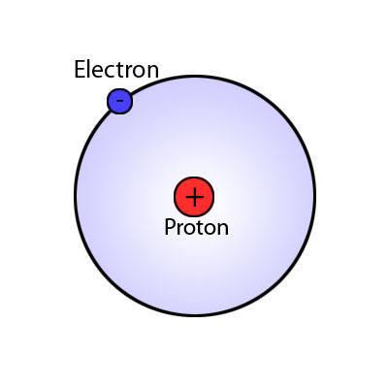
Things we understand pretty well
A single dimensionless parameter
determines behaviour.

Slide 59
Things we understand pretty well
earth
sun
A single dimensionless parameter
determines behaviour.

Slide 60
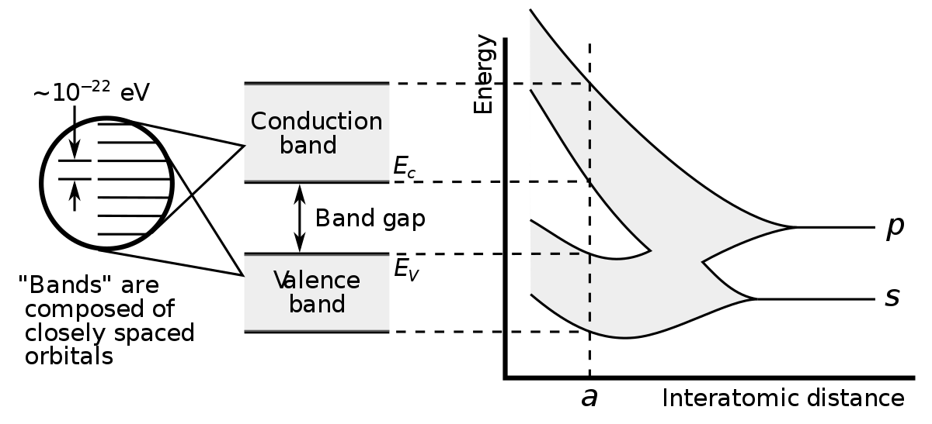
Things we understand pretty well
A handful of so-called “order parameters”
determine behaviour.

Slide 61
Things we sort of understand
earth
moon
++
sun

Slide 62
Things we sort of understand
the effect of carbon on climate
max
prediction accuracy
floating point operations
humans, ~10²
computers, ~10¹⁵

Slide 63
Can we understand something like the brain, whose behavior depends on a large number of parameters?
Remember, we only want to understand what happens on a 1-D path through parameter space.
Except that a complete understanding means we need to know what happens on all relevant 1-D paths!
Given that we can’t even understand a vanilla deep network, probably not!

Slide 64
So what should we do?
Choose neuroscience problems carefully!
Give up on understanding how the brain works, and be happy with smaller problems.

Slide 65
Outline
What the brain does (big picture)
How it does it, sort of (micro picture)
What you’ll get out of this course
What we want to know about the bra
So what should we do?
Choose neuroscience problems carefully!
Give up on understanding how the brain works, and be happy with smaller problems.

