Slide 1
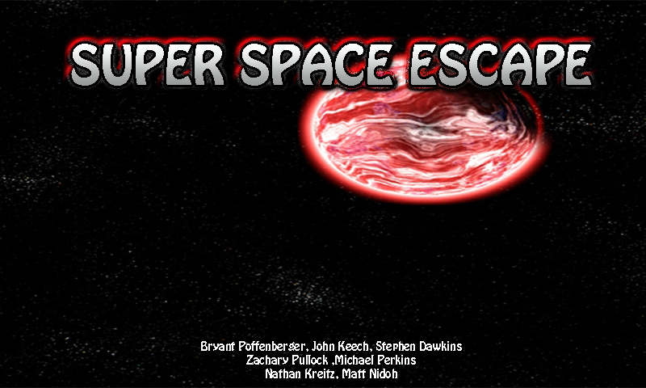

Slide 2
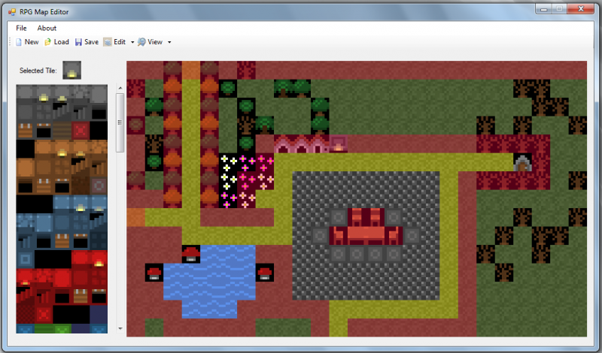
Subgroup 1: Tile Engine
Loads map data from disk using our own file format
Header with the name and size of the map
4 arrays of integers describing
Background
Collision
Foreground
Objects
Converts map into objects that can be used in game
Draws the tiles onto the map

Slide 3
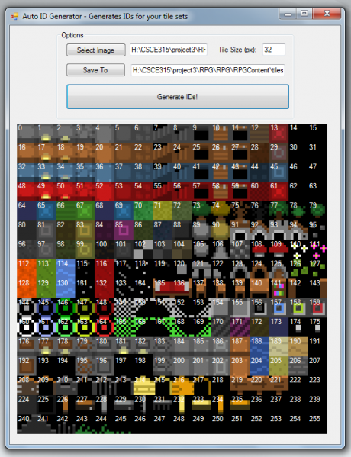
Subgroup 1: Map Editor
Load and save to disk using the predefined file format
Create new maps or edit existing maps
User interface
Selection Bar
Background
Objects
Foreground
Collision(Background)
Click tile to select it
Then Click on screen to place tile in location

Slide 4
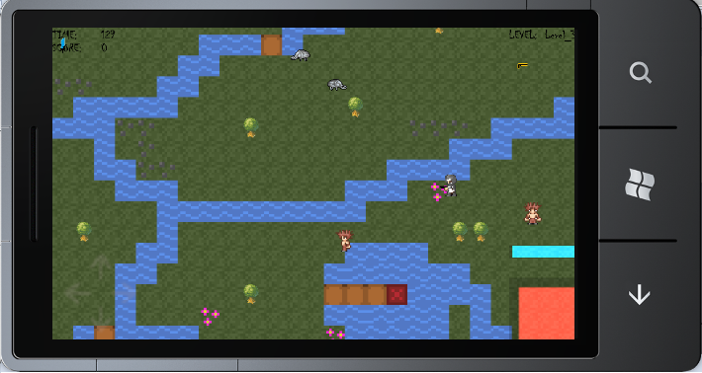
Subgroup 2: Game Engine
Keep track of local player through a position vector
Local position based on movement determined by arrow keys
Keep track of monsters on screen
Monster handling
Monster path finding/AI
Deal with items
Item classes for collecting objects
Collision Engine
Controls boundaries, damage updates, and item collection
Handle level events
Using keys and level transition

Slide 5
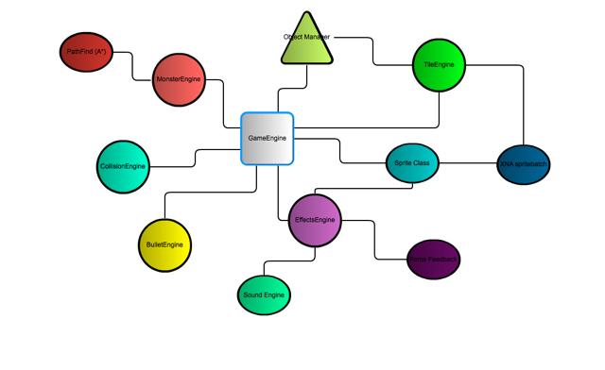
Software Architecture

Slide 6
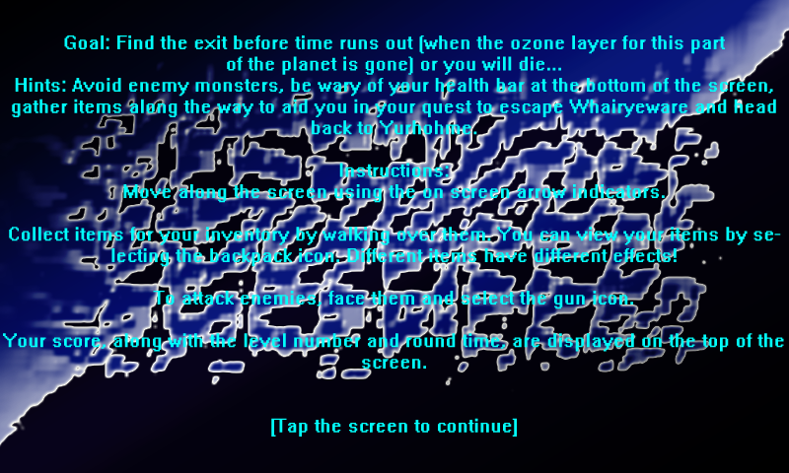
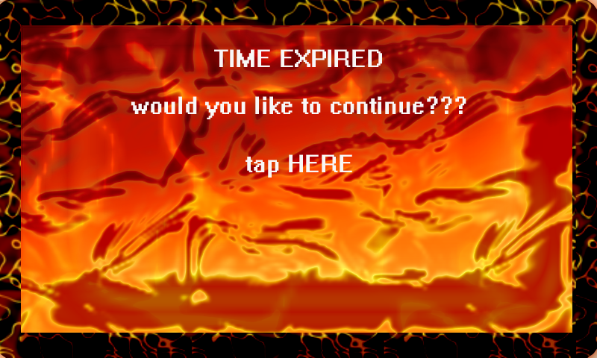
Subgroup 2: User Interface
Menus
Includes instructions and begins game
Player input
Use of control pad, fire button, and inventory
Game Over screens
Game ends from loss of all health or time expiration that runs down from top of screen

Slide 7
Monster AI
For monster AI we used an A* path finding algorithm
Uses two functions Think and Act
Uses those to create a rating through the following formula
Y = (-100/max)*x +100
Where max is the max value of the factor, xi is the current factor, and y is the rating.
Decision matrix is two-dimensional array uses the rating to determine action to be taken

Slide 8
Video Demo
http://www.youtube.com/watch?v=s7Zg38ZUIYU

