Slide 1
Social Athlete
Iteration 1

Slide 2
Schedule
Marketecture
Development View
Logical View
Physical View
Demo

Slide 3
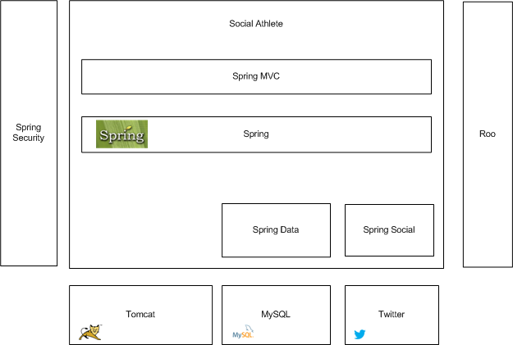
Marketecture
Notes:
The key feature of this architecture is the re-use of COTS software. This project relies heavily on the Spring Framework and its various components. Spring MVC is being used as the web front-end. Spring Security is handling authorization and authentication. Spring Data is handling the interaction with the persistence component (MySQL). Spring Social is controlling the integration with the various social platforms that this platform will utilize. This entire project will run in the Tomcat container. Spring Roo is being utilized to generate cookie cuter code and reduce the total development time.

Slide 4
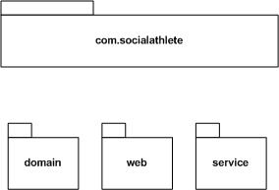
Development View

Slide 5
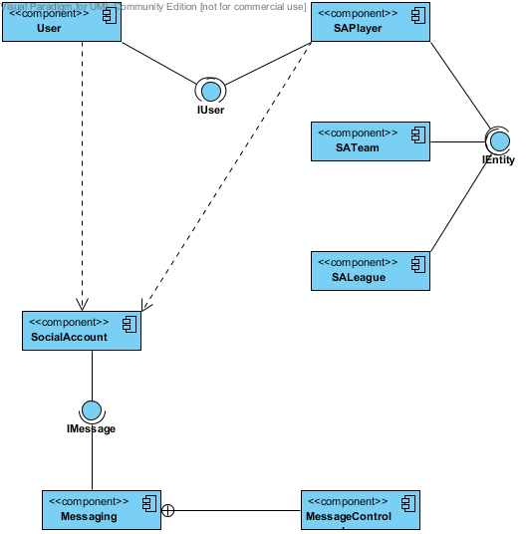
Logical View

Slide 6
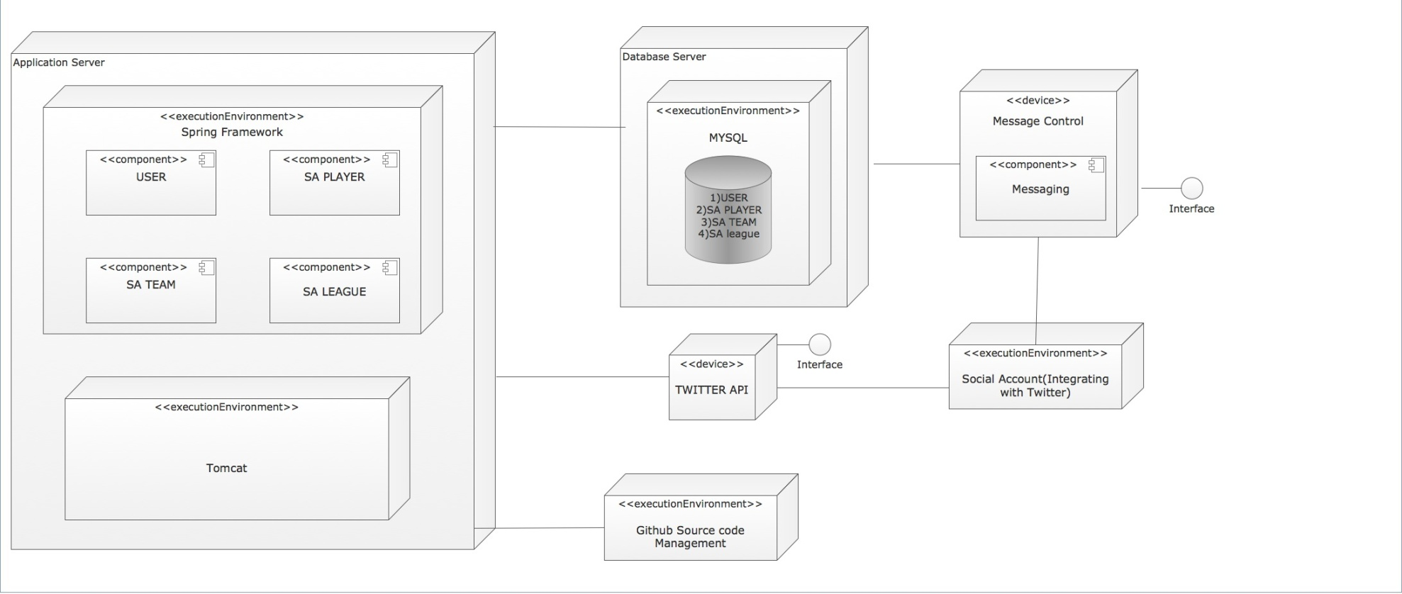
Physical View

Slide 7
Demo

