Slide 1
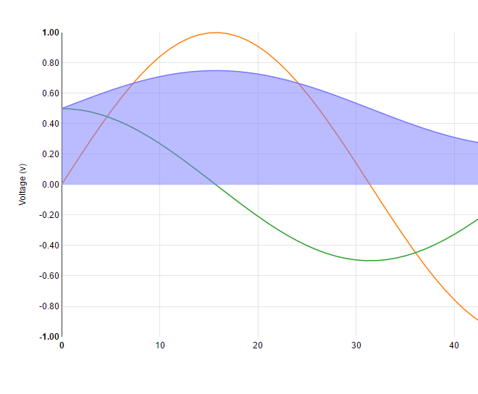
Option 1 (implemented)
Temperature
Sensor
Arduino
LAMP VM
Browser / Web Client
Web Server
Current Readings
Current Readings
Now: 10C
current readings
Web Server
Data
Logging
Timed
Every 10m
Data Logger
(php)
All Data Logged
To Date
memory
…/data/datalog.txt
Data service on timer (every 10 minutes), connect to Web Server and push reading.
Failure to connect means loss of data since variables would be reset each hour.

