Slide 1
Security Controls in Shared Source Code Repositories
Joshua Kelbley
Module 11.2
7/21/24

Slide 2
Importance of Security in Source Code Repositories
Securing source code repositories is crucial due to the sensitive nature of the data they contain. Source code embodies the core intellectual property of software companies and often includes sensitive information such as credentials, configuration files, and proprietary algorithms. High-profile breaches, such as the 2020 SolarWinds attack, have underscored the vulnerabilities associated with inadequate repository security. Such incidents highlight the necessity of implementing comprehensive security measures to safeguard the integrity and confidentiality of the code.

Slide 3
Access Controls
Access control is a fundamental security measure that ensures only authorized individuals can access the repository. Implementing robust access controls involves several best practices.
Least Privilege Principle: Grant users the minimum level of access required to perform their duties. This minimizes the potential damage from compromised accounts.
Role-Based Access Control (RBAC): Assign permissions based on user roles, ensuring that access levels align with job responsibilities.
Regular Reviews: Periodically review and update access permissions to reflect changes in roles and responsibilities. This prevents outdated permissions from becoming security vulnerabilities.

Slide 4
Authentication and Authorization
Effective authentication and authorization mechanisms are critical for ensuring that only authorized users can access the repository. Best practices include:
Multi-Factor Authentication (MFA): Implement MFA to add an extra layer of security beyond just passwords. This typically involves something the user knows (password) and something they have (a mobile device).
Single Sign-On (SSO): Use SSO to streamline the login process and enhance security by reducing the number of credentials users must manage.
Secure Credentials: Ensure users create strong, unique passwords and store them securely, avoiding common passwords and reusing credentials across multiple platforms.

Slide 5
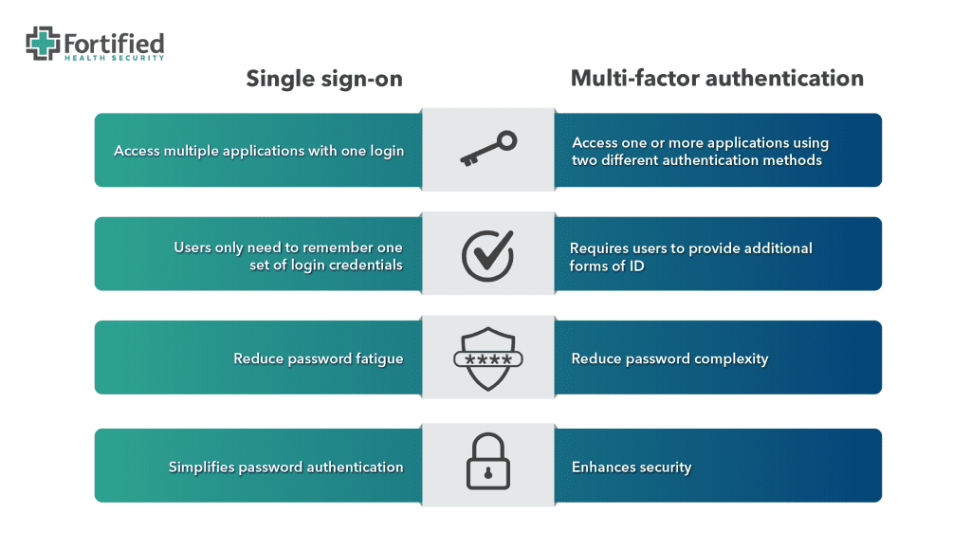

Slide 6
Encryption
Encryption is essential for protecting data both at rest and in transit. Using strong encryption algorithms to protect sensitive information stored in the repository is crucial. Ensuring all data transmitted over the network is encrypted using HTTPS prevents interception and tampering. Additionally, securely storing SSH keys and tokens and rotating them regularly minimizes the risk of unauthorized access.

Slide 7
Monitoring and Logging
Continuous monitoring and logging are vital for detecting and responding to security incidents. Implementing tools to continuously monitor repository access and changes helps detect unauthorized activities in real-time. Keeping detailed logs of user activities, including login attempts, code changes, and access to sensitive data, is necessary. These logs should be protected from tampering and accessible for audit purposes. Periodically reviewing logs to identify and investigate suspicious activities ensures compliance with security policies and identifies areas for improvement.

Slide 8
Secure Code Practices
Ensuring the integrity and security of the code within the repository is crucial. Conducting regular code and peer reviews helps identify and rectify security vulnerabilities and coding errors. Using automated tools to scan code for vulnerabilities ensures adherence to security best practices. Performing both static (code-level) and dynamic (runtime) analysis detects and addresses security issues throughout the development lifecycle.

Slide 9
Backup and Recovery
Preparing for data loss or breaches ensures business continuity. Scheduling frequent backups of repository data ensures that it can be restored in case of data loss or corruption. Storing backups in a secure, off-site location protects against physical and cyber threats. Periodically testing recovery processes ensures that backups can be successfully restored and that data integrity is maintained.

Slide 10
Training and Awareness
Educating users about security practices reduces the risk of human error and enhances overall security. Providing regular training sessions for developers and users on security best practices, including secure coding, password management, and recognizing phishing attempts, is essential. Implementing programs to raise awareness about common security threats, such as social engineering and malware, helps users stay vigilant. Encouraging a culture where users feel comfortable reporting suspicious activities or potential security vulnerabilities without fear of repercussions fosters a proactive security environment.

Slide 11
Works Cited
Digital.gov (n.d.). An introduction to security and privacy controls. An Introduction to Security and Privacy Controls. Retrieved July 20, 2024, from https://digital.gov/resources/an-introduction-to-security-and-privacy-controls/
Fortified Health Security (2023, May 17). Single Sign-On vs Multi-Factor Authentication: Do you Know the Difference? Single Sign-On vs Multi-Factor Authentication: Do you Know the Difference? Retrieved July 21, 2024, from https://fortifiedhealthsecurity.com/blog/single-sign-on-vs-mfa-do-you-know-the-difference/
GitHub (n.d.). Best practices for securing accounts. Best Practices for Securing Accounts. Retrieved July 20, 2024, from https://docs.github.com/en/code-security/supply-chain-security/end-to-end-supply-chain/securing-accounts

