Slide 1
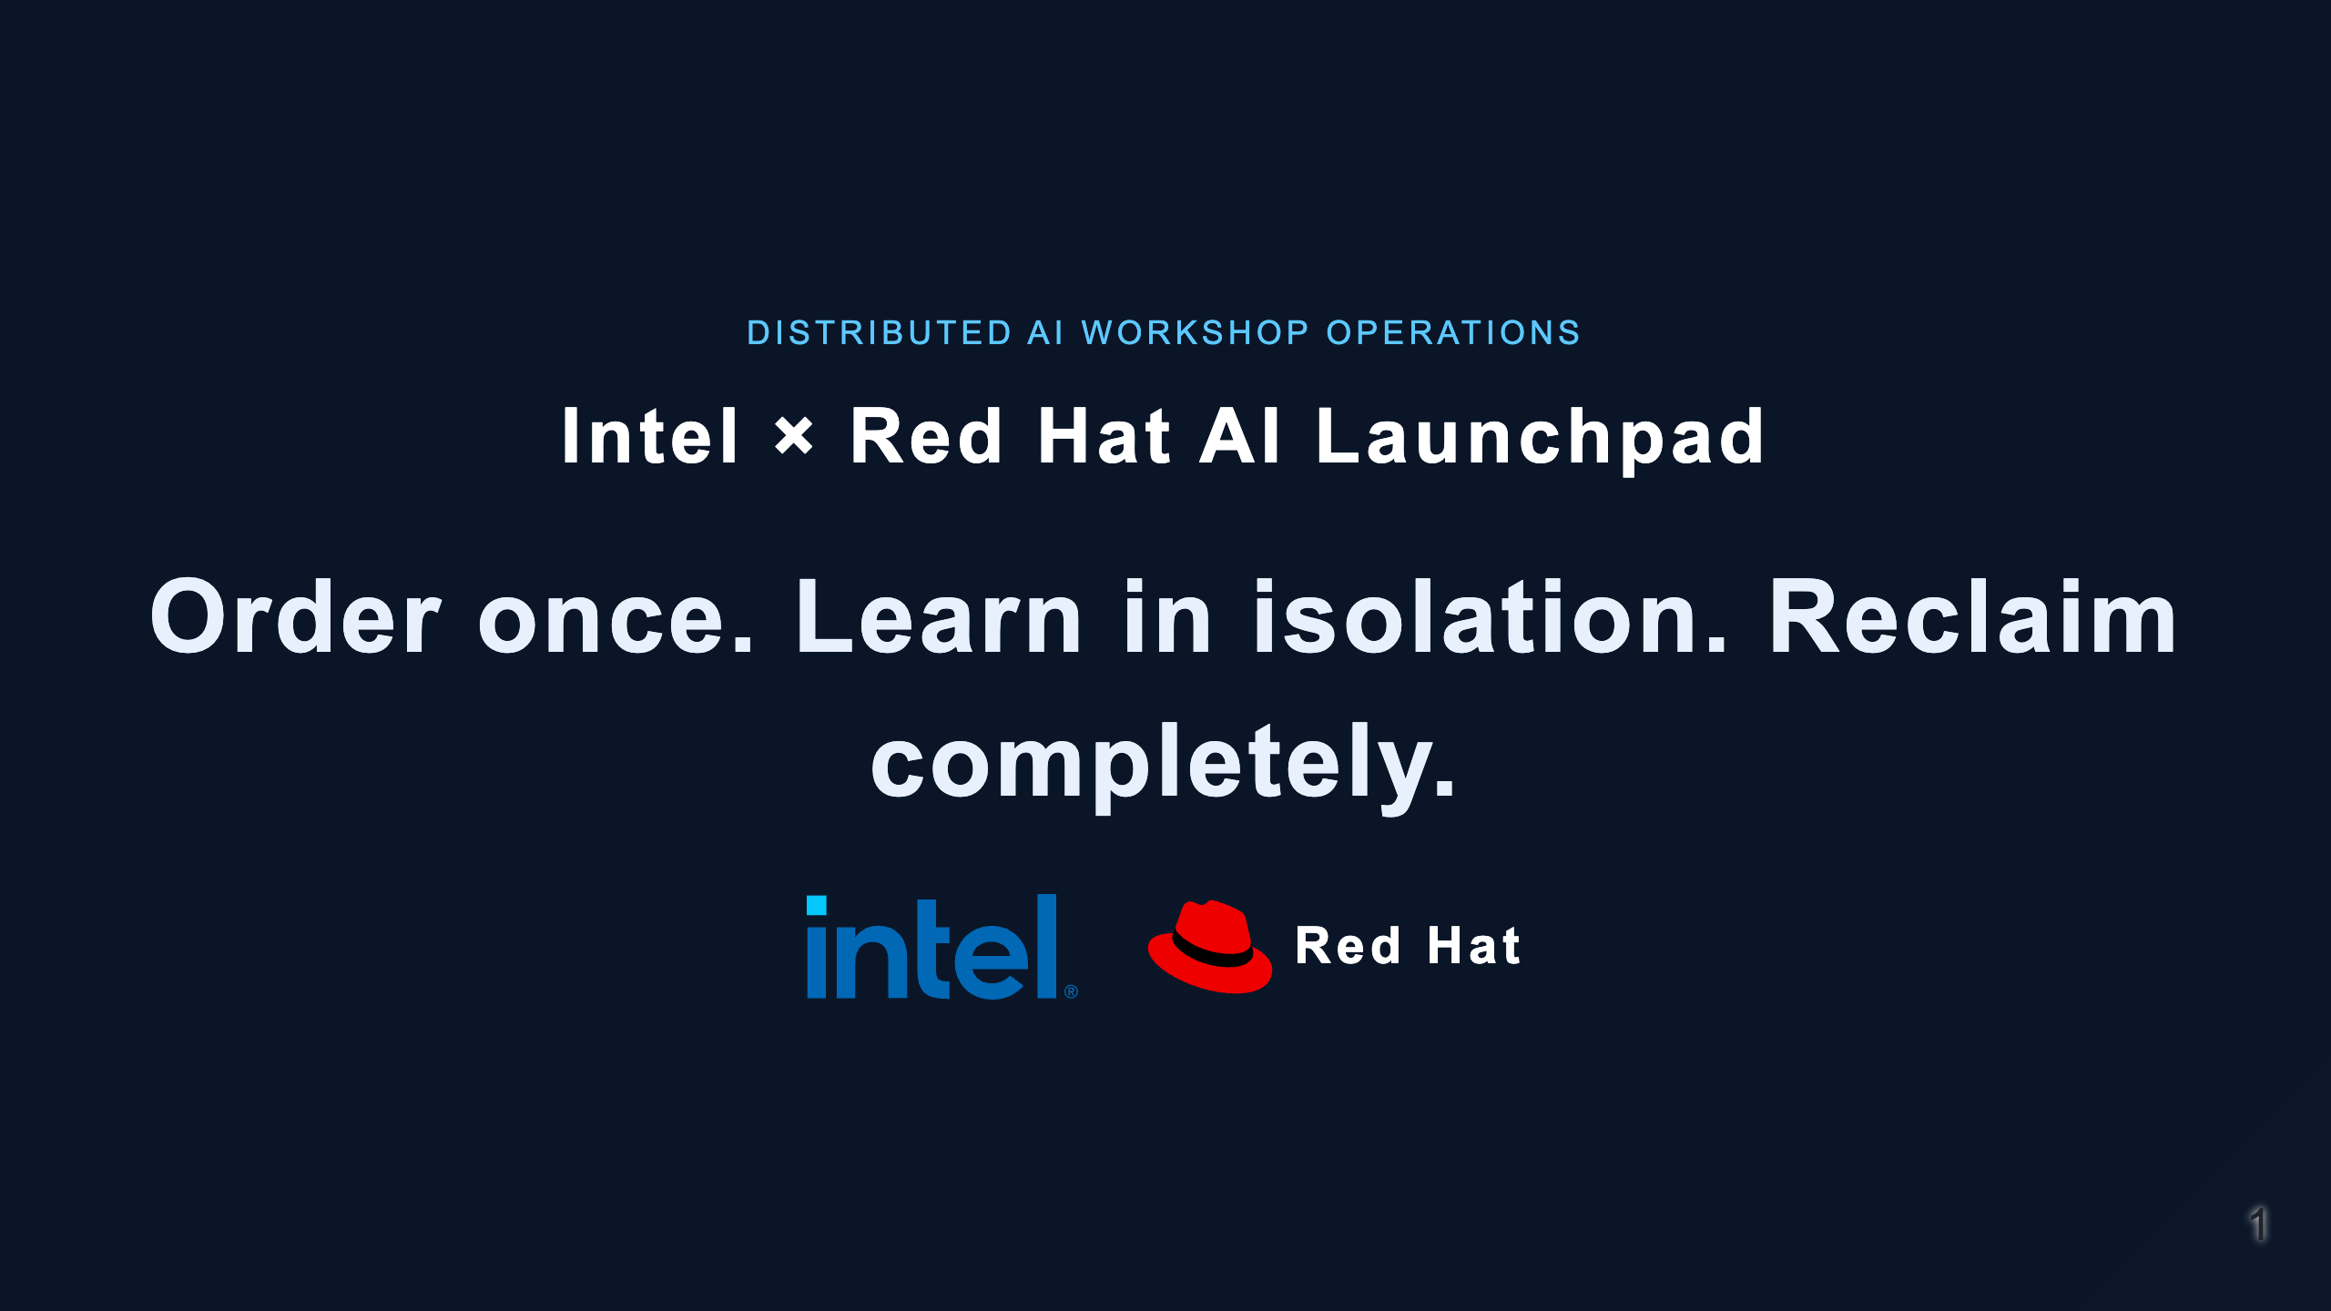
Notes:
Open with the operational problem, not the implementation. Launchpad turns a versioned lab into a repeatable distributed workshop lifecycle. This is a supervised internal pilot, not a GA announcement.

Slide 2
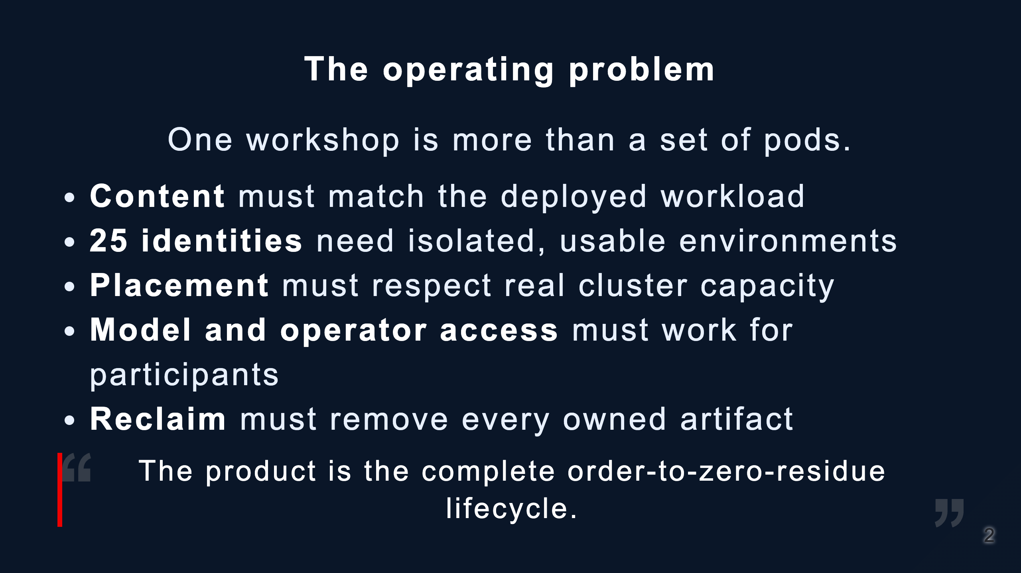
Notes:
Stress that pod readiness is not success. The learner journey, authorization, evidence, and cleanup are part of the product contract.

Slide 3
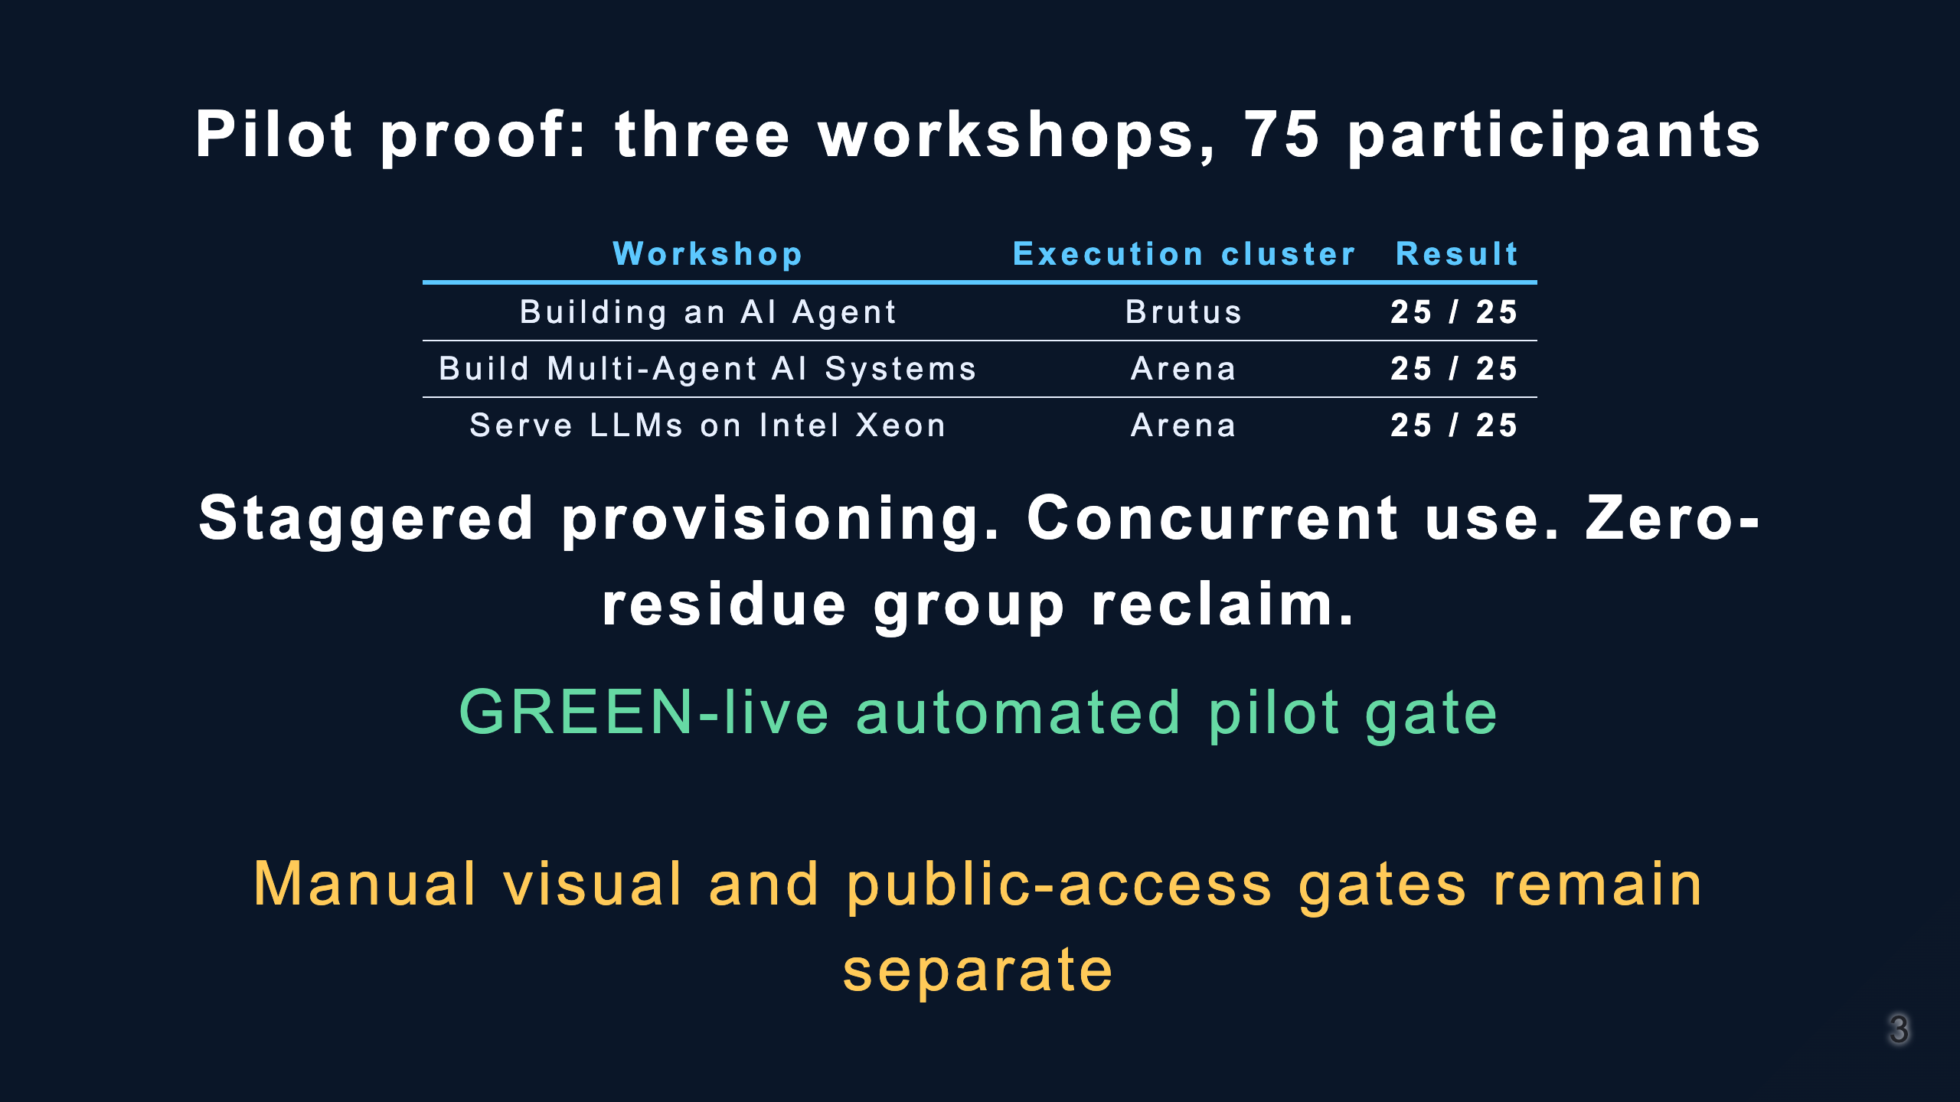
Notes:
Use the exact language: three orders were staggered, then all 75 participant environments ran together. Do not claim one arbitrary 75-seat workshop fits one cluster or that the service is production certified.

Slide 4
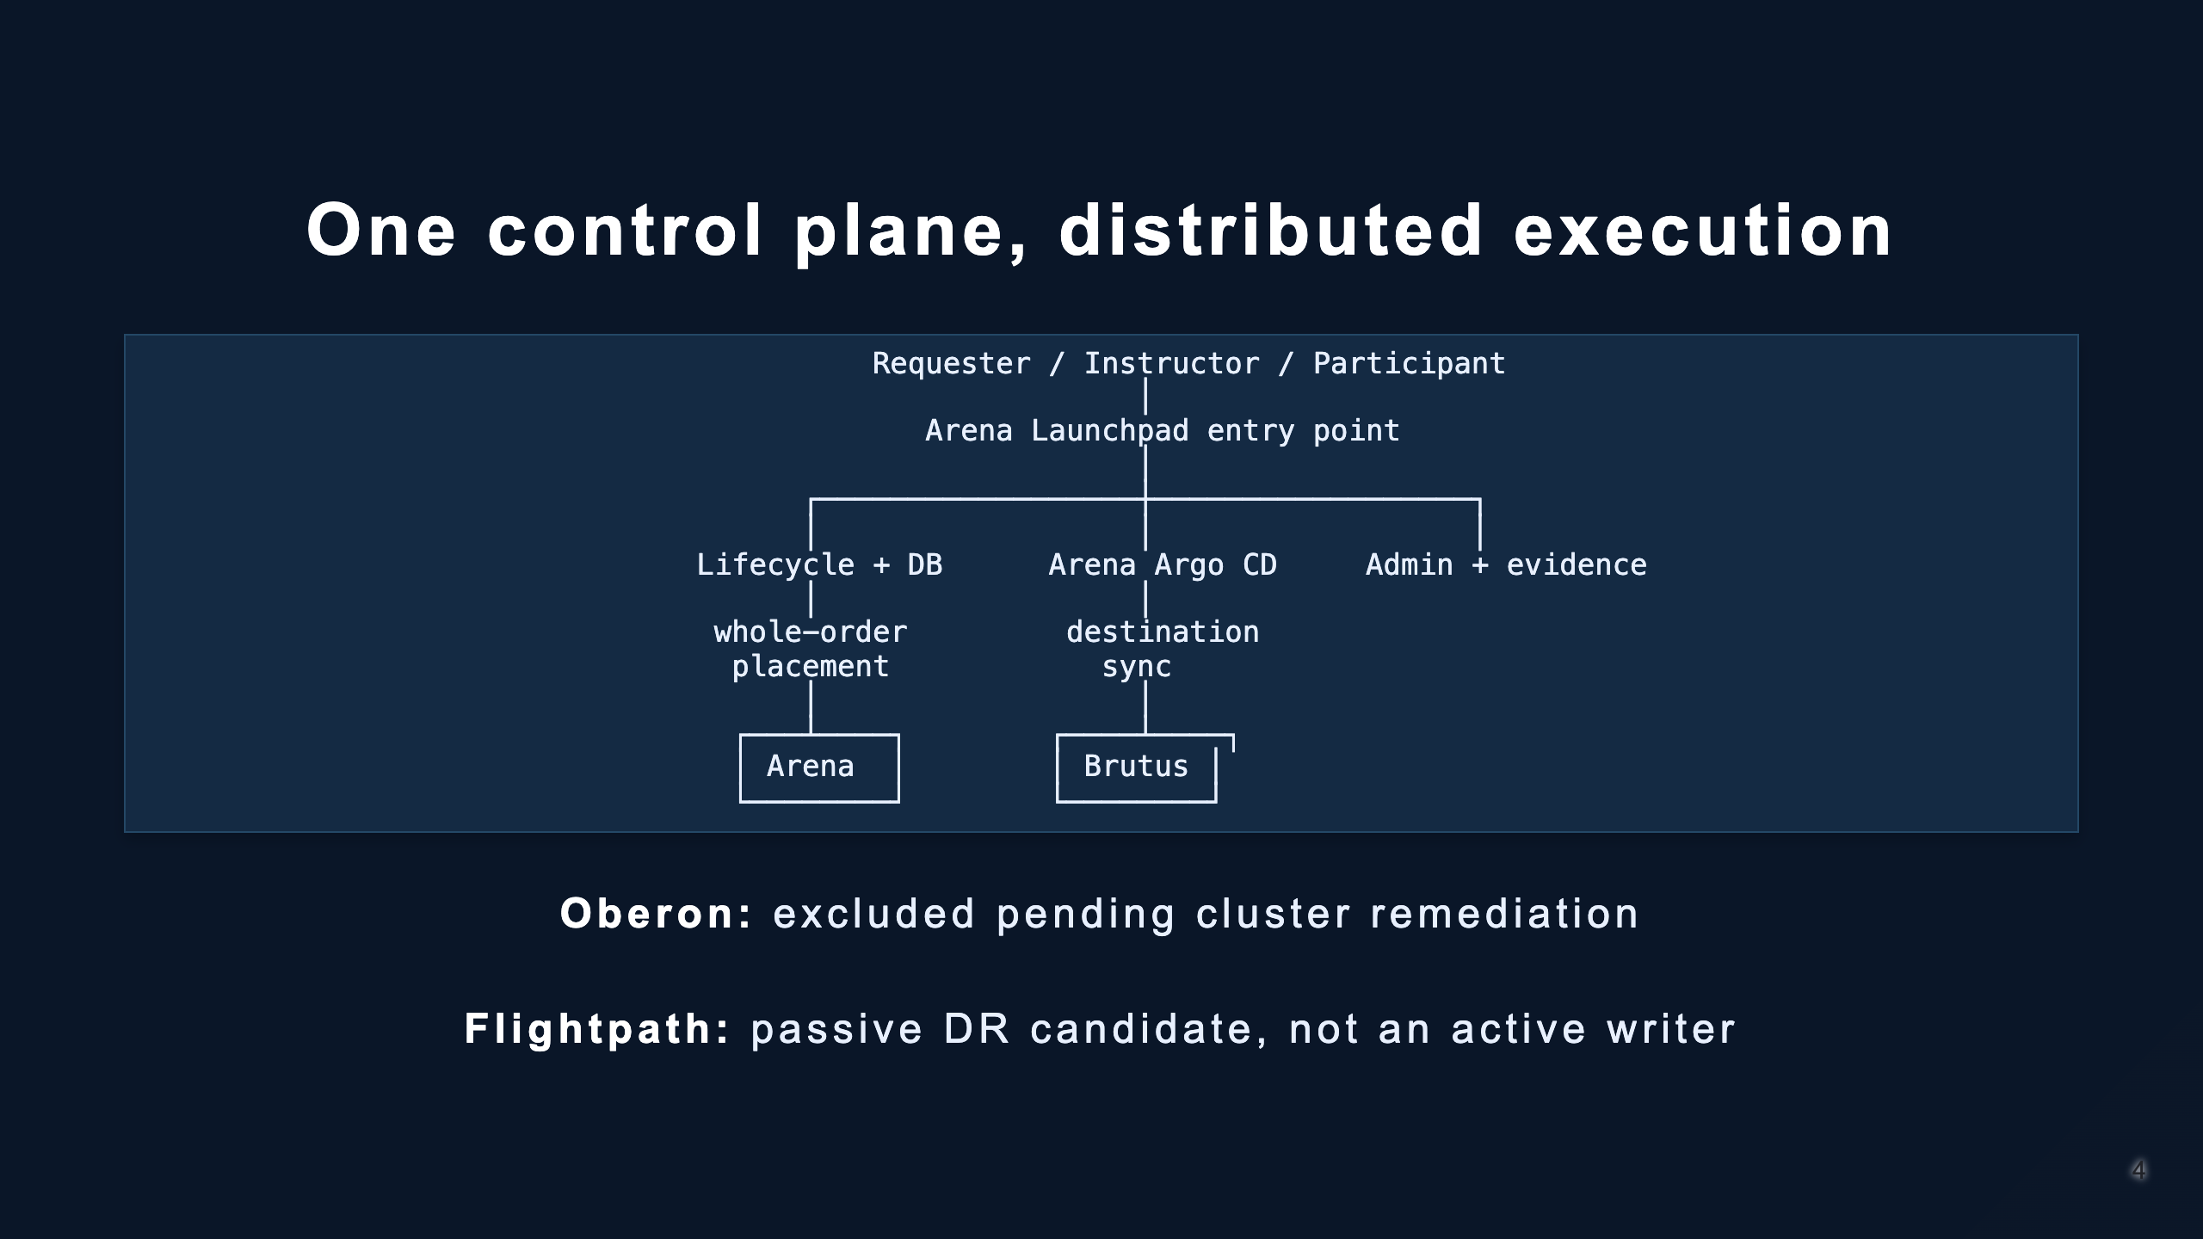
Notes:
Arena owns the current control plane. A single entry point does not mean one execution cluster. Placement is persisted before any seat resource is created.

Slide 5
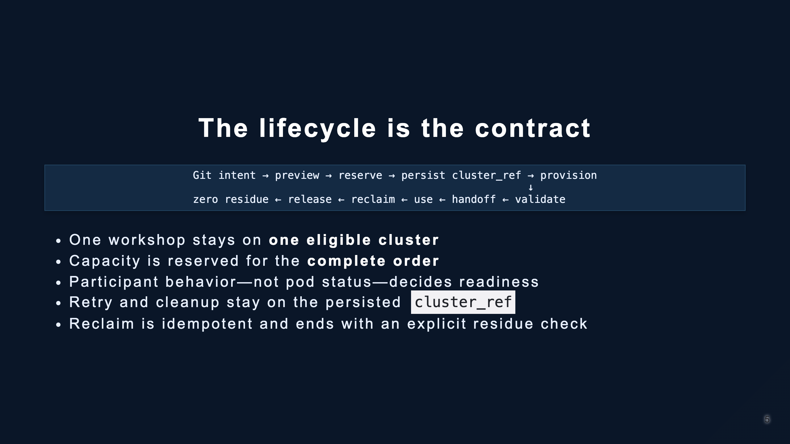
Notes:
If the whole workshop cannot fit, Launchpad rejects before creating seats. It never silently splits an order or retries cleanup against a different cluster.

Slide 6
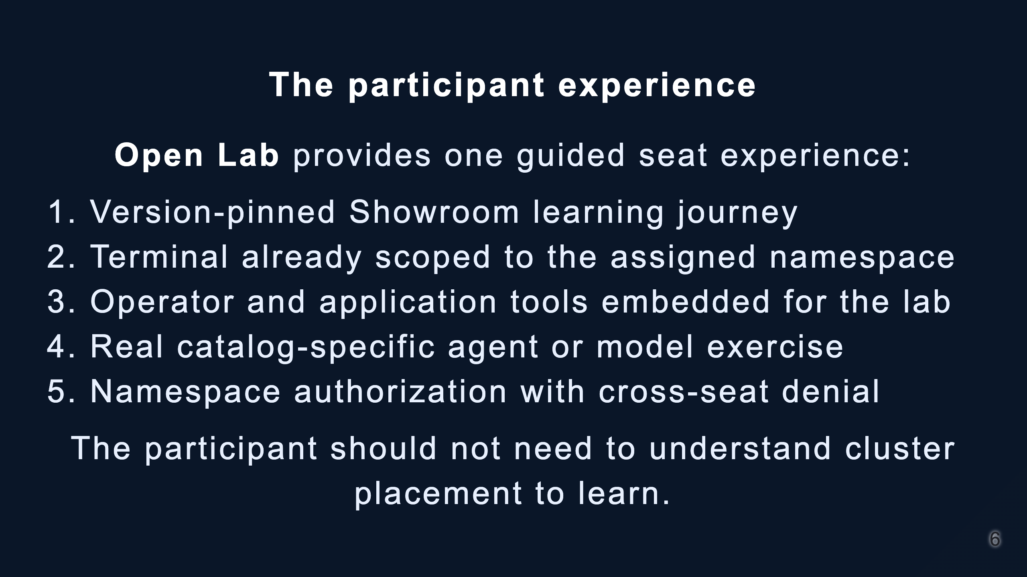
Notes:
During the demo, prove oc project, a permitted namespaced action, a denied cross-namespace action, and one real application/agent/model result.

Slide 7
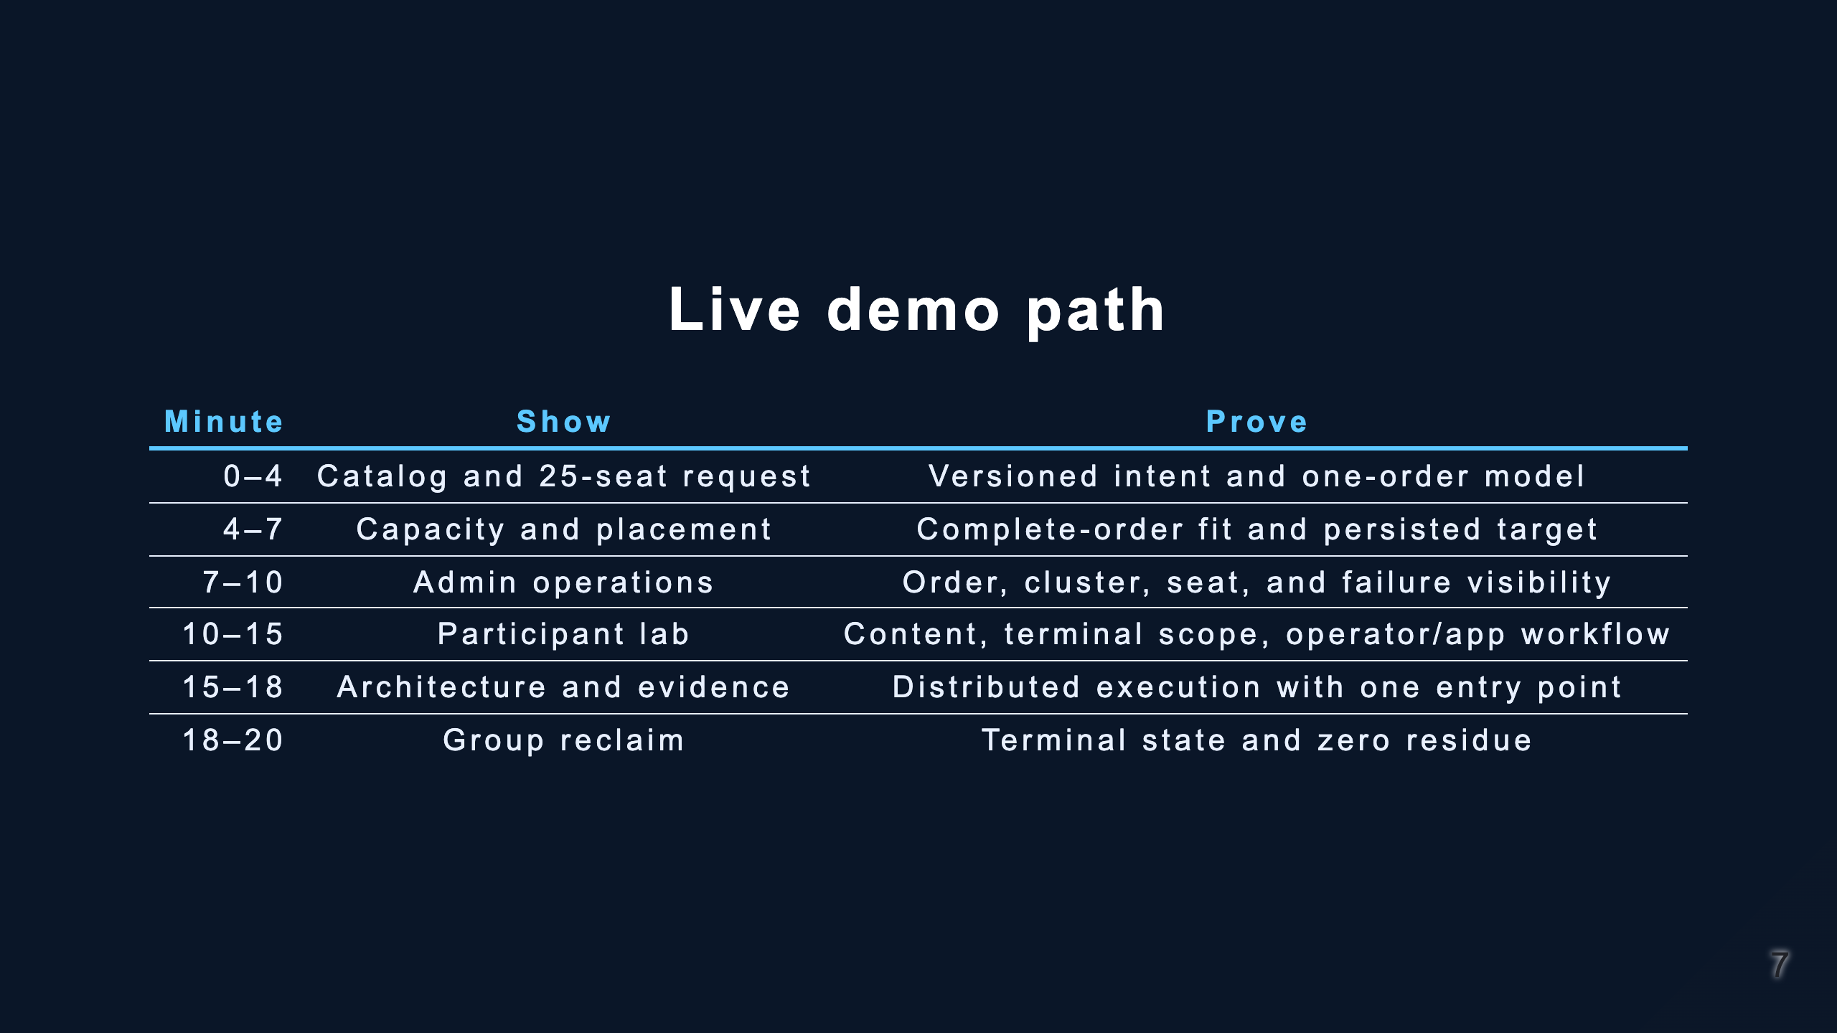
Notes:
Use docs/presenter-demo-walkthrough.md for preflight, exact operator cues, fallbacks, and the closing talk track.

Slide 8
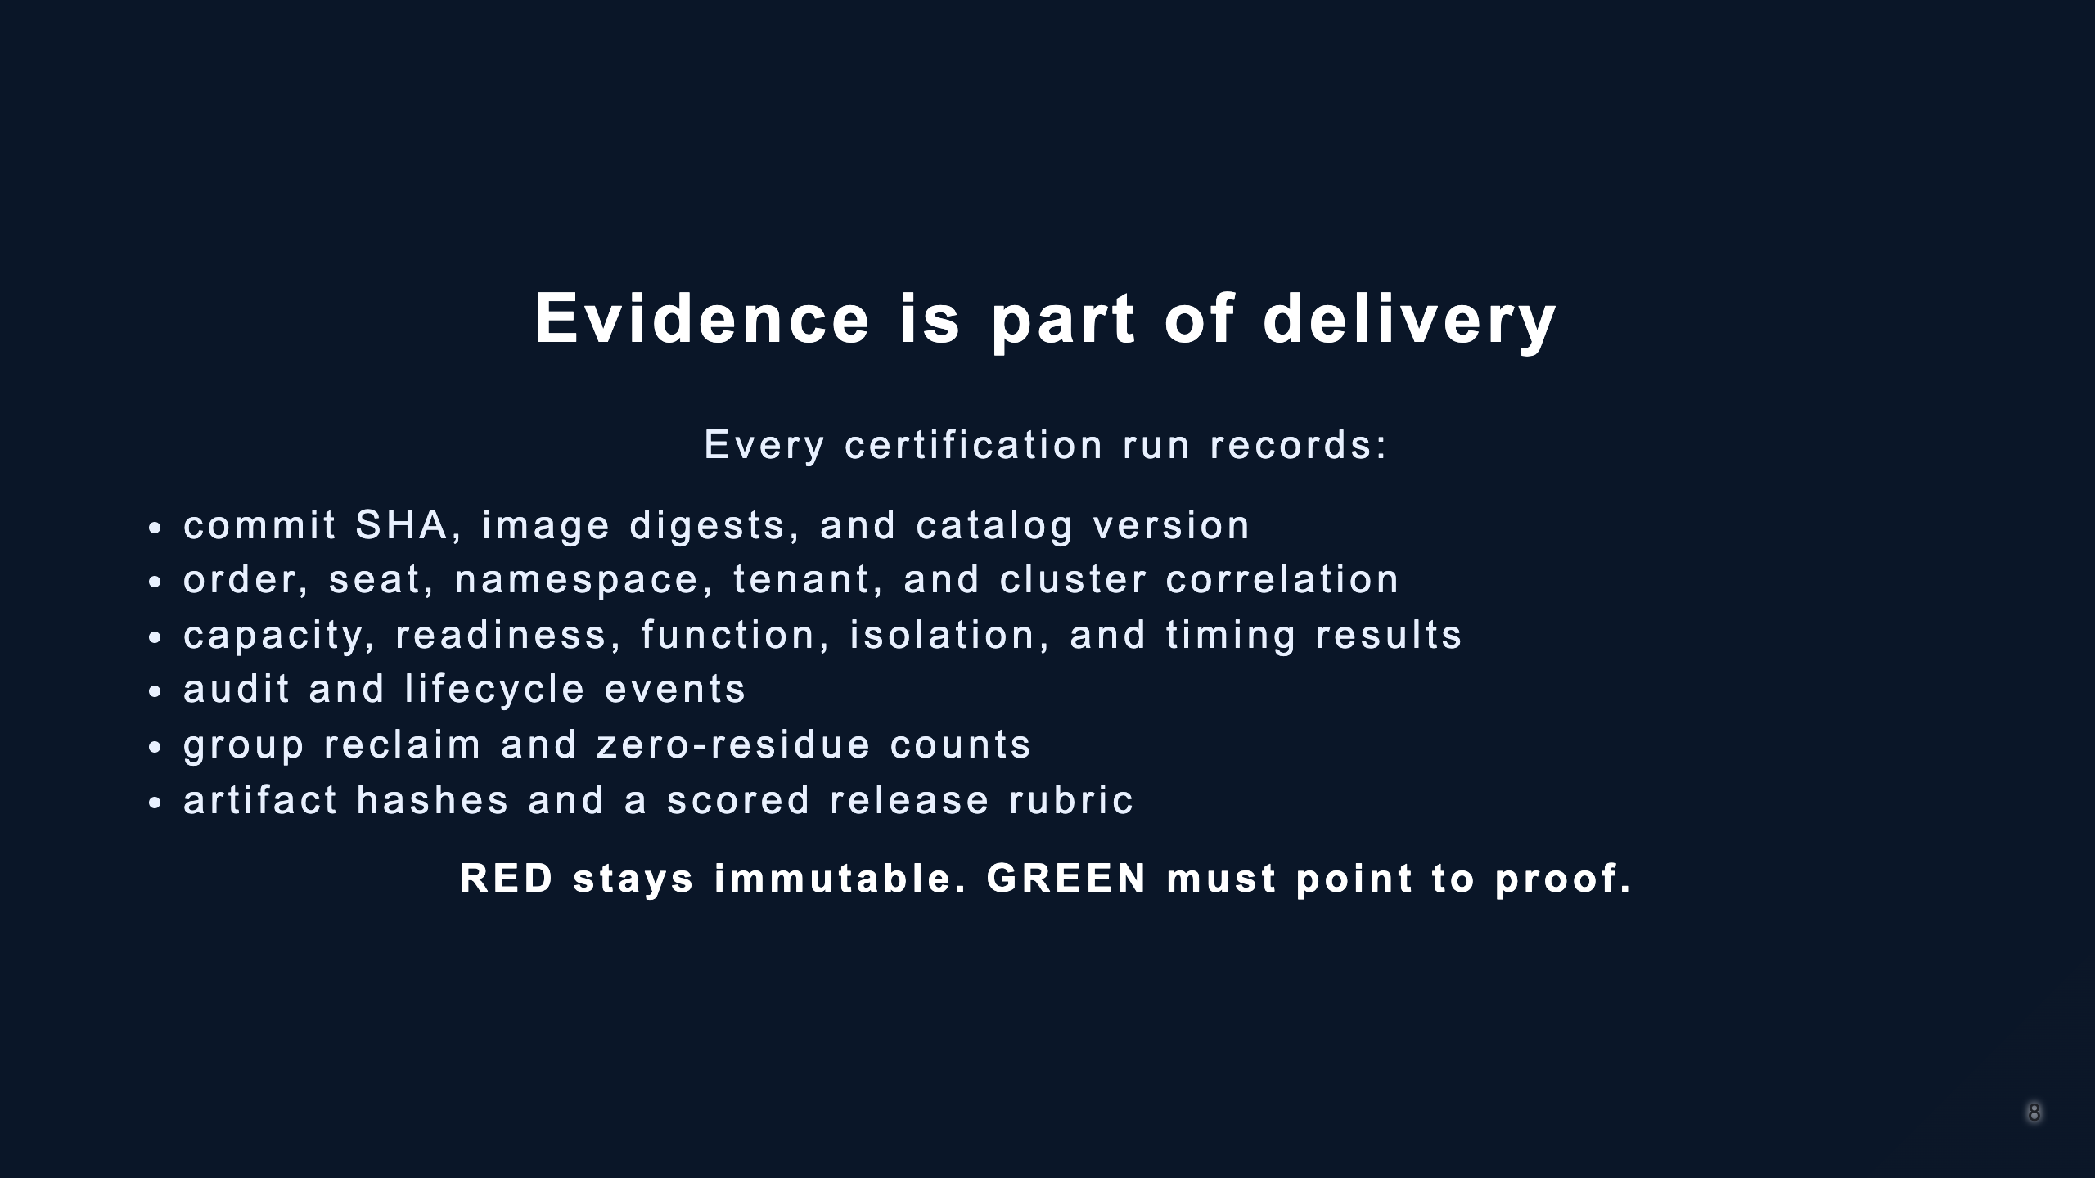
Notes:
This is the EDD portion of the delivery model. Defects first become a failing regression test; no evidence is replaced simply because a later run passes.

Slide 9
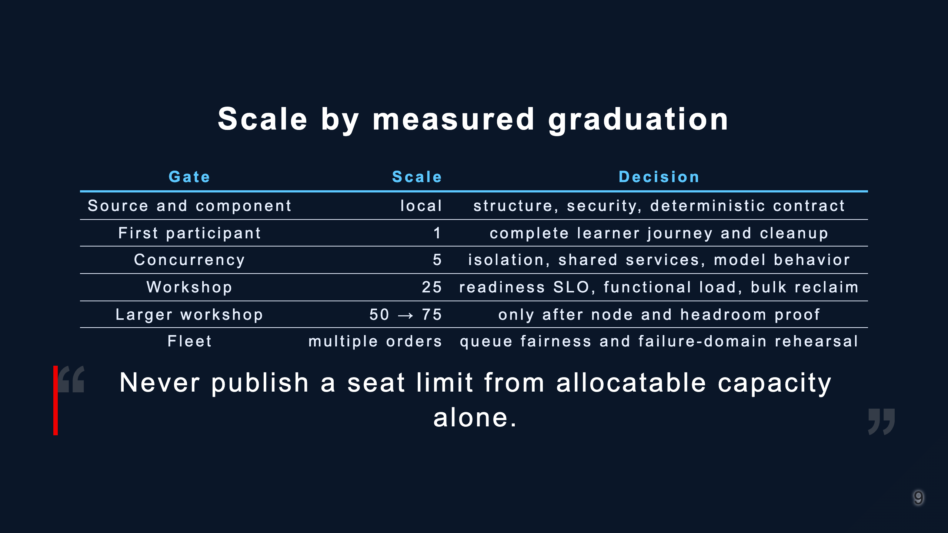
Notes:
The current event proof is three 25-seat orders across Arena and Brutus. A single-cluster 50- or 75-seat claim remains a future certification gate.

Slide 10
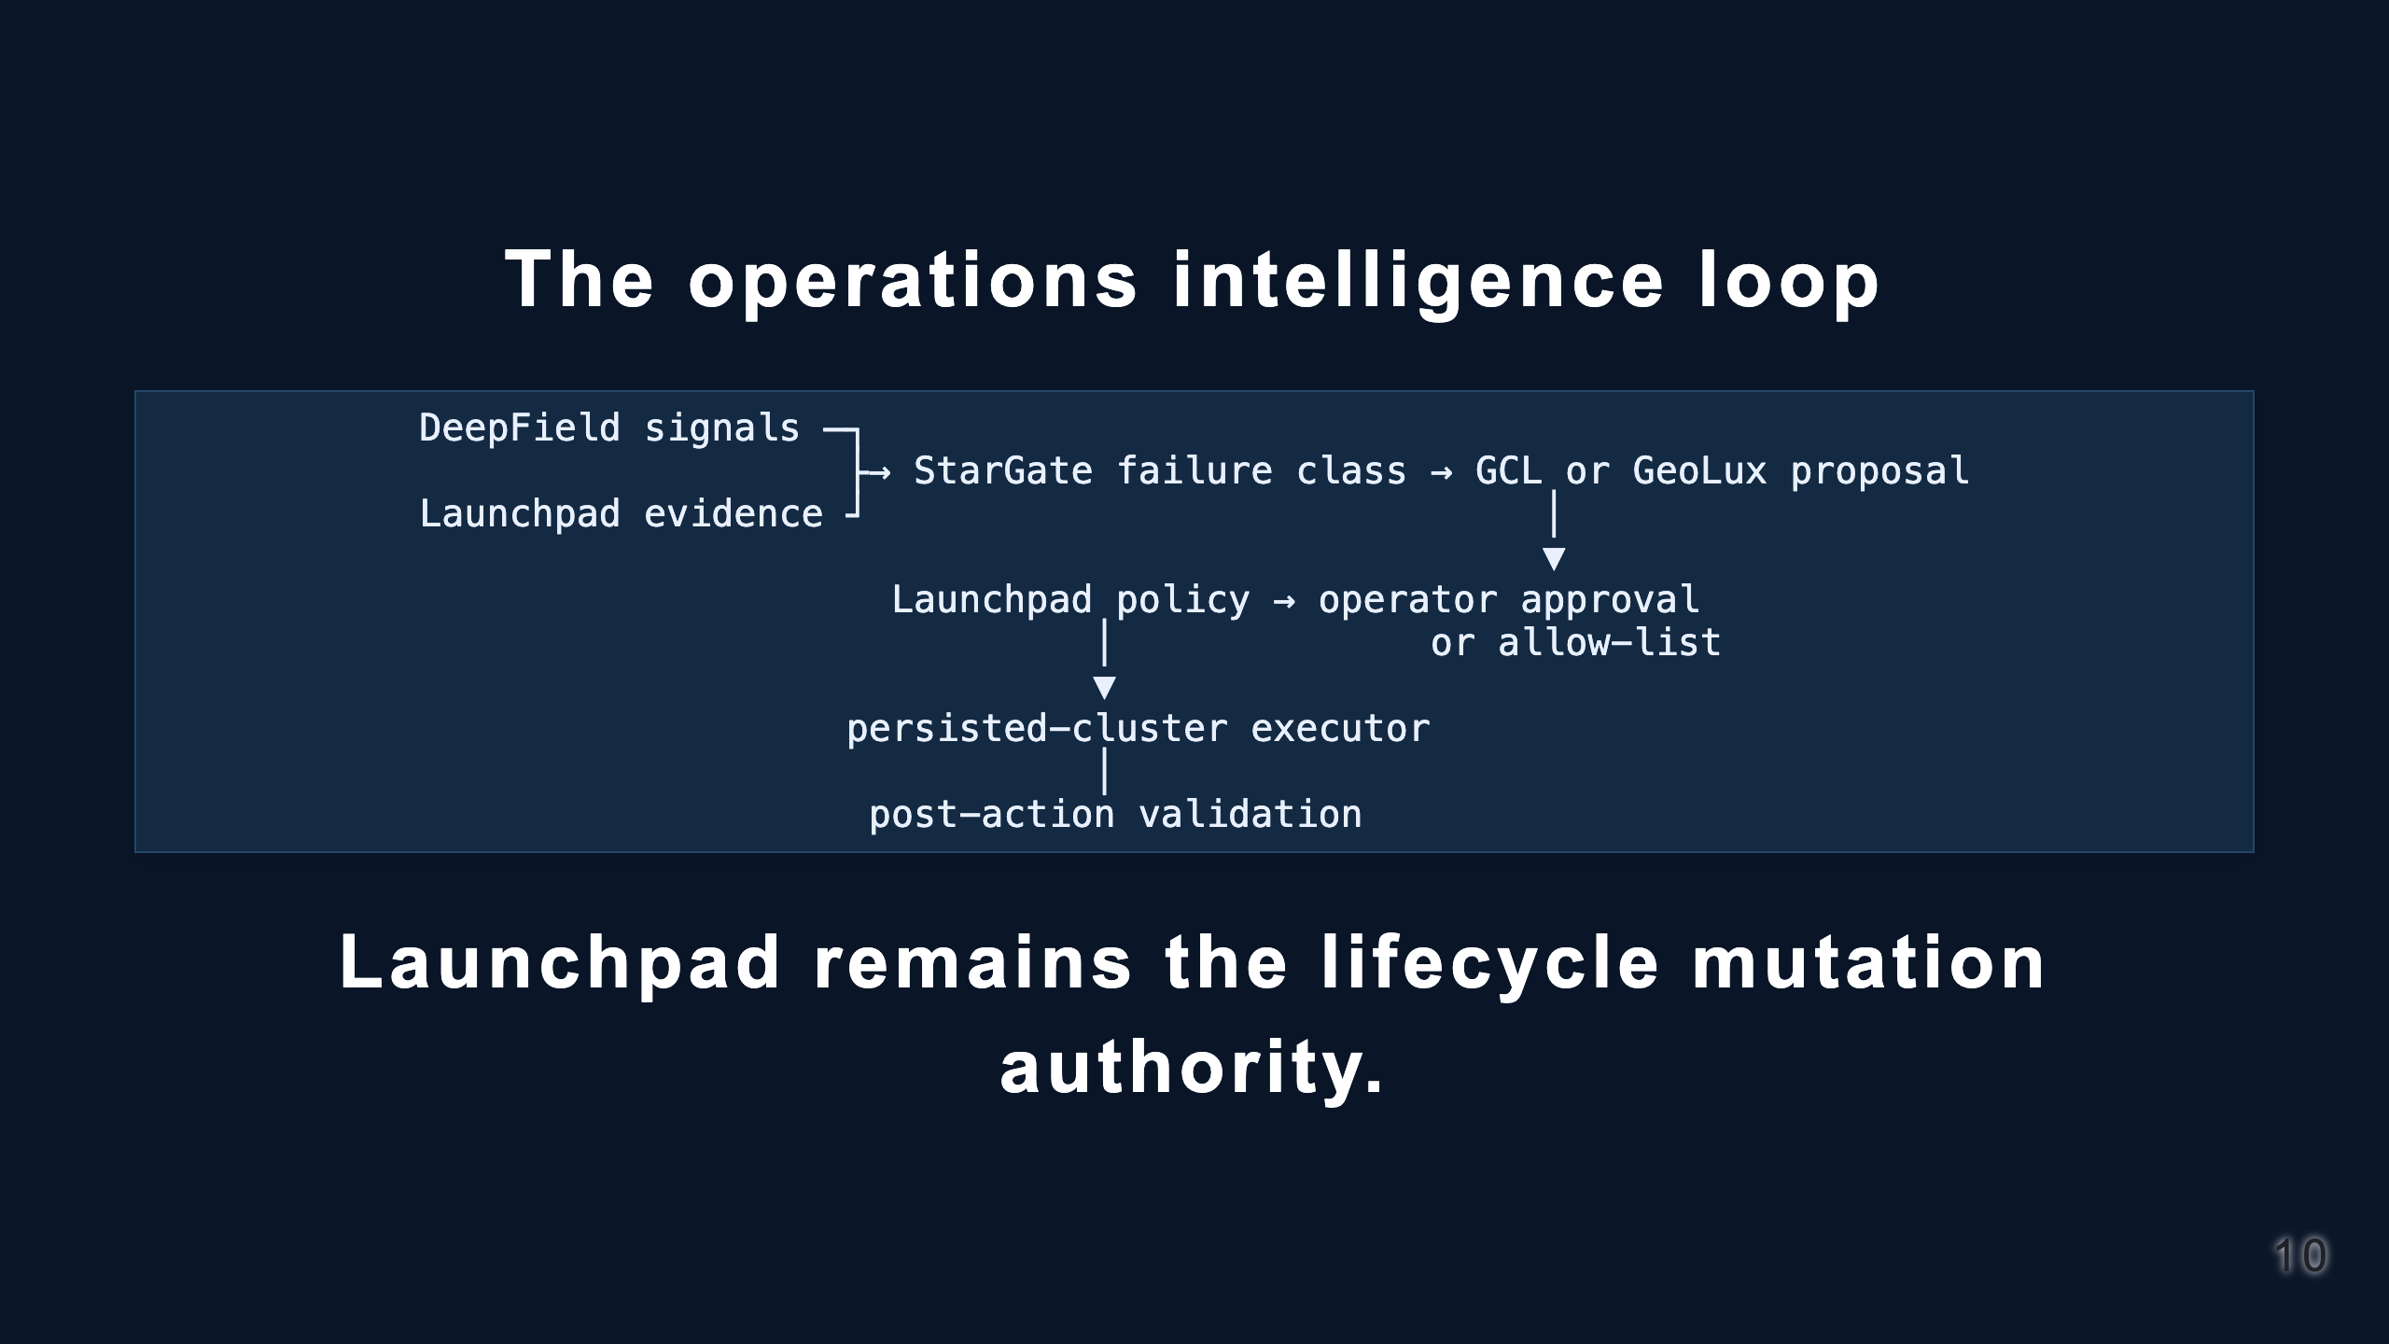
Notes:
DeepField provides fleet/network/inference signals. StarGate normalizes preflight and failure evidence. GCL or GeoLux is a future governed decision provider, not a second provisioner. The selection is intentionally unresolved.

Slide 11
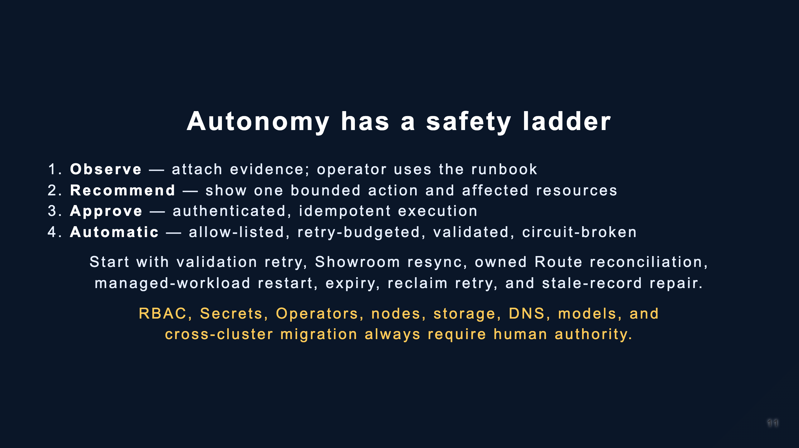
Notes:
Do not imply current autonomous remediation. The integrations are a graduated roadmap and every failure class earns its own promotion.

Slide 12
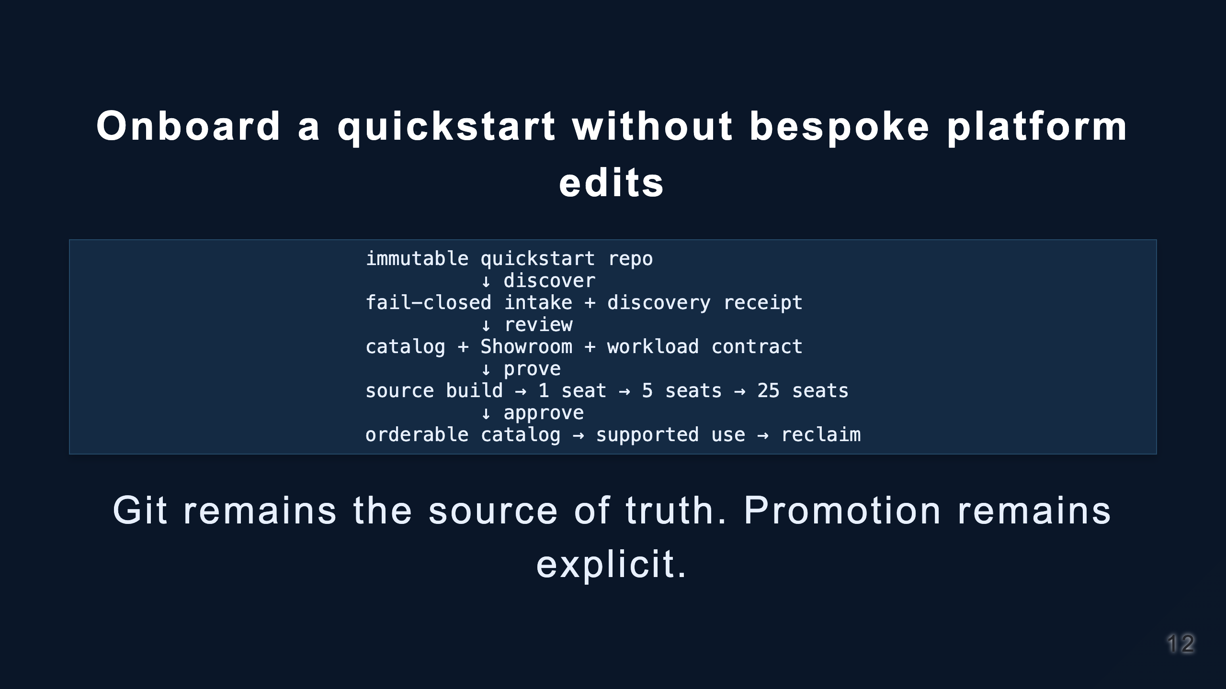
Notes:
Demonstrate scripts/catalog_onboarding.py scaffold. It discovers Antora and Helm/Kustomize/manifests, but never guesses models, resources, identity, tabs, or certification results.

Slide 13
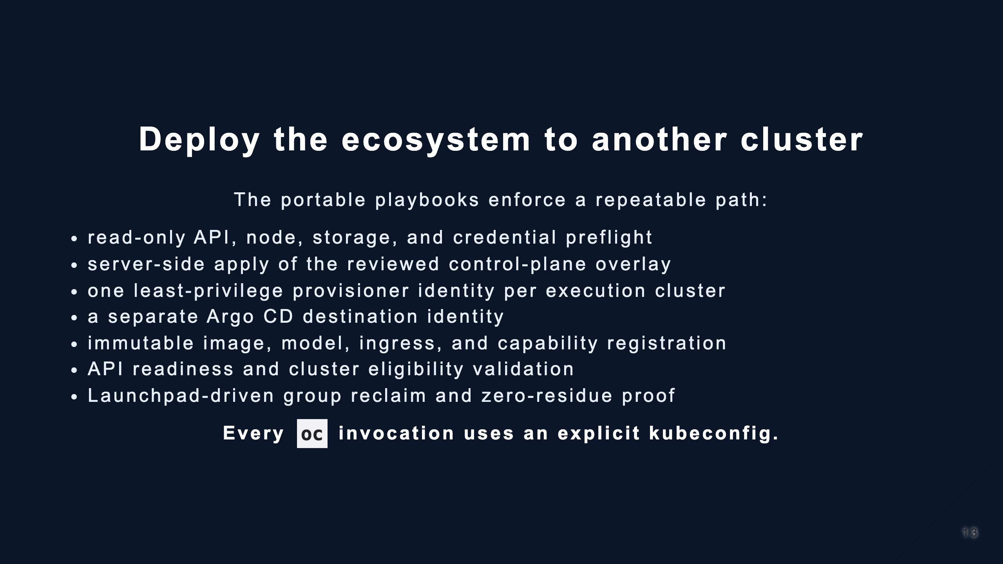
Notes:
Point to deploy/ecosystem. It is a thin orchestrator around repository-native contracts, not a new AgnosticD implementation and not a kubeadmin workflow.

Slide 14
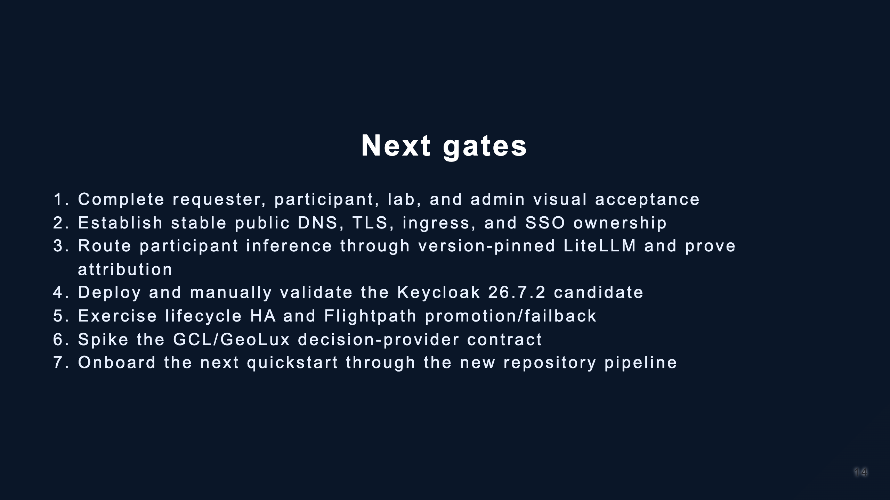
Notes:
These are deliberate release gates, not hidden defects. The internal 3x25 automated pilot proof remains valid while these paths graduate independently.

Slide 15
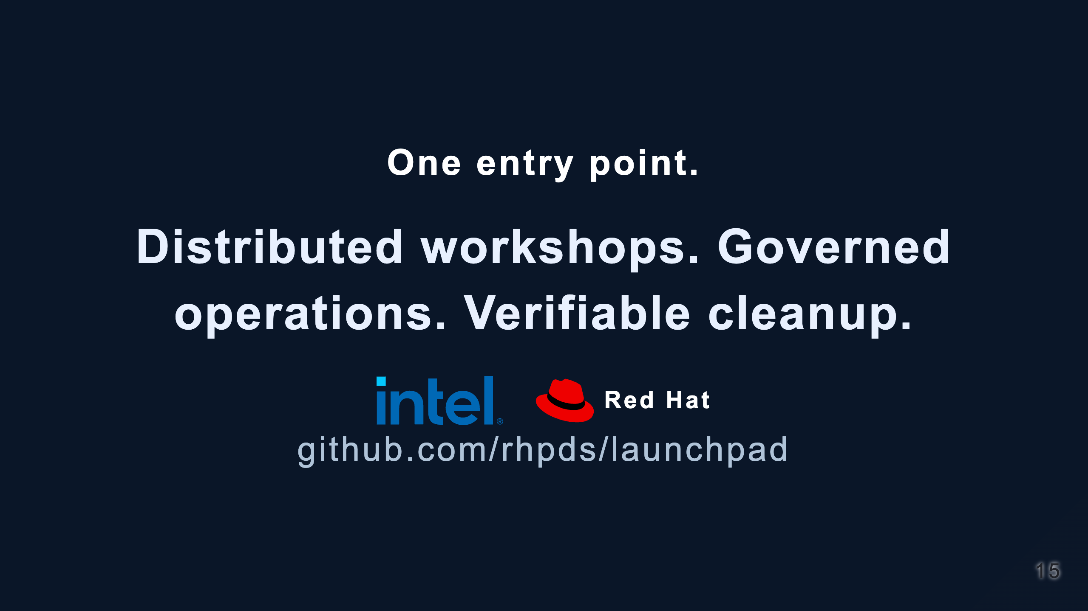
Notes:
Close on the operating model: reusable content plus lifecycle proof. Offer the live demo or architecture deep dive depending on the audience.

