Slide 1

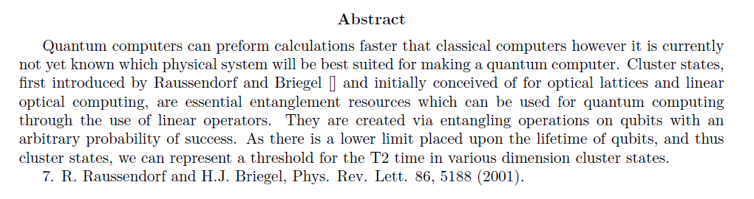
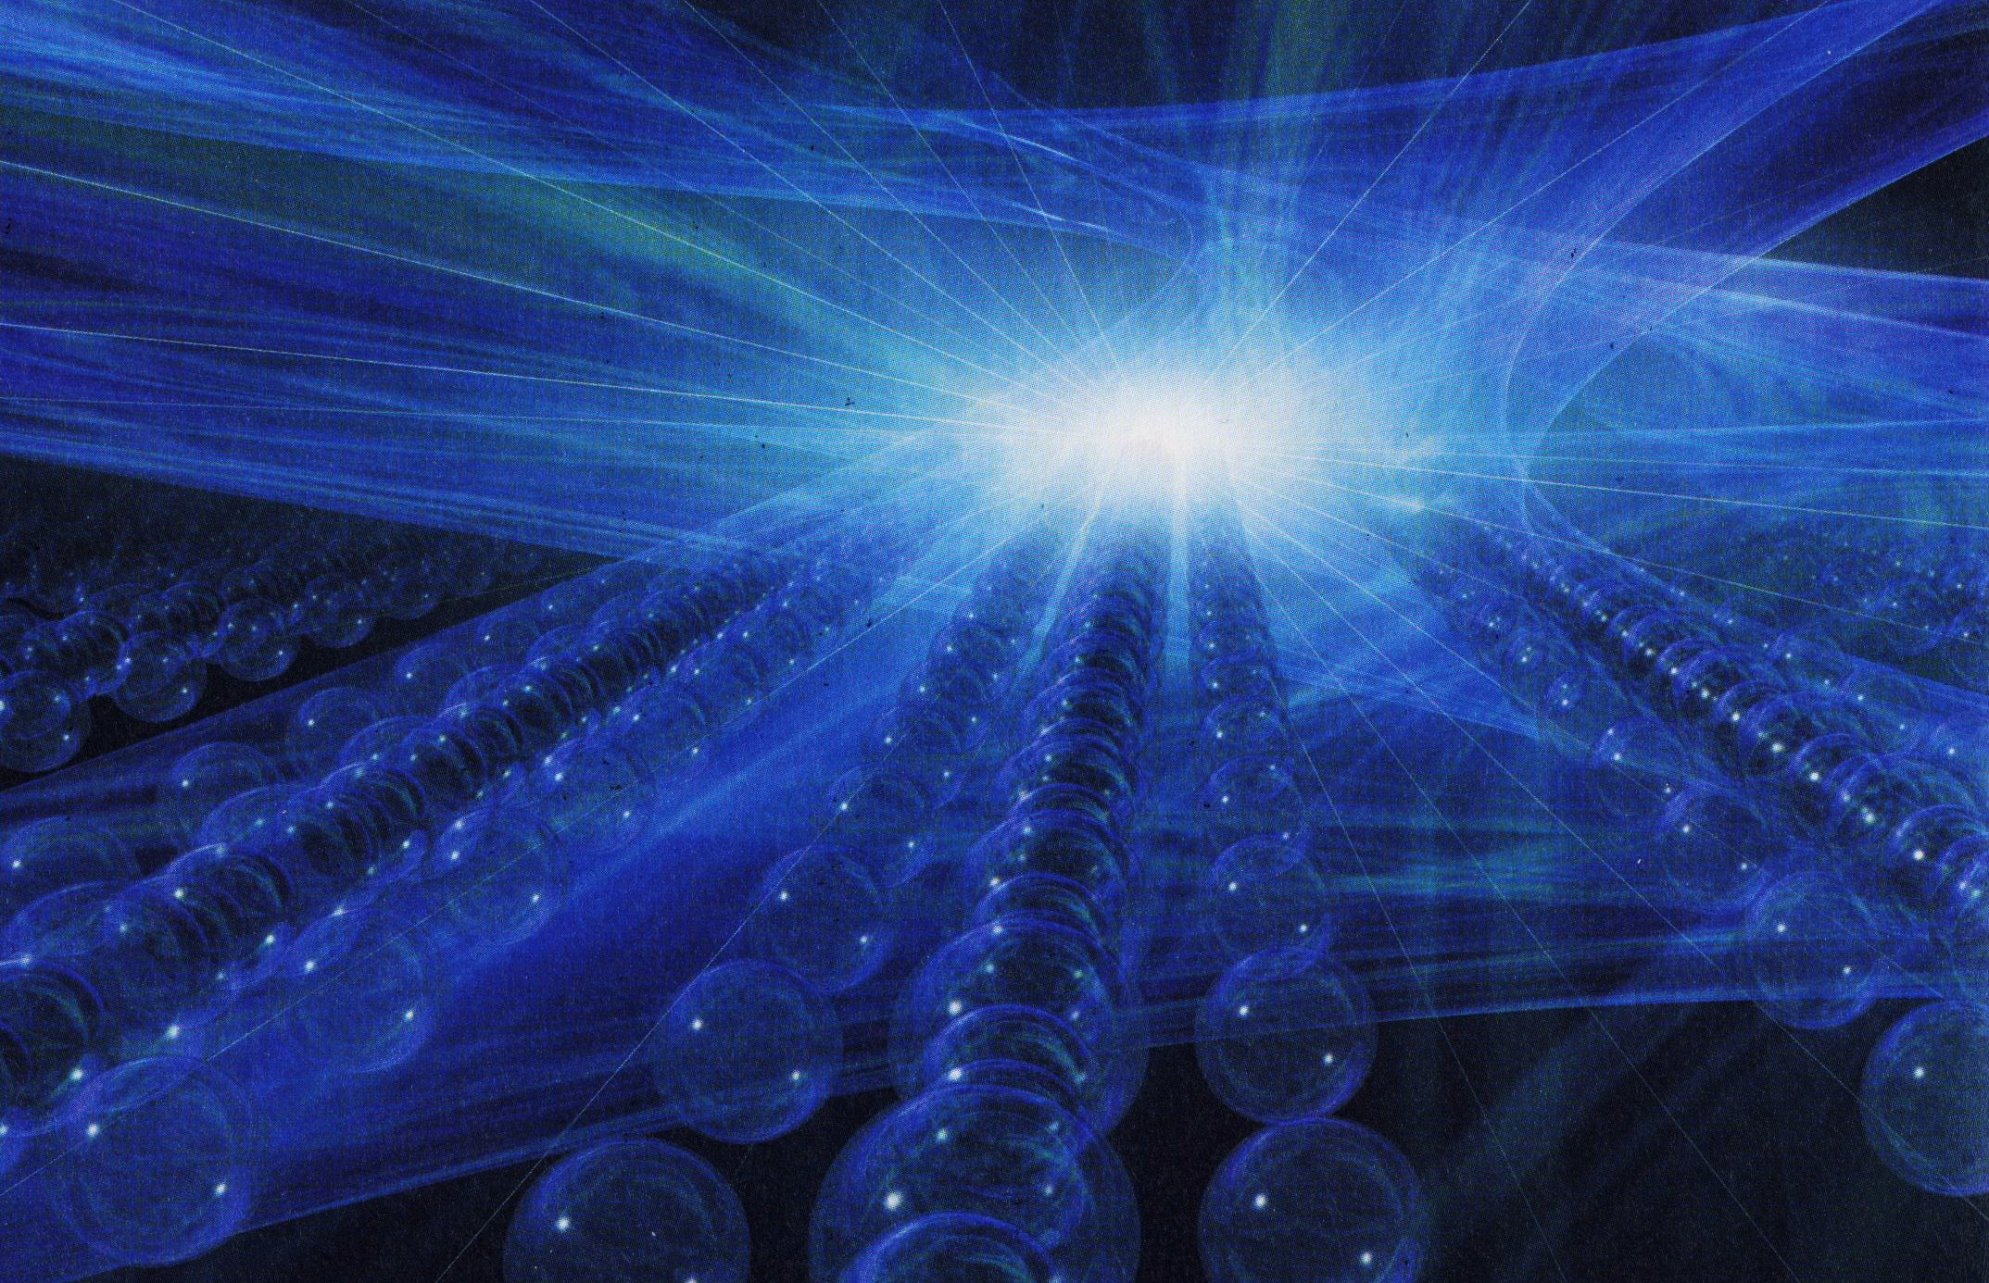
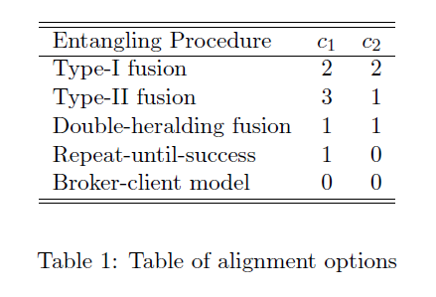
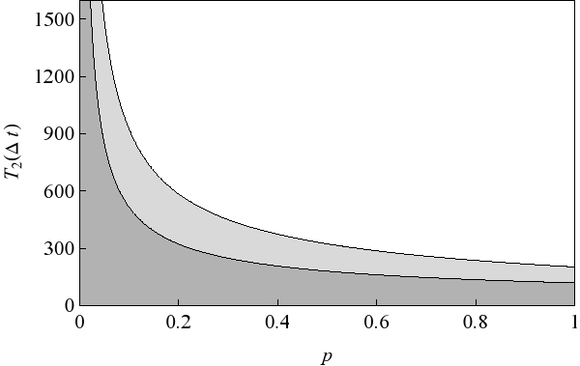
Abstract
Measurement Based Quantum Computing
Production of an improved batch of stronger PDEAEMA gels by reducing the concentration of cross-linker (EGDMA) in the solution.
Further adhesion measurements of both PMAA and PDEAEMA using steel probes in solutions of varying pH.
Further adhesion measurements between PMAA gels and PDEAEMA brush & PDEAEMA gels and PMAA brush in solutions of varying pH.
Adhesion measurements between PMAA gels and PDEAEMA gels in solutions of varying pH.
Entanglement
Temporal Information Flow
ΔN
Picture acknowledgements
Entanglement
M
N
m
Results
Method
References
Production of an improved batch of stronger PDEAEMA gels by reducing the concentration of cross-linker (EGDMA) in the solution.
Further adhesio

Slide 2
Temporal Information Flow
ΔN
M
N
m

