Slide 1
CONCLIFE: Service Life Predictions for Concrete Pavements and Bridge Decks Exposed to Sulfate Attack and Freeze-Thaw Deterioration
Software prepared for the FHWA by:
Building and Fire Research Laboratory
2001

Slide 2
What is CONCLIFE?
WindowsTM-based software for estimating the service life of concrete pavements and bridge decks
  limited to degradation mechanisms of sulfate attack and freeze-thaw deterioration
  considers only transport due to sorption (rainfall and condensation) by partially saturated concrete
  uses “real” weather data from a wide variety of U.S. geographical locations

Slide 3
Overall Project Objective
Determine relationships between
service life and transport properties
Assess relevance of current tests
for measuring transport properties
Develop guidelines and software (CONCLIFE) for selecting, using, and interpreting the results of recommended test methods.

Slide 4
Transport Mechanisms
With project limited to transport mechanisms other than diffusion, determined that sorption by partially saturated concrete is most relevant transport mechanism for pavements and bridge decks
No standard test for sorptivity exists at present
  proposed ASTM standard test method to ASTM Committee C 09 as part of overall project
    currently 2nd draft is under balloting

Slide 5
Sorptivity test method
Pre-condition the specimen to constant RH
  3 days at 50 ºC and 80 % RH
  15 days in closed container to constant RH
Sorption measurement
  (ponding most relevant for CONCLIFE)
Capillary
Ponding

Slide 6
Sorptivity (Ponding test setup)
All vertical surfaces are covered with a high-quality tape
The bottom surface is protected with saran wrap held by a rubber band
A watertight dike should be built “above” the specimen
Weigh the specimen regularly after removing the water and patting dry the top surface
Calculation:
  Slope of mass/surface area vs. square root of time

Slide 7
Three major sub-models in CONCLIFE
Heat transfer model for predicting concrete surface temperature, time-of-wetness, and time-of-freezing
Sulfate attack model
Freeze-thaw deterioration model

Slide 8
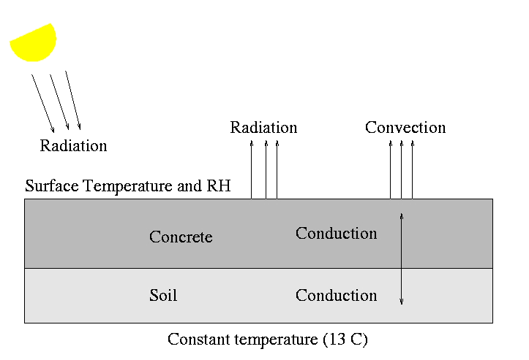
Heat Transfer Model for Pavements

Slide 9
Heat Transfer Model Features - I
1-D finite difference scheme
includes heat transfer due to conduction, convection, and radiation
utilizes Typical Meteorological Year (TMY2DATA) weather data from the National Renewable Energy Laboratory (239 stations nationwide- http://www.nrel.gov)
predicts surface temperature, time-of-wetness due to both precipitation and condensation, and time-of-freezing
Notes:
The model is a standard 1-D finite difference model and includes all the likely
sources of heat transfer: conduction within the concrete and soil subbase,
convection to the environment, incoming solar radiation, and radiation from
the concrete to the “sky”
One key was finding realistic weather data for locations throughout
the US. Fortunately, the NREL had already taken care of this for us and
distributes the files on a CD-ROM for a large number of US geographical
locations.

Slide 10
Heat Transfer Model Features - II
Convection coefficient based on equations provided in FEMMASSE software (Dutch company INTRON) --- similar to those used in HIPERPAV (FHWA product)
Radiation from concrete to (night) sky based on equations developed by Walton at NIST (for roofing and other applications)
Details at: http://ciks.cbt.nist.gov/bentz/nistir6551

Slide 11
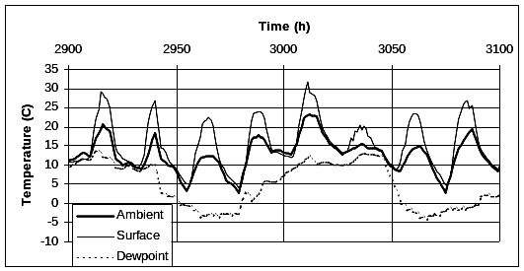
Temperature Predictions for Concrete Pavement in Providence, RI (Spring)

Slide 12
Connection to Overall Project
Time-of-wetness and time-of-freezing files are used as inputs to the CONCLIFE system to predict service life under conditions of sulfate attack and freeze-thaw deterioration
Sorptivity coefficients are adjusted for concrete surface temperature (based on surface tension and viscosity of water as a function of T) and ambient RH (based on lab testing results) prior to the start of the wetting event
Notes:
Hopefully, this will link to the latest lab results for sorptivity measured at different temperatures! Also important to measure sorptivity at a low
enough internal RH (e.g., 60 %) so that intermediate RH sorptivities can be interpolated between this measured value and an assumed sorptivity of
zero at 100 % RH.

Slide 13
Sulfate Attack Model - Basics
Based on model of Atkinson and Hearne
  modified to consider sorption as the dominant transport mechanism (instead of diffusion)
  sulfate ions penetrate due to sorption and react with cement to form expansive ettringite causing spalling of concrete layers
  Atkinson, A., and Hearne, J.A., Mechanistic Model for the Durability of Concrete Barriers Exposed to Sulphate-Bearing Groundwaters, MRS Symp. Proc., Vol. 176, 149-156, 1990.
X_{spall} = (2αγ_{f}(1-υ))/(E(βC_{E})²

Slide 14
Sulfate Attack Model- Procedure
Penetration depth calculated based on sorptivity coefficient at current concrete surface temperature, current “duration” of time-of-wetness, and concrete porosity
Sulfate concentrations down to the penetration depth updated based on sulfate content of “sorbed” water and concrete porosity
Critical buildup of sulfate (ettringite) results in spalling at depth x
When cumulative spalling depth (x₁ + x₂ +…) exceeds user-specified failure criteria, service life is reached

Slide 15
Freeze-Thaw Deterioration Model - Basics
Based on critical saturation concept of Fagerlund in Sweden
Assumes that sorption after the nick-point in the sorption vs. time curve is due to the slow imbibition of water by the concrete air void system
At a critical saturation level, the air void system is compromised and the next freezing event will result in the initiation of cracking (considered to be equal to the service life)

Slide 16
Freeze-Thaw Deterioration Model- Procedure
If duration of current time-of-wetness event is greater than nick-point time, compute depth of penetration based on sorption coefficient and concrete porosity
Update air void saturation down to current depth of penetration based on concrete porosity and air void content
If saturation at some depth is greater than critical saturation, update “spalling” depth
Once again, when cumulative spalling depth (x₁ + x₂ +…) exceeds user-specified failure criteria, service life is reached

Slide 17
Inputs for CONCLIFE
Weather data (based on geographical location)
  sulfate ion concentration in rainwater, etc.
Pavement or bridge deck dimensions (and thermal properties)
Early and late age concrete sorptivity functions
  W/(ρA) = I₀ + S√t
Mechanical properties of concrete
  elastic modulus
  fracture energy
Concrete porosity and air void content

Slide 18
Auxiliary Features of CONCLIFE
User can create own weather data files based on geographical location, system geometry and concrete/soil thermal properties
User can analyze laboratory sorptivity data to determine “best-fit” sorptivity functions
User can view U.S. map of weather data locations, graph of wetting events, graph of sorptivity function, or graph of spalling predictions

Slide 19
User’s Manuals for CONCLIFE
Ehlen, M.A., and Bentz, D.P., “Service Life Predictions for Concrete Pavements and Bridge Decks Exposed to Sulfate Attack and Freeze-Thaw Deterioration, Volume I: CONCLIFE User’s Manual,” 2001.
Bentz, D.P., Ferraris, C.F., and Winpigler, J., “Service Life Predictions for Concrete Pavements and Bridge Decks Exposed to Sulfate Attack and Freeze-Thaw Deterioration, Volume II: Technical Basis for CONCLIFE: Sorptivity Testing and Computer Models,” 2001.

Slide 20
Additional Reports from the Project
1) Bentz, D.P., Clifton, J.R., Ferraris, C.F., and Garboczi, E.J., “Transport Properties and Durability of Concrete: Literature Review and Research Plan,” NISTIR 6395, U.S. Dept. of Commerce, Sept. 1999.
2) Bentz, D.P., “A Computer Model to Predict the Surface Temperature and Time-of-Wetness of Concrete Pavements and Bridge Decks,” NISTIR 6551, U.S. Dept. of Commerce, August 2000.
3) Bentz, D.P., Ehlen, M.A., Ferraris, C.F., and Garboczi, E.J., “Sorptivity-Based Service Life Predictions for Concrete Pavements,” 7th Int’l. Conference on Concrete Pavements, Orlando, FL, Sept. 2001.

