Slide 1
The Architecture of Transaction Processing Systems

Slide 2
Evolution of Transaction Processing Systems
The basic components of a transaction processing system can be found in single user systems.
The evolution of these systems provides a convenient framework for introducing their various features.

Slide 3
Single-User System
Centralized Multi-User System
Two-Tiered Model of Transaction Processing Systems (TPS)
Three-Tiered Model of TPS

Slide 4
Single-User System
centralized system
Presentation
Services
Application
Services
DBMS
DB
user module
Presentation Services - displays forms, handles flow of information to/from screen
Application Services - implements user request, interacts with DBMS
ACID properties automatic (isolation is trivial) or not required (this is not really an enterprise)

Slide 5
Centralized Multi-User System
communication
central machine
presentation application
services services
• • •
DBMS
DB
presentation application
services services
user module
Transaction and ACID properties, implemented by DBMS
dumb terminal

Slide 6
Two-Tiered Model of TPS
database server
machine
client machines
presentation application
services services
communication
• • •
DBMS
DB
SPs
presentation application
services services
Stored Procedures
Advantages of SPs: security&authorization, network traffic & response time, maintenance, ......

Slide 7
Three-Tiered Model of TPS
application server
machine
database server
machine
client machines
presentation
server
• • •
application
server
DBMS
DB
presentation
server
communication

Slide 8
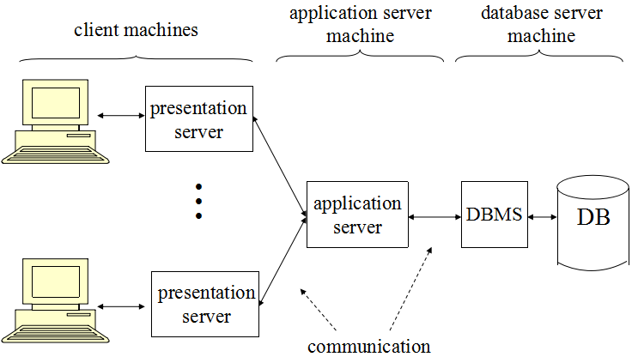
Application Server
Sets transaction boundaries
Acts as a workflow controller
implements user request as a sequence of tasks
Acts as a router
Distributed transactions involve multiple servers
Server classes are used for load balancing

Slide 9
Three-Tiered Model of TPS
applic. server
machines
trans. server
machines
database server
machine
client machines
present.
server
DBMS
A
DB-A
• • •
trans.
server
DBMS
applic.
server
DB
present.
server
communication
Distributed Transactions

Slide 10
Levels of Abstraction
Presentation server implements the abstraction of the user interface
Application server implements the abstraction of a user request
Stored procedures (or transaction server) implement the abstraction of individual sub-tasks
Database server implements the abstraction of the relational model

Slide 11
Interconnection of Servers in Three-Tiered Model
presentation
server
• •
presentation
server
presentation
server
• •
presentation
server
application
server
application
server
• • •
transaction
server
transaction
server
database
server
database
server

Slide 12
Architectures for Transaction Processing on the Internet
Many high throughput applications require a three or four-tiered architecture
Web
Server
Application
Server
Database
Server
Interacts with client & App. Server
Executes the application
Hosts the database

Slide 13
Sessions and Context
A session exists between two entities if they exchange messages while cooperating to perform some task
Each maintains some information describing the state of their participation in that task
State information is referred to as context

Slide 14
Communication in TPSs
Two-tiered model:
Presentation/application server communicates with database server
Three-tiered model:
Presentation server communicates with application server
Application server communicates with transaction/database server
In each case, multiple messages have to be sent
Sessions are used to achieve these goals
Session set-up/take-down costly => session is long-term

Slide 15
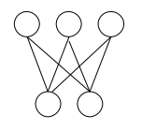
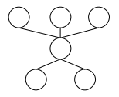
Communication Sessions
Two-tiered model:
A client has a session with each database server it accesses
Three-tiered model:
Each client has a session with its application server
Each application server multiplexes its connection to a database server over all transactions it supports
client
trans. / DB
client
application
trans. / DB
Two-tiered
Three-tiered

Slide 16
Interconnection of Servers in Three-Tiered Model
presentation
server
• •
presentation
server
presentation
server
• •
presentation
server
Transaction
Manager
application
server
application
server
• • •
transaction
server
transaction
server
database
server
database
server
DB Server A
DB Server B
Distributed Transactions Processing System

Slide 17
Transaction Manager
Middleware to support global atomicity of distributed transactions
Application invokes manager when transaction is initiated
Manager is informed each time a new server joins the transaction
Application invokes manager when transaction completes
Manager coordinates atomic commit protocol among servers to ensure global atomicity

Slide 18
Transaction Manager (Two-Tiered Model)
Transaction
manager
database server
machines (local
ACID properties)
atomic commit
protocol
• • •
begin /
commit
DBMS
present. applic.
services services
• • •
• • •
DBMS
service
invocations
client machines

Slide 19
TP Monitor
A TP Monitor is a collection of middleware components that is useful in building heterogeneous transaction processing systems
Includes transaction manager
Application independent services not usually provided by an operating system
Layer of software between operating system and application
Produces the abstraction of a (global) transaction

Slide 20
TP Monitor Services
Communication services
ACID properties
Routing and load balancing
Threading
Recoverable queues
Security services
Miscellaneous servers

Slide 21
TP Monitor Services
ACID properties
Local isolation for a (non-db) server might be provided by a lock manager
Implements locks that an application can explicitly associate with instances of any resource
Local atomicity for a (non-db) server might be provided by a log manager
Implements a log that can be explicitly used by an application to store data that can be used to roll back changes to a resource
Global isolation and atomicity are provided by transaction manager

Slide 22
Remote Procedure Call (RPC)
Procedural interface
Convenient to use
Provides type checking
Naturally supports client/server model
RPC extends procedural communication to distributed computations
Deallocation of local variables limits ability to store context (stateless)
Context can be stored globally (e.g., in database) or …
passed between caller and callee (context handle)

Slide 23
Transactional RPC and Global Atomicity
Client executes tx_begin to initiate transaction
Client stub calls transaction manager (TM)
TM returns transaction id (tid)
Transactional RPC (TRPC):
Client stub appends tid to each call to server
Server stub informs TM when it is called for first time
Server has joined the client’s transaction.
Client commits by executing tx_commit
Client stub calls TM
TM coordinates atomic commit protocol among servers to ensure global atomicity

