Slide 1
Isolation in Relational Databases
1

Slide 2
Isolation in Relational Databases
Locking in Relational Databases
SQL Isolation Levels
Granular Locks
Index Locking
Multiversion Controls (MVCs)
SNAPSHOT Isolation
2

Slide 3
What’s Different About Locking in Relational Databases?
In relational databases, accesses are made to items that satisfy a predicate (for example, a SELECT statement)
What should we lock?
What is a conflict?
T₁:
...
...
SELECT SUM (balance)
FROM Accounts
WHERE name = ‘Mary’;
...
...
3

Slide 4
Conflicts in Relational Databases
Audit:
SELECT SUM (balance)
FROM Accounts
WHERE name = ‘Mary’;
SELECT totbal
FROM Depositors
WHERE name = ‘Mary’
T₁
NewAccount:
INSERT INTO Accounts
VALUES (‘123’,‘Mary’,100);
UPDATE Depositors
SET totbal = totbal + 100
WHERE name = ‘Mary’
T₂
p_{1,1}
p_{2,1}
p_{1,2}
p_{2,2}
Operations on Accounts and Depositors conflict
Interleaved execution is not serializable
4

Slide 5
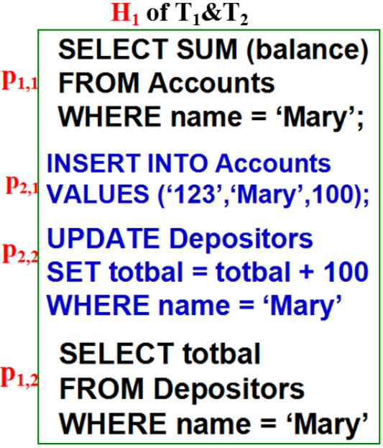
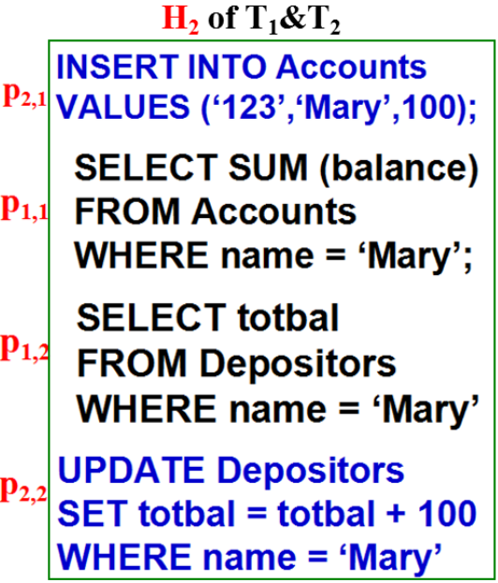
Interleaved execution
R_{1,1}(A);W_{2,1}(A);W_{2,2}(D);R_{1,2}(D);
W_{2,1}(A);R_{1,1}(A);R_{1,2}(D);W_{2,2}(D);
Interleaved execution is not conflict serializable!

Slide 6
What to Lock?
Lock tables (TL)
Execution is serializable but ...
Performance suffers because lock granularity is coarse
Lock rows (RL)
Performance improves because lock granularity is fine but ...
Execution is not serializable
6

Slide 7
with Table Locking
Audit:
SELECT SUM (balance)
FROM Accounts
WHERE name = ‘Mary’;
SELECT totbal
FROM Depositors
WHERE name = ‘Mary’
T₁
NewAccount:
INSERT INTO Accounts
VALUES (‘123’,‘Mary’,100);
UPDATE Depositors
SET totbal = totbal + 100
WHERE name = ‘Mary’
T₂
p_{1,1}
p_{2,1}
p_{1,2}
p_{2,2}
S₁: p_{1,1}; p_{1,2}; c₁; p_{2,1}; p_{2,2}; c₂;
S₂: p_{2,1}; p_{2,2}; c₂; p_{1,1}; p_{1,2}; c₁;
在采用‘Table Locking’的情况下，无论以何种顺序执行，最终产生的一定是这两个事务之间的串行调度(S₁ or S₂)
7

Slide 8
Problem with Row Locking
Audit
(1) Locks and reads Mary’s rows in Accounts
NewAccount
(2) Inserts and locks new row t, in Accounts
(3) Locks and updates Mary’s row in Depositors
(4) Commits and releases all locks
Audit
(5) Locks and reads Mary’s row in Depositors
(6) Commits and releases all locks
p_{1,1}
p_{2,1}
p_{2,2}
c₂
p_{1,2}
c₁
time
8

Slide 9
Problem with Row Locking
SELECT SUM (balance)
FROM Accounts
WHERE name = ‘Mary’;
INSERT INTO Accounts
VALUES (‘123’,‘Mary’,100);
UPDATE Depositors
SET totbal = totbal + 100
WHERE name = ‘Mary’;
COMMIT;
SELECT totbal
FROM Depositors
WHERE name = ‘Mary’;
COMMIT;
p_{1,1}
Problem: The two SELECT statements in Audit see inconsistent data
Reason: Audit’s SELECT and NewAccount’s INSERT (on table Accounts) do not commute, but the row locks held by Audit did not delay the INSERT.
Phantom: The inserted row is referred to as a phantom.
p_{2,1}
p_{2,2}
c₂
p_{1,2}
c₁
S₃:
p_{1,1}; p_{2,1}; p_{2,2}; c₂; p_{1,2}; c₁;
9

Slide 10
Phantom Reads & Predicate Locks
Dirty Reads
Dirty Writes
Table Locks
Row Locks

Slide 11
Phantoms (幻像) in RL
Phantoms occur when row locking is used and
T₁ SELECTs, UPDATEs, or DELETEs using a pred. P
T₂ creates a row (using INSERT or UPDATE) satisf. P
Example:
T₁: UPDATE Table T₂: INSERT INTO Table
SET Attr = …. VALUES ( … satisfies P…)
WHERE P
在采用行级(或元组级)封锁粒度的情况下，在事务T₁和T₂的上述两条SQL语句之间不会产生锁冲突现象！
11

Slide 12
Phantoms in Row Locking
rows in
table R
rows in R satisfying P
(rows that can be locked)
rows satisfying
predicate P
rows satisfying P
that do not exist in R
all rows that can
possibly be in table R
(cann't be locked!!!)

Slide 13
Phantoms in RL
INSERT and UPDATE cause phantoms with row locking.
Question: Why does DELETE not cause a similar problem with row locking?
Answer: A row that has been read cannot be deleted because it is locked
13

Slide 14
Predicate Locking (PL)
TL prevents phantoms; RL does not ! BUT ......
Predicate locking also prevents phantoms
A predicate describes a set of rows, some are in a table and some are not;
In Row Locking (RL), name = ‘Mary’ is a subset of the rows satisfying name = ‘Mary’ are in Accounts
Every SQL statement has an associated predicate
When executing a statement, acquire a (read or write) lock on the associated predicate
Two predicate locks conflict if one is a write and there exists a row (not necessarily in the table) that is contained in both
14

Slide 15
Preventing Phantoms With PLs
Audit:
SELECT SUM (balance)
FROM Accounts
WHERE name = ‘Mary’
NewAccount:
INSERT INTO Accounts
VALUES (‘123’,‘Mary’,100)
Audit gets read lock on predicate name=‘Mary’
NewAccount requests write lock on predicate
(acctnum=‘123’ ∧ name=‘Mary’ ∧ bal=100)
Request denied since predicates overlap
15

Slide 16
Conflicts And Predicate Locks
Example 1:
Statements conflict since:
Predicates overlap and one is a write
There might be acc. with bal < 100 and name = ‘Mary’
Locking is conservative: there might be no rows in Accounts satisfying both predicates
SELECT SUM (balance)
FROM Accounts
WHERE name = ‘Mary’
DELETE
FROM Accounts
WHERE bal < 100
16

Slide 17
Conflicts And Predicate Locks
Example 2:
Statements commute since:
Predicates are disjoint.
There can be no rows (in or not in Accounts) that satisfy both predicates
No phantom involved in this (DELETE) case
SELECT SUM (balance)
FROM Accounts
WHERE name = ‘Mary’
DELETE
FROM Accounts
WHERE name = ‘John’
17

Slide 18
Serializability in Relational DB
Table locking
prevents phantoms and produces serializable schedules, but ...
negatively impacts performance
Row locking
does not prevent phantoms and can produce nonserializable schedules
Performance ok
Predicate locking
prevents phantoms and produces serializable schedules, but ...
too complex to implement
18

Slide 19
Serializability in Relational DB
What’s an implementor to do?
Later we discuss more efficient locking methods (granular locking and index locking) that prevent phantoms and produce serializable schedules
19

Slide 20
Isolation in Relational Databases
Locking in Relational Databases
SQL Isolation Levels
Granular Locks
Index Locking
Multiversion Controls (MVCs)
SNAPSHOT Isolation
20

Slide 21
Isolation Levels
SQL defines several isolation levels weaker than SERIALIZABLE that allow non-serializable schedules and hence allow more concurrency
Serializable schedules
delays
input
serializable
conc. control
s′
s
•
s′
•
input
weaker
conc. control
s
Schedules allowed
at a weaker isolation level
fewer delays
21

Slide 22
Isolation Levels
Schedules produced by CC operating at isolation levels lower than SERIALIZABLE:
Might be correct for some applications
SQL standard defines isolation levels in terms of certain anomalies they do or do not allow
22

Slide 23
Anomaly (异常)
We have already talked about some anomalies
Dirty Read
Dirty Write
Lost Update
Non-Repeatable Read
Phantom
Now we discuss:
Non-Repeatable Read vs. Phantom
23

Slide 24

Dirty Read:
Dirty Write:
T₁ : w(x) abort
T₂ : w(x) abort
Lost Update:
T₁ : w(x) commit
T₂ : w(x) commit
Non-Repeatable Read:
T₁ : w(x) commit
T₂ : r(x) r(x) commit

Slide 25
Anomaly: Non-Repeatable Read
T1 T2
SELECT SUM (balance)
FROM Accounts
WHERE name = ‘Mary’
UPDATE Accounts
SET balance = 1.05 * balance
WHERE name = ‘Mary’
SELECT SUM (balance)
FROM Accounts
WHERE name = ‘Mary’
does not introduce a
phantom into predicate
name=‘Mary’
25

Slide 26
Non-Repeatable Reads and Phantoms
/* query by T₁ */
SELECT SUM (balance)
FROM Accounts
WHERE name = ‘Mary’;
/* update by T₂ */
UPDATE Accounts
SET balance = 1.05*balance
WHERE name = ‘Mary’;
/* commit by T₂ */
COMMIT;
/* query by T₁ */
SELECT SUM (balance)
FROM Accounts
WHERE name = ‘Mary’;
/* query by T₁ */
SELECT SUM (balance)
FROM Accounts
WHERE name = ‘Mary’;
/* update by T₂ */
INSERT INTO Accounts
VALUES('123', ‘Mary’, 100);
/* commit by T₂ */
COMMIT;
/* query by T₁ */
SELECT SUM (balance)
FROM Accounts
WHERE name = ‘Mary’;
With a non-repeatable read, execution of same SELECT twice yields the same set of rows, but attribute values might be different.
With a phantom read, execution of same SELECT twice yields different sets of rows. The second returns at least one row not returned by the first.
26

Slide 27
SQL Isolation Levels
READ UNCOMMITTED – dirty reads, non-repeatable reads, and phantoms allowed
READ COMMITTED - dirty reads not allowed, but non-repeatable reads and phantoms allowed
REPEATABLE READ – dirty reads, non-repeatable reads not allowed, but phantoms allowed
SERIALIZABLE – dirty reads, non-repeatable reads, and phantoms not allowed; all schedules must be serializable
27

Slide 28
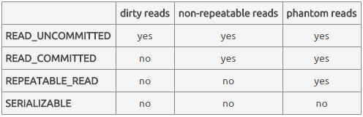
SQL Isolation Levels
Defining isolation levels in terms of anomalies leads to an ambiguous specification:
At what levels are dirty writes allowed?
Are there other anomalies that are not accounted for?
Transaction Isolation / Statement Isolation
28

Slide 29
Statement Isolation
In addition, statement execution must be isolated
DBMS might be executing several SQL statements (from different transactions) concurrently
The execution of statement involves the execution of a program implementing that statement’s query plan
This might be a complex program
While the execution of transactions T₁ and T₂ might not be isolated, the execution of each statement within T₁ must be isolated with respect to the execution of each statement within T₂.
29

Slide 30
Locking Implementation of SQL Isolation Levels
SQL standard does not say how to implement levels
Locking implementation is based on:
Entities locked: rows, predicates, …
Lock modes: read & write
Lock duration:
Short: locks acquired in order to execute a statement are released when statement completes
Long: locks acquired in order to execute a statement are held until transaction completes
Medium: something in between
30

Slide 31
Locking Implementation of SQL Isolation Levels
Write locks are handled identically at all isolation levels:
Long-duration predicate write locks are associated with UPDATE, DELETE, and INSERT statements
This rules out dirty writes
In practice, predicate locks are implemented with table locks or by acquiring locks on an index as well as the data
We discuss index locking later
Read locks handled differently at each level
31

Slide 32
Locking Implementation of SQL Isolation Levels
READ UNCOMMITTED: no read locks
Hence a transaction can read a write-locked item!
Allows dirty reads, non-repeatable reads, and phantoms
READ COMMITTED: short-duration read locks on rows returned by SELECT
Prevents dirty reads, but non-repeatable reads and phantoms are possible
REPEATABLE READ: long-duration read locks on rows returned by SELECT
Prevents dirty and non-repeatable reads, but phantoms are possible
SERIALIZABLE: long-duration read lock on predicate specified in WHERE clause
Prevents dirty reads, non-repeatable reads, and phantoms and …
Guarantees serializable schedules
32

Slide 33
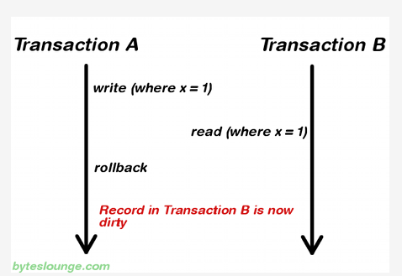
Dirty read

Slide 34

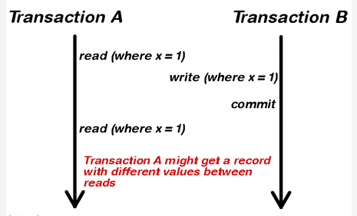
non-repeatable read

Slide 35
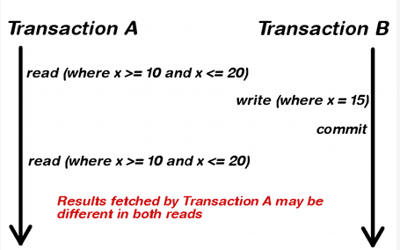
phantom read

Slide 36
Bad Things Can Happen
At every isolation level lower than SERIALIZABLE, bad things can happen
Schedules can be
Non-serializable
Specifications of transactions might not be met
36

Slide 37
Some Problems at READ UNCOMMITTED
Since no read locks are obtained, T₂ can read a row t, write locked by T₁
Some DBMSs allow only read-only transactions to be executed at this level
T₁: w(t) abort
T₂: r(t) w(t′) commit
T₁: w(t) w(t) commit
T₂: r(t) w(t′) commit
T₁: w(t) w(t′) commit
T₂: r(t) r(t′) commit
T₂ uses an aborted
value to update db
T₂ uses an intermediate
value to update db
T₂ does not see a
committed snapshot
37

Slide 38
Some Problems at READ COMMITTED
Non-repeatable reads:
Lost updates:
T₁: r(t) r(t) commit
T₂: w(t) commit
T₁: r(t) w(t) commit
T₂: r(t) w(t) commit
38

Slide 39
Problems at REPEATABLE READ
Phantoms:
t satisfies pred
A constraint relates rows satisfying pred and t′
Audit: r(pred) r(t′) commit
NewAccount: insert(t) update(t′) commit
39

Slide 40
Levels of Isolation
Levels of Isolation
Types of Locks
Write locks
Read Locks
( row )
Read Locks
(Predicates)
Problem
Read Uncommitted
No
(Read Only)
No
No
Dirty Reads
Read Committed
Yes
short-term
short-term
Lost Update
Repeatable Read
Yes
long-term
short-term
Update Anomaly
Serializable
Yes
long-term
long-term
No
40

Slide 41
Implications of Locking Implementation
Transactions can be assigned to different isolation levels and can run concurrently.
Since all write locks are long-duration predicate locks and SERIALIZABLE transactions have long-duration predicate read locks, SERIALIZABLE transactions are serialized with respect to all writes.
A SERIALIZABLE transaction either sees the entire effect of another transaction or no effect.
A transaction at a lower level does not see the anomalies prohibited at that level.
41

Slide 42
Implications of Locking Implementation
Even though all transactions are designed to be consistent,
Transactions executed at lower isolation levels can see anomalies that can cause them to write inconsistent data to the database
Transactions executed at any isolation levels can see that inconsistent data and as a result return inconsistent data to user or store additional inconsistent data in database
42

Slide 43
Update Locks
Some DBMS provide update locks to alleviate deadlock problem
A transaction that wants to read an item now and possibly update it later requests an update lock on the item (manual locking)
An update lock is a read lock that can be upgraded to a write lock
Often used with updatable cursors
43

Slide 44
Update Locks
An update lock conflicts with other update locks and with write locks, but not with read locks.
Granted mode
Requested mode read write update
read x
write x x x
update x x
Granted mode
Requested mode read write
read x
write x x
44

Slide 45
Update Locks
Schedule that causes a deadlock at CURSOR STABILITY (游标稳定性):
T₁: fetch(t) request_update(t)
T₂: fetch(t) request_update(t)
If both fetches had requested update locks, T₂’s fetch would be made to wait until T₁ had completed, avoiding the deadlock
45

Slide 46
Isolation in Relational Databases
Locking in Relational Databases
SQL Isolation Levels
Granular Locks
Index Locking
Multiversion Controls (MVCs)
SNAPSHOT Isolation
46

Slide 47
Granular Locks (粒度锁)
Transactions access data at different levels of granularity
Many DBMSs provide both fine and coarse granularity locks
DBMS attempts to automatically choose appropriate granularity
A particular application might be able to force a particular granularity
47

Slide 48
Granular Locks
Problem:
T₁ holds a (fine grained) lock on field F₁ in record R₁
T₂ requests a conflicting (coarse grained) lock on R₁
Lock requested by T₂
Record R₁ :
Field F₁ | Field F₂ | ……
Locked by T₁
How does the concurrency control detect the conflict
since it sees F₁ and R₁ as different items?
48

Slide 49
Granular Locks (GL)
Solution:
Organize locks hierarchically by containment
Require that a transaction to get a fine grained lock it
must first get a coarse grained lock on the containing item
Record R₁ :
Field F₁ | Field F₂ | ……
Hence, T₁ must:
First get a lock on R₁ Before getting a lock on F₁
When T₂ requests a conflicting lock on R₁
The conflict with T₁ is detected at R₁
49

Slide 50
Intention Locking
Performance improvement: if lock on parent is weak
Intention shared (IS): to get an S lock on an item, T must first get IS locks on all containing items (↑root)
Intention exclusive (IX): to get an X lock on an item, T must first get IX locks on all containing items (↑root)
Shared Intention Exclusive (SIX): Equivalent to an S lock and an IX lock on an item
Intention lock indicates transaction’s intention to
acquire conventional lock on a contained item
50

Slide 51
Conflict Table
T₂ Requested T₁ Granted mode
mode IS IX S X SIX
IS
IX
S
X
SIX
x
x x x
x x x
x x x x x
x x x x
Example 1: T₂ denied an IX lock (intends to update some contained items) since T₁ is reading all contained items
51

Slide 52
Conflict Table
T₂ Requested T₁ Granted mode
mode IS IX S X SIX
IS
IX
S
X
SIX
x
x x x
x x x
x x x x x
x x x x
Example 2: T₂ granted IS lock even though T₁ holds IX lock (since they may be accessing different subsets of contained items)
52

Slide 53
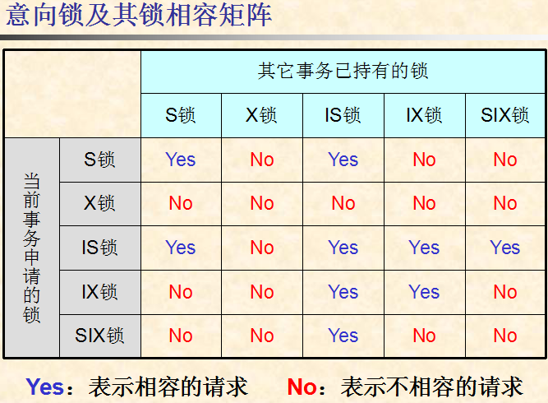

Slide 54
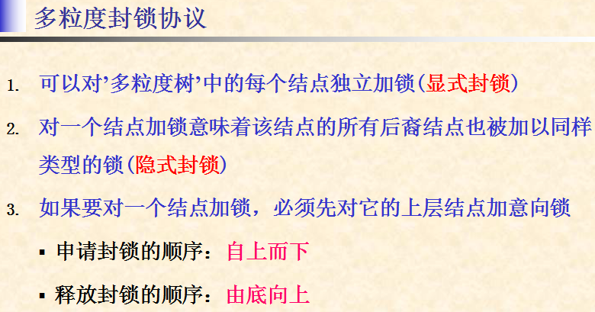

Slide 55
Isolation in Relational Databases
Locking in Relational Databases
SQL Isolation Levels
Granular Locks
Index Locking
Multiversion Controls (MVCs)
SNAPSHOT Isolation
55

Slide 56
Index Locking
Index Locks
Predicate Locks
Key-Range Locks
56

Slide 57
Preventing Phantoms
Lock entire table - this works
T₁ executes SEL(P): (where P is a predicate), obtains long-duration S lock on table
T₂ executes INS(t): requires long-duration X lock on table
Phantom prevented
Lock the predicate P - this works but entails too much overhead
Can granular locking be used?
57

Slide 58
Lock entire table - Example
T₁: SELECT F.Name
FROM Faculty F
WHERE F.Salary > 70000
Holds: long-duration S lock on Faculty
pages of row which salary>7000
Faculty
...,75000,...
c
a b d
T₂: INSERT INTO Faculty
VALUES (…75000, …)
Requests: long-duration X lock on Faculty
inserted row
lock conflict detected on table Faculty, T₂ is waiting......

Slide 59
No Appropriate Index for P
Assume containment hierarchy is table/pages:
T₁ does SEL(P): obtains long-duration S lock on table
Since it must read every page to find rows satisfying P
T₂ requests INS(t): obtains long-duration IX lock on table and X lock on page into which t is to be inserted.
lock conflict detected (on table), hence (a potential) phantom is prevented
However other transaction can read parts of the table that are stored on pages other than the one on which t is stored
59
Notes:
提供‘表/页面’两级的多粒度封锁

Slide 60
No Index Granular Locking - table / pages
T₁: SELECT F.Name
FROM Faculty F
WHERE F.Salary > 70000
Holds: long-duration S lock on Faculty
because no index can be used for salary>7000, T₁ must read every page to find rows satisfying salary>7000
pages of row which salary>7000
Faculty
...,75000,...
c
a b d
T₂: INSERT INTO Faculty
VALUES (…75000, …)
Requests: long-duration IX lock on Faculty,
计划在页面c中插入新元组，需要申请表上的IX锁和页面c上的X锁
waiting ......
lock conflict detected on table Faculty, T₂ is waiting......

Slide 61
Index I exists on attribute P
T₁ obtains long-duration IS lock on table, uses I to locate pages containing rows satisfying P, and acquires long-duration S locks on them.
T₂ obtains long-duration IX lock on table (no conflict) and X lock on page p, into which t is to be inserted.
Problem: Since p might not be locked by T₁, a phantom can result.
61

Slide 62
Index Locking
Solution: lock pages of the index in addition
Example: I is an unclustered B⁺ tree.
T₁ (SEL(P)) obtains:
long-duration IS lock on table,
long-duration S locks on the pages containing rows satisfying P, and
long-duration S locks on the leaf index pages containing entries satisfying P
T₂ (INS(t)) requests:
long-duration IX lock on table (granted),
long-duration X locks on the page into which t is to be inserted (might be granted), and
long-duration X lock on the leaf index page into which the index entry for t will be stored (lock conflict if t satisfies P)
The phantom is prevented!

Slide 63
Index Locking - Example
T₁: SELECT F.Name
FROM Faculty F
WHERE F.Salary > 70000
Holds: IS lock on Faculty,
S lock on a, b, d, S lock on e
unclustered
index on
Salary
e
Faculty
c
a b d
T₂: INSERT INTO Faculty
VALUES (…75000, …)
Requests: IX lock on Faculty,
X lock on c, X lock on e
inserted row
lock conflict detected on index page e, phantom is prevented !

Slide 64
Index, Predicate & Key-Range Locks
If a WHERE clause:
refers to a predicate name = mary and if there is an index on name,
then an index lock on index entries for name = mary
is like a predicate lock on that predicate
If a WHERE clause refers to a
predicate such as 50000< salary < 70000 and if there is an index on salary,
then a key-range index lock can be used to get the
equivalent of a predicate lock on 50000<salary<70000
64

Slide 65
Key-Range Locking
Instead of locking index pages, index entries at the leaf level are locked
Each such lock is interpreted as a lock on a range
Suppose the domain of an attribute is A…Z and suppose at some time the entries in the index are
C G P R X
a lock on G is interpreted as a lock on the half-open interval [G P) which includes G but not P
65

Slide 66
Key-Range Locking (cont)
Recall the index entries are: C G P R X
Two special cases
a lock on X locks everything greater than X
a new lock must be provided for [A C)
Then for example to lock the interval H<K<Q,
we would lock G and P
C G P R X
H Q
66

Slide 67
Key-Range Locking (cont)
Recall the index entries are: C G P R X
To insert a new key, J, in the index
Lock G thus locking the interval [G P)
Insert J thus splitting the interval into [G J) [J P)
Lock J thus locking [J P)
Release the lock on G
If a SELECT statement had a lock on G as part of a key-range, then the first step of the insert protocol could not be done
Thus phantoms are prevented and the key-range lock is equivalent to a predicate lock
67

Slide 68
Locking a B⁺-Tree Index
Many operations need to access an index structure concurrently
This would be a bottleneck if conventional two-phase locking mechanisms were used
Understanding index semantics, we can develop a more efficient locking algorithm
Goal is to maintain isolation among different operations, concurrently accessing the index
The short term locks on the index are called latches
The long term locks on leaf entries we have been discussing are still obtained
68

Slide 69
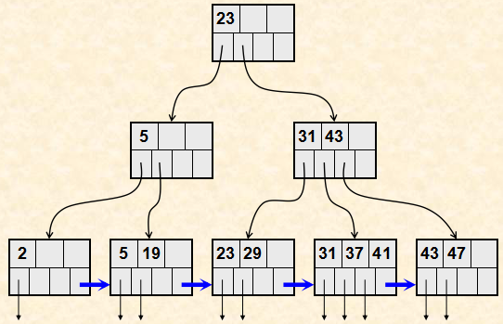
Example of B⁺-Tree Index
69

Slide 70
Read Locks on a B⁺-Tree Index
Obtain a read lock on the root, and work down the tree locking each entry as it is reached
When a new entry is locked, the lock on the previous entry (its parent) can be released
This operation will never revisit the parent
No write operation of a concurrent transaction can pass this operation as it goes down the tree
Called lock coupling or crabbing
70

Slide 71
request for read lock of node K
N := root of B⁺ tree
申请节点N上的read lock
N = K ?
yes
结束
no
寻找N的子节点M
申请节点M上的read lock
lock
coupling
释放节点N上的read lock
N := M

Slide 72
Write Locks on a B⁺-Tree Index
Obtain a write lock on the root, and work down the tree locking each entry as it is reached
When new entry N is locked, if that entry is not full, the locks on all its parents can be released
An insert operation might have to go back up the tree, revisiting and perhaps splitting some nodes
Even if that occurs, because N is not full, it will not have to split N and therefore will not have to go further up the tree
Thus it can release locks further up in the tree.
72

Slide 73
request for write lock of node K
N := root of B⁺ tree
申请节点N上的write lock
if ( 节点N not full )
then (释放N的所有祖先节点上的write lock)
N = K ?
yes
结束
no
寻找N的子节点M
申请节点M上的write lock
N := M

Slide 74
Granular and Index Locking Summary
Algorithm has property that a lock conflict that prevents phantoms will occur:
In the index, when an index is used
At the table level, when no index is used
Even if there is no index, write operations need not get an X lock on whole table, only an IX lock, which allows more concurrency
74

Slide 75
UPDATE Statement
An UPDATE can be treated as if it were a DELETE followed by an INSERT
If an index attribute is changed, the index entry for the tuple must be moved to a new position
The transaction must obtain write locks on both the old and new index pages
75

Slide 76
Lock Escalation
To avoid acquiring many fine grain locks on a table, a DBMS can set a lock escalation threshold.
If more than the threshold number of tuple (or page) locks are acquired, the DBMS automatically trades them in for a table lock but …
Beware of deadlock
76

Slide 77
Performance Hints
Use lowest correct isolation level
Embedding constraints in schema might permit the use of an even lower level
Constraint violation due to interleaving detected at commit time (an optimistic approach)
No user interaction after a lock has been acquired
Use indexes and denormalization to support frequently executed transactions
Avoid deadlocks by controlling the order in which locks are acquired
77

Slide 78
Isolation in Relational Databases
Locking in Relational Databases
SQL Isolation Levels
Granular Locks
Index Locking
Multiversion Controls (MVCs)
SNAPSHOT Isolation
78

Slide 79
Multiversion Controls (MVCs)
Version: a snapshot of the database containing the updates of all and only committed transactions
A multi-version DBMS maintains all versions created in the (recent) past
Major goal of a multi-version DBMS: avoid the need for read locks
w₁(x) w₂(y) c₁ w₃(x) w₂(z) c₂ ......
create version 1
(contains updates
of T₁, but not T₂)
create version 2
(contains updates of
T₁ and T₂, but not T₃)
79

Slide 80
Multiversion Controls
80

Slide 81
Read-Consistency
All DBMSs guarantee that statements are isolated:
Each statement sees state produced by the complete execution of other statements, but state might not be committed
A MVC guarantees that each statement sees a committed state:
Statement executed in a state whose value is a version
Referred to as statement-level read consistency
A MVC can also guarantee that all statements of a transaction see the same committed state:
All statements of a transaction access same version
Referred to as transaction-level read consistency
81

Slide 82
Read-Only MVC
Distinguishes in advance read-only (R/O) transactions from read/write (R/W) transactions.
R/W transactions use a (conventional) immediate-update, pessimistic control. Hence, transactions access the most current version of the database.
All the reads of a particular R/O transaction T_{RO} are satisfied using the most recent version that existed when T_{RO} requested its first read.
82

Slide 83
Read-Only MVC
Assuming R/W transactions are executed at SERIALIZABLE, all schedules are serializable:
R/W transactions are serialized in commit order.
Each R/O transaction is serialized after the transaction that created the version it read.
Equivalent serial order is not commit order.
All transactions see transaction-level read consistency.
83

Slide 84
Example
r₁(x) w₁(y) r₂(x) c₁ w₂(x) r₃(x) w₂(y) c₂ r₃(y) c₃
T₁ and T₂ are read/write, T₃ is read/only
T₃ sees the version produced by T₁
The equivalent serial order is T₁ T₃ T₂
84

Slide 85
Implementation
DBMS maintains a version counter (VC).
Incremented each time a R/W transaction commits.
The new version of a data item created by a R/W transaction is tagged with the value of VC at the time the transaction commits.
When a R/O transaction makes its 1st read request, the value of VC becomes its counter value.
Each request to read an item is satisfied by the version of the item having the largest version number less than or equal to the transaction’s counter value.
85

Slide 86
Multiversion Database
x
y
z
u
v1
v2
v1
v4
17
a
.223
.223
v1
38
38
v4
v2
v3
v5
22
ab
ab
v3
.24
v3
v6
123
123
v3
abf
Values read by a R/O transaction with counter value 4
86

Slide 87
Read-Only Multiversion Control
R/O transactions do not use read locks.
They never wait.
They never cause R/W transactions to wait.
87

Slide 88
Read-Consistency MVC
R/O transactions:
As before: get transaction-level read consistency.
R/W transactions:
Write statements acquire long-duration write locks (delay other write statements)
Read statements use most recent (committed) version at time of read
Not delayed by write locks, since read locks are not requested.
88

Slide 89
Example
w₁(x) w₁(y) r₂(x) c₁ w₂(x) r₃(x) r₂(y) w₂(y) c₂ r₃(y) c₃
T₁ and T₂ are R/W, T₃ is R/O.
T₃ uses v1.
T₂ takes the value of x from v0, y from v1.
There is no equivalent serial order.
89

Slide 90
Read-Consistency MVC
Satisfies ANSI definition of READ COMMITTED isolation level, but in addition ...
Provides transaction-level read consistency for R/O transactions
No read locks: reads do not wait for writes and writes do not wait for reads
Version of READ COMMITTED supported by Oracle.
90

Slide 91
SNAPSHOT Isolation
Does not distinguish between R/W and R/O transactions
A transaction reads the most recent version that
existed at the time of its first read request
Guarantees transaction-level read consistency
The write sets of any two concurrently executing transactions must be disjoint
Two implementations of this specification
First Committer Wins
Locking implementation
91

Slide 92
First Committer Wins Implementation
Writes use deferred-update (intentions list).
T is allowed to commit only if no concurrent transaction:
committed before T, and
updated a data item that T also updated.
92

Slide 93
First Committer Wins
to intentions list
T₁: r(x_{n}) w(x) request_commit
T_{2:} r(x_{n}) w(x) request_commit
abort
counter value = n
commit and create w(x_{n+1})
Control is optimistic:
It can be implemented without any locks
Deadlock not possible
Validation (write set intersection) is required for R/W transactions and abort is possible
Schedules might not be serializable
93

Slide 94
Locking Implementation of SNAPSHOT Isolation
Immediate update pessimistic control
Reads do not get any locks and execute as in the previous implementation
94

Slide 95
Locking Implementation of SNAPSHOT Isolation
A transaction T that wants to perform a write on some item I must request a write lock
If the version number of I is greater than that of T, T is aborted (first committer wins)
Otherwise, if another transaction T’ has a write lock on that item, T waits until that T’ completes
If T’ commits, T is aborted (first committer wins)
If T’ aborts, T is given the write lock and allowed to write
95

Slide 96
Anomalies at SNAPSHOT Isolation
Many anomalies are impossible:
Dirty read, dirty write, non-repeatable read, lost update
However, schedules might not be serializable.
Example:
Constraint a+b≥0 violated
Referred to as write skew
T₁: r(a=10) r(b=10) w(a=-5) commit
T₂: r(a=10) r(b=10) w(b=-5) commit
96

Slide 97
Phantoms at SNAPSHOT Isolation
Audit:
SELECT SUM (balance)
FROM Accounts
WHERE name = ‘Mary’
SELECT totbal
FROM Depositors
WHERE name = ‘Mary’
NewAccnt:
INSERT INTO Accounts
VALUES (‘123’,‘Mary’,100)
UPDATE Depositors
SET totbal = totbal + 100
WHERE name = ‘Mary’
Both transactions commit.
All reads of a transaction satisfied from the same version.
Hence Audit works correctly! why?
97

Slide 98
Phantoms at SNAPSHOT Isolation
After a transaction executes SELECT, a concurrent transaction might insert a phantom
If the SELECT is repeated, the phantom will not be in the result set
Therefore, apparently, phantoms cannot occur at SNAPSHOT isolation
But …
98

Slide 99
Phantoms at SNAPSHOT Isolation
Non-serializable schedules due to phantoms are possible
Example: concurrent transactions each execute SEL(P) and then insert a row satisfying P
Neither sees the row inserted by the other.
The schedule is not serializable.
This would be considered a phantom if it occurred at REPEATABLE READ.
Can be considered write skew
99

Slide 100
Correct Execution at SNAPSHOT Isolation
Many applications execute correctly at SNAPSHOT isolation, even though schedules are not serializable
Example: reserving seats for a concert
Integrity constraint: a seat cannot be reserved by more than one person
100

Slide 101
Reserving Seats for a Concert
A reservation transaction checks the status of two seats and then reserves one that is free
Schedule below is non-serializable, but is correct and preserves the constraint
Alternatively, if both transactions had tried to reserve the same seat, then ...
T₁: r(s1:Free) r(s2:Free) w(s1:Res) commit
T₂: r(s1:Free) r(s2:Free) w(s2:Res) commit
T₁: r(s1:Free) r(s2:Free) w(s1:Res) ......
T₂: r(s1:Free) r(s2:Free) w(s1:Res) commit
abort
101

