Slide 1
博士资格考核报告
2018/07/04

Slide 2
提纲
修课情况
科研工作
下一步研究计划
服务工作情况

Slide 3
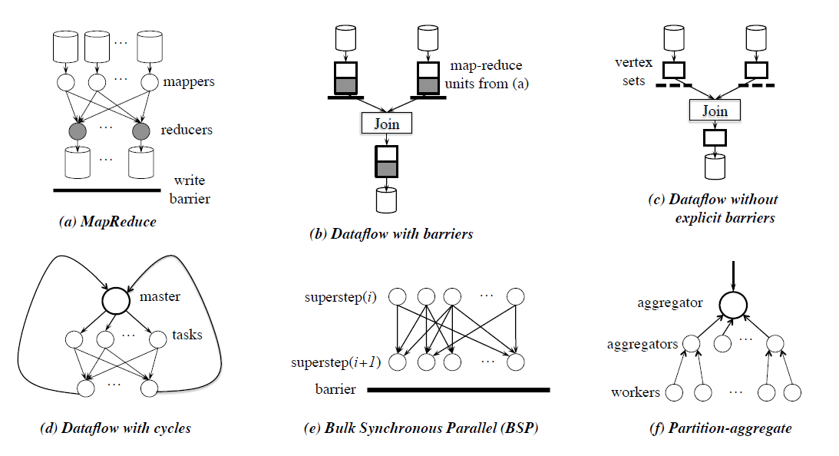
Coflow适用的环境
Notes:
Figure 1: Communication patterns in cluster computing applications: (a) Shuffle and DFS replication in MapReduce
[13]; (b) Shuffle across multiple MapReduce jobs in dataflow pipelines that use MapReduce as the building block (e.g.,
Hive [5]); (c) Dataflow pipelines without explicit barriers (e.g., Dryad [17]); (d) Dataflow with cycles and broadcast
support (e.g., Spark [28]); (e) Bulk Synchronous Parallel or BSP (e.g., Pregel [19]); (f) Aggregation during partitionaggregate
communication in online services (e.g., user-facing backend of search engines and social networks).

Slide 4
Coflow的定义
一种网络流抽象，描述了当前流行的并行数据编程范式中数据传输的需求。
a networking abstraction to express the communication requirements of prevalent data parallel programming paradigms.
[1] M. Chowdhury, and I. Stoica. "Coflow: a networking abstraction for cluster applications." ACM Workshop on Hot Topics in Networks ACM, 2012:31-36.

Slide 5
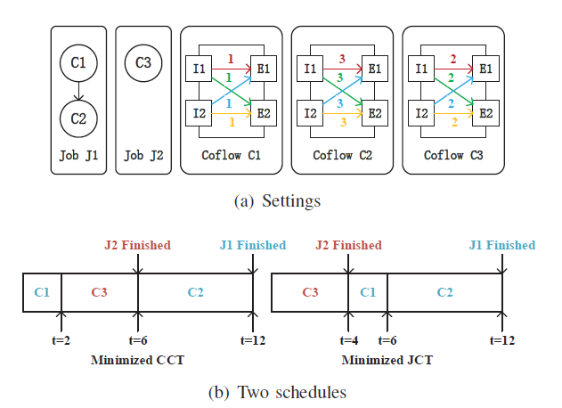




Motivative Example
CCT
CCT
JCT
JCT

Slide 6
Coflow的调度问题
Efficient and fair coflow scheduling improves application-level networking performance in today’s datacenters.
Two objectives:
Minimum average CCT
Isolation guarantees

Slide 7
Coflow的调度问题
1. Minimum average CCT: Varys^{[2]}, Aalo^{[3]}
一般使用shortest-first策略，但是规模比较大的coflow可能会持续被新到来的小规模coflow取代，导致完成时间不断被延长。
[2]M. Chowdhury, Y. Zhong, and I. Stoica, “Efficient coflow scheduling with varys,” in ACM SIGCOMM, 2014.
[3] M. Chowdhury and I. Stoica, “Efficient coflow scheduling without prior knowledge,” in ACM SIGCOMM, 2015.

Slide 8
Coflow的调度问题
2. Isolation guarantees: HUG^{[4]}
公平地分配带宽给予不同的coflow，以保证每个coflow的完成时长，但是相应的average CCT会被延长，实验表明约是Varys的1.45倍。
3. Tradeoff between fairness and efficiency: Coflex
[4] M. Chowdhury, Z. Liu, A. Ghodsi, and I. Stoica, “HUG: Multi-resource fairness for correlated and elastic demands,” in USENIX NSDI, 2016.

Slide 9

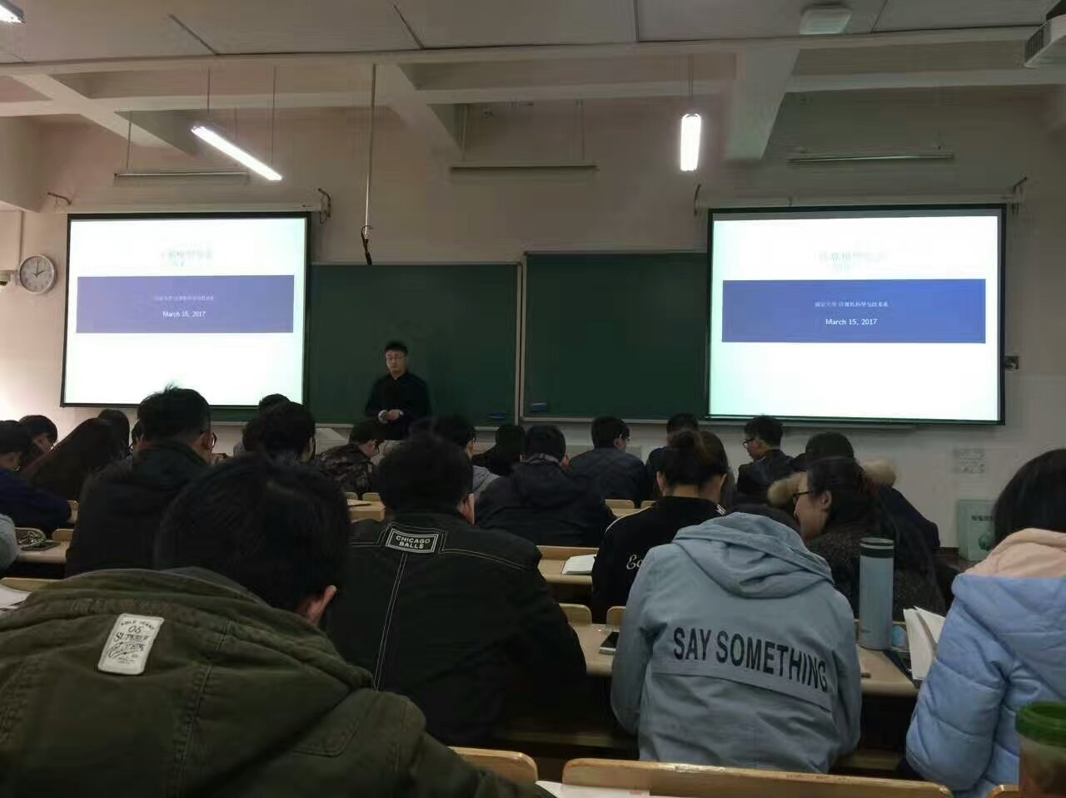
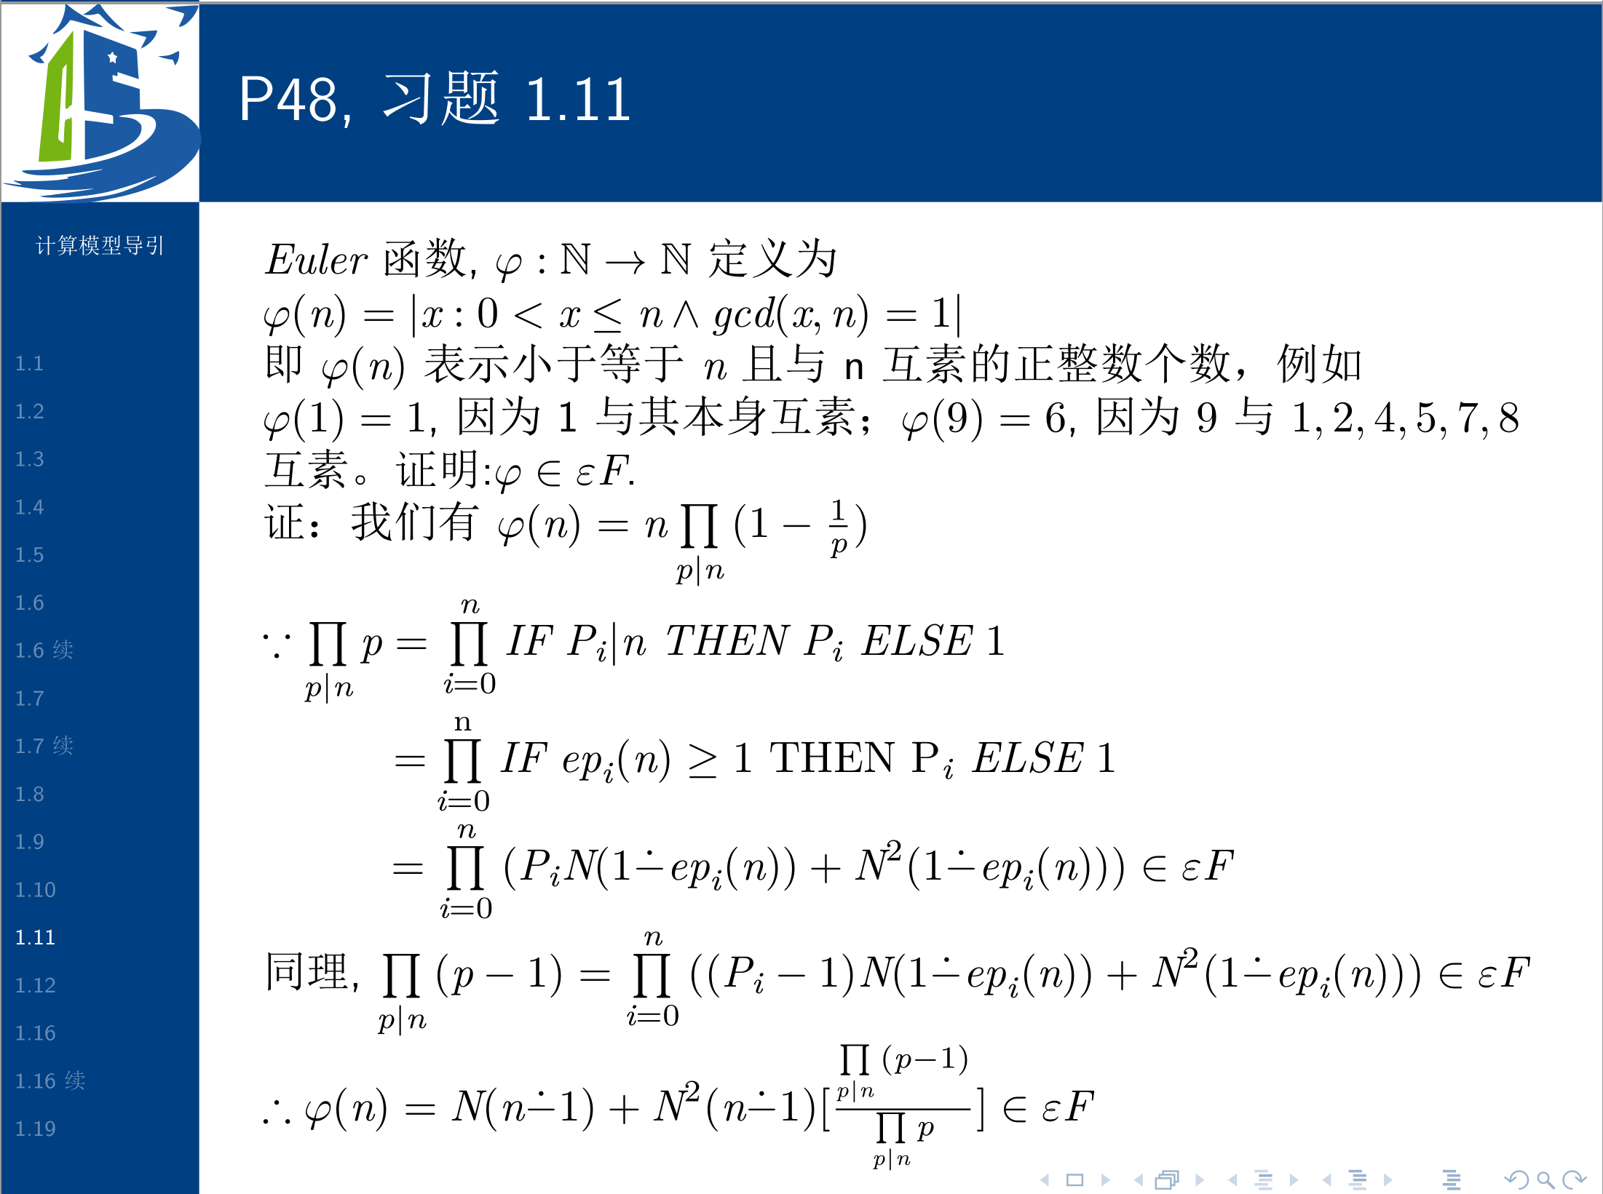
服务工作情况
2017学年的上半学年担任研究生课程《计算理论导引》的助教工作，负责这门课两次习题课讲解以及批改试卷工作。
备课充分，得到任课老师和学生们的好评。

Slide 10
谢谢各位老师！
Q&A

