Slide 1

Landing Gear
Jeremiah Goates

Slide 2
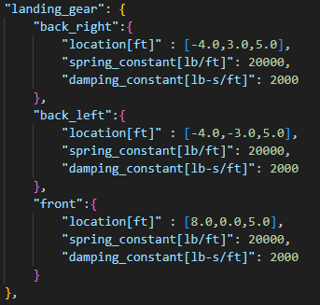


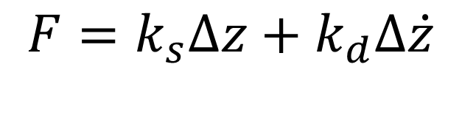


Landing gear modelled as parallel spring-damper system
$$F=k_{s}Δz+k_{d}Δ\dot{z}$$
$$k_{s}$$
$$k_{d}$$
$$Δ\dot{z}$$
$$Δz$$

Slide 3









$$x_{b}$$
$$z_{b}$$
$$F$$
$$Δz$$
$$x_{f}$$
$$F=N⋅{\hat{z}}_{b}$$
$$N$$
$$Δz={\left.\frac{r_{LG}}{{\hat{z}}_{b}}\right)}_{3}^{f}$$
$$z_{f}$$

Slide 4
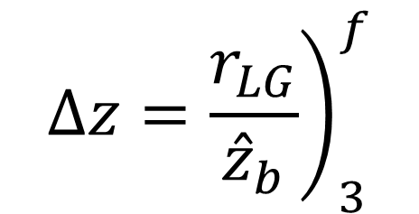


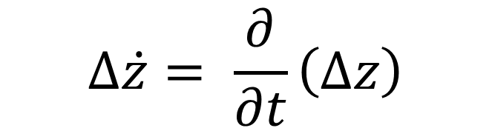
$$F=N⋅{\hat{z}}_{b}$$
$$Δ\dot{z}= \frac{∂}{∂t}\left(Δz\right)$$
$$Δz={\left.\frac{r_{LG}}{{\hat{z}}_{b}}\right)}_{3}^{f}$$
$${\dot{\hat{z}}}_{b}=ω×{\hat{z}}_{b}$$

Slide 5
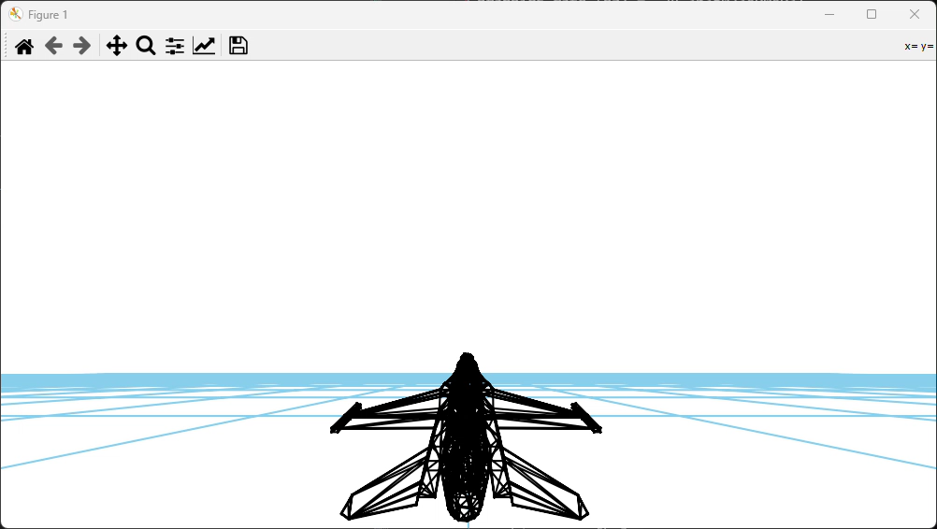
Airspeed [ft/s] | 200
Altitude [ft] | 50
Climb angle [deg] | -5.0
Alpha [deg] | 21.194
Elevation angle | 16.194

Slide 6
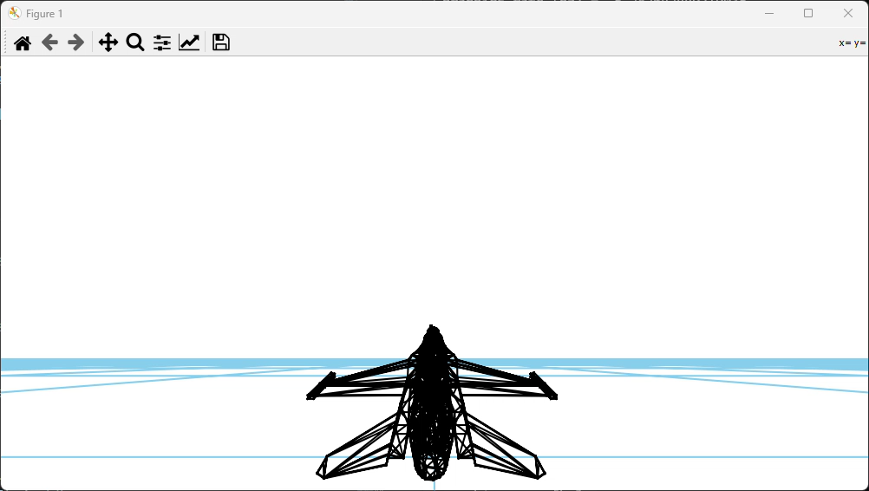
Airspeed [ft/s] | 200
Altitude [ft] | 20
Climb angle [deg] | -2.0
Alpha [deg] | 20.883
Elevation angle | 18.883

Slide 7
