Slide 1
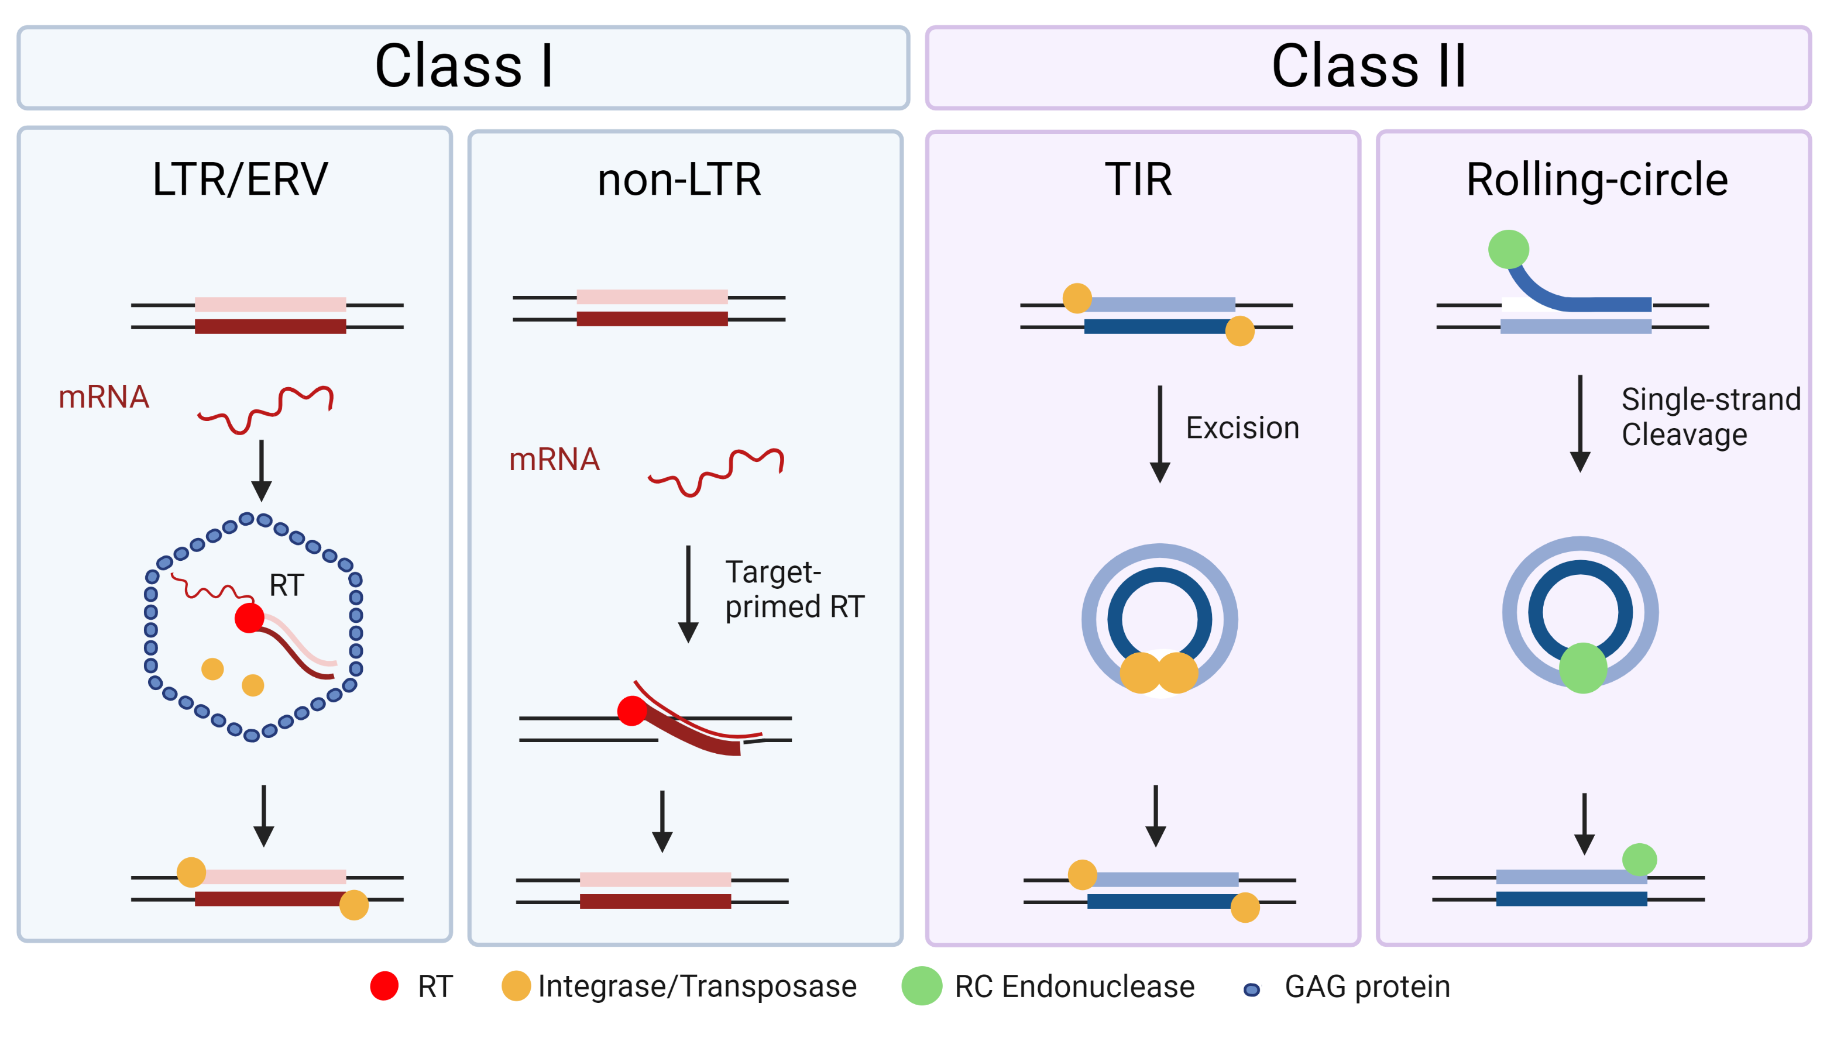

TE diversity recap
A FIELD GUIDE TO THE TEs OF THE WORLD
Miriam Merenciano, Anaïs Larue, Cristian Groza, Cristina Vieira, Rita Rebollo, Clément Goubert (2024). Epigenetics and genotypic variation. In : On Epigenetics and Evolution. Elsevier, 119-151

Slide 2
How do LINE/SINE/LTR/DNA (retro)transposons get transcribed, replicated, and integrated?
FEATURE | LINE | SINE | LTR | DNA (TIR)
Class
Structural features (e.g., internal repeats, ORFs)
Transcription
Replication mechanism
Integration enzyme
Mobilization in cis/trans
Increase in copy number
Presence of introns

Slide 3
Where do these TEs jump, what happens to the new insertion site, and what happens to the new insertion?
FEATURE | LINE | SINE | LTR | DNA (TIR)
Class
Structural features (e.g., internal repeats, ORFs)
Transcription
Replication mechanism
Integration enzyme
Mobilization in cis/trans
Increase in copy number
Presence of introns
Target site preferentiality
Target site duplication
State of the new insertion

Slide 4
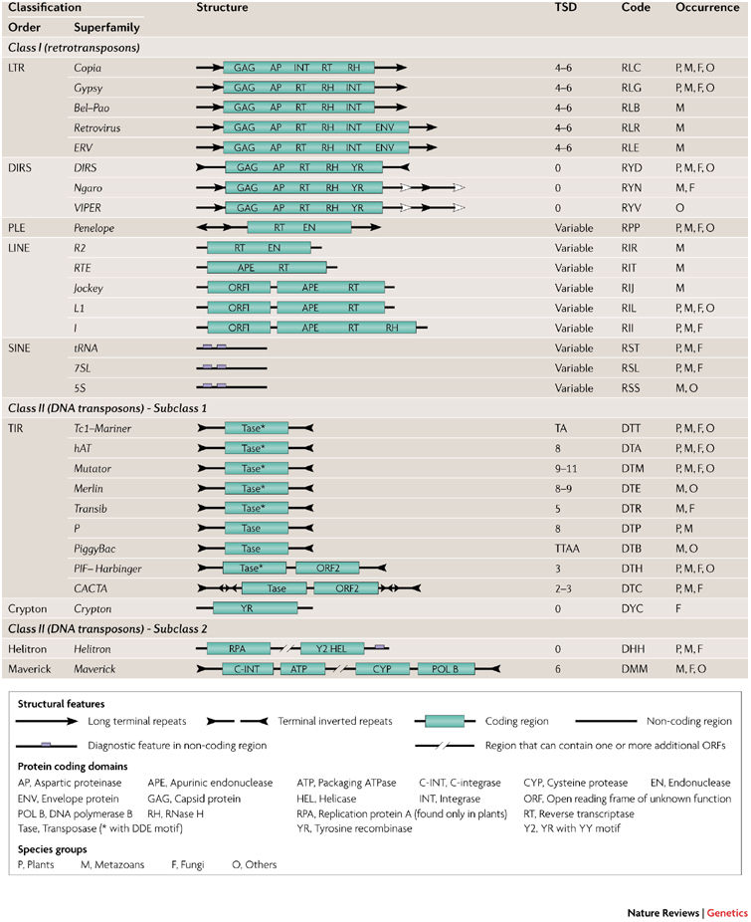
Wicker et al 2007

Slide 5
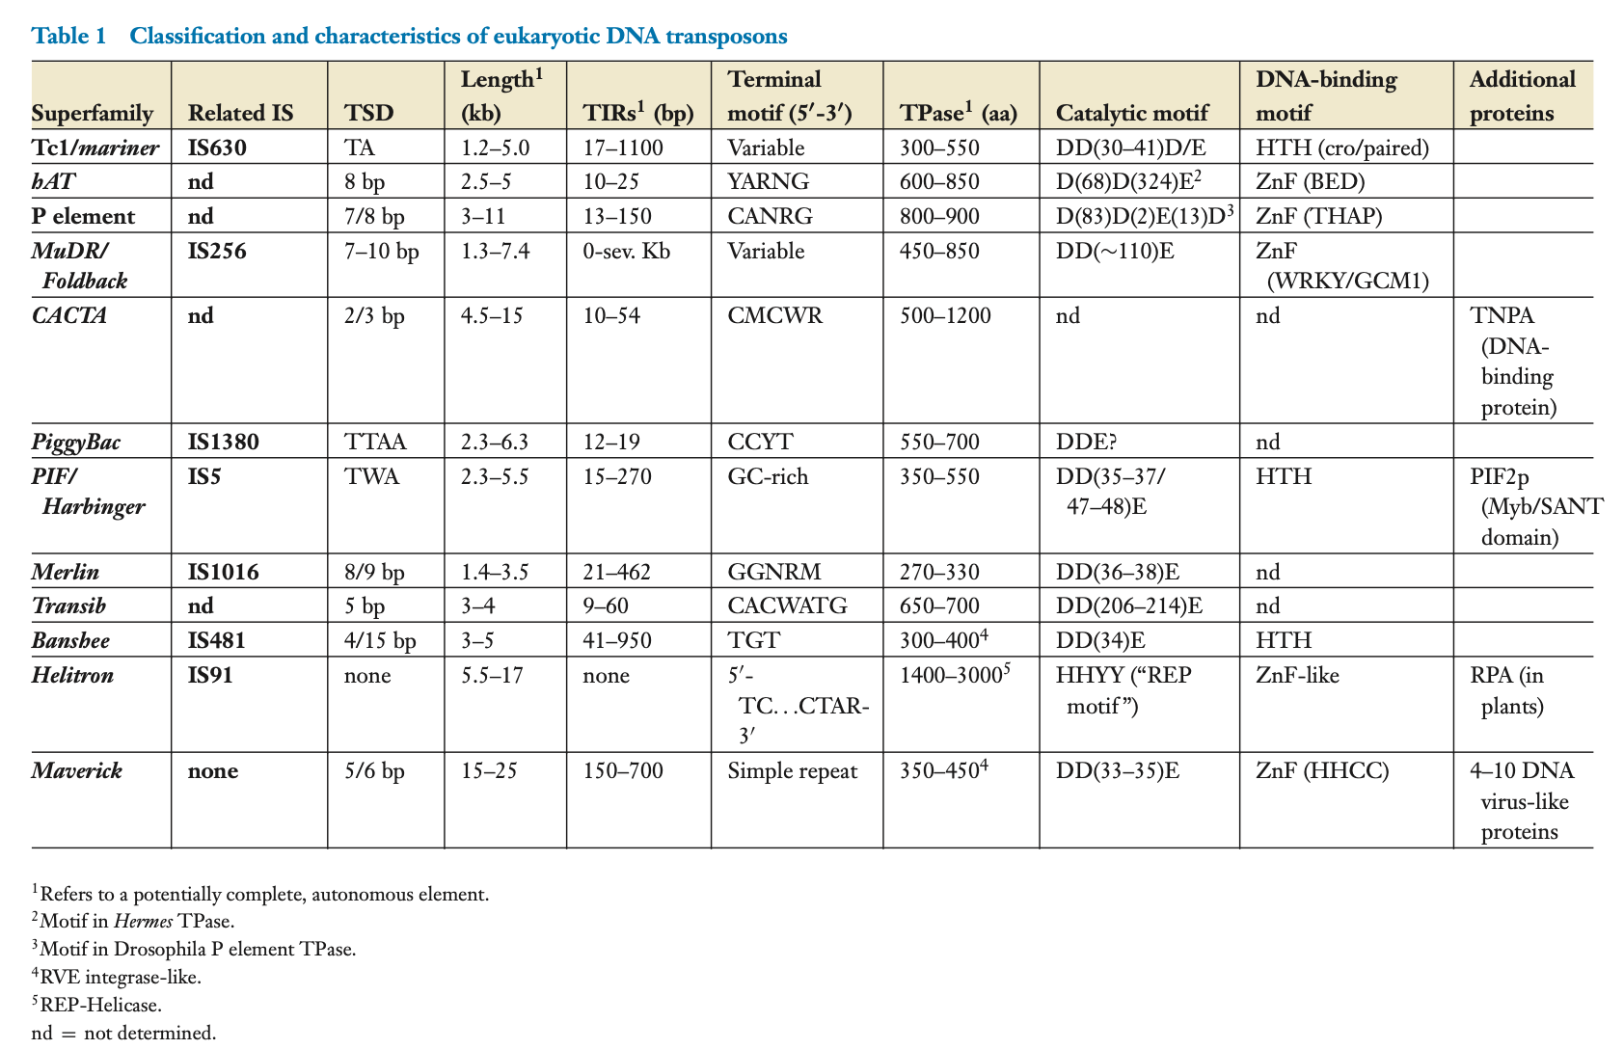
Feschotte and Pritham 2007

