Slide 1
Practical 1 – wrap up
RepeatModeler2
https://github.com/ValentinaPeona/PhysaliaTE2025/blob/main/Practicals/Practical1_part1.md

Slide 2
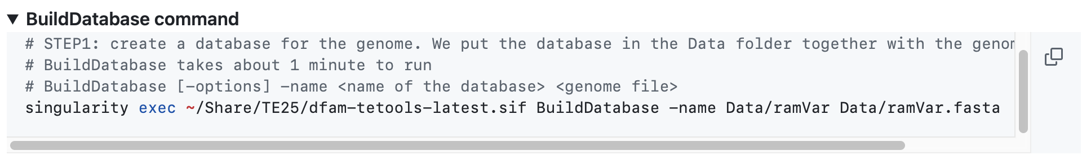
RepeatModeler2

Slide 3
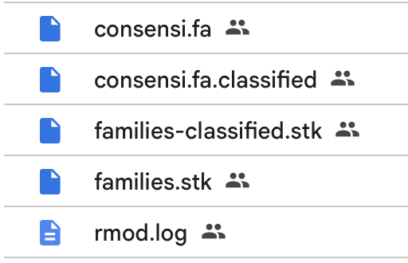
RepeatModeler2
Fasta library of consensus sequences
Stockholm file of the TE families
Aligned sequences to be used as HMM profiles

Slide 4
Fasta
Stockholm
>rnd-1_family-7#Unknown ( RepeatScout Family Size = 601, Final Multiple Alignment Size = 100, Localized to 139 out of 149 contigs )
AAATGGGAGCTGGGCAAACAAAACGTACAAGATCGTTATCTCAAGTGGCG
CACGTTTTCATTGTTATTGGCTGGAAGNGTGCGCCACTCGAGATAACGAT
CTTGTACGTTTTGTTTGCCCAGCTC
# STOCKHOLM 1.0
#=GF ID rnd-1_family-7
#=GF DE RepeatModeler Generated - rnd-1_family-7, RepeatScout: [ Index = R=86, RS Size = 601, Refiner Input Size = 100, Final Multiple Alignment Size = 100 ]
#=GF TP Interspersed_Repeat;Unknown
#=GF CC refLength=261 refName=family-7
#=GF BM RepeatModeler/MultAln
#=GF SQ 100
#=GC RF xxxxxxxx.xxxx....x......xx.xxxxx.xx....x.......x.x.xx.....x.....xxx....xxxx.x...x...x.xxxx.x.x.xxx.......xxxxx.xx.x..................xxx...xxxx.xxx.xx.x.xx.xxxxxx..x..xxxxxxxx.x..xx.x..xxx..x..........x..xxx.xx........xxx..xxxxxx....x.......xxxx.xxxxxx..xx.xxxx
BDGG01000003.1:3811508-3811391 ....GGGA.GCTG....G..........AACA.AA....A.......C.G.TA.....C.....AAG....ACCG.C...A...A.TTTC.G.A.GTG.......GCGCA.CG.C..................TCC...CGAA.GTC.AC.T.AG.CTGGGA..A..GGTGCGCC.A..TG.C..AAG..A..........C..AAC.GA........TCT..TGTACG....T.......TCTG.TTCGTC..CA.GCTC

Slide 5
RepeatMasker
# run RepeatMasker with uncurated ramVar_rm1.0.fasta library
RepeatMasker -pa 1 -a -xsmall -gccalc -excln -gff -s -dir RMSK/ramVar_rm1.0 -lib Data/ramVar_rm1.0.fasta Data/ramVar.fasta
Output
ramVar.fasta.out
ramVar.fasta.gff
ramVar.fasta.tbl

Slide 6
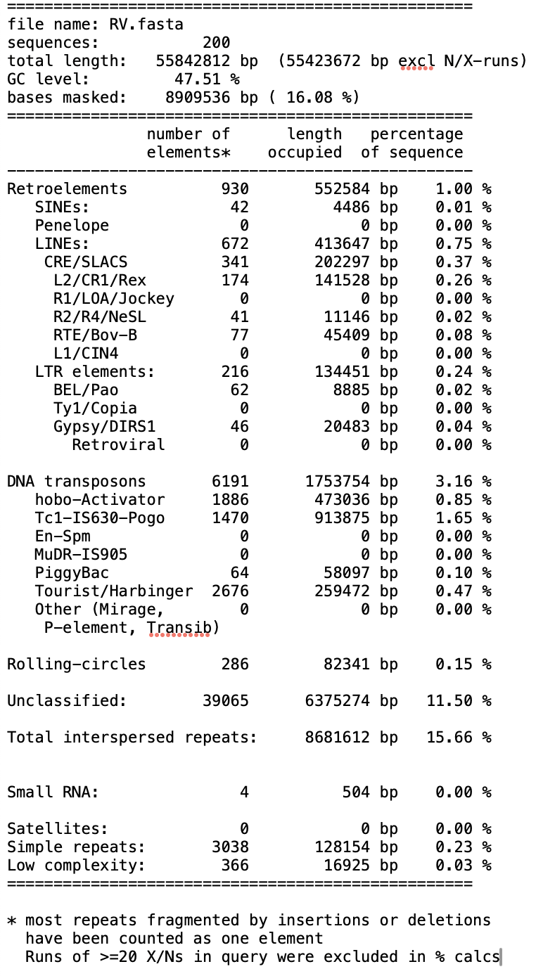

Slide 7
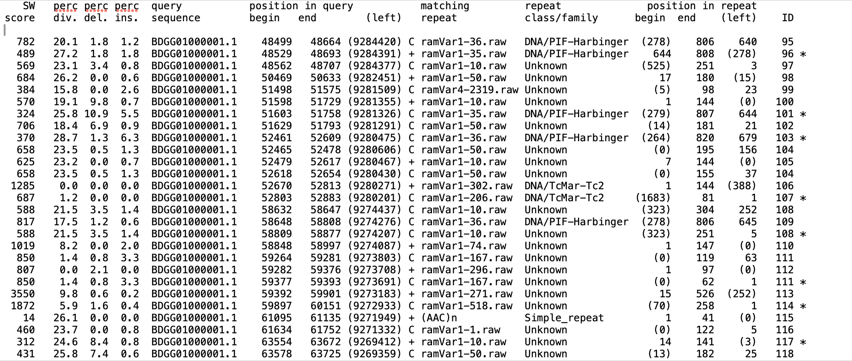
RepeatMasker

Slide 8
RepeatMasker
# Calculate the divergence with Kimura 2-parameter distances (excluding CpG sites)
singularity exec ~/Share/TE25/dfam-tetools-latest.sif calcDivergenceFromAlign.pl -s ramVar.fasta.align.divsum -a ramVar.fasta.align_with_div ramVar.fasta.align
# Create a repeat landscape
SIZE=`grep -i 'total length' ramVar.fasta.tbl | tr -s ' ' | cut -f 3 -d ' '`
singularity exec ~/Share/TE25/dfam-tetools-latest.sif createRepeatLandscape.pl -div ramVar.fasta.align.divsum -g $SIZE > ramVar.fasta.align.divsum.html
The createRepeatLandscape.pl is a good start, easy to run but has its limitations (you should have got some warnings!)
Good to plot your own landscapes

Slide 9
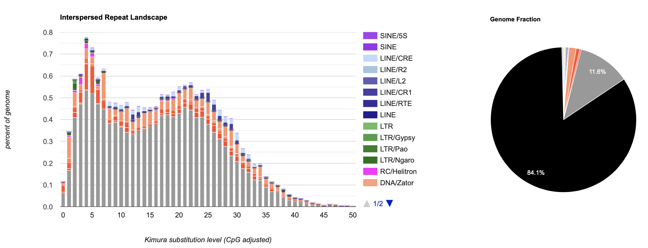
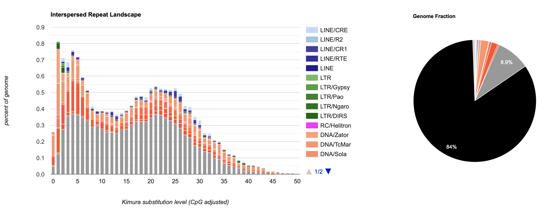
RepeatMasker
Completely uncurated
Partially curated

