Slide 1

Project Report
By: James Kyle Harrison

Slide 2
Requirements for Data Warehouse
“This data warehouse facilitates the study of the number of graduates for different majors, degrees, colleges, GPAs, semesters, and/or any combination of them.”
Major/Degree/College – Incredibly similar data about academic study
GPAs – Data directly related to the graduates
Semesters – Data in regards to Time.

Slide 3
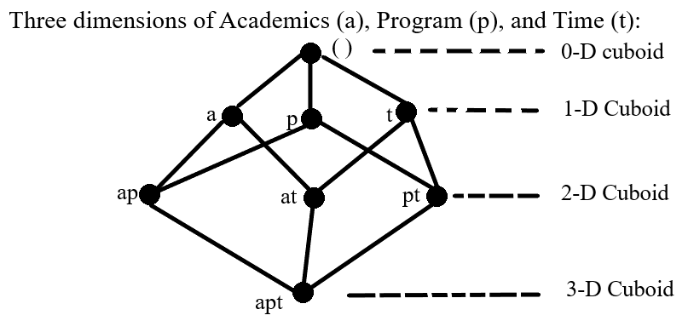
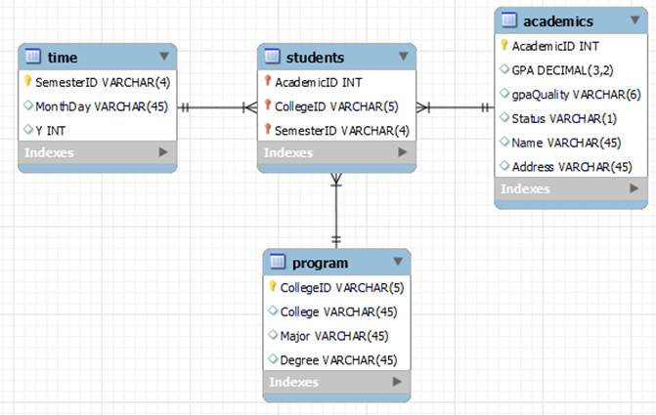
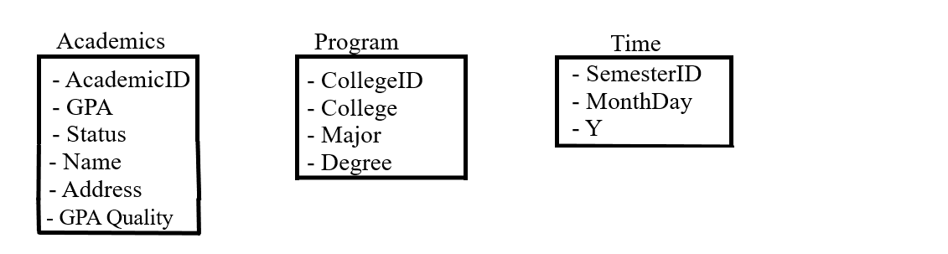
Three-Dimensional Star Schema

Slide 4
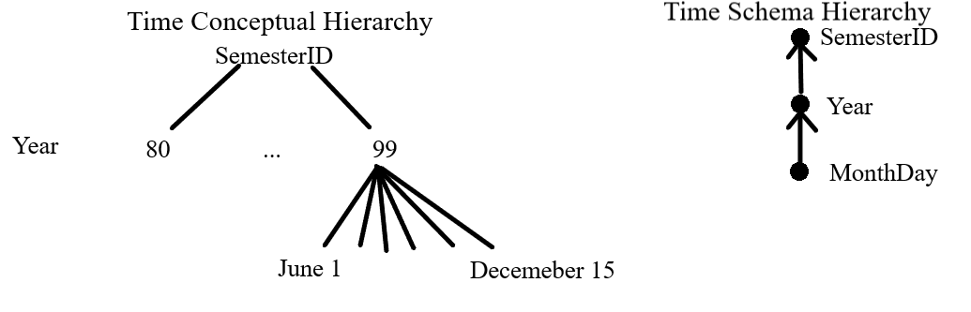
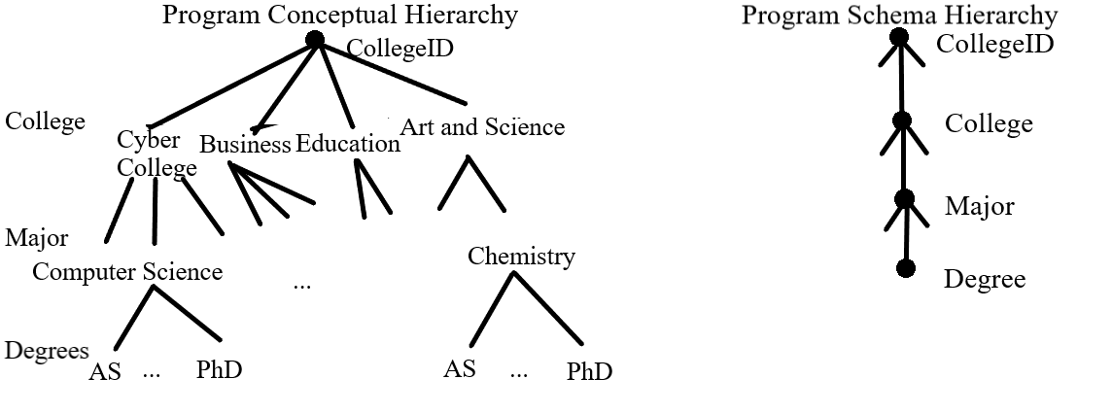
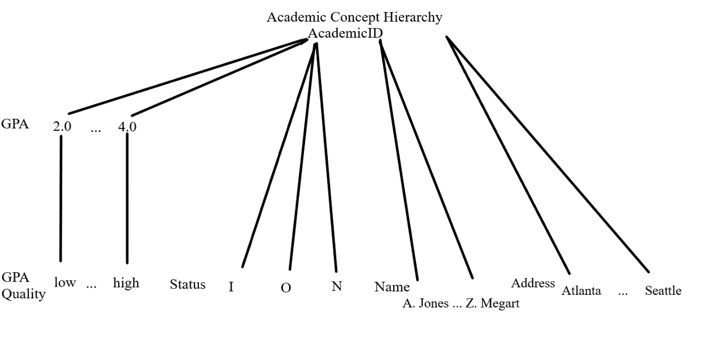
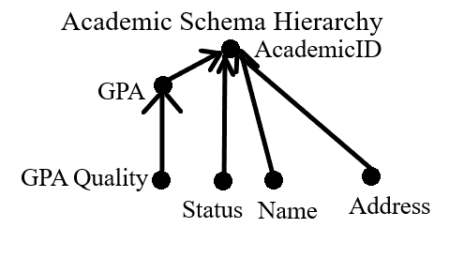
Conceptual and Schema Hierarchies

Slide 5
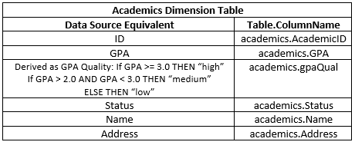
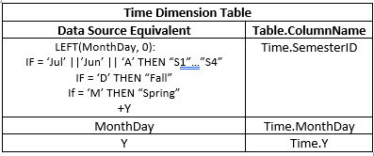
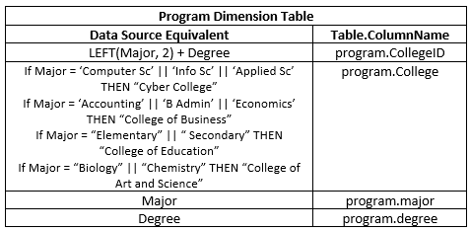
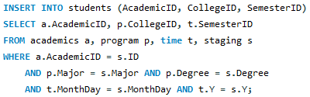
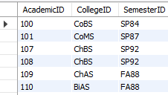
Populating Dimensions and Fact Table

Slide 6
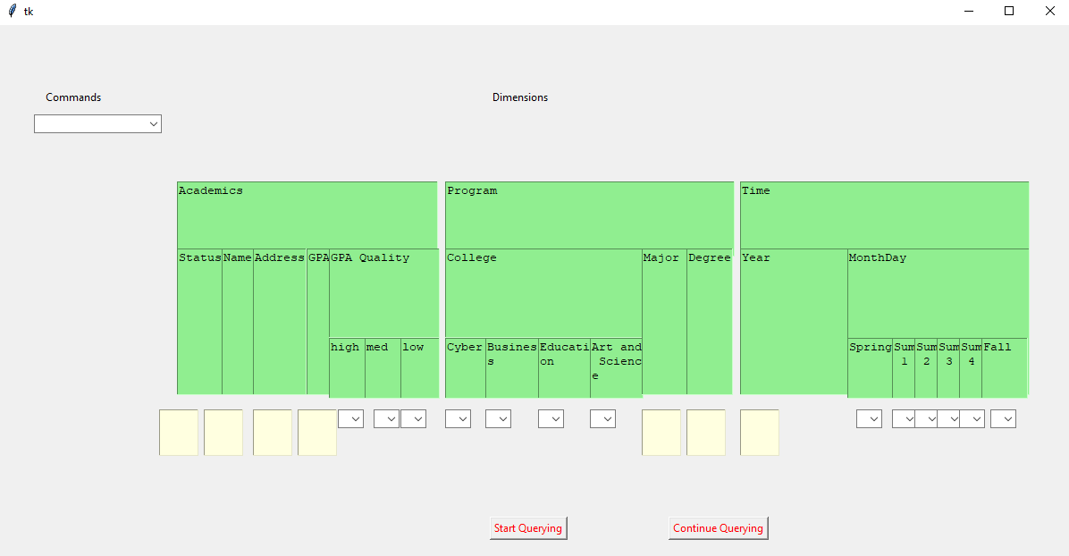
The Interface

