Slide 1
An IDW-based Approach to Interpolating Particle Pollution Data
By: James Kyle Harrison

Slide 2
Introduction
Geographic Information Systems is an important form of storing and processing geographical reference data. Particularly Spatial and Attribute Data using vector or raster data models.
Spatio-temporal Interpolation is of particular concern when it comes to geographical data as well.
Spatial Interpolation: An estimation of unknown values at unsampled locations using data with known values at different instances of time.
Ex: Weather and Rainfall Estimation
Interpolation is tried and true and must be performed to measure particulate matter, yet there are various methods one can use to obtain results of varying accuracy.

Slide 3
Problem
Create a GUI to interpolate particulate matter data, validate the results, create error metrics, and finally query resulting measurements.
Why a GUI?
Although GIS has been a developing field since the 60s, the advancements of GUI changed the field in the 90s.
Why should you use Spatio-temporal Interpolation?
Make up for Data Scarcity
Cost-effectiveness
Integration of multiple data sources to validate information
Why Validation?
Assess the accuracy of results
Identify potential errors
Why Error Metrics?
Define the accuracy
Model Comparison
Evaluate Robustness
Discuss Generalizability
What are the principal concerns when working spatial interpolation?

Slide 4
Methods
Interpolation -Extension or Reduction:
Extension: Adds time as another dimension in space. ‘Extends’ problem to add a dimension into the problem.
Reduction: ‘Reduces’ the interpolation problem by using 1-D interpolation in time.
Inverse Distance Weighting-Based or Shape Function-Based:
IDW: Distance-based method to estimate values using the assumption that closer observation points to the point of prediction are more similar than those farther away. Computationally less complex.
Shape: Divides area of interest into small regions and constructs a set of shape functions based on the distance to the cell center. Computationally more complex.
K-Fold Cross-over validation or Leave-one-out Cross-Validation:
K-Fold: Dataset is divided into k-subsets of equal size then trained on k-1 and tested on remaining subsets. Computationally less complex.
LOOVC: Special case k-fold where k is the number of samples in dataset, and one sample is left for testing. Computationally more complex.
Our Model: IDW-Based Extension with Leave-One-Out Cross Validation

Slide 5
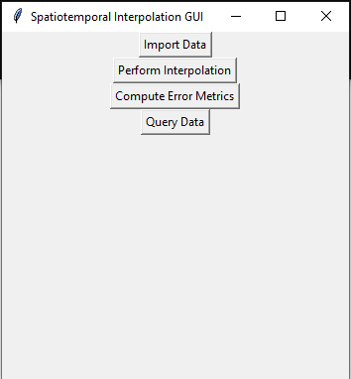
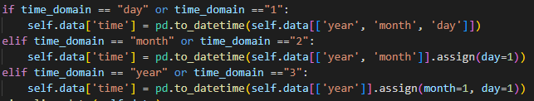
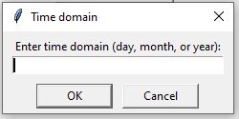
Implementation
Approach written in Python.
GUI: Tkinter
Import Data:
Imports… Data…
Visualizes imported data on US Map (next slide)
Time Domain: Let us be ignorant to show the importance of parsing time domain

Slide 6
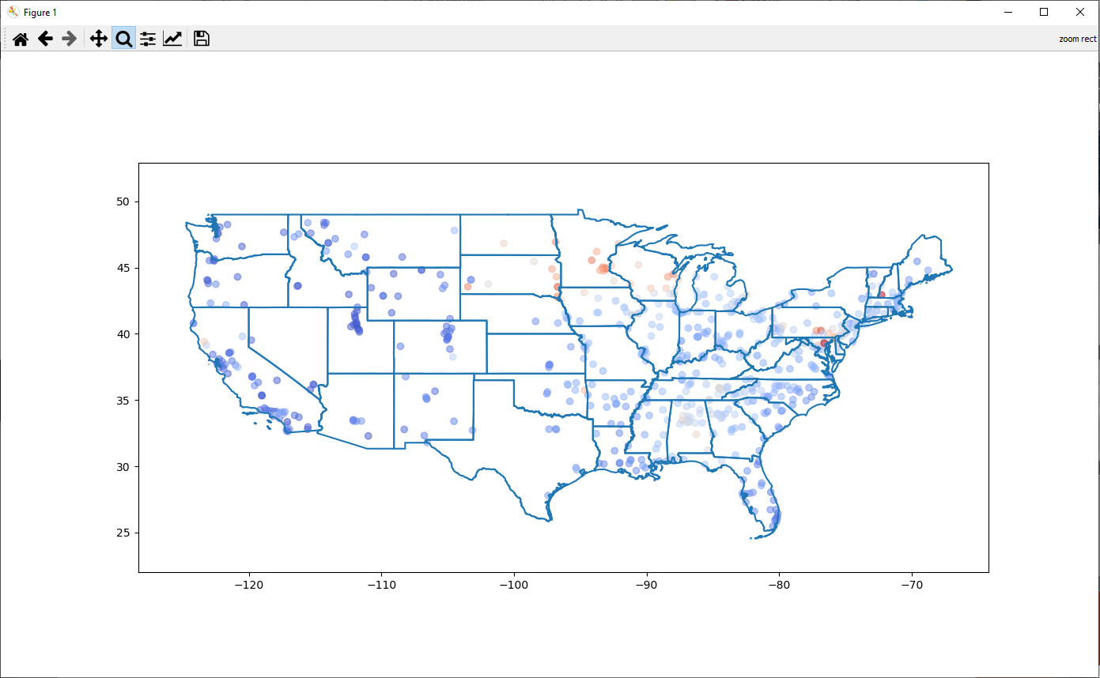
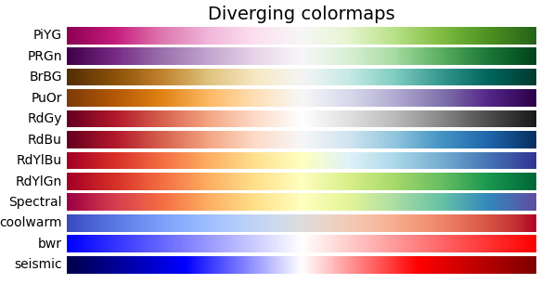
Visualization

Slide 7
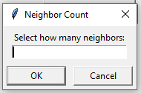
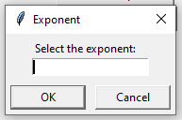
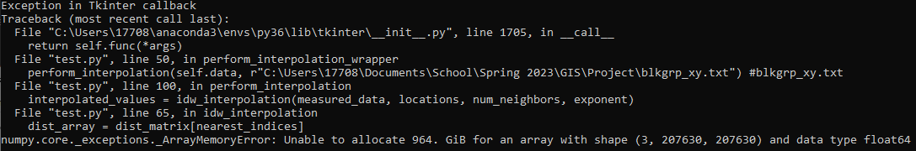
IDW-Based Extension Interpolation
Implementation: Two prompts. If user selects 0 on either they receive our test values.
Perform_Interpolation function: Pilots interpolation by setting values and formatting data
IDW_Intepolation function: Steps listed below
SciPy’s cdist: Allows one to calculate the distance matrix between data points and locations.
Input neighbor count to locate that many nearest neighbors using panda’s argpartition.
Calculate weights for each neighbor and create interpolated values for each location.
County_xy.txt selected

Slide 8
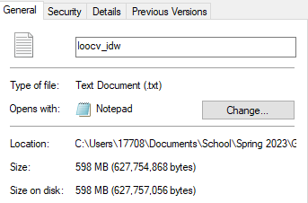
Leave-One-Out Cross-Validation
Initialize empty list of errors to store errors in validation
Go through data selecting all but one entry for training
The list of errors is populated such that we can obtain MSE.
Note: Validation is performed in application after interpolation, but on the same button meaning that you must go through both at once.
Makes a big file, and was quite computationally expensive (5-7 hours of processing on 8-core i7, 16GB DDR4, Nvidia RTX 2070)

Slide 9
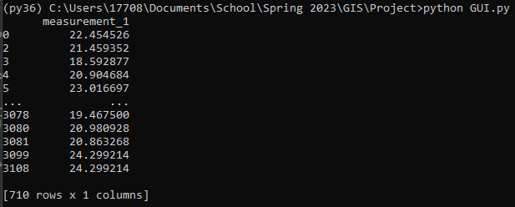
Error Metrics and Querying
SELECT *
FROM import
WHERE time = 1-3-5 AND measurement > 15 AND measurement < 25
Stat | N3e1.5 | N3e3 | N4e1 | N5e2.5 | N6e3 | N7e1 | N7e5
MAE | 5.627746383 | 5.573559 | 5.652893 | 5.443735 | 5.403477 | 5.703161 | 5.355295
MSE | 56.42727327 | 56.77956 | 56.30631 | 53.16313 | 52.76574 | 56.22326 | 53.0653
RMSE | 7.511808921 | 7.535221 | 7.503753 | 7.291305 | 7.264003 | 7.498217 | 7.284593
MARE | 1.043786151 | 1.016651 | 1.064534 | 0.987459 | 0.976768 | 1.087963 | 0.963657

Slide 10
Concerns of Design
Importance of Time Domain: Implementation imported time as such
Resulting in the need to transform the time dataframe to fit the functions properly many times, resulting in a less efficient application. Having the time domain convert to YYYY-MM-DD immediately would have been much simpler.
Further into Time Domain: 1/1/2009 = 1 vs .1 – Clearly rendering time as more simplified information as these two would work much better for any approach to this.
1 – 365 has the advantage in smaller datasets due to its simplistic interpretability.
.1 – 36.5 has the advantage in larger sets that may require the decimal to handle the time scale more efficiently.

Slide 11
Concerns of Design
Memory and Space Usage: The solution functions, but it could be streamlined to run more efficiently.
Could create visualization via matplotlib, could not animate via FuncAnimation

Slide 12
Conclusions
Spatial Interpolation is a critical method in GIS that will continue to increase in importance as weather becomes more extreme with climate change.
Time Domain is of importance to creating an application that does not require so much data transformation.
Leave-One-Out-Validation is very computationally complex
The overall strengths and function of spatial interpolation was demonstrated
Importance of GUI in the advancement of GIS was displayed
The reasons for validation and error metrics were shown, and were used to explain the accuracy of the application

Slide 13
References
1. Q Fu et al. “Rainfall Spatial Estimations: A Review from Spatial Interpolation to Multi-Source Data Merging” (2019) https://www.mdpi.com/2073-4441/11/3/579 Retrieved April 23, 2023
2. K. Fung et al. “Evaluation of spatial interpolation methods and spatiotemporal modeling of rainfall distribution in Peninsular Malaysia” Ain Shams Engineering Journal 13 (2022). https://reader.elsevier.com/reader/sd/pii/S209044792100335X?token=9C9DD6A6D5F28B774523D956DEDF60B5B656537BB6FD575E0C127A37697E795E98D4EDA56A455ADFF0919C426967BC8D&originRegion=us-east-1&originCreation=20230424193112 Retrieved April 23, 2023
3. Revesz, P., & Li, L. (2002a). Constraint-based visualization of spatial interpolation data. In Proc. of the Sixth International Conference on information visualization (pp.563–569).London, England: IEEE Press. Retrieved April 24, 2023
4. P. Ohlert, M. Bach, and L Breuer. “Accuracy assessment of inverse distance weighting interpolation of groundwater nitrate concentrations in Bavaria (Germany)” Environmental Science and Pollution Research (2023) 30:9445–9455 https://link.springer.com/article/10.1007/s11356-022-22670-0 Retrieved 04/21/2023
5. K. Zheng, Y. Kangkang, G. Zhou. “Response simulating interpolation methods for expanding experimental data based on numerical shape functions” (2019) https://www.researchgate.net/profile/Kaikai-Zheng/publication/332405126_Response_simulating_interpolation_methods_for_expanding_experimental_data_based_on_numerical_shape_functions/links/5cb59cea4585156cd79b1e10/Response-simulating-interpolation-methods-for-expanding-experimental-data-based-on-numerical-shape-functions.pdf
6. Esri. (n.d.). How Inverse Distance Weighted interpolation works. ArcGIS Pro Help. Retrieved from https://pro.arcgis.com/en/pro-app/latest/help/analysis/geostatistical-analyst/how-inverse-distance-weighted-interpolation-works.htm Retrieved April 21, 2023
7. P. Antoniadis. Cross-Validation: K-Fold and Leave-One-Out (March 2023) https://www.baeldung.com/cs/cross-validation-k-fold-loo Retrieved 04/23/2023

