Slide 1

Industrial Strength
Design Management™

Slide 2
Agenda
Company Background
Technology Foundation
Features and Benefits
Performance Metrics
Comparison Summary

Slide 3
Company Background

Slide 4

IC Manage Background
Founded Q1, 2003
Commercial evolution of ‘cdsp4’ technology
Extensive input from IC companies
    SGI, nVidia, Apple, Matrix Semi, TriCN, Pixim, Raza Micro, Afara, 3dfx
Powered by
Notes:
Shiv Sikand, IC Manage's VP of Engineering, developed the fundamental concepts for IC Manage when he was working at Silicon Graphics. At the time, SGI software developers were using a new Software Configuration Management (SCM) developed by a company called Perforce. Perforce took an entirely new approach to SCM, using a relational database.
Shiv created a Cadence-Perforce integration called “cdsp4” in 1998 and successfully implemented the robust IC design management system that he had envisioned. He placed the product into the public domain in 2000. It has since been deployed at a number of companies for large-scale design like SGI, NVIDIA, Apple and Matrix Semiconductor.
IC Manage was founded to created a commercial product based on the cdsp4 approach. Although our company is new, the approach has been used in industry for several years already.

Slide 5
Known as the FAST SCM solution
Truly great base technology for the Engine
120,000+ worldwide users
2,400+ organizations worldwide
50+ operating systems
Near-zero administration overhead
Unequalled technical support
Notes:
Perforce took an entirely new approach to SCM, using a relational database.
Perforce is very robust with over 120,000 copies in daily use around the world.
In addition to the best performance in the industry, Perforce is known for having very high reliability.

Slide 6

Executive team
    Dean Drako, President and CEO
    Shiv Sikand, VP of Engineering
    Stephen Pollock, VP of Marketing
    Rich Cerruto, VP of Sales
Board member
    Christopher Seiwald
      President and CTO, Perforce Software, Inc.
www.icmanage.com
Notes:
The CEO is Dean Drako who has led a number of successful start-up companies in EDA and in networking.
IC Manage has a very close relationship with Perforce.
Perforce's president Christopher Seiwald is on IC Manage's board of directors.

Slide 7
Technology Foundation

Slide 8
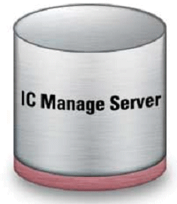

Technology Foundation
Database driven, change based architecture
Atomic Transactions
Virtual branching
Raw TCP/IP communications
Design Data
Change Data
Raw TCP/IP
Powered By
Notes:
The heart of the IC Manage tool is the Perforce database
It’s key characteristics are:
Using a relational database coupled with a change-based architecture (each change has a unique entry in the database providing total traceability).
Atomic transactions (all elements involved in a change are logged into the database as a traceable event)
Virtual branching (giving the ability to branch a design without having to carry multiple copies of the design data).
Raw TCP/IP network communications
I will explain these characteristics in more detail.

Slide 9
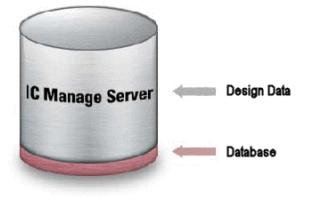
Database Driven
Change-based
No tags
Database on server
Database Stores
  Checkout status
  Who has what files
  Changes to files
  Version information
  Branches
  History
  Defects
  MD5 sums for all files
Notes:
The first unique characteristic is the change information is stored separately from the design data itself. This differs from “tag based” systems which store change information inside the design file itself.

Slide 10
Release Tagging Example
Tag 1
Tag 2
Tag 3
Tag 4
Tag 5
A
A
A
A
A
Conventional
Tag-Based
System
B
B
B
B’
B
C
C
C
C
C’
D
D
D’
D
D
E
E
E
E
IC Manage
Change-Based
System
A
B
B’
C
C’
D
D’
E
Notes:
This shows the difference between the so called “tag based” system and IC Manage.
In this example, a certain design configuration initially consists of 4 files. In a tag based system, each design file is opened and some information called a tag is added to the file. Here, “Tag #1” is written into each file. As the design progresses, file “E” is added resulting in a new configuration. Each file is then edited and another tag, “Tag #2” is added. Each time a new configuration of the design is created, all the files must be edited with new tag information.
In the IC Manage method, there are two major differences:
First we do not open the file to add a tag. Instead the database keeps track of the files that are associated with the initial design.
Second, as the design evolves, we IC Manage keeps track of only the changes that occur in each new configuration.

Slide 11
Database Driven – Not Tags
Data is managed by a relational database
Design data is separate from change data (“metadata”)
  Change data is orders of magnitude smaller than design data
  Change data can be directly queried rather than collecting file status from distributed workspaces
All changes assigned a unique change number
  Enables design to be restored to any previous state
Notes:
Therefore we say IC Manage is “database driven” and does not use tags.
Every transaction in the system is assigned a unique change number, making it very easy to track changes throughout the entire design history.
As IC Manage follows a client-server architecture, all metadata is stored on the server and thus all prior states of the design can be queried directly through the database rather than having to collect file status information from distributed workspaces across your network. Data queries and reporting tasks are fast and easy to perform.

Slide 12
Atomic Transactions
In hardware design sets of files are changed together and therefore must be tracked together
Atomic Transactions allow a set of files, which together form a change, to be tracked together
All files are synchronized (checked in) as a set, or none at all
  No partial tagging or data corruption
Comparison of data on server is done through MD5 signature (checksum) not through “diff”
Notes:
To properly do configuration management and track change history, the tool must be able to keep track of groups of files which together constitute a change. This is handled easily and reliably though “atomic transactions”.
One can reliably create a release without worrying about corrupted data due to partial tagging

Slide 13
Virtual Branching – No Copying
Cell 1 and Cell 2 are not replicated in the database
The only differences in the databases are the caches.
Full dependency tracking
Parallel design can be done with only incremental data growth
1
2
4k Cache
1
2
Variable
Cache
1
2
8k Cache
Notes:
A “branch” is a database term. In hardware design in might be called a “derivative”. Essentially we mean the original design files are copied then edited to create a new design. The new design can be thought of as the child while the original design is the parent. In this example, blocks 1 and 2 are common to the two branched designs; the difference is only in the cache.
IC Manage handles branches very efficiently by first creating a virtual copy of the files, then creating an actual copy of just the files that have changed. In other words, we do not create unnecessary copies.
I will explain the benefits to this approach in a subsequent slide.

Slide 14
Raw TCP/IP Communications
IC Manage
Server
LAN (TCP/IP)
IC Manage
Server
Sync
Server
Mirrored
Server
HTTP
LAN (TCP/IP)
LAN (TCP/IP)
Each Client
NFS Mounted
IC Manage
  Stateless TCP/IP – no latency penalty
  Same TCP/IP used over LAN, WAN, VPN
  Only incremental data is transferred
Traditional method
  HTTP – Slow, high latency
  NFS – unreliable, high OS load
Enabling Operations to Complete in Seconds not Hours
Notes:
Unlike previous generation systems, IC Manage delivers the performance required to handle today’s large chip designs. The IC Manage architecture provides high bandwidth performance via its streaming architecture. At the same time, the IC Manage database architecture which tracks configurations, versions, and other information makes sure only the incremental data is transferred. These combined features deliver performance over 100 times faster than conventional “tag” based systems.

Slide 15
Features and Benefits

Slide 16
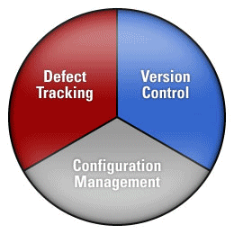
Comprehensive Design Management

Slide 17
The IC Manage Approach
Corporate-Wide Reuse
True Variation Management
Cross-Coupled Defect Tracking
Maximum Network Performance
Highest Reliability
Easy To Use
Simple Installation
Design Data
Change Data
Raw TCP/IP
Powered By
Notes:
Next, I will explain the features, listed here, which can be realized from the unique approach taken by IC Manage.

Slide 18
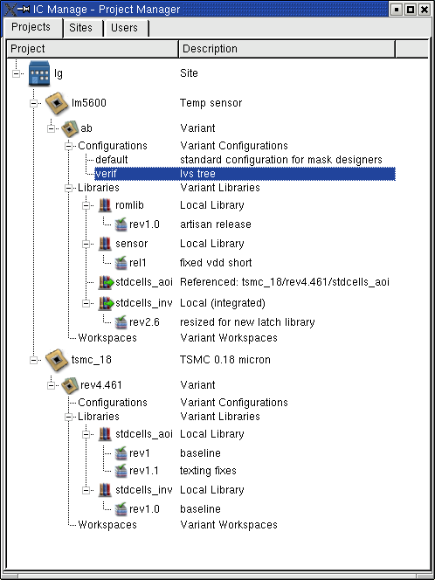
Corporate-Wide Reuse
All corporate design data on server
Full integration history
Detailed location and usage information on shared components available as metadata for fast access
Faster time to market with reuse
Notes:
One of the fundamental requirements for design reuse is having easy and rapid access to the available design data in the first place. To be accessible the data must be well-organized and available in real time.
This is accomplished by IC Manage by putting all the design data in a central server.
Designers can easily view the design data history, select appropriate components, and create designs from any of the enterprise’s assets.

Slide 19
Design Reuse – Complete Audit Trail History
A
A^{I}
1
2
1
2^{I}
Chip A
3
3
B
B^{I}
4
2^{I}
4¹
2^{I}
At this point we know the complete history of cell 2
  Revision History
  Every design that uses cell 2
Chip B
5
5
C
C^{I}
6
2^{I}
6
2^{II}
Chip C
8
8
9
9
Notes:
As an example, here we show 3 chips being developed where 2 of the chips are based on previous designs. In addition, all the chips contain cell 2, but some contain different versions of it. With IC Manage, we can track the complete revision history of cell 2 and also find out every design which uses cell 2.

Slide 20

True Variant Management
Q: What is a variant? (derivative)
  An alternate configuration of a design element that must exist in parallel to the original
Q: What is a version?
  A modification or bug-fix that replaces the original
IC Manage tracks variants differently from versions
Instead of copying and tagging all files, IC Manage just keeps track of which files are modified
  Change based approach
  Prevents “data explosion”
  Allows multiple scenario evaluation with only incremental growth in data
IC Manage easily propagates changes of a file through all the designs that utilize that file
Managing Multiple Designs in Parallel
Notes:
Note to translator: “Data explosion” refers to huge growth in data (file) size. Please translate carefully.
Earlier, I explained the concept of the “virtual branch”. Based on this approach we offer the unique capability of true variant management.
IC Manage easily propagates changes of a file through all the designs that utilize the file. This eliminates the manual operations needed to update all the locations where the file was reused. Designers no longer have to remember where a block is reused and manually update all the copies of the files.

Slide 21
Cross-Coupled Defect Tracking
IC Manage tracks all key information
  Design configuration
  Design file and versions when defect was discovered
  Who fixed the defect
  Which files where changed to fix the defect
Can precisely replicate bug by synching design to exact state when bug was reported
Linking Defects to Design Changes
Notes:
The IC Manage defect tracker is integrated with the configuration management system. In other words, when a bug is fixed, the bug is bound (associated with) all the files that fix the bug. With IC Manage one can query the system such as: “give me all the versions of files that fix this bug”
With conventional systems, the defect tracker is not necessarily connected to the configuration management system. Also, with tag-based systems, the user must specifically create tags for the bug fix. With IC Manage it’s handled automatically.

Slide 22
Highest Reliability
“ACID”- Four key criteria for a reliable database
  Atomicity – all files transferred or none at all – prevents data corruption
  Consistency - database is transformed from one valid state to another
    Illegal transactions not allowed
  Isolation -race conditions eliminated so multiple transactions do not collide
  Durability - once a transaction commits, it survives, even if a hardware failure occurs
Checkpoint and journal support allow design data to be returned to any previous state
MD5 signatures
Industrial Strength Database for Highest Reliability
Notes:
In the database field, there is an acronym called “ACID” which refers to the four key criteria for a reliable database. Perforce meets these criteria.

Slide 23
Simple Installation
Optional pre-configured servers enable system administrators to quickly install IC Manage
No software or OS to install
No lengthy configuration process
Easy client installation and network configuration
Notes:
IC Manage does not require any complex networking changes or a complex installation. No NFS mounts, no port openings, and no services are required.
IC Manage’s optional pre-configured servers enable system administrators to quickly install IC Manage so designers can be immediately productive. There is no software to install, no OS to install, no problems and no lengthy configuration process. System administrators just simply plug it in.

Slide 24
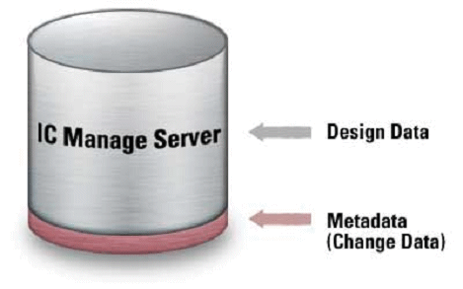
Hot Backups
Metadata is orders of magnitude smaller than design data
Design suspends momentarily to back up metadata
All requests are queued during backup
New changes can be checked in while archive is being backed up
Notes:
A major disadvantage of conventional archive-based systems is that the design data must be static in order to perform a backup. This might seem to be a minor inconvenience for a local design group but can grow to be a severe problem in a multi-site environment that covers multiple time zones. IC Manage does not have this problem because only the much smaller metadata (change data) needs to be static for the backup. The change data is typically several orders of magnitude smaller than the design data itself.
Design suspends only momentarily during an IC Manage backup and all requests are queued during that time for execution once the appropriate locks have been released. Once the change data is backed up, the database is unlocked and the user can continue to check in data. New data can continue to be checked in while the design data itself is being backed up. Since only changes are checked into the database, the only data relevant to the backup is the state of the design data when the metadata was backed up. Therefore the design data can be in a dynamic state with new data being added since the new design data is irrelevant to the backup.
Locking the design data for a few hours is practical for a single site location since the data can be locked during off hours. For companies with time zone distributed sites, locking the design data can cause serious productivity issues and designer downtime.
IC Manage does not have this problem because its database is typically several orders of magnitude smaller than the design data and far simpler in structure.

Slide 25
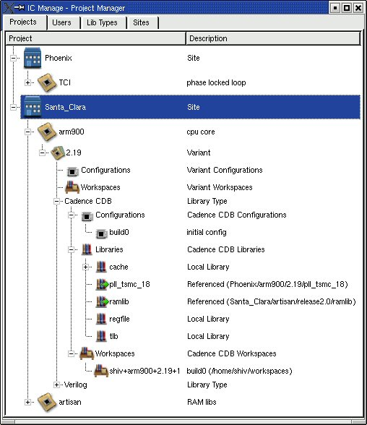
Project Manager

Slide 26
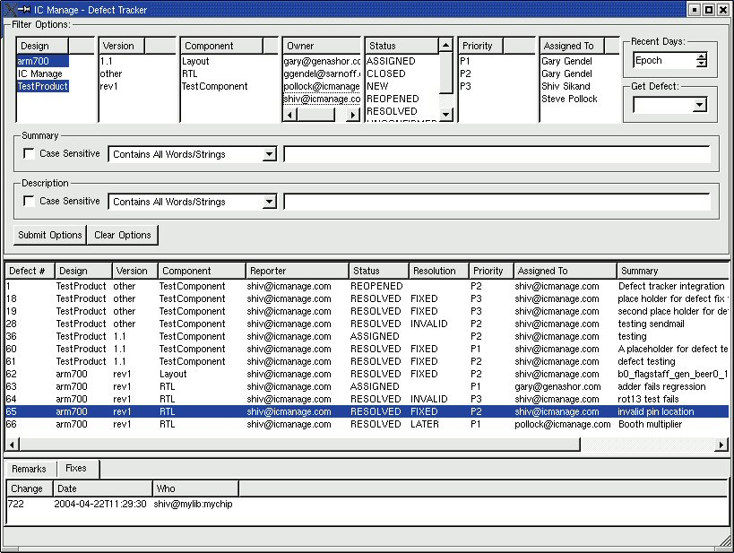
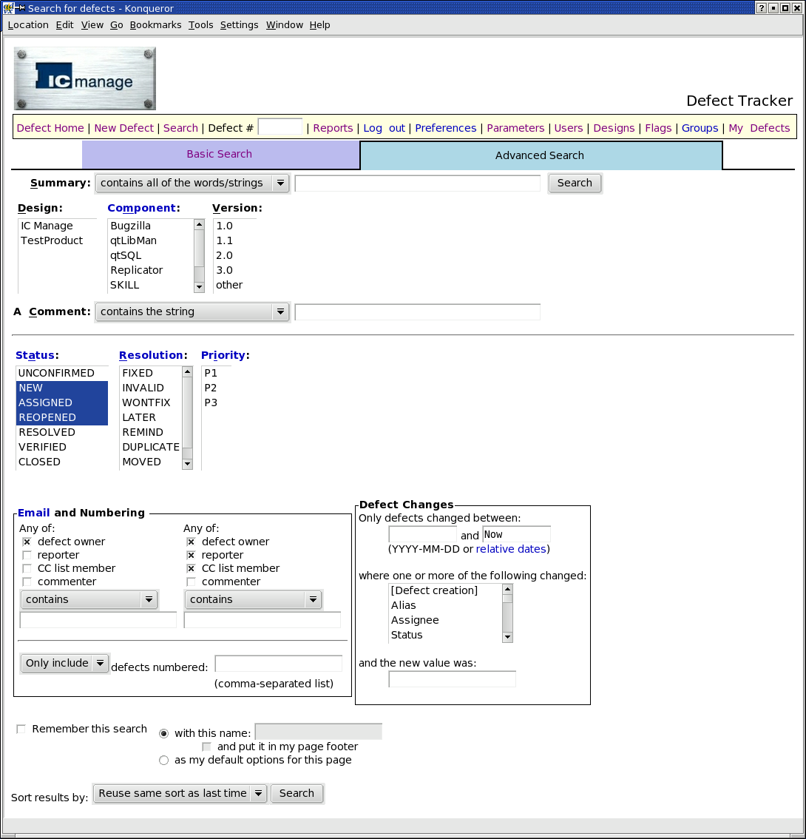
Defect Tracker
Defect Query
Query Result
Fix Change #
Web Window

Slide 27
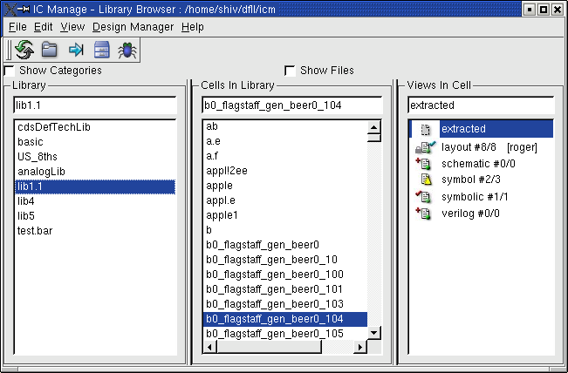
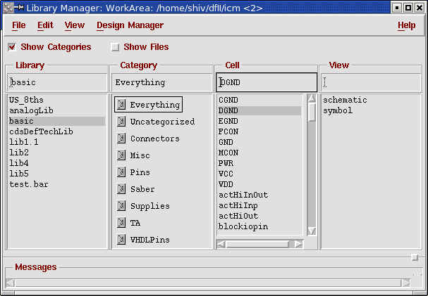
DFII Library Manager
Replaces Cadence library manager

Slide 28
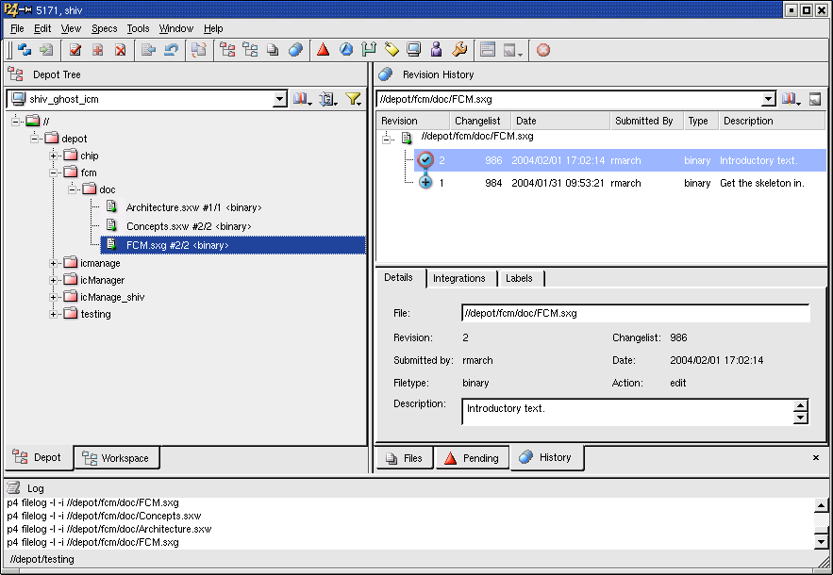
Browser

Slide 29
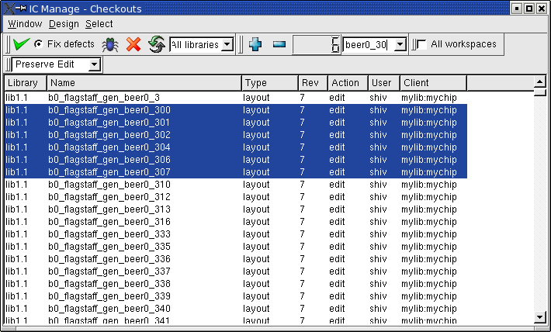
Checkout Manager
Shows what has been checked out from the server
User selects files to checkin
Fix selected defects with checkin

Slide 30
IC Manage Advantage
Industrial Strength Design Management
Highest Productivity
  Up to 100 x Faster
  Highest Capacity
  Highest Reliability
  Designer Mobility
  Easy Installation and Use
The Next Generation in IC Design Management
  True Variation Management
  Corporate-Wide Reuse
  Maximum Network Performance
  Cross-Coupled Defect Tracking

Slide 31
Benchmark Data

Slide 32
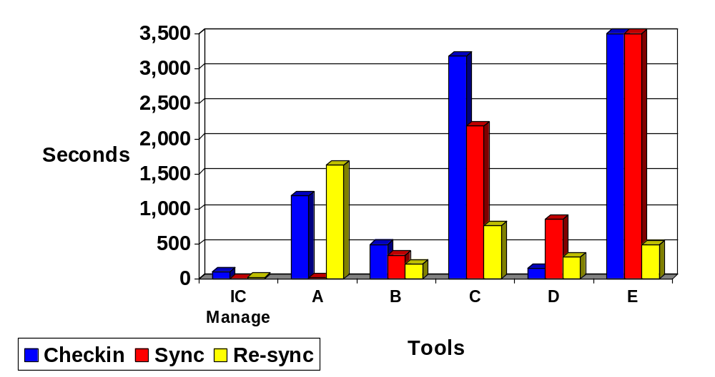
Up to 100 Times Faster
Truncated (actual times 6,143 & 3,999 seconds)
Single DFII library
30K files
50 MB of data
Notes:
A company with a full custom design provided the data for the benchmark below. The benchmark was conducted independently by senior industry EDA experts.
The data set used consisted of a single DFII library of approximately 30K files and 50 MBytes of data. The five most common configuration management tools, currently used in hardware design data management, were compared on identical hardware with 2GB of RAM. The graph above shows the amount of time to perform the operation.

Slide 33
Highest Capacity
Microprocessor Design – Load Time
IC Manage
1.2 Hr
A
12 Hr
B
12 Hr
Tool
C
12 Hr
D
12 Hr
E
12 Hr
0
2
4
6
8
10
12
Time (Hr)
Single DFII library
91,265 directories
287,195 files
6 GB of data
A through E truncated at 12 hrs (not allowed to finish)
Notes:
IC Manage provides the highest capacity in the industry because of its extremely efficient and robust TCP-based communications implementation.
The test was to read in the design files for a microprocessor design. This design had 91,265 directories, 287,195 files, and used 6 Gbytes of disk space. IC Manage loaded this design in 1.2 hours and the other systems were unable to load the design even after 12 hours (when they were terminated).

Slide 34
Proven Reliability
Company name | Files at head revision | Total number of files | Database size | Number of crashes, failures, core dumps
Silicon Graphics | 9,995,324 | 54 Million | 150 GB | 0
nVidia | 6,869,424 | Not available | 1.2 TB | 0
Notes:
IC Manage utilizes the Perforce engine with over 120,000 users. Unlike other design management systems, IC Manage implements advanced database reliability features more commonly found in enterprise databases. The Perforce reliability is so outstanding that there has never been a reported problem with corruption throughout Perforce's large installed base. This is in sharp contrast to many others where their customers have reported such issues.
The following table gives some real customer data and demonstrates the reliability of IC Manage.

Slide 35
Comparison Summary

Slide 36
IC Manage vs. Tag Based Approaches
 | IC Manage | Tag Based (Others)
Reliability | Excellent | Poor
Scalability | Excellent | Poor
IT Admin Cost | Low | High – ongoing
Network Architecture | High Perf Data Access | Unreliable Data Transmission
Backups | Hot Backups – Minutes | Off-Line Backups – Hrs/Days
Cross Coupled Defect Tracker | Yes | No
Handle Moved Directories | Yes | No
Variant Tracking | Yes | No
Variant Change Propagation | Yes | No

Slide 37
Extra Slides

Slide 38
Multi-Team Collaboration
LAN
IC Manage
Server
LAN
IC Manage
Server
WAN
(Reliable T1
Connection)
Small #
of users

Slide 39
Multi-Team Collaboration
LAN
IC Manage
Server
WAN
IC Manage
Cache
Larger #
of users
WAN

Slide 40
Multi-Team Collaboration
LAN
IC Manage
Server
IC Manage
Server
LAN
IC Manage
Server
LAN

Slide 41
3rd Party Tool Integration Support
Tight Integration for Cadence DFII
  Component Data Bank (CDB) database format
  Open Access (OA) database format
Synopsys
  Apollo
  Milkyway
Others

Slide 42
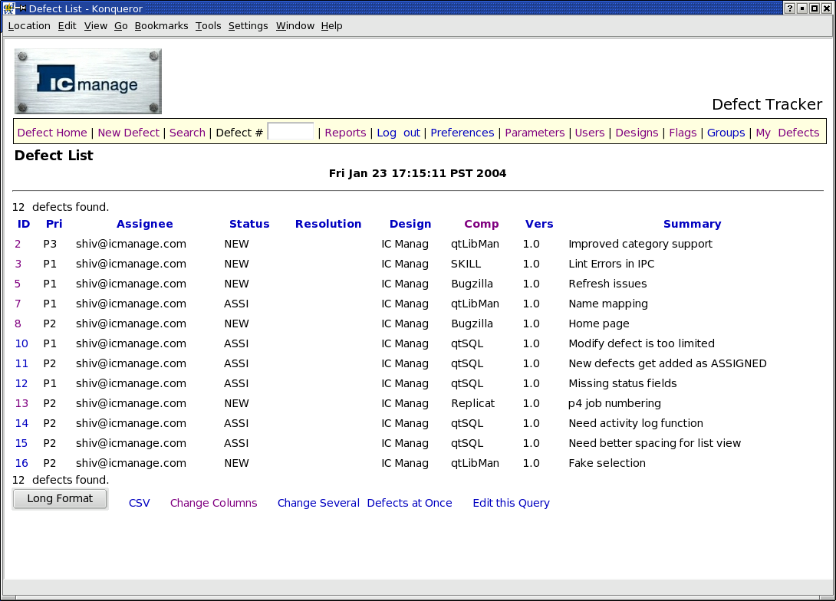
Web Based Defect Tracker
Query
Detail

Slide 43
DFII Integration
Powerful visual environment
Custom library tool allows single point of access and extended feature set
Support for co-managed sets without additional files
  Competitors add files to your database!
Free movement in revision space
Implicit configuration engine
  No tag creation and management issues
C++ integration

