Slide 1
Design and comparison of a straight microstrip line and a periodic EBG structure microstrip line in HFSS
Soumojit Bose
Nagaraj Siddeshwar
Presented in partial fulfillment of the requirements of
“High Speed Digital Design” (ECEN 5224)
Spring Semester 2018
Professor Eric Bogatin
Professor Melinda Picket-May
Department of Electrical and Computer Engineering
University of Colorado at Boulder
April 27, 2018
ECEN 5224 Final Presentation
April 27, 2018
Boulder, CO
Notes:
Capitalizations

Slide 2
Outline
Introduction
Bloch Waves
The Band-Gap effect
HFSS Modelling
Straight Microstrip Line (MLIN)
EBG structure in Ground plane
EBG structure in trace
Results and Conclusion
ECEN 5224 Final Presentation
April 27, 2018
Boulder, CO
1

Slide 3
Introduction
ECEN 5224 Final Presentation
April 27, 2018
Boulder, CO

Slide 4
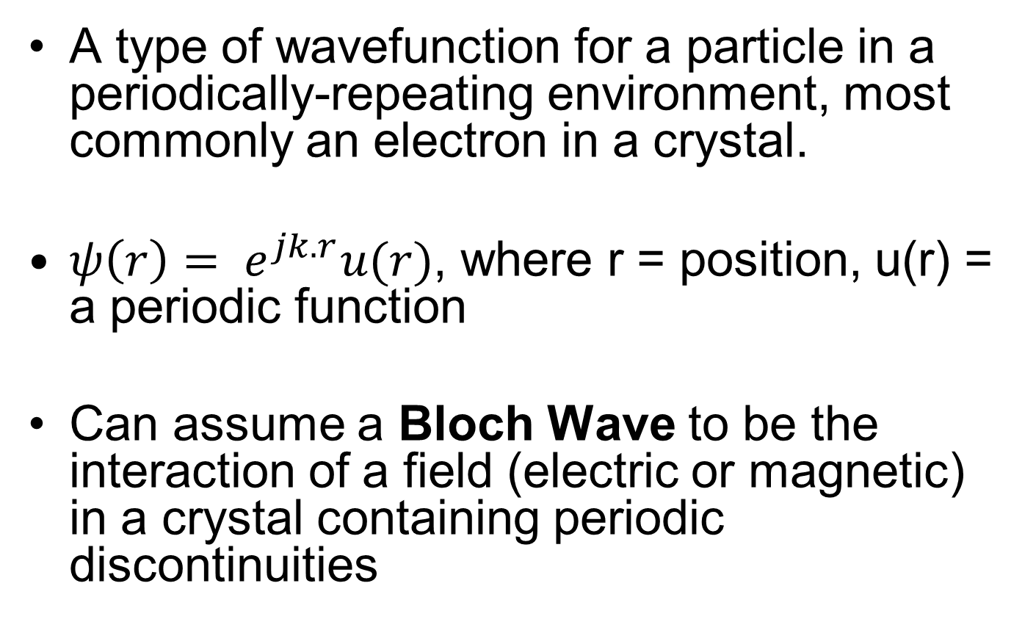
Bloch Waves
A type of wavefunction for a particle in a periodically-repeating environment, most commonly an electron in a crystal.
$ψ\left(r\right)= e^{jk.r}u(r)$, where r = position, u(r) = a periodic function
Can assume a Bloch Wave to be the interaction of a field (electric or magnetic) in a crystal containing periodic discontinuities
ECEN 5224 Final Presentation
April 27, 2018
Boulder, CO
2

Slide 5
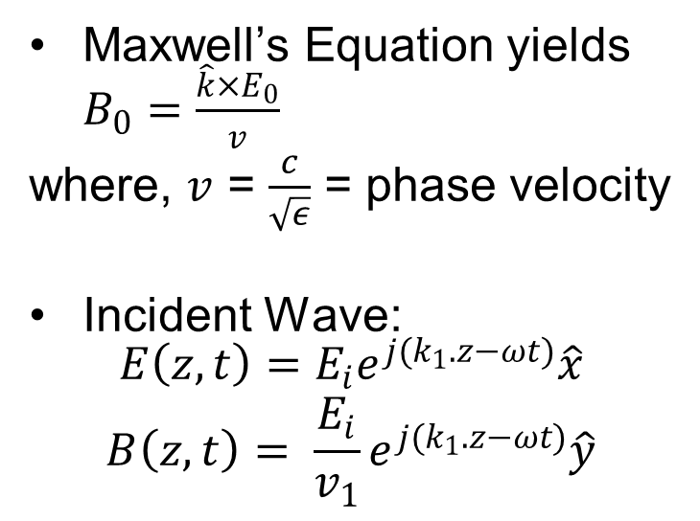
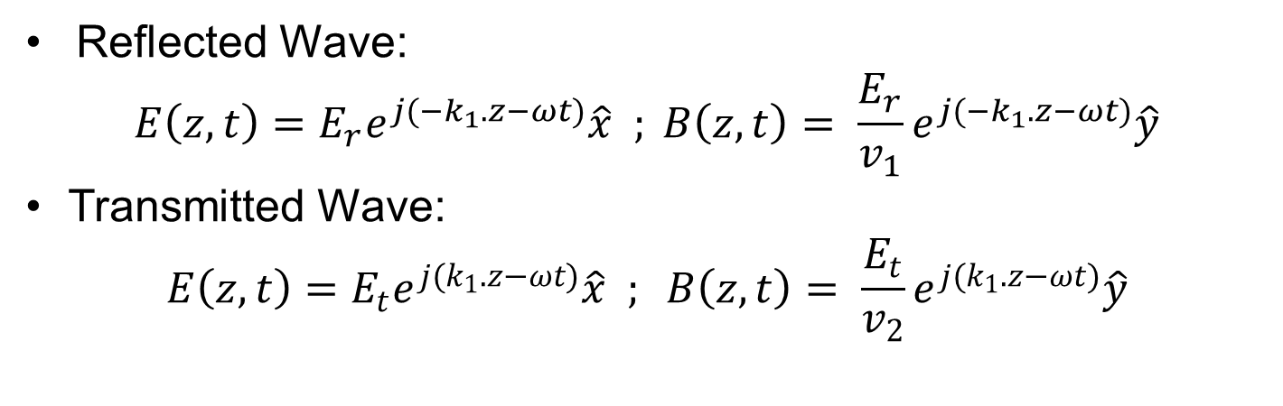
The Band-Gap Effect
Maxwell’s Equation yields $B_{0}=\frac{\hat{k}×E_{0}}{v}$
where, $v$ = $\frac{c}{\sqrt{ε}}$ = phase velocity
Incident Wave:
$$E\left(z,t\right)=E_{i}e^{j(k_{1}.z−ωt)}\hat{x}$$
$$B\left(z,t\right)= \frac{E_{i}}{v_{1}}e^{j(k_{1}.z−ωt)}\hat{y}$$
Reflected Wave:
$$E\left(z,t\right)=E_{r}e^{j(−k_{1}.z−ωt)}\hat{x} ; B\left(z,t\right)= \frac{E_{r}}{v_{1}}e^{j(−k_{1}.z−ωt)}\hat{y}$$
Transmitted Wave:
$$E\left(z,t\right)=E_{t}e^{j(k_{1}.z−ωt)}\hat{x} ; B\left(z,t\right)= \frac{E_{t}}{v_{2}}e^{j(k_{1}.z−ωt)}\hat{y}$$
ECEN 5224 Final Presentation
April 27, 2018
Boulder, CO
3

Slide 6
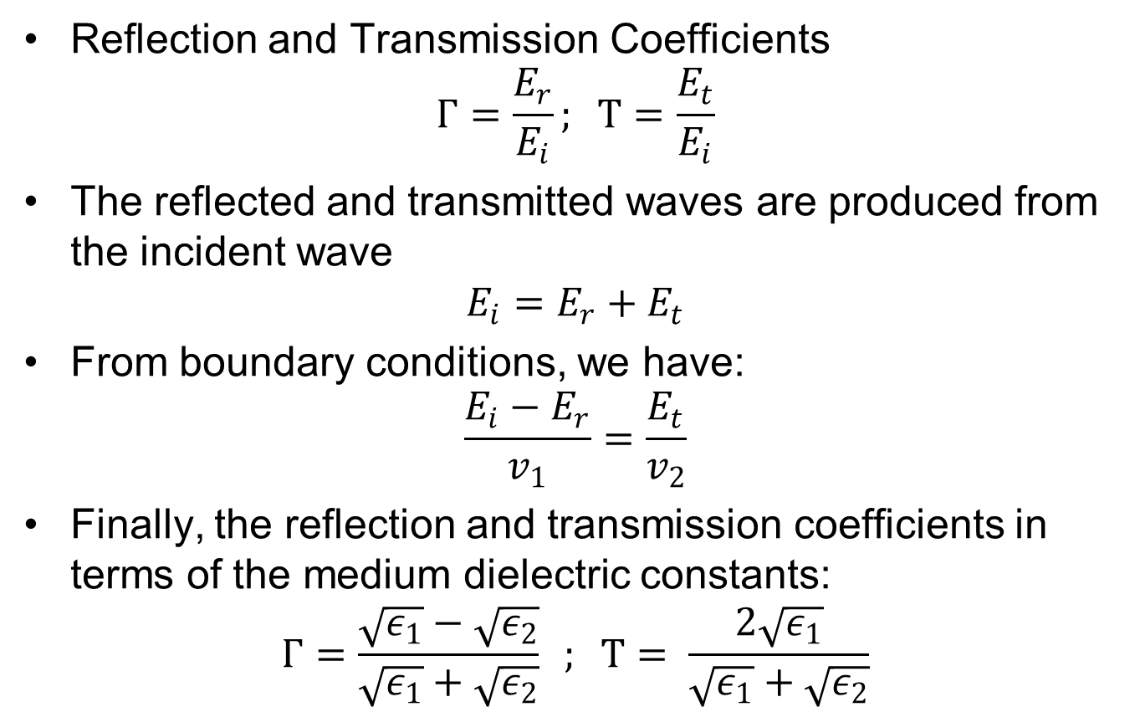
The Band-Gap Effect (contd.)
Reflection and Transmission Coefficients
$$Γ=\frac{E_{r}}{E_{i}}; Τ=\frac{E_{t}}{E_{i}}$$
The reflected and transmitted waves are produced from the incident wave
$$E_{i}=E_{r}+E_{t}$$
From boundary conditions, we have:
$$\frac{E_{i}−E_{r}}{v_{1}}=\frac{E_{t}}{v_{2}}$$
Finally, the reflection and transmission coefficients in terms of the medium dielectric constants:
$$Γ=\frac{\sqrt{ε_{1}}−\sqrt{ε_{2}}}{\sqrt{ε_{1}}+\sqrt{ε_{2}}} ; Τ= \frac{2\sqrt{ε_{1}}}{\sqrt{ε_{1}}+\sqrt{ε_{2}}}$$
ECEN 5224 Final Presentation
April 27, 2018
Boulder, CO
4

Slide 7
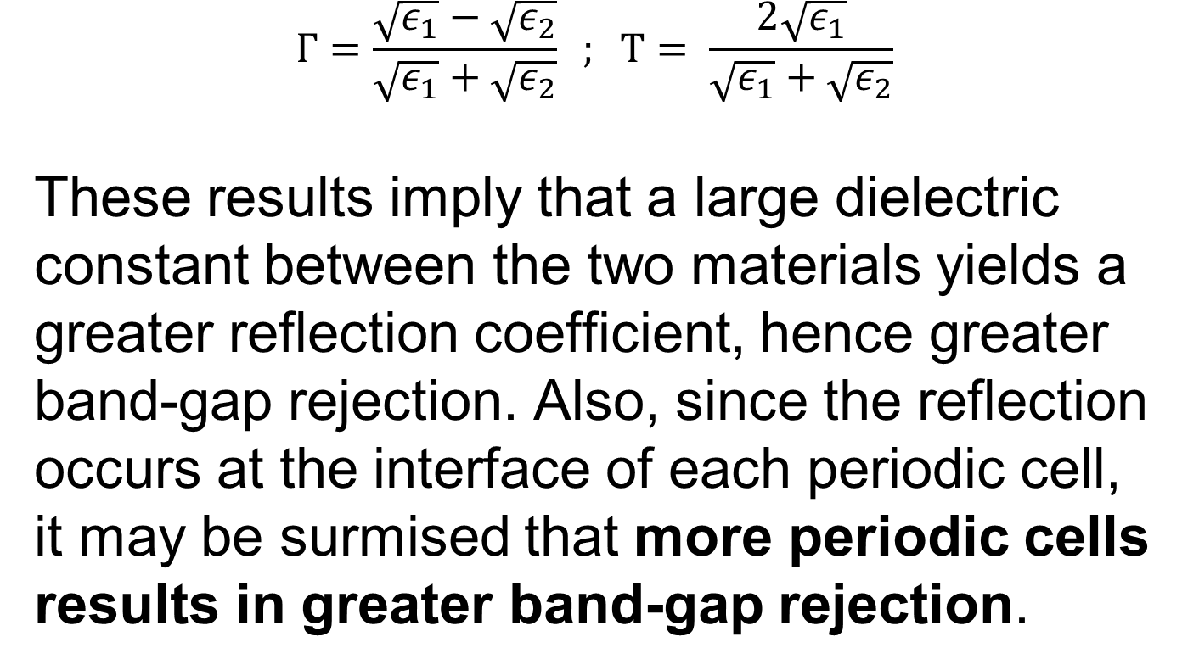
The Band-Gap Effect (contd.)
$$Γ=\frac{\sqrt{ε_{1}}−\sqrt{ε_{2}}}{\sqrt{ε_{1}}+\sqrt{ε_{2}}} ; Τ= \frac{2\sqrt{ε_{1}}}{\sqrt{ε_{1}}+\sqrt{ε_{2}}}$$
These results imply that a large dielectric constant between the two materials yields a greater reflection coefficient, hence greater band-gap rejection. Also, since the reflection occurs at the interface of each periodic cell, it may be surmised that more periodic cells results in greater band-gap rejection.
ECEN 5224 Final Presentation
April 27, 2018
Boulder, CO
5

Slide 8
HFSS Modelling
ECEN 5224 Final Presentation
April 27, 2018
Boulder, CO

Slide 9
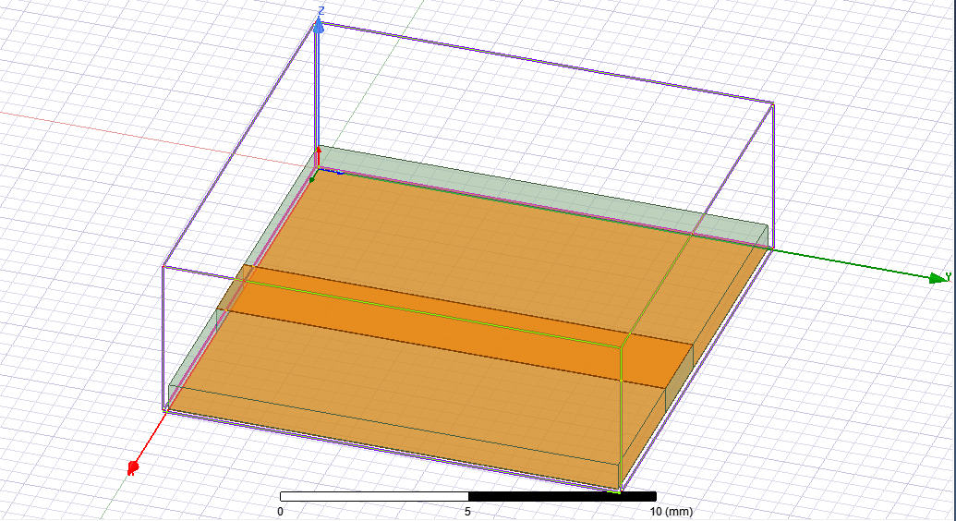

Straight Line Microstrip
Dielectric substrate: Taconic ($ε_{r}=2.43, δ=0.0019)$
$w=2.32$ mm, $h=0.76$ mm, length = 0.5 in
$\frac{w}{h}>1⇒$ $ε_{eff}=\frac{ε_{r}+1}{2}+\frac{ε_{r}−1}{2}{\left(1+12\left(\frac{h}{w}\right)\right)}^{−\frac{1}{2}}=2.037$
$⇒Z_{0}= \frac{120π}{\sqrt{ε_{eff}}\left[\frac{w}{h}+1.393+\frac{2}{3}\ln\left(\frac{w}{h}+1.444\right)\right]}=48.485$ ohms
ECEN 5224 Final Presentation
April 27, 2018
Boulder, CO
6

Slide 10
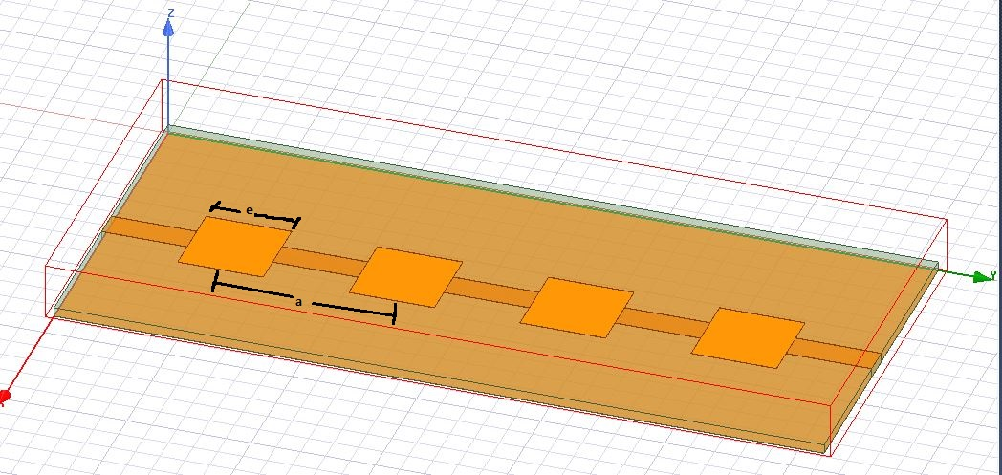

Top Plane Patch EBG
Dielectric substrate: Taconic ($ε_{r}=2.43, δ=0.0019)$
$w=2.32$ mm, $h=0.76$ mm, length $\sim 4.5×$ period
$\frac{w}{h}>1⇒$ $ε_{eff}=\frac{ε_{r}+1}{2}+\frac{ε_{r}−1}{2}{\left(1+12\left(\frac{h}{w}\right)\right)}^{−\frac{1}{2}}=2.037$
$⇒Z_{0}= \frac{120π}{\sqrt{ε_{eff}}\left[\frac{w}{h}+1.393+\frac{2}{3}\ln\left(\frac{w}{h}+1.444\right)\right]}=48.485$ ohms
Patch Properties: Edge length, $e=6.89$ mm ; period, $a=2e=13.78$ mm, which corresponds to an optimum filling factor $\left(\frac{e}{2a}\right)$ of $0.25$
ECEN 5224 Final Presentation
April 27, 2018
Boulder, CO
7

Slide 11
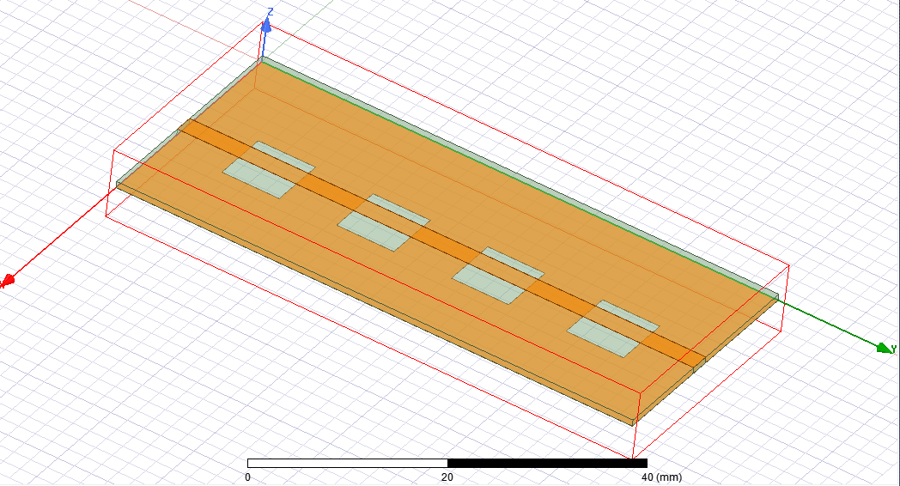
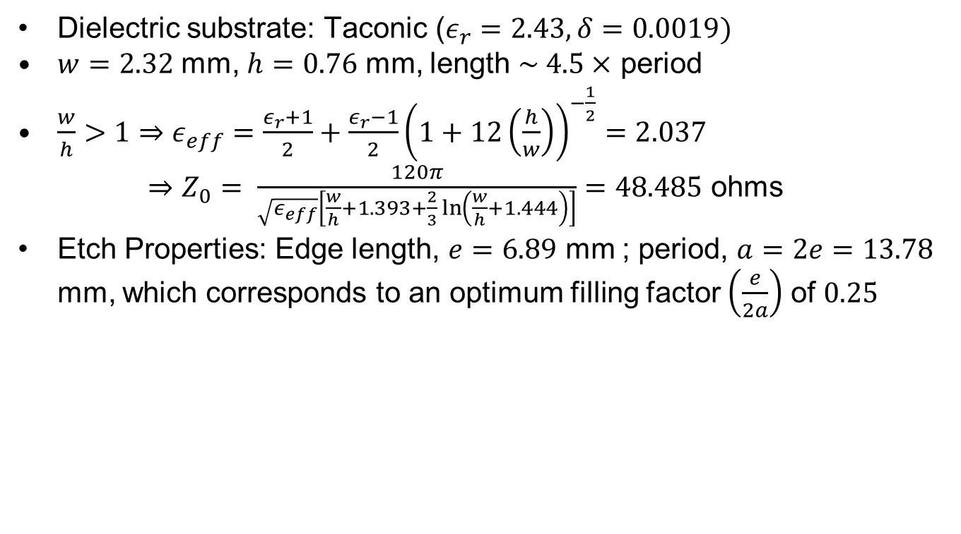
Ground Plane Etch EBG
Dielectric substrate: Taconic ($ε_{r}=2.43, δ=0.0019)$
$w=2.32$ mm, $h=0.76$ mm, length $\sim 4.5×$ period
$\frac{w}{h}>1⇒$ $ε_{eff}=\frac{ε_{r}+1}{2}+\frac{ε_{r}−1}{2}{\left(1+12\left(\frac{h}{w}\right)\right)}^{−\frac{1}{2}}=2.037$
$⇒Z_{0}= \frac{120π}{\sqrt{ε_{eff}}\left[\frac{w}{h}+1.393+\frac{2}{3}\ln\left(\frac{w}{h}+1.444\right)\right]}=48.485$ ohms
Etch Properties: Edge length, $e=6.89$ mm ; period, $a=2e=13.78$ mm, which corresponds to an optimum filling factor $\left(\frac{e}{2a}\right)$ of $0.25$
ECEN 5224 Final Presentation
April 27, 2018
Boulder, CO
8

Slide 12
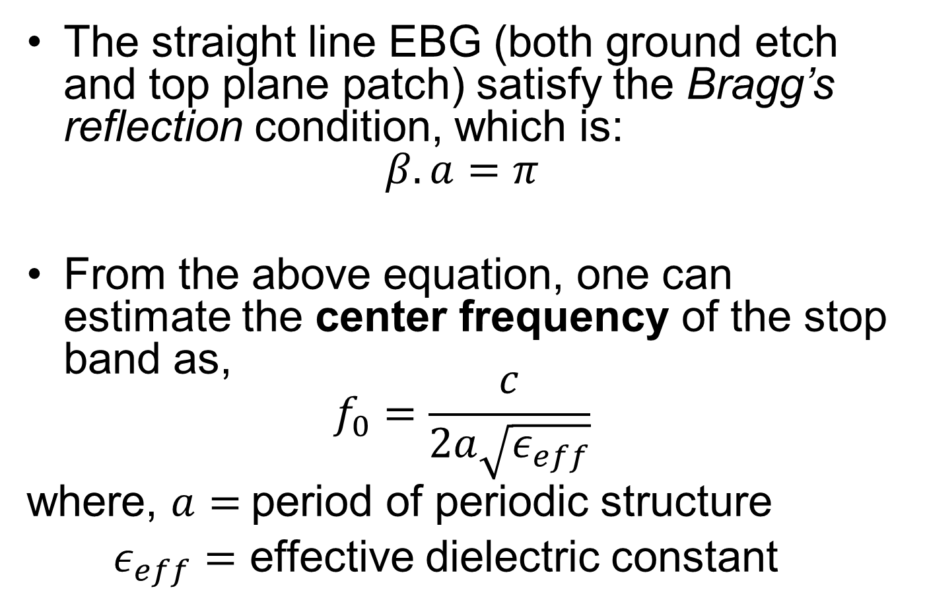
Properties of EBG structures
The straight line EBG (both ground etch and top plane patch) satisfy the Bragg’s reflection condition, which is:
$$β.a=π$$
From the above equation, one can estimate the center frequency of the stop band as,
$$f_{0}=\frac{c}{2a\sqrt{ε_{eff}}}$$
where, $a=$period of periodic structure
$ε_{eff}=$ effective dielectric constant
ECEN 5224 Final Presentation
April 27, 2018
Boulder, CO
9

Slide 13
Results and Conclusion
ECEN 5224 Final Presentation
April 27, 2018
Boulder, CO

Slide 14
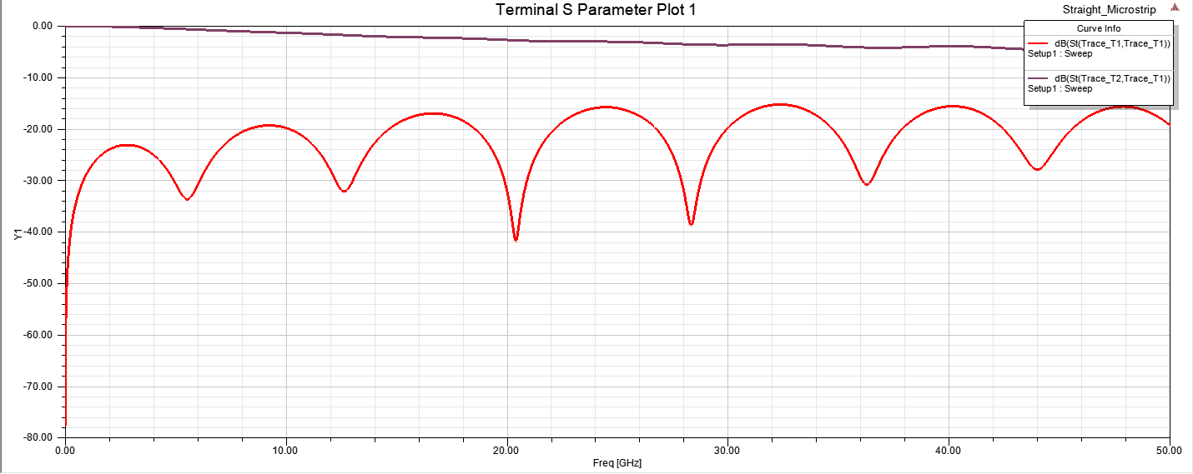
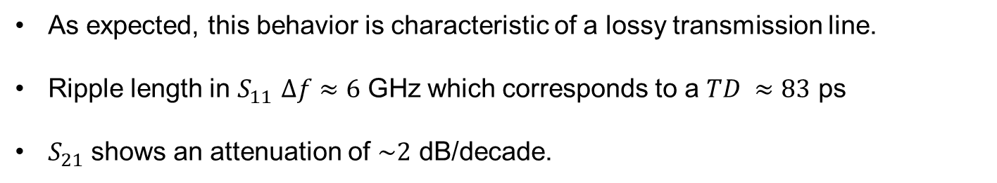
Straight Line Microstrip
As expected, this behavior is characteristic of a lossy transmission line.
Ripple length in $S_{11}$ $Δf≈6$ GHz which corresponds to a $TD ≈83$ ps
$S_{21}$ shows an attenuation of $\sim 2$ dB/decade.
ECEN 5224 Final Presentation
April 27, 2018
Boulder, CO
10

Slide 15
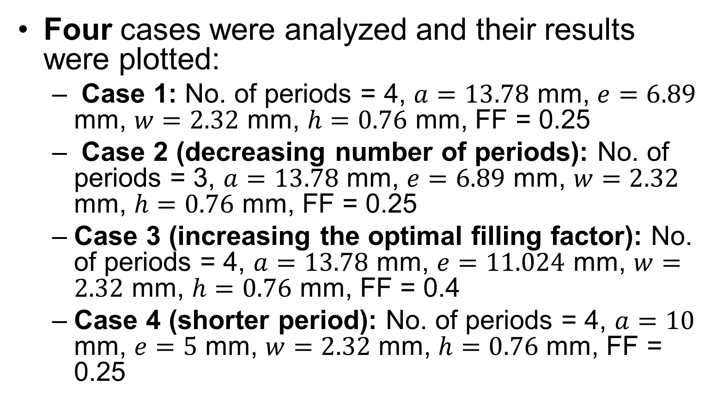
Top Plane Patch EBG
Four cases were analyzed and their results were plotted:
Case 1: No. of periods = 4, $a=13.78$ mm, $e=6.89$ mm, $w=2.32$ mm, $h=0.76$ mm, FF = 0.25
Case 2 (decreasing number of periods): No. of periods = 3, $a=13.78$ mm, $e=6.89$ mm, $w=2.32$ mm, $h=0.76$ mm, FF = 0.25
Case 3 (increasing the optimal filling factor): No. of periods = 4, $a=13.78$ mm, $e=11.024$ mm, $w=2.32$ mm, $h=0.76$ mm, FF = 0.4
Case 4 (shorter period): No. of periods = 4, $a=10$ mm, $e=5$ mm, $w=2.32$ mm, $h=0.76$ mm, FF = 0.25
ECEN 5224 Final Presentation
April 27, 2018
Boulder, CO
11

Slide 16
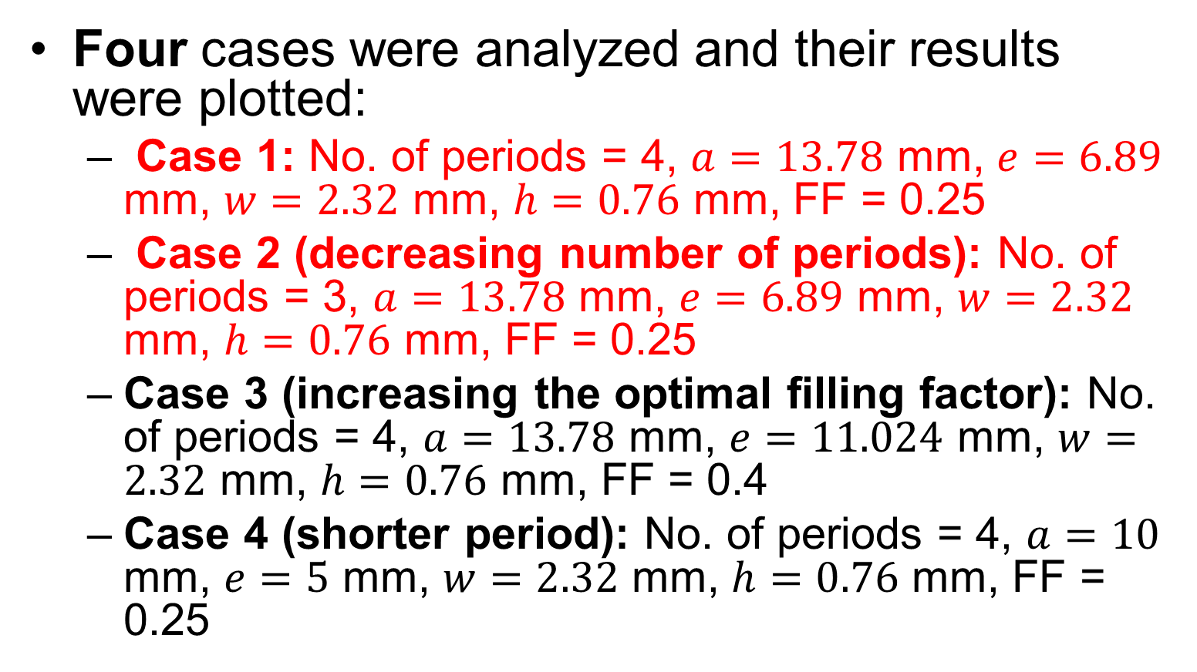
Top Plane Patch EBG
Four cases were analyzed and their results were plotted:
Case 1: No. of periods = 4, $a=13.78$ mm, $e=6.89$ mm, $w=2.32$ mm, $h=0.76$ mm, FF = 0.25
Case 2 (decreasing number of periods): No. of periods = 3, $a=13.78$ mm, $e=6.89$ mm, $w=2.32$ mm, $h=0.76$ mm, FF = 0.25
Case 3 (increasing the optimal filling factor): No. of periods = 4, $a=13.78$ mm, $e=11.024$ mm, $w=2.32$ mm, $h=0.76$ mm, FF = 0.4
Case 4 (shorter period): No. of periods = 4, $a=10$ mm, $e=5$ mm, $w=2.32$ mm, $h=0.76$ mm, FF = 0.25
ECEN 5224 Final Presentation
April 27, 2018
Boulder, CO
11

Slide 17
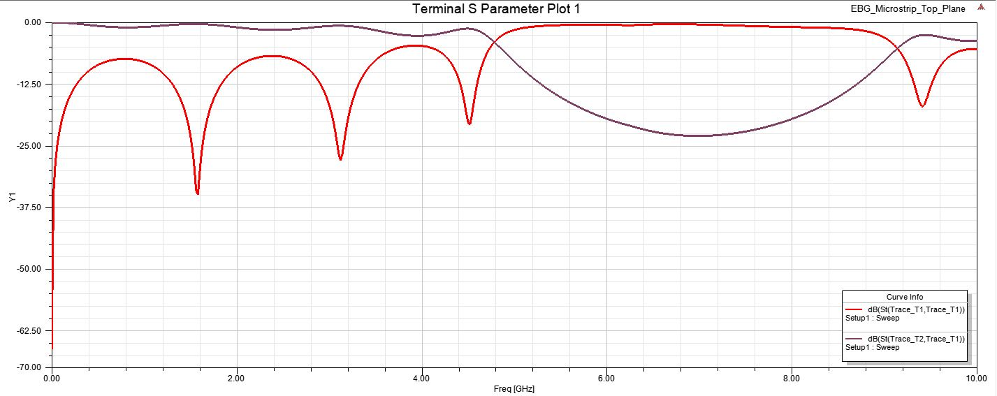
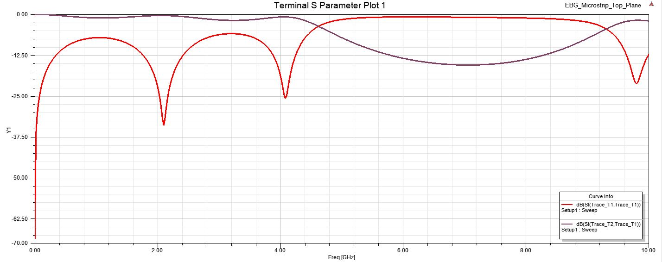
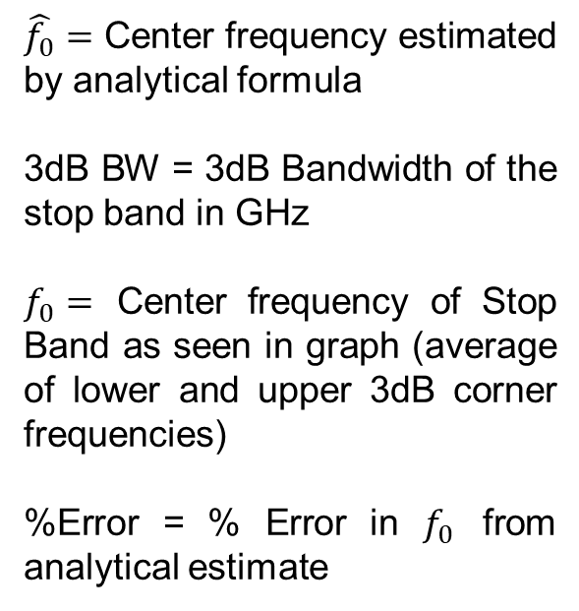
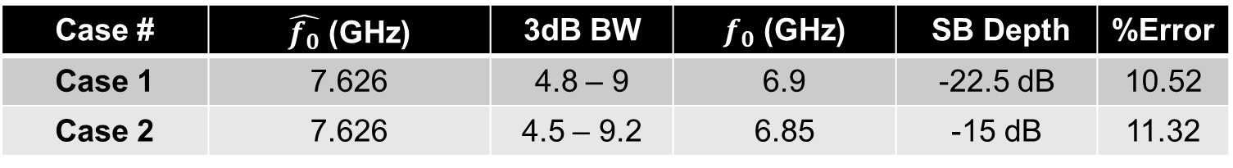
Plots of S-parameters
Case # | $\hat{f_{0}}$ (GHz) | 3dB BW | $f_{0}$ (GHz) | SB Depth | %Error
Case 1 | 7.626 | 4.8 – 9 | 6.9 | -22.5 dB | 10.52
Case 2 | 7.626 | 4.5 – 9.2 | 6.85 | -15 dB | 11.32
$\hat{f_{0}}=$ Center frequency estimated by analytical formula
3dB BW = 3dB Bandwidth of the stop band in GHz
$f_{0}=$ Center frequency of Stop Band as seen in graph (average of lower and upper 3dB corner frequencies)
%Error = % Error in $f_{0}$ from analytical estimate
Case 1
Case 2
ECEN 5224 Final Presentation
April 27, 2018
Boulder, CO
12

Slide 18
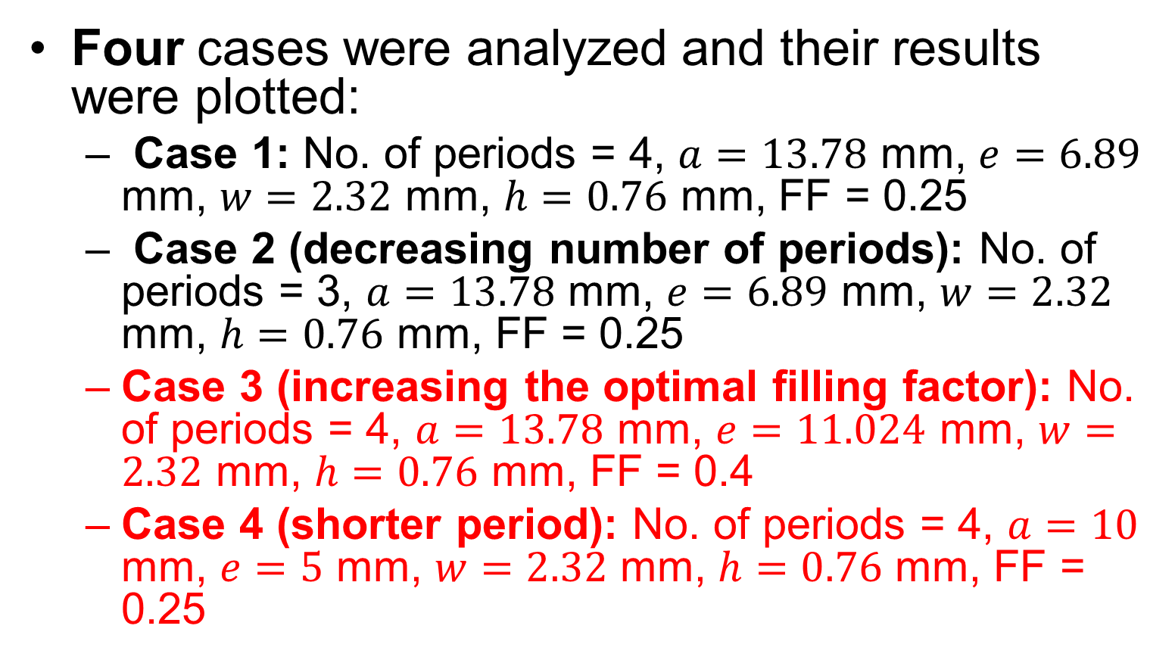
Top Plane Patch EBG
Four cases were analyzed and their results were plotted:
Case 1: No. of periods = 4, $a=13.78$ mm, $e=6.89$ mm, $w=2.32$ mm, $h=0.76$ mm, FF = 0.25
Case 2 (decreasing number of periods): No. of periods = 3, $a=13.78$ mm, $e=6.89$ mm, $w=2.32$ mm, $h=0.76$ mm, FF = 0.25
Case 3 (increasing the optimal filling factor): No. of periods = 4, $a=13.78$ mm, $e=11.024$ mm, $w=2.32$ mm, $h=0.76$ mm, FF = 0.4
Case 4 (shorter period): No. of periods = 4, $a=10$ mm, $e=5$ mm, $w=2.32$ mm, $h=0.76$ mm, FF = 0.25
ECEN 5224 Final Presentation
April 27, 2018
Boulder, CO
11

Slide 19
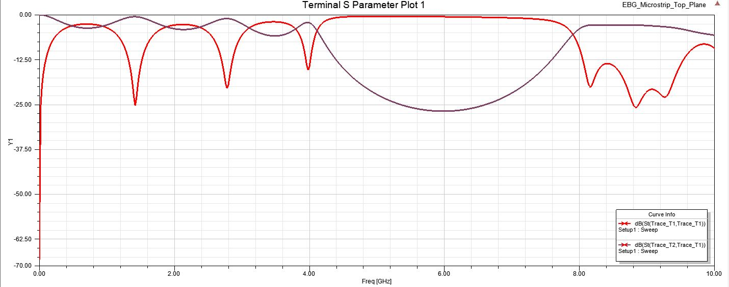
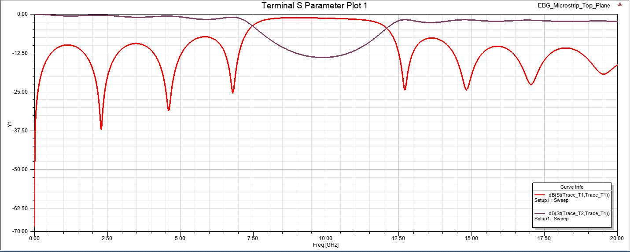
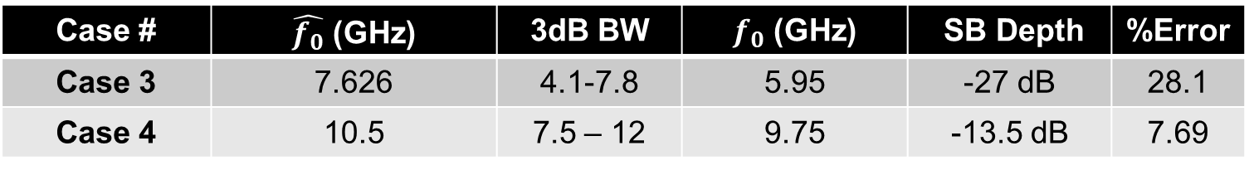
Plots of S-parameters (contd.)
Case # | $\hat{f_{0}}$ (GHz) | 3dB BW | $f_{0}$ (GHz) | SB Depth | %Error
Case 3 | 7.626 | 4.1-7.8 | 5.95 | -27 dB | 28.1
Case 4 | 10.5 | 7.5 – 12 | 9.75 | -13.5 dB | 7.69
$\hat{f_{0}}=$ Center frequency estimated by analytical formula
3dB BW = 3dB Bandwidth of the stop band in GHz
$f_{0}=$ Center frequency of Stop Band as seen in graph (average of lower and upper 3dB corner frequencies)
%Error = % Error in $f_{0}$ from analytical estimate
Case 3
Case 4
ECEN 5224 Final Presentation
April 27, 2018
Boulder, CO
13

Slide 20
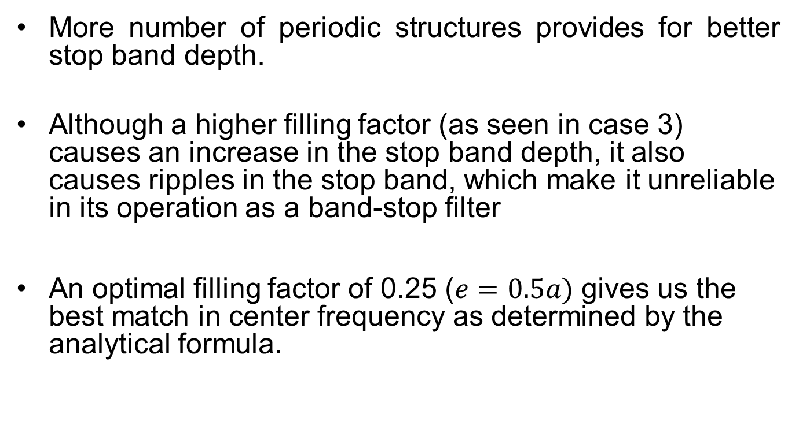
Conclusion
More number of periodic structures provides for better stop band depth.
Although a higher filling factor (as seen in case 3) causes an increase in the stop band depth, it also causes ripples in the stop band, which make it unreliable in its operation as a band-stop filter
An optimal filling factor of 0.25 ($e=0.5a)$ gives us the best match in center frequency as determined by the analytical formula.
ECEN 5224 Final Presentation
April 27, 2018
Boulder, CO
14

Slide 21
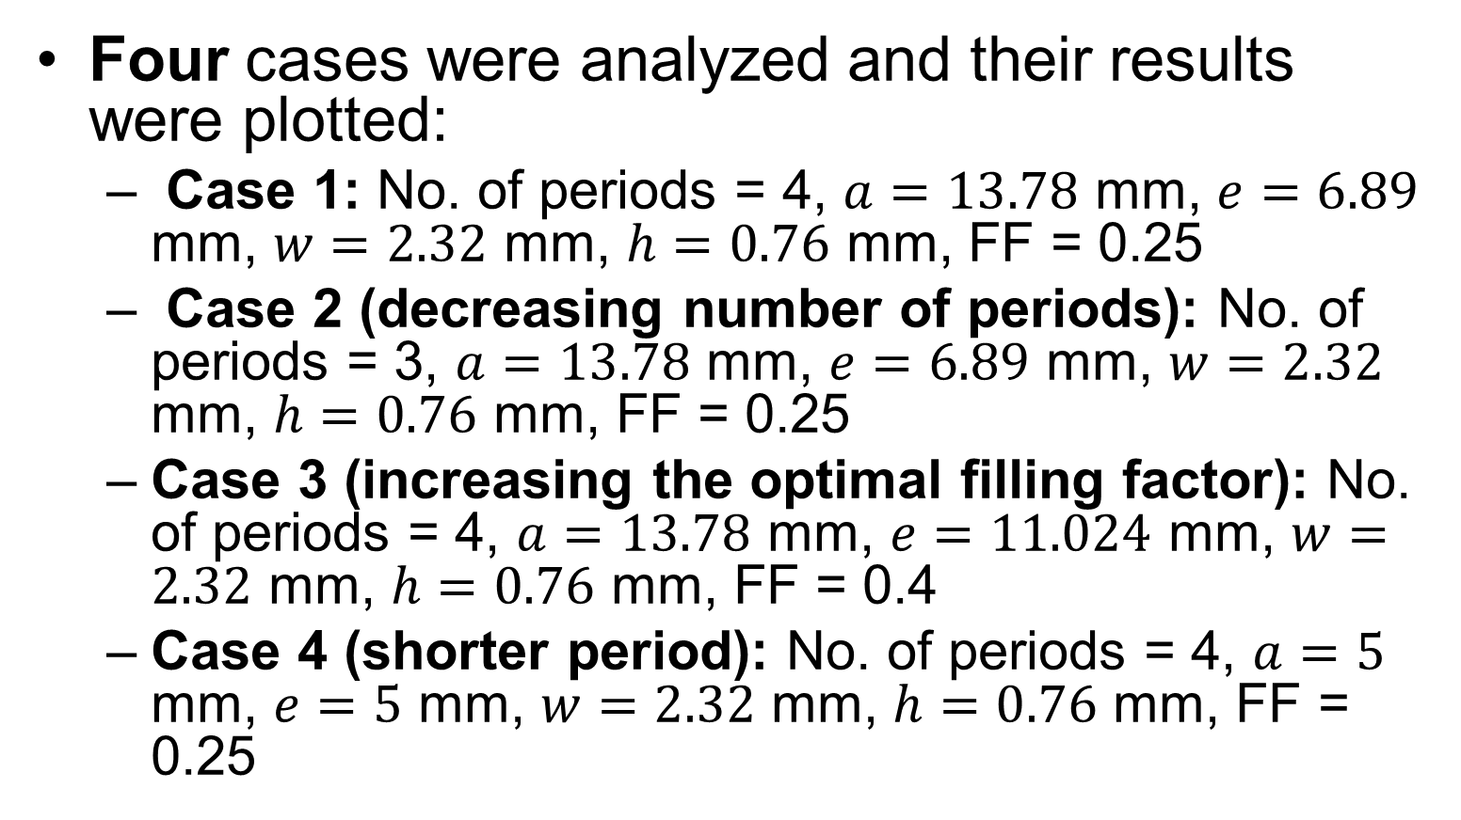
Ground Plane Etch EBG
Four cases were analyzed and their results were plotted:
Case 1: No. of periods = 4, $a=13.78$ mm, $e=6.89$ mm, $w=2.32$ mm, $h=0.76$ mm, FF = 0.25
Case 2 (decreasing number of periods): No. of periods = 3, $a=13.78$ mm, $e=6.89$ mm, $w=2.32$ mm, $h=0.76$ mm, FF = 0.25
Case 3 (increasing the optimal filling factor): No. of periods = 4, $a=13.78$ mm, $e=11.024$ mm, $w=2.32$ mm, $h=0.76$ mm, FF = 0.4
Case 4 (shorter period): No. of periods = 4, $a=5$ mm, $e=5$ mm, $w=2.32$ mm, $h=0.76$ mm, FF = 0.25
ECEN 5224 Final Presentation
April 27, 2018
Boulder, CO
15

Slide 22
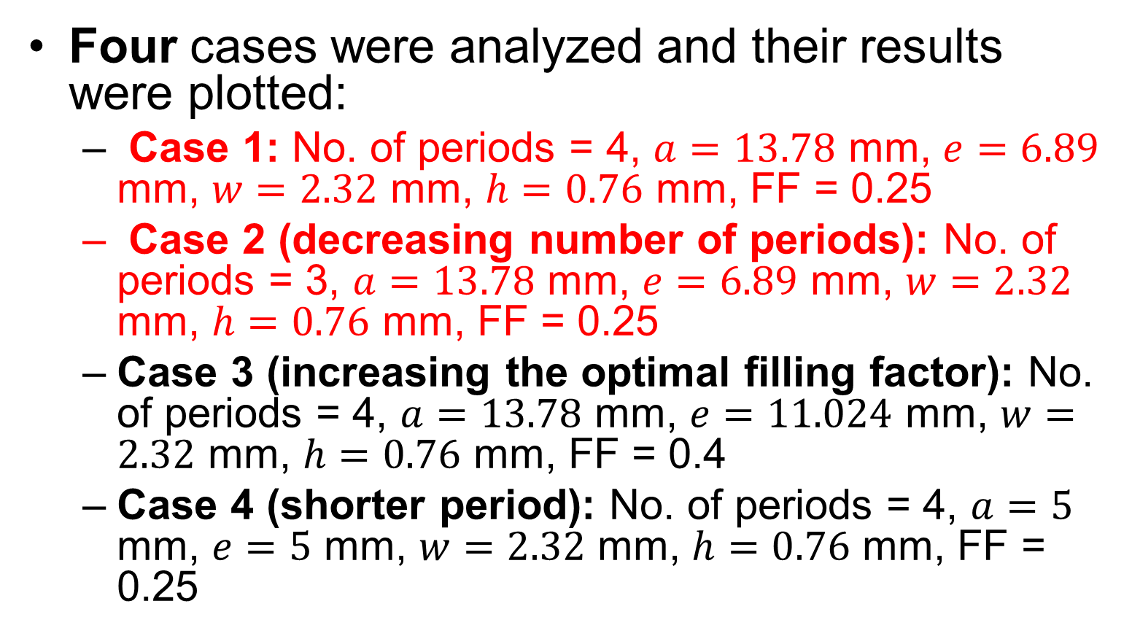
Ground Plane Etch EBG
Four cases were analyzed and their results were plotted:
Case 1: No. of periods = 4, $a=13.78$ mm, $e=6.89$ mm, $w=2.32$ mm, $h=0.76$ mm, FF = 0.25
Case 2 (decreasing number of periods): No. of periods = 3, $a=13.78$ mm, $e=6.89$ mm, $w=2.32$ mm, $h=0.76$ mm, FF = 0.25
Case 3 (increasing the optimal filling factor): No. of periods = 4, $a=13.78$ mm, $e=11.024$ mm, $w=2.32$ mm, $h=0.76$ mm, FF = 0.4
Case 4 (shorter period): No. of periods = 4, $a=5$ mm, $e=5$ mm, $w=2.32$ mm, $h=0.76$ mm, FF = 0.25
ECEN 5224 Final Presentation
April 27, 2018
Boulder, CO
15

Slide 23
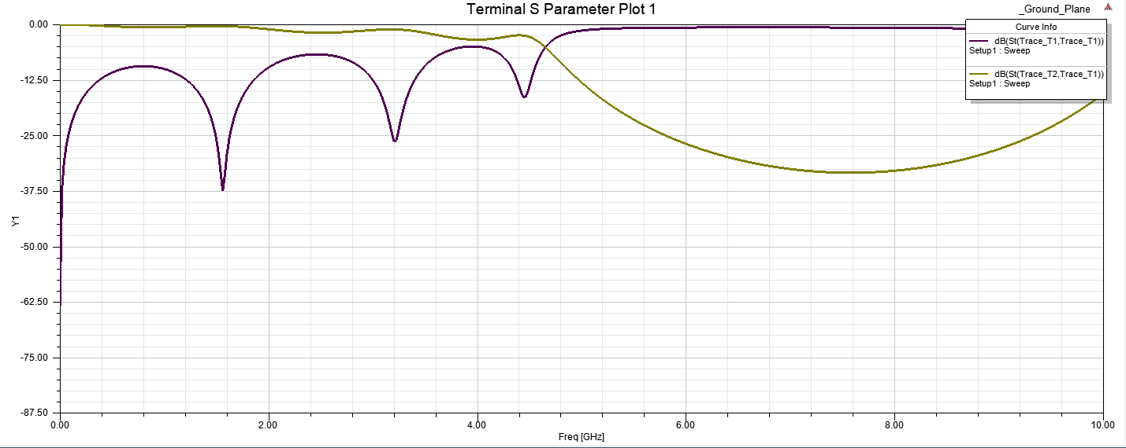
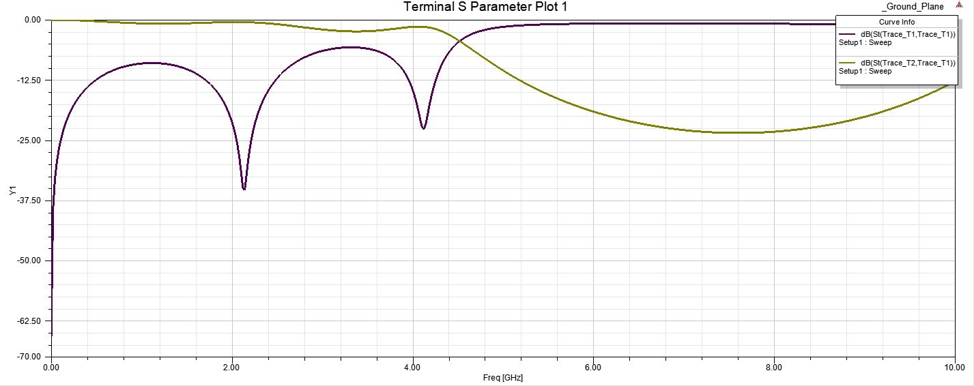
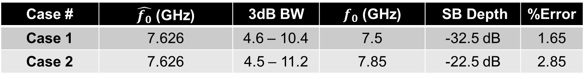
Plots of S-parameters
Case # | $\hat{f_{0}}$ (GHz) | 3dB BW | $f_{0}$ (GHz) | SB Depth | %Error
Case 1 | 7.626 | 4.6 – 10.4 | 7.5 | -32.5 dB | 1.65
Case 2 | 7.626 | 4.5 – 11.2 | 7.85 | -22.5 dB | 2.85
$\hat{f_{0}}=$ Center frequency estimated by analytical formula
3dB BW = 3dB Bandwidth of the stop band in GHz
$f_{0}=$ Center frequency of Stop Band as seen in graph (average of lower and upper 3dB corner frequencies)
%Error = % Error in $f_{0}$ from analytical estimate
Case 1
Case 2
ECEN 5224 Final Presentation
April 27, 2018
Boulder, CO
16

Slide 24
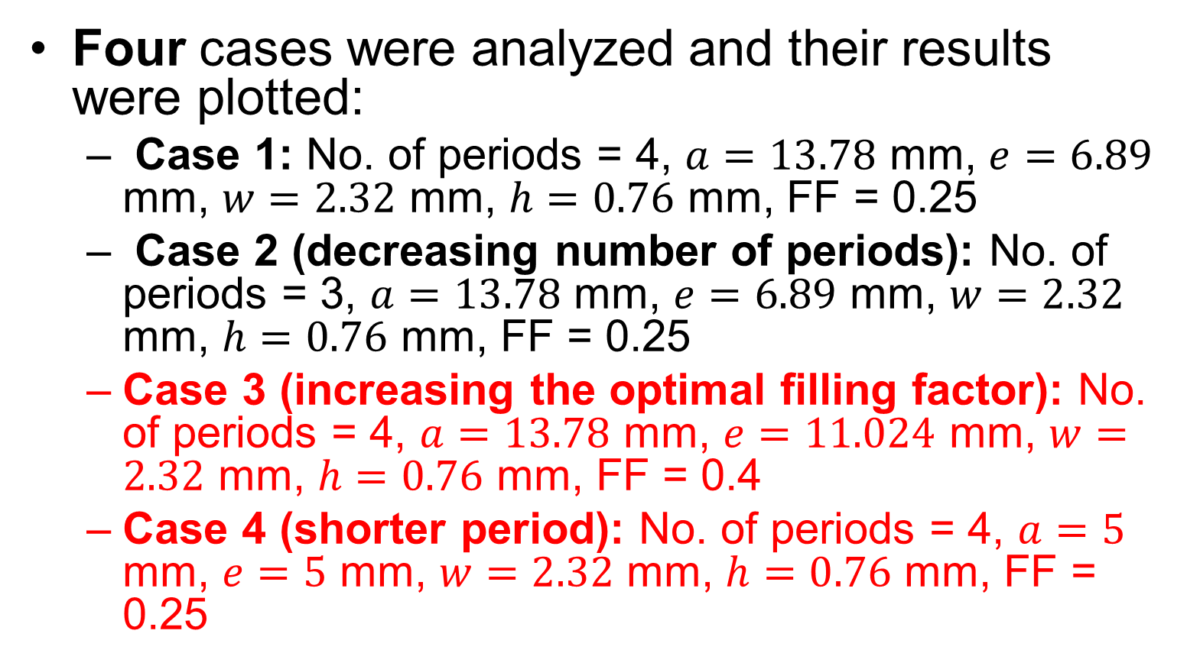
Ground Plane Etch EBG
Four cases were analyzed and their results were plotted:
Case 1: No. of periods = 4, $a=13.78$ mm, $e=6.89$ mm, $w=2.32$ mm, $h=0.76$ mm, FF = 0.25
Case 2 (decreasing number of periods): No. of periods = 3, $a=13.78$ mm, $e=6.89$ mm, $w=2.32$ mm, $h=0.76$ mm, FF = 0.25
Case 3 (increasing the optimal filling factor): No. of periods = 4, $a=13.78$ mm, $e=11.024$ mm, $w=2.32$ mm, $h=0.76$ mm, FF = 0.4
Case 4 (shorter period): No. of periods = 4, $a=5$ mm, $e=5$ mm, $w=2.32$ mm, $h=0.76$ mm, FF = 0.25
ECEN 5224 Final Presentation
April 27, 2018
Boulder, CO
15

Slide 25
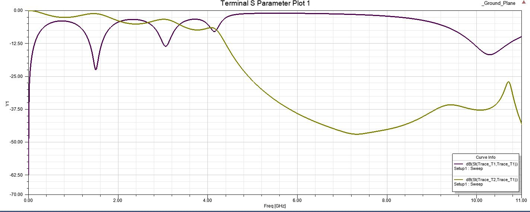
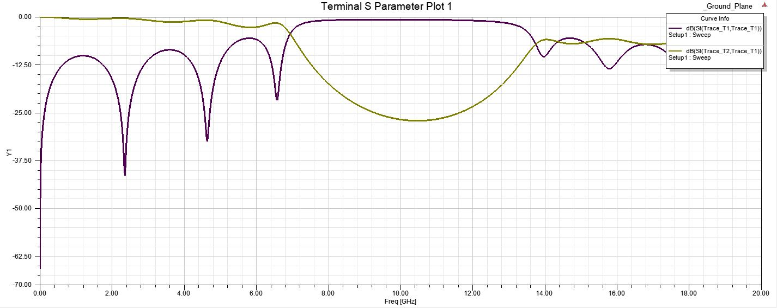
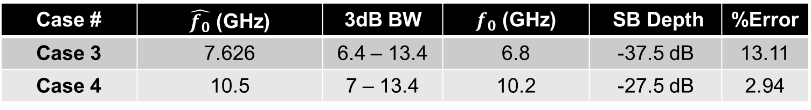
Plots of S-parameters (contd.)
Case # | $\hat{f_{0}}$ (GHz) | 3dB BW | $f_{0}$ (GHz) | SB Depth | %Error
Case 3 | 7.626 | 6.4 – 13.4 | 6.8 | -37.5 dB | 13.11
Case 4 | 10.5 | 7 – 13.4 | 10.2 | -27.5 dB | 2.94
Case 3
$\hat{f_{0}}=$ Center frequency estimated by analytical formula
3dB BW = 3dB Bandwidth of the stop band in GHz
$f_{0}=$ Center frequency of Stop Band as seen in graph (average of lower and upper 3dB corner frequencies)
%Error = % Error in $f_{0}$ from analytical estimate
Case 4
ECEN 5224 Final Presentation
April 27, 2018
Boulder, CO
17

Slide 26
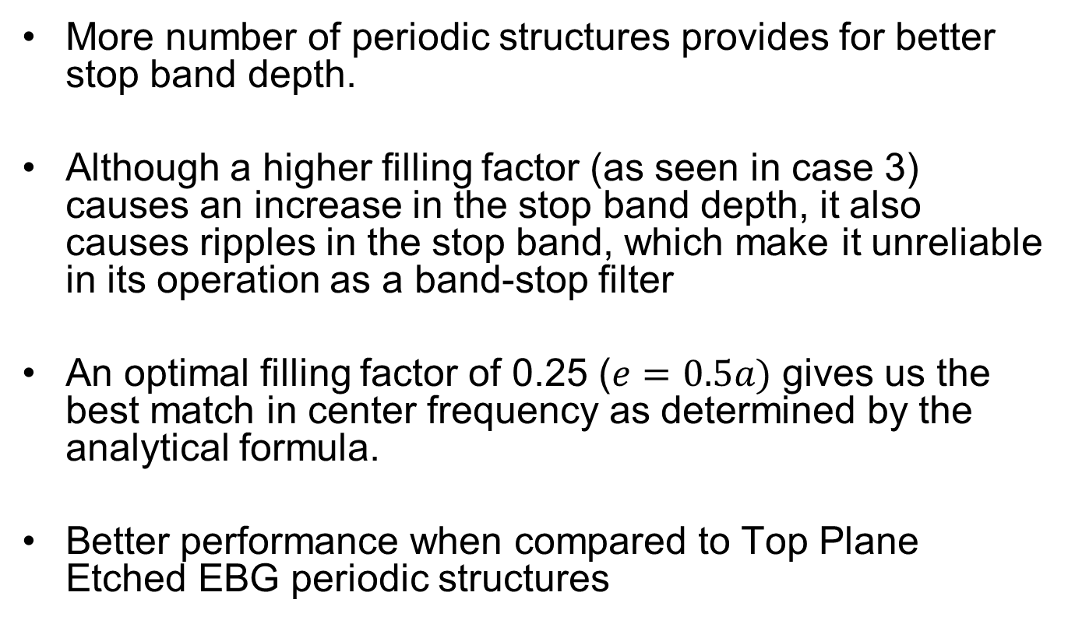
Conclusion
More number of periodic structures provides for better stop band depth.
Although a higher filling factor (as seen in case 3) causes an increase in the stop band depth, it also causes ripples in the stop band, which make it unreliable in its operation as a band-stop filter
An optimal filling factor of 0.25 ($e=0.5a)$ gives us the best match in center frequency as determined by the analytical formula.
Better performance when compared to Top Plane Etched EBG periodic structures
ECEN 5224 Final Presentation
April 27, 2018
Boulder, CO
18

Slide 27
Acknowledgements
Prof. Eric Bogatin and Prof. Melinda Picket-May, for being teachers to this wonderful course and foraying us into the world of Signal Integrity
Kevin Quillen, for guiding us to set up our project problem in ANSYS HFSS
Neeti Sonth, for being ever so patient with our doubts and questions during office hours
ECEN 5224 Final Presentation
April 27, 2018
Boulder, CO
19

Slide 28
References
[1] Huang, Y.S., Lee, H.Y, “Compact U-shape Dual Planar EBG Microstrip Low Pass Filter”, IEEE Trans. Microwave Th. Tech., Vol 53, No. 12, Dec 2005
[2] Radisic et. al, “Novel 2-D Photonic Bandgap Structure for Microstrip lines”, IEEE Microwave Guided Wave Lett., Vol 8, No. 2, Feb 1998
[3] Nagesh, E., “Photonic Band Gap Studies at Microwave Frequencies”, PhD Thesis, 2006, Indian Institute of Technology, Madras
[4] Falcone, F., Lopetegi, T., Sorolla, M., “1-D and 2-D Photonic Bandgap Microstrip Structures”, Microwave Opt. Technol. Lett., vol. 22, Issue 6, Sep 1999
ECEN 5224 Final Presentation
April 27, 2018
Boulder, CO
20

Slide 29

ECEN 5224 Final Presentation
April 27, 2018
Boulder, CO

