Slide 1
All life bank Personal loan Predict case study Jameel Khan

Slide 2
Objective
AllLife Bank has a growing customer base. Majority of these customers are liability customers (depositors) with varying size of deposits. The number of customers who are also borrowers (asset customers) is quite small, and the bank is interested in expanding this base rapidly to bring in more loan business and in the process, earn more through the interest on loans
To predict whether a liability customer will buy a personal loan or not. Which variables are most significant. Which segment of customers should be targeted more.
Provide Key insights and Recommendations from Data Analysis

Slide 3
Dataset Characteristics
Dataset Column | Description
ID | Customer ID
Age | Customer’s age in completed years
Experience | #years of professional experience
Income | Annual income of the customer (in thousand dollars)
ZIP Code | Home Address ZIP code.
Family | Family size of the customer
CCAvg | Avg. spending on credit cards per month (in thousand dollars)
Education | Education Level. 1: Undergrad; 2: Graduate;3: Advanced/Professional
Mortgage | Value of house mortgage if any. (in thousand dollars)
Personal_Loan | Did this customer accept the personal loan offered in the last campaign?
Securities_Account: | Does the customer have securities account with the bank?
CD_Account | Does the customer have a certificate of deposit (CD) account with the bank?
Online | Do customers use internet banking facilities?
CreditCard | Does the customer use a credit card issued by Universal Bank?
The dataset contains Customer centric and other metrics of Bank customers
Observations on Data Set:
There are 14 columns of data for each customer, with a total of 5000 rows of data
The dataset has no missing data or duplicates

Slide 4
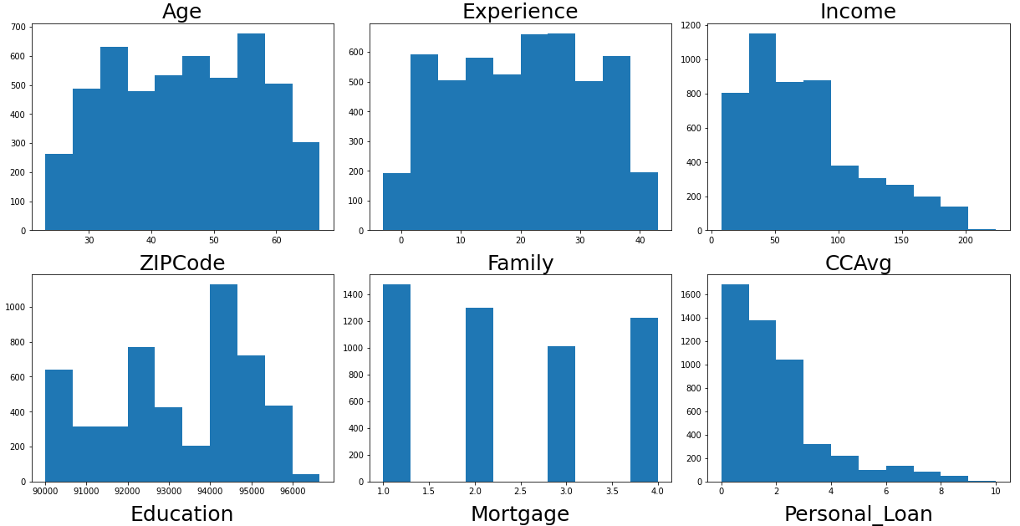
Exploratory Data Analyses – Distribution
Observations on Numerical Data Distribution in the dataset:
Age and Experience looks uniformly distributed.
Income and CCAvg looks rightly skewed.
Most other features are boolean

Slide 5
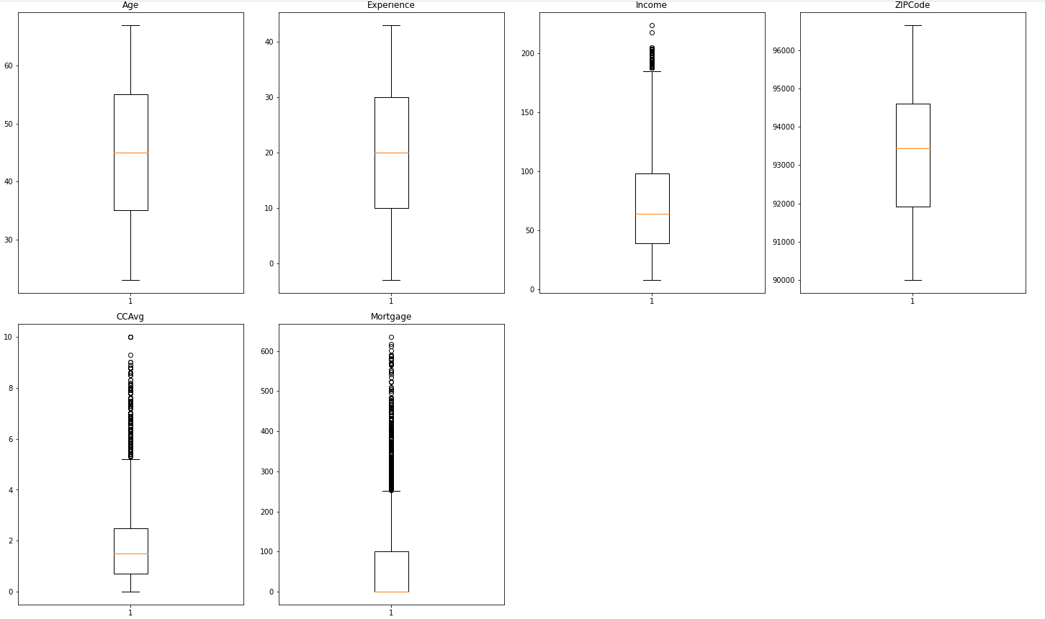
Exploratory Data Analyses – Outliers
Observations on Numerical Data Distribution in the dataset:
CCavg and Mortgage have a lot of outliers. We will leave them in the dataset.

Slide 6
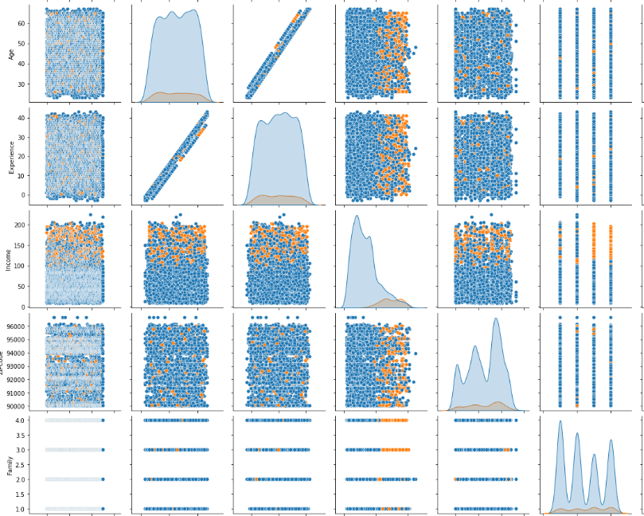
Exploratory Data Analyses – Correlation
Observation on pair plots
Using hue of Personal loans, the data imbalance is clear in each feature, with minority class of no loans taken
Age and Experience are very highly correlated with each other, so one of these features will be dropped.
When someone has a CD_Account, the probability of them having take a personal loan is high Income and CC_Avg are highly mutually correlated Income and Mortgage are highly mutually correlated, with no outliers
Family with size 3 or 4 have higher probability of taking a personal loan
Education level of 2 and up have higher probability of taking a personal loan

Slide 7
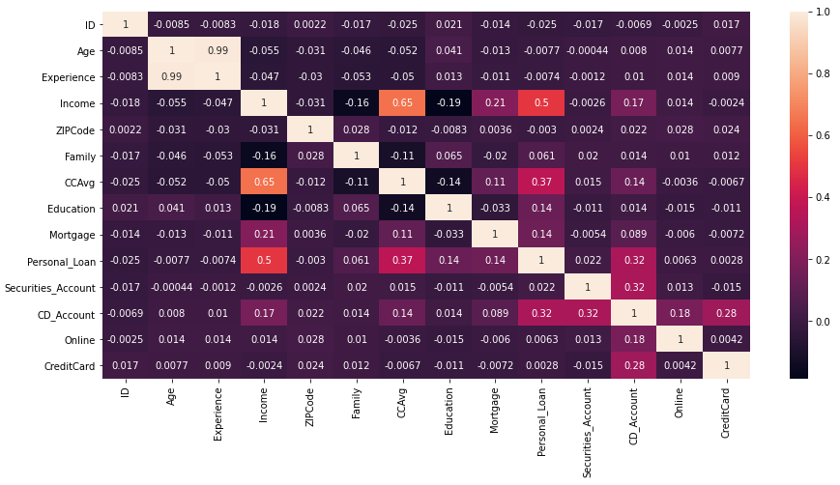
Exploratory Data Analyses – Correlation
Observation on Correlation Matrix of Numeric Features
Personal loan has the highest correlation with Income, followed by CCAvg and CD_account
Age and Experience are very highly correlated with each other, so one of these features will be dropped.
Income and CC_Avg(Average Card spend) are highly mutually correlated

Slide 8
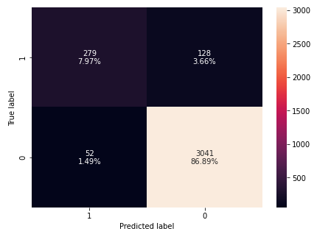
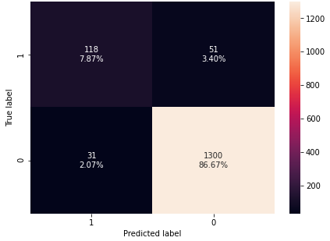
ML Model Building – Logistic Regression
Post Data Preprocessing,
We selected Personal Loan as Dependent(Predicted) Feature and majority of Numerical features as Independent Features(Predictors)
Next, we split the dataset into 70% to Train on and 30% to Test the Model on subsequently
Next, we fit the Logistic regression model on the Train and got following model metrics and Train and test confusion matrix
 | Train | Test
Accuracy | 0.94 | 0.94
Recall | 0.84 | 0.79
Precision | 0.68 | 0.69
F1 score | 0.75 | 0.74

Slide 9
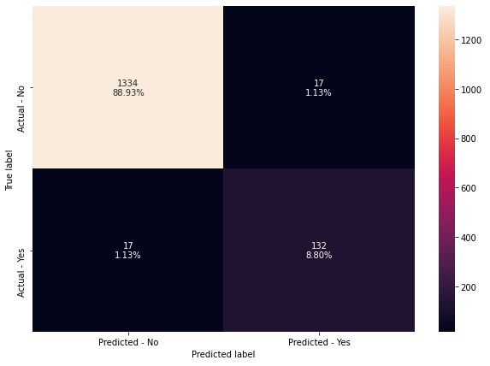
ML Model Building – Baseline Decision tree
Insights:
True Positives:
Reality: A liability customer signs up for personal loan
Model predicted: The customer will sign up for personal loan
Outcome: The model is good. We targeted well.
True Negatives:
Reality: A liability customer does NOT sign up for personal loan
Model predicted: A liability customer will NOT sign up for personal loan
Outcome: The business is unaffected, as no extra expense to business
False Positives:
Reality: A liability does NOT sign up for personal loan
Model predicted: The customer will sign up for personal loan
Outcome: The team which is targeting the potential customers will be wasting their resources on the people/customers who will not be contributing to the revenue.
False Negatives:
Reality: A liability does NOT sign up for personal loan
Model predicted: The customer would have signed up for personal loan
Outcome: The potential customer is missed by the sales/marketing team. (Customer retention will get affected.)
In this case, not being able to identify a potential customer for personal loan is the biggest loss we can face. Hence, recall is the right metric to check the performance of the model.
Misclassification analysis
The data imbalance is present in the sample or population itself, as only a small percentage of customers actually sign up for the targeted schemes such as a personal loan. So the model itself is not doing a poor job of misclassifying between the predicted and actual. The false positives and false negatives (Class 1 and Class 2 errors) are actually fairly low(~1%) in the confusion matrix above

Slide 10
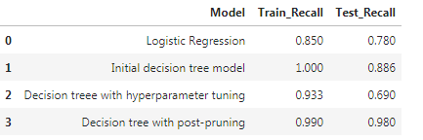
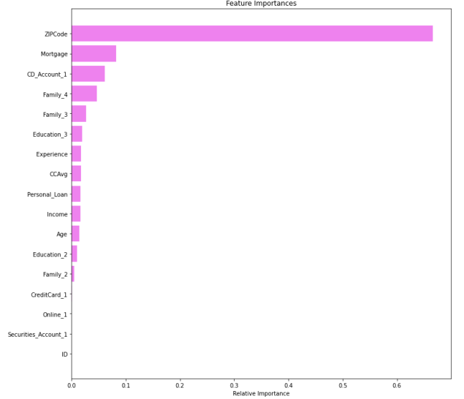
Model Comparison– Logistic and All Decision tree
We ran decision tree with Hyper parameter tuning and post pruning to improve the Recall scores .
Following table illustrates and compares all the results
Chart illustrates the important features from Decision tree model

Slide 11
Actionable Insights & Recommendations
Insights -
We analyzed the "Personal Loan campaign" using EDA and used Logistic Regression and Decision Tree Classifier to build a predictive model for the same.
The model built can be used to predict if a liability customer is going to sign up for a personal loan.
We visualized different trees and their confusion matrix to get a better understanding of the model.
We compared the recall metrics of different ML models as outlined in the comparison table. Decision tree with pruning had the best metric.
We verified the fact that how much less data preparation is needed for Decision Trees and such a simple model gave good results even with outliers and imbalanced classes which shows the robustness of Decision Trees.
ZIPcode, Mortgage, Education(graduate level), Family size of 3 or 4 are the most important variable in predicting the customers that will signup for a personal loan
We established the importance of hyper-parameters/ pruning to reduce overfitting
Recommendations -
According to the decision tree model, Zipcode is the most important variable for predicting the potential customer for loan. This could be due to certain zipcodes have houses where families with high income and high education live and have high credit card usage.
Website could be used for personalized loan offers could be provided from within the dashboard itself. Provides easy tracking and immediate response from eth customer.
When someone has a CD Account, the probability of them having take a personal loan is high. So good base for marketing/sales effort
When someone has a high credit card balance, the probability of them having take a personal loan is high. So good base for marketing/sales effort
Family with size of 4 or more have higher probability of taking a personal loan

