Slide 1
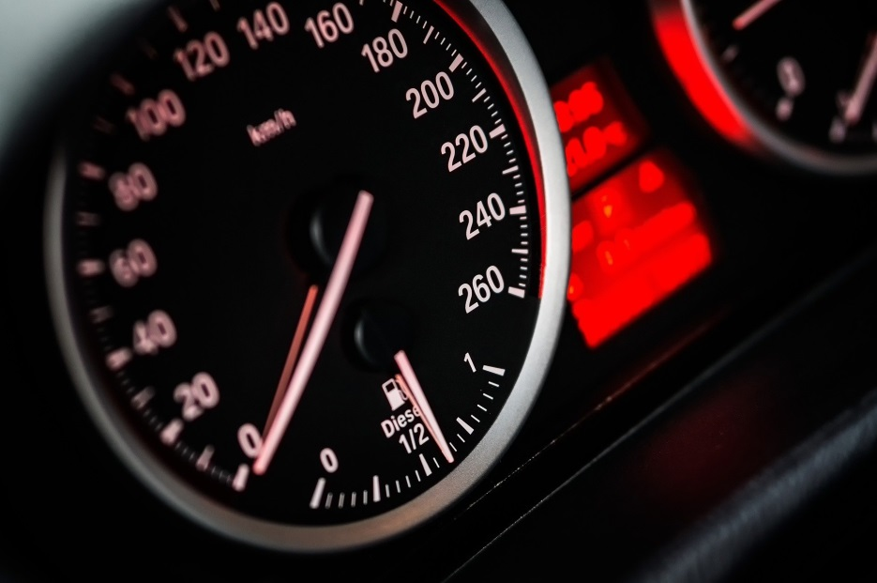
Car4U Cars Price Predict case study Jameel Khan

Slide 2
Objective
There is a huge demand for used cars in the Indian Market today. In 2018-19, while new car sales were recorded at 3.6 million units, around 4 million second-hand cars were bought and sold. There is a slowdown in new car sales and that could mean that the demand is shifting towards the pre-owned market. For example, if the business knows the market price, it will never sell anything below it.
Come up with a pricing model that can effectively predict the price of used cars and can help the business in devising profitable strategies using differential pricing.
Are there Key insights and Recommendations from Data Analysis

Slide 3
Dataset Characteristics
Dataset Column | Description
Name | Name of the car which includes Brand name and Model name
Location | The location in which the car is being sold or is available for purchase Cities
Year | Manufacturing year of the car
Kilometers driven | The total kilometers driven in the car by the previous owner(s) in KM
Fuel Type | The type of fuel used by the car. (Petrol, Diesel, Electric, CNG, LPG)
Transmission | The type of transmission used by the car. (Automatic / Manual)
Owner ​ | Type of ownership
Mileage | The standard mileage offered by the car company in kmpl or km/kg
Engine | The displacement volume of the engine in CC
Power | The maximum power of the engine in bhp
Seats | The number of seats in the car
New Price | The price of a new car of the same model in INR Lakhs.(1 Lakh = 100, 000)
Price | The price of the used car in INR Lakhs (1 Lakh = 100, 000)
The dataset contains Customer centric and other metrics of Used Cars
Observations on Data Set:
There are 14 columns of data for each customer, with a total of 7253 rows of data
The dataset has missing data in some columns, that were dropped for analysis

Slide 4
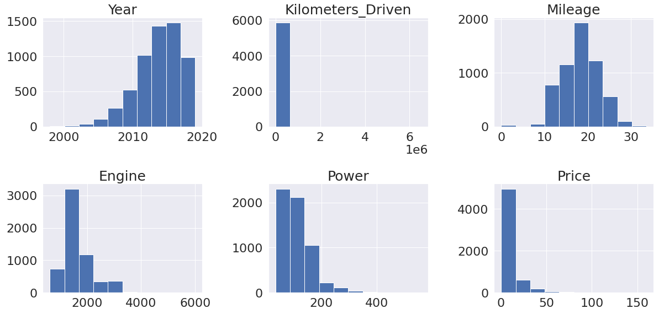
Exploratory Data Analyses – Distribution
Observations on Numerical Data Distribution in the dataset:
Year, Mileage, Engine size of the car is somewhat normal distribution
Year is left skewed with some older cars
Most of the features are right skewed with lot of extreme outliers

Slide 5
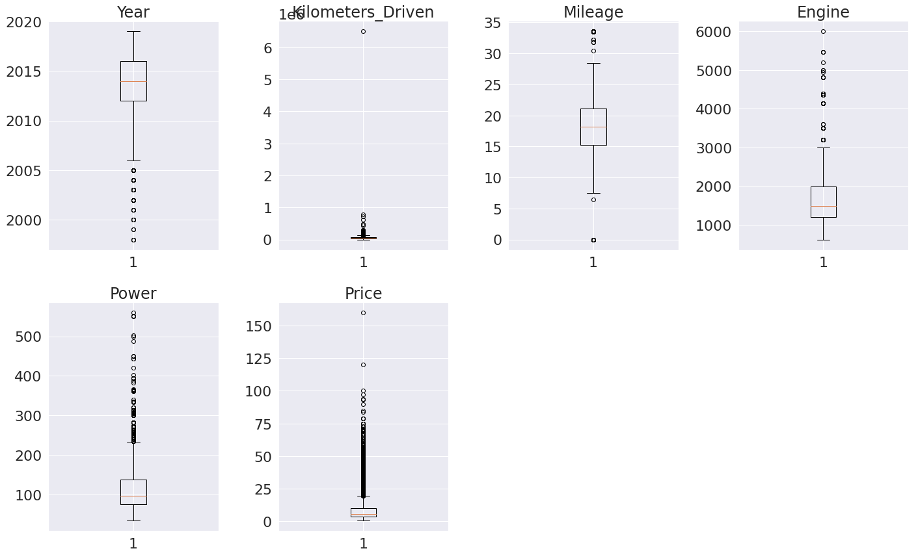
Exploratory Data Analyses – Outliers
Observations on Numerical Data Distribution in the dataset:
Year has lower outliers while all other numerical features have upper outliers
Most cars are in the year 2013 and up
Outliers for Engine and Power are for high performance cars and luxury models, which also
explains their respective outliers in price
4. Outlier in KM driven looks unrealistic and can be considered as a data error.

Slide 6
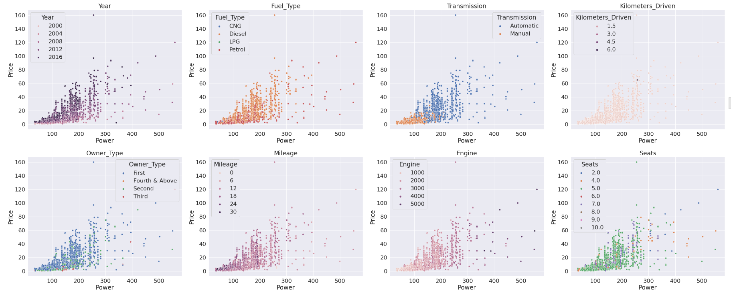
Exploratory Data Analyses – Price v Power
Observation on Price vs Power
The dependent feature Price has a linear relationship with Power.
We will use this feature for our Linear model
As expected, the older cars are priced lower and higher performance cars, with higher power, are priced higher.
Petrol and Deisel cars outnumber LPG and CNG cars.
We can do further analysis on each one of the hue feature.

Slide 7
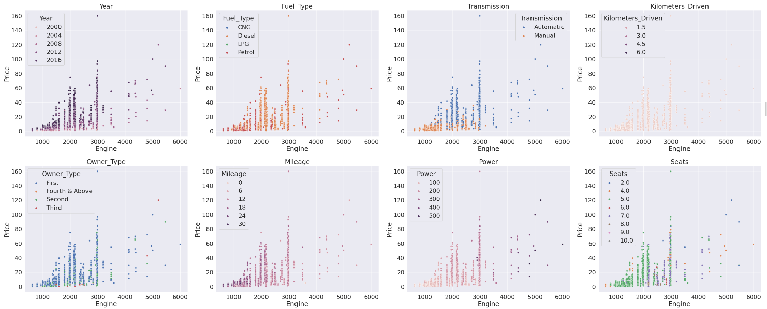
Exploratory Data Analyses – Price v Engine
Observation on Price vs Engine
The dependent feature Engine has a linear relationship with Power.
We will use this feature for our Linear model.
As expected, the cars with higher performance are priced more than lower performance.
As number of owners increase, price decreases.
We can do further analysis on each one of the hue feature.

Slide 8
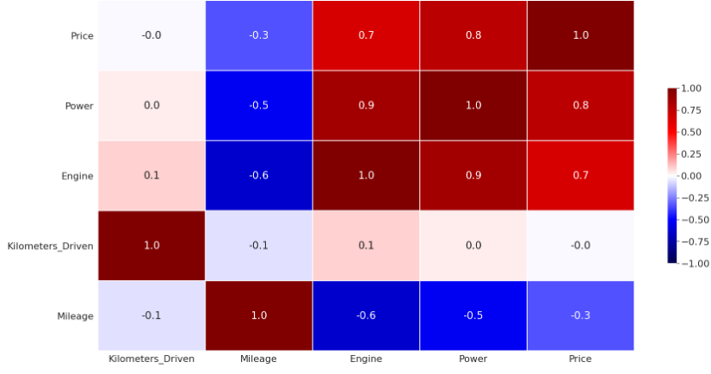
Exploratory Data Analyses – Correlation
Observation on Correlation Matrix of Numeric Features
1. Price is negatively correlated with Mileage, which is intuitive as expensive performance cars generally have
low mileage
2. Price is highly positively correlated with Power and Engine, which is intuitive as the expensive performance
cars have high Power and Engine

Slide 9
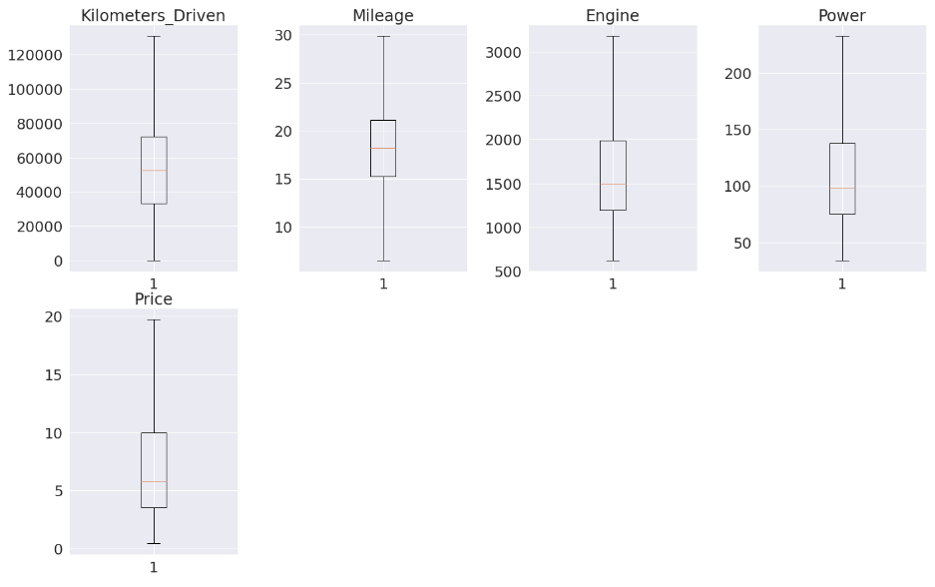
Data Preprocessing – Outlier Treatment
To prepare for the Linear Regression model:
We dropped outliers that were over 1.5 * Inter Quartile Range, on either sides.
We also dropped Missing values
We also One-Hot encoded categorical features like Location, FuelType, Transmission and owner type

Slide 10
ML Model Building – Linear Regression
Post Data Preprocessing,
We selected Price as Dependent(Predicted) Feature and majority of Numerical features as Independent Features(Predictors)
Next, we split the dataset into 70% to Train on and 30% to Test the Model on subsequently
Next, we fit the Linear regression model on the Train and got following model metrics
Mean Absolute Error on test data = 1.7084287754746332
RMSE on test data = 2.3092039254744083
R Squared score = 0.8381842771561248
Conclusion
R2_score is 0.83, that explains 83% of total variation in the dataset. So, overall the model is satisfactory. So price has a strong relationship with numerical variables. We will next investigate if this can be improved further

Slide 11
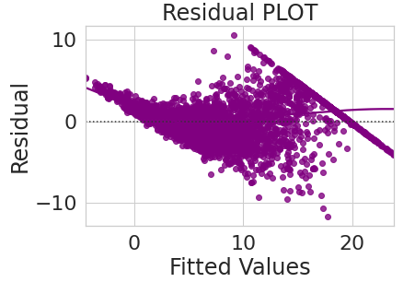
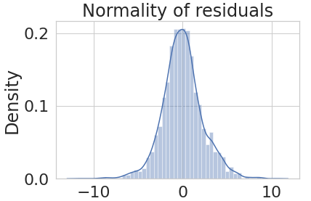
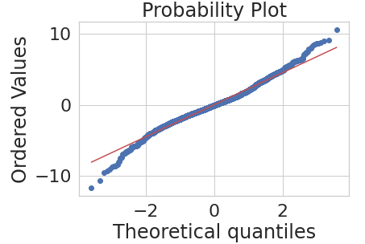
Model Building – Test Linearity Assumptions
We verified the linearity assumptions of the model
1. Mean of residuals - should be close to Zero and it was calculated to be -9.317773478985816e-12
2. Linearity of variables -
Scatter plot shows the distribution of residuals (errors) vs
fitted values (predicted values. There is no pattern in residual
3. Normality of error terms -
The QQ plot confirms normality of residuals.
The normal probability plot of residuals
follows a straight line approximately
4. No Heteroscedaticity –
Null hypothesis : Residuals are homoscedastic
Alternate hypothesis : Residuals have heteroscedasticity
With p-value = 0.9697 > 0.05 we fail to reject the null hypothesis. Hence residuals are homoscedastic.

Slide 12
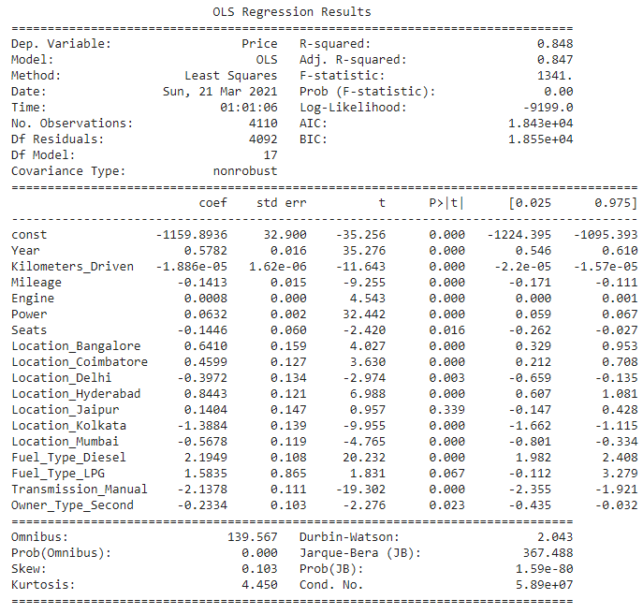
ML Model Building – Key Features and Fit
Train error: 2.2688249279001225 Test error: 2.3153769015684915
With OLS Stats, post several iterative rounds of dropping the least significant features, here are the results
1. Year, Fuel Type are very significant with low P values. 2. 1 unit increase in a Diesel car leads to 2.19
units increase in price of car. 3. Manual Transmission and certain Locations
(Delhi, Mumbai, Kolkata) have negative
relationship with price
4. Certain Southern metro locations(Bangalore,
Coimbatore, Hyderabad) have a positive
relationship with price.
5. Older the car and the higher number of owners decreases the price as expected
Model Fit - Predicting on the test data with RMSE error
Train RMSE error: 2.2688249279001225
Test RMSE error: 2.3153769015684915
Conclusion
We have low test and train error, and also both the errors are comparable, so our model is not suffering from overfitting

Slide 13
Cars4U - Actionable Insights & Recommendations
Insights -
1. Linear Model is a good model to fit on the dataset to predict the price, with Rsq. score of 0.83
2. Year, Fuel Type are very significant predictors for Price 3. One unit increase in a Diesel car leads to around 2 units increase in price of car. 4. Manual Transmission has a negative relationship with price
5. Certain Southern metro locations(Bangalore, Coimbatore, Hyderabad) have a positive
relationship with price, whereas other metro locations(Delhi, Mumbai, Kolkata) have negative
relationship with price
6. Older the car and the higher number of owners decreases the price, as expected 7. 2014 Maruti Swift VDI is the most popular car in the dataset
8. Most cars are in the year 2013 and up
9. Outliers for Engine and Power are for high performance cars and luxury models, which also
explains their respective outliers in price
10. Linear Model is a good model to fit on the dataset to predict the price, as outlined earlier.
Recommendations -
1. For popular cars, for the same model car, a recommendation could be made to increase price of
older years or more owners. As these are popular cars( on account of their reliability), one can
argue reliability of car can be used as a premium for increasing price of older models. 2. For older models and cars that have been owned by multiple owners, a reliability study could be
done to identify the reliable models like Camrys and Hondas in the US
3. Certain metro have a positive relationship with price, whereas others have negative
relationship with price. So there is a possibility to increase prices in metros , especially if a
neighboring city has higher prices on same year and model of the car.

