Slide 1
Expedia Marketplace Analysis
Competitive Positioning Diagnosis

Slide 2
Problem Statement
Booking rates vary significantly by market segment:
• Budget: 3.04% booking rate (Highest)
• Mid: 2.89% booking rate (Middle)
• Luxury: 2.20% booking rate (Lowest (-27% vs Budget))
Why does Luxury underperform? Is it pricing, visibility, or quality trust?

Slide 3
Methodology
Outcome Data Available
100k searches with click_bool, booking_bool, gross_bookings_usd
Causal Measurement
Direct measurement of what drives conversions, not hypothetical
Segment Analysis
Budget (price <$99 OR rating ≤2), Mid (3-4★), Luxury (price >$159 AND rating ≥4)
5 Core Analyses
Funnel, Ranking Impact, Competitive Positioning, Quality Trust Gap, User Behavior
Data-Driven Scope
Skip redundant analyses when findings are conclusive

Slide 4
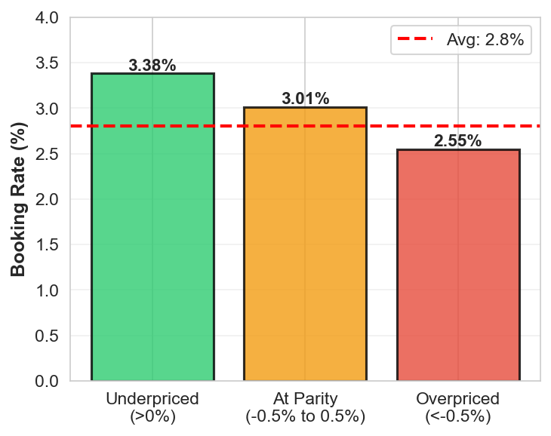
Finding 1: Competitiveness = Market Parity
Price is NOT the issue
Median comp_score: 0.0% (market parity)
Underpriced hotels: 3.38% booking rate
Overpriced hotels: 2.55% booking rate
Difference: 0.83pp (negligible)
Correlation to bookings: +0.0289
Verdict: Price optimization has minimal ROI

Slide 5
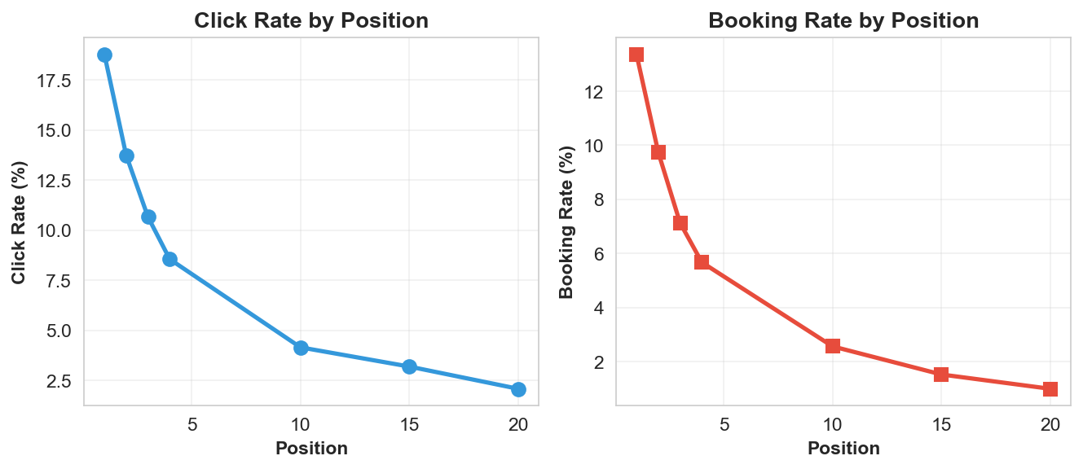
Finding 2: Ranking Position Impact
Position MATTERS
Position 1 vs Position 10:
Click rate: 18.78% vs 4.15% → 4.53x elasticity
Booking rate: 13.37% vs 2.56% → 5.22x elasticity
Insight: Position elasticity for BOOKING is stronger than for CLICKS
Verdict: Position 1 hotels are higher quality or better-matched to user intent

Slide 6
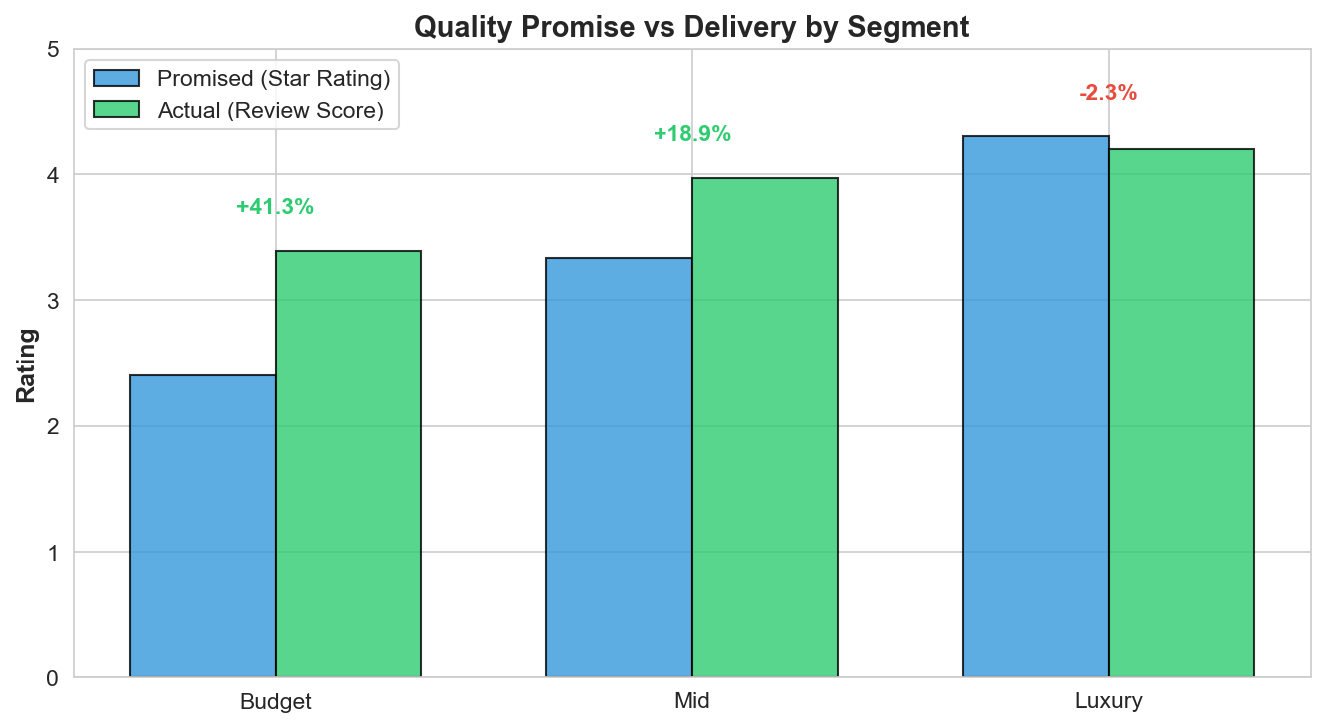
Finding 3: Quality Trust Gap by Segment

Slide 7
Finding 4: Luxury Quality Problem Detail
Segment | Beat Promise | Fail Promise | Booking Rate
Budget | 78% (30.7k hotels) | 10% (4.0k) | 3.04%
Mid | 73% (27.0k) | 12% (4.3k) | 2.89%
Luxury | 39% (9.0k) | 31% (7.2k) | 2.20%
Key Insight: Luxury Buyers Expectations Problem
Luxury segment has LOWEST % beating promise (39%) and HIGHEST % failing (31%)
When luxury buyer sees 4.30★ hotel but discovers 4.20★ reality → disappointment → abandonment
Result: Lowest booking rate (2.20%) among all segments

Slide 8
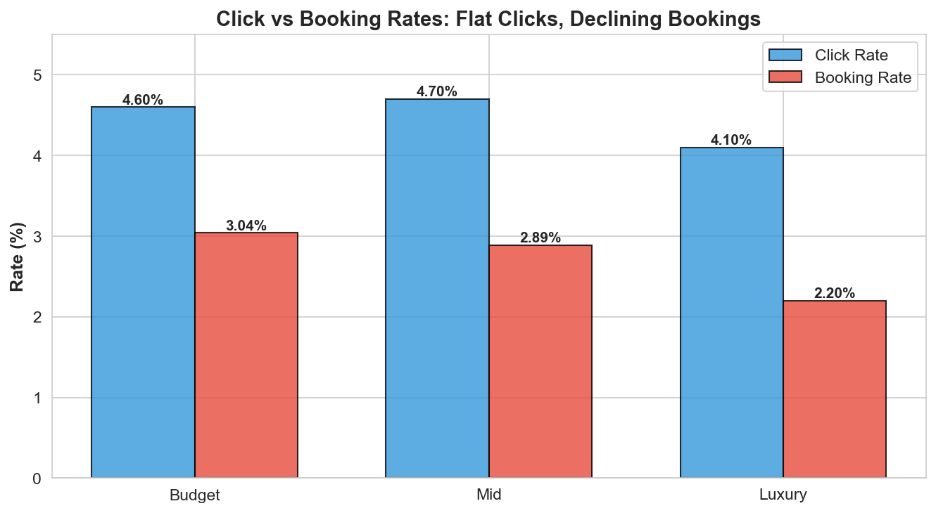
Finding 5: Funnel Analysis by Segment

Slide 9
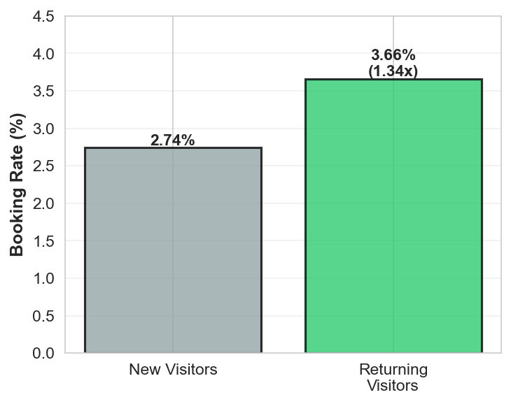
Finding 6: Returning Visitors Convert Better
Experience Drives Conversion
New Visitors
• Click rate: 4.49%
• Booking rate: 2.74%
Returning Visitors
• Click rate: 4.61% (+2.7%)
• Booking rate: 3.66% (+33.6%)
Conversion Lift: 1.34x

Slide 10
Root Cause: Quality Trust Gap Explains Everything
Budget Segment ✓ SUCCEEDS
Promise: 2.40★ | Delivery: 3.39 | Gap: +41.2% (beats) | Booking: 3.04%
Mid Segment ✓ STABLE
Promise: 3.34★ | Delivery: 3.97 | Gap: +18.7% (beats) | Booking: 2.89%
Luxury Segment ✗ FAILS
Promise: 4.30★ | Delivery: 4.20 | Gap: -2.3% (fails) | Booking: 2.20%
31% of luxury hotels fail their promise → Highest abandonment
VERDICT: Not price. Not visibility. Not user type. QUALITY TRUST.

Slide 11
Strategic Recommendations (Prioritized)
1. FIX LUXURY QUALITY GAP (Highest Impact)
Audit all 4.3★ hotels in luxury segment
Verify star rating accuracy against actual review scores
Remove misaligned listings or update ratings
Expected impact: 5% lift in luxury booking rate (2.20% → 2.31%)
2. IMPROVE RANKING ALGORITHM (Strong Impact)
Optimize position 1 for quality-intent alignment
5.22x booking elasticity shows position matters more for booking than clicks
Position quality score should incorporate review-rating alignment
3. BUILD TRUST SIGNALS (Secondary)
Highlight verified buyer reviews on luxury listings
Show returning visitor booking rates as proof point
1.34x lift from familiarity demonstrates trust value
4. STOP PRICE OPTIMIZATION (Avoid Waste)
Price correlation to bookings: +0.0289 (negligible)
Redirect resources from pricing strategy to quality alignment
Price is NOT the conversion lever

Slide 12
Implementation Roadmap
Phase 1: Luxury Segment Audit (Week 1-2)
Extract all luxury hotels with 4.3★ rating
Calculate actual vs promised quality gap per hotel
Flag hotels with >2% gap for review
Output: Audit report + remediation list
Phase 2: Ranking Algorithm Update (Week 3-4)
Implement quality-alignment score in ranking
A/B test: Control (current algo) vs Treatment (quality-weighted)
Measure booking lift in luxury segment
Output: Algorithm improvement + A/B results
Phase 3: Trust Signal Rollout (Week 5-6)
Add verified buyer labels to luxury listings
Test impact on click-to-book conversion
Measure returning visitor preference
Output: Feature + effectiveness metrics

Slide 13
Success Metrics & Targets
Metric | Current | Target
Luxury Booking Rate | 2.20% | 2.31% (+5%)
Quality Gap (Luxury) | -2.3% | -1.0% (-57%)
Hotels Beating Promise (Luxury) | 39% | 50%
Overall Marketplace Booking Rate | 2.80% | 2.90% (+3.6%)
Timeline: 6 weeks | Measurement: Weekly tracking of luxury booking rate, quality gap
Success: 5% lift in luxury bookings confirms quality alignment is the conversion lever

Slide 14
Next Steps
1. Stakeholder Alignment - Present findings to product, data science, and operations teams
2. Data QA - Verify luxury hotel star ratings and review scores (manual audit sample)
3. Tool Setup - Build luxury audit tool to identify misaligned hotels
4. Ranking Review - Work with ML team to understand current ranking factors
5. A/B Testing Plan - Design experiment structure for quality-weighted ranking
6. Communication - Draft messaging for hotels about star rating accuracy
7. Launch Week 1 - Begin luxury audit; identify first batch of hotels to remediate

