Slide 1
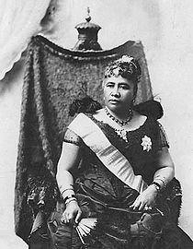
ALOHA ʻOE
Na Ka Mōʻīwahine Liliʻuokalani

Slide 2
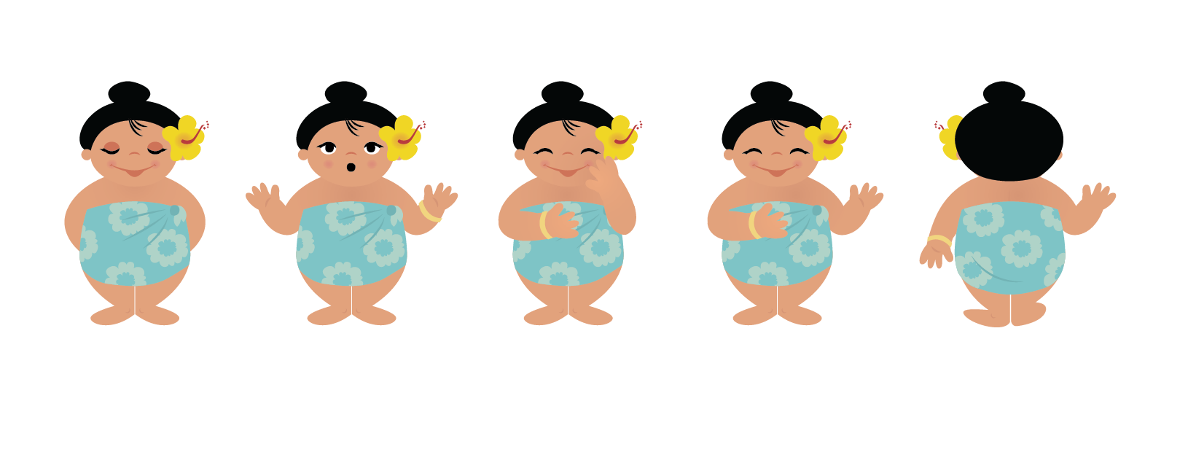
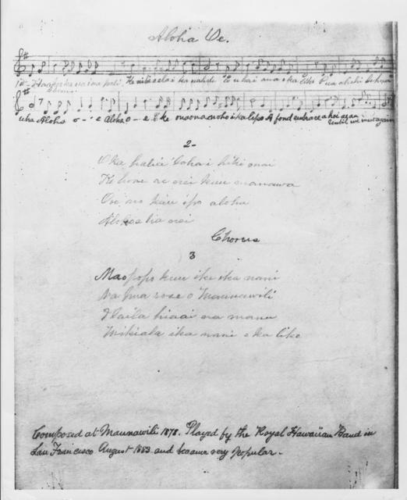
PANE HAOLE
E hoʻolohe a e hoʻopili mai.
ʻO “Aloha ʻOe” kekahi
o kuʻu mele punahele.

Slide 3
PANE HAOLE
Listen and repeat.
“Aloha ʻOe” is one of my favorite songs.

Slide 4
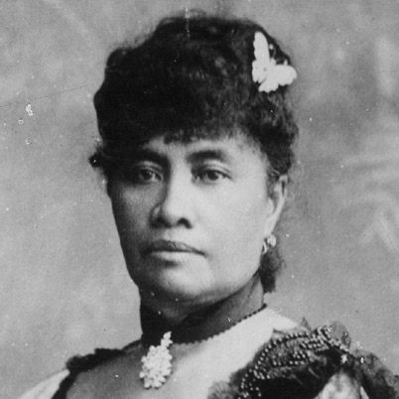
PANE HAOLE
E hoʻolohe a e hoʻopili mai.
Haku ka mōʻīwahine ʻo Lili'uokalani i kēia mele i ka makahiki 1878.

Slide 5
PANE HAOLE
Queen Lili'uokalani composed this song in 1878.

Slide 6
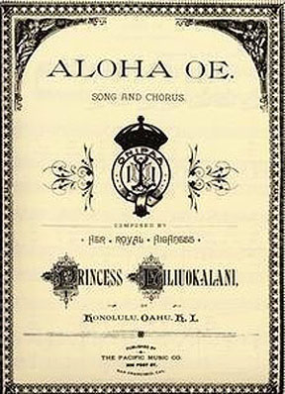
E hoʻolohe a e hoʻopili mai.
PANE HAOLE
Kaulana ʻo “Aloha ʻOe” a puni i ka honua.

Slide 7
PANE HAOLE
“Aloha ʻOe” is famous around the world.

Slide 8
PANE HAOLE
E hoʻolohe a e hoʻopili mai.
Eia nā huaʻōlelo no “Aloha ʻOe.”
Na Liliʻuokalani i kākau
i kēia pepa.

Slide 9
PANE HAOLE
Here are the words to “Aloha ʻOe.”
This paper was written by Liliʻuokalani

Slide 10

PANE HAOLE
He mele aloha ʻo “Aloha ʻOe”.
A he mele “a hui hou” kekahi.

Slide 11
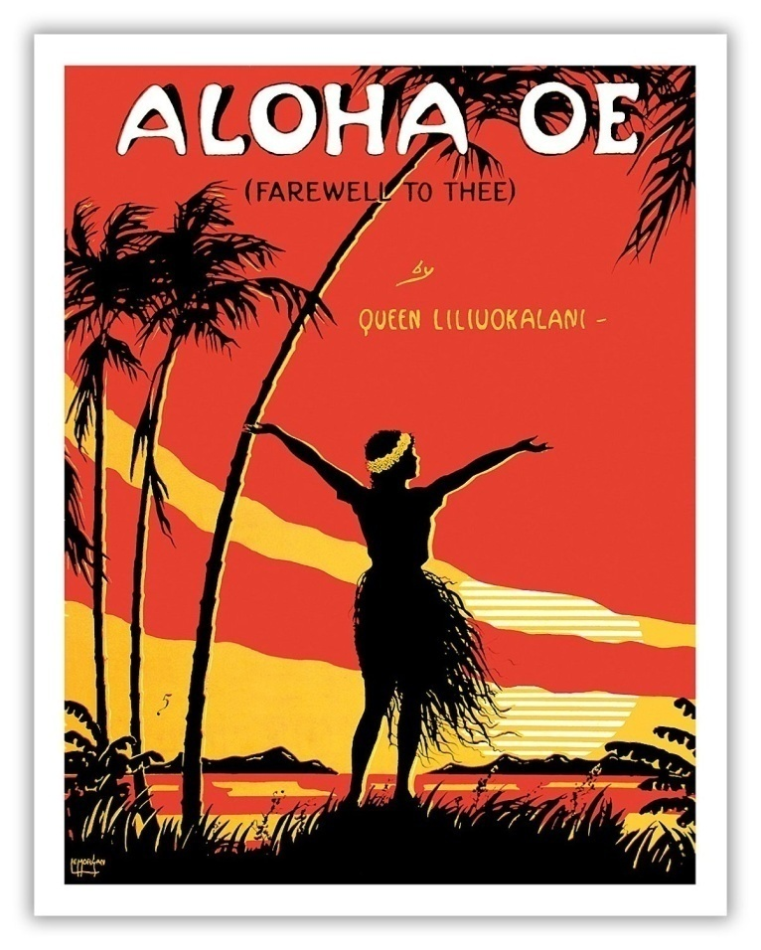
PANE HAOLE
“Aloha ʻOe is a love song.
It is also a farewell song.

Slide 12
Eia ʻo Kainani Kahaunaele. Mele ʻoia i ke mele “Aloha ʻOe.” Aia ʻoia ma Hilo, i ka makahiki 2013
E nānā a e hoʻolohe mai.
PANE HAOLE
LINK TO YOUTUBE VIDEO

Slide 13
Kainani Kahaunaele sings “Aloha ʻOe.” in Hilo, in 2013
PANE HAOLE
Watch and listen!

Slide 14
No laila, e aʻo kākou i ke mele “Aloha ʻOe.” Mākaukau?
PANE HAOLE

Slide 15
So letʻs learn the song “Aloha ʻOe.” Ready?
PANE HAOLE

Slide 16
PANE HAOLE
E hoʻolohe a e hoʻopili mai.
Paukū ʻEkahi (1)
Haʻaheo ka ua i nā pali
Ke nihi aʻela i ka nahele
E hahai (uhai) ana paha i ka liko
Pua ʻāhihi lehua o uka

Slide 17
PANE HAOLE
VERSE 1
Haʻaheo ka ua i nā pali
Proudly swept the rain by the cliffs
Ke nihi aʻela i ka nahele
As it glided through the trees
E hahai (uhai) ana paha i ka liko
Still following ever the bud
Pua ʻāhihi lehua o uka
The ʻāhihi lehua of the vale

Slide 18

E hoʻolohe a e hoʻopili mai.
PANE HAOLE
Hui:
Aloha ʻoe, aloha ʻoe
E ke onaona noho i ka lipo
One fond embrace,
A hoʻi aʻe au
Until we meet again

Slide 19
PANE HAOLE
Hui/Chorus:
Aloha ʻoe, aloha ʻoe
Farewell to thee, farewell to thee
E ke onaona noho i ka lipo
The charming one who dwells in the shaded bowers
One fond embrace,
One fond embrace,
A hoʻi aʻe au
‘Ere I depart
Until we meet again
Until we meet again

Slide 20
E hoʻolohe a e hoʻopili mai.
PANE HAOLE
Paukū ʻElua (2)
ʻO ka haliʻa aloha i hiki mai
Ke hone aʻe nei i kuʻu manawa
ʻO ʻoe nō kaʻu ipo aloha
A loko e hana nei
Notes:
VER

Slide 21
PANE HAOLE
VERSE 2
ʻO ka haliʻa aloha i hiki mai
Sweet memories come back to me
Ke hone aʻe nei i kuʻu manawa
Bringing fresh remembrances of the past
ʻO ʻoe nō kaʻu ipo aloha
Dearest one, yes, you are mine own
A loko e hana nei
From you, true love shall never depart
Notes:
VER

Slide 22
E hoʻolohe a e hoʻopili mai.
PANE HAOLE
Paukū ʻEkolu (3)
Maopopo kuʻu ʻike i ka nani
Nā pua rose o Maunawili
I laila hiaʻia nā manu
Mikiʻala i ka nani o ka lipo

Slide 23
PANE HAOLE
VERSE 3
Maopopo kuʻu ʻike i ka nani
I have seen and watched your loveliness
Nā pua rose o Maunawili
The sweet rose of Maunawili
I laila hiaʻia nā manu
And 'tis there the birds of love dwell
Mikiʻala i ka nani o ka lipo
And sip the honey from your lips

Slide 24
PANE HAOLE
Maikaʻi!
E hoʻomaʻamaʻa i nā huaʻōlelo a me ka leo o ke mele “Aloha ʻOe” a paʻa loa nā mea ʻelua.

Slide 25
PANE HAOLE
Great
Now practice the words and the melody of Aloha ʻOe, until you got both of them down.

Slide 26

A hui hou!

Slide 27
MELE/CHANTS EXERCISES
Haʻaheo ka ___________ i nā pali.
UA
WAI
MANU

Slide 28
MELE/CHANTS EXERCISES
Ke nihi aʻele i ka _______________.
PALI
NAHELE
LIKO

Slide 29
MELE/CHANTS EXERCISES
E hahai ana paha i ka _______________.
LIKO
UA
MANU

Slide 30
MELE/CHANTS EXERCISES
_____________ ʻāhihi lehua o uka.
UA
PUA
LIKO

Slide 31
HANA PONO KAULELE
Surprise someone with your best rendition of Aloha ʻOe. You can perform it by yourself, with your learning ʻohana, or with anyone else who will embellish your performance.
Chose your audience. Perhaps someone dear or special, perhaps a baby or a beloved kūpuna…..

