Slide 1
EECS 678 Lab

Slide 2
Second TA of this course
Ahmet Soyyigit, Ph.D. student from Turkey
E-mail for questions: ahmet.soyyigit@ku.edu
Will be grading the labs, quiz and homework with Ishrak (First TA.)
Office hours: Tuesday 2:25PM-3:55PM
  Is that OK?
  Appointment is possible.

Slide 3
What we are going to do
At each lab:
  Students are going to access lab website in order to download lab materials.
    https://eecs678.github.io/Spring2020/
  TA is going to introduce the topic through slides.
  Students are going to accomplish the tasks given at lab webpage. Then, they will demo (all labs) to TA and give written report (not for all labs). Printed and hand-written are both OK. Reports must be delivered during demo.

Slide 4
What we are going to do
At each lab:
  Your code will be put in a tarball and send to TA just before demo: eecs678as@yahoo.com
  E-mail subject: EECS678 LABX ID SURNAME
    Ex: EECS678 LAB1 3024090 SOYYIGIT
  Filename: <student-id>_eecs678_labx.tar.gz
    Ex: 3024090_eecs678_lab1.tar.gz
  In case the code become adjusted, the students will send the code again with concatenating UPDATED phrase to the subject of the e-mail and file.

Slide 5
Important
After TA finishes introducing the topic, students have two choice:
  Preferred: Stay at lab, finish tasks and demo before leaving.
  Leave, then demo jest before next weeks lab or at office hours.
  Demo after two weeks with %10 penalty.
  After that, no demo.
Grading: Demo %80 + Report %20
  TA will question/quiz you during demo which will affect your grade.

Slide 6
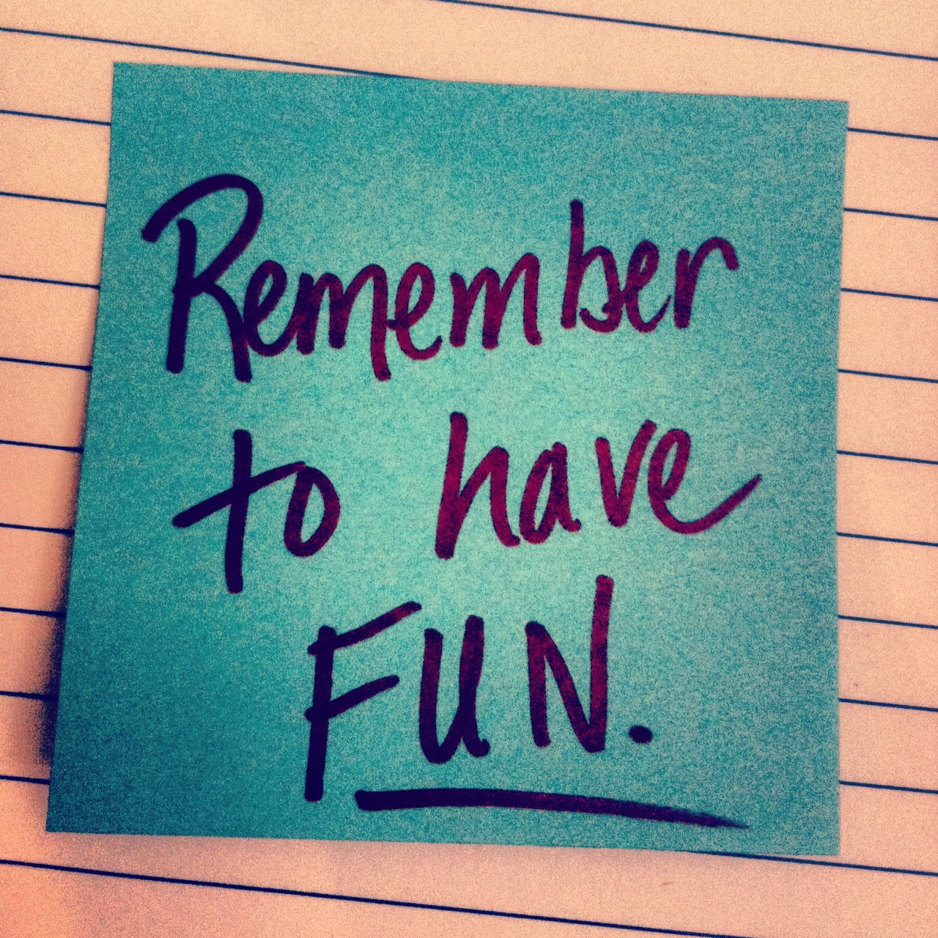
That’s it

