Slide 1
Angular
It is an open source web application framework
It provides developers options to write client side application in a clean MVC(Model View Controller) way.
Single Page application
Angular2+ is built in typescript(superset of javascript)
In typescript we have many features which Javascript don’t have .
Classes
Interface
Import-Export,
Annotations
Constructors
Fat arrow functions(shorthand notation for writing javacript function)

Slide 2
Node.js for Angular2+ application
Angular is entirely written in Typescript.
Browser does not understand Typescript JS (i.e., .ts) we need to compile them in plain JavaScript i.e., .js.
We need to use Node and NPM compile them into js file so that we can deploy them in production.
Most of the Angular packages or libraries are distributed as different NPM packages
We can have any package or library from npm registry by using npm commands and import it in our application npm install crypto-js

Slide 3
Angular CLI
The Angular CLI is a command line interface tool
It can create a project, add files, and perform a variety of ongoing development tasks such as testing, bundling, and deployment.
ng generate:Generate components, routes, services and pipes with a simple command. ng generate component comp-name
ng serve:Easily run your app locally while developing.

Slide 4
Set up the Development Environment
Install Node.js® and npm
Verify that you are running at least Node.js by running node -v and npm -v
Then install the Angular CLI globally. npm install -g @angular/cli
Create a new project by running the command: ng new my-app
Angular CLI installs the necessary npm packages, creates the project files
Serve the application : ng serve

Slide 5
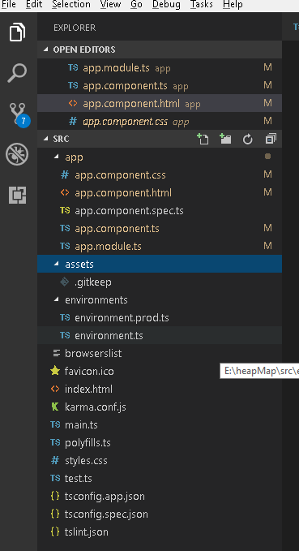
Package Structure

Slide 6
Modules
Angular apps are modular: Every angular module is a class with an @NgModule decorator
Modules are a great way to organize an application
Every Angular App has at least one module: the root module (app.module.ts)
We have to bootstrap that module to launch the application.
Root module can have multiple components
Each component can have its child components
NgModules consolidate components, directives, and pipes into cohesive blocks of functionality
Modules can also add services to the application which can be injected in any component inside application

Slide 7
Components
Every Angular application has at least one component that can be of root component.
Each component defines a class that contains application data, logic and view
The @Component() decorator identifies the class immediately below it as a component
Each component can have its child component
@Component({ selector: 'app-hero-list', templateUrl: './hero-list.component.html', providers: [ HeroService ] })
Command to install component in application: ng generate component comp-name

Slide 8
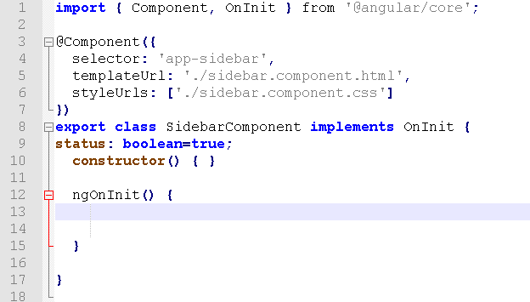
Component.ts(structure)

Slide 9
Http
HTTP is a request/response protocol. You make a request, it returns a response.
Need to import the Angular HttpClientModule
Inject the HttpClient into an application class
import { HttpClient } from '@angular/common/http';
Every HTTP method returns an Observable of configuration data, the component subscribes to the method's return value.

Slide 10
Getting the data from text file.
download() { this.http.get('assets/textfile.txt') .subscribe(results => this.contents = results); }
Receiving data from a server: this.http.get(‘Url’).subscribe(response=>this.fnName(response))
HttpClient supports mutating requests, that is, sending data to the server with other HTTP methods such as PUT, POST, and DELETE.
Sending data to a server this.http.post(‘Url’,data).subscribe(response=>this.fnName(response))

Slide 11
Error Handling
We handle error in client for few reasons:
poor network connection
request fails on the server
HttpClient will return an error object instead of a successful response.
Ways to handle error
this.http.get(‘Url’) .subscribe( (data) => this.config = data, // success path error => this.error = error // error path );
catchError(this.handleError)

Slide 12
Intercepting requests and responses
With interception, we can transform HTTP requests from your application to the server.
The same interceptors may also inspect and transform the server's responses on their way back to the application.
Interceptors can perform a variety of implicit tasks, from authentication to logging, in a routine, standard way, for every HTTP request/response.
Without interception, developers would have to implement these tasks explicitly for each HttpClient method call.
HttpInterceptor interface has a method called intercept() where we write application logic

Slide 13
Data Binding
Mechanism for coordinating parts of a template with parts of a component
Four main forms: • {{data}}: interpolation • [data]: property binding : passes the value of from parent to the child comp. • (click): event binding : calls the component's method when the user clicks • [(ngModel)]: Two-way data binding : combines property and event binding, with ngModel If we update the model it will reflect the view part and vice -versa

