Slide 1
Merger and Acquisitions by Tech Companies
Justin Yoon

Slide 2
Why?
Wanted to look at data of mergers and acquisitions made by major companies to look at the history of the timeline

Slide 3
Data
CSV file from kaggle

Slide 4
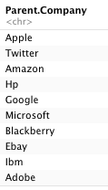
The major parent companies in the data

Slide 5
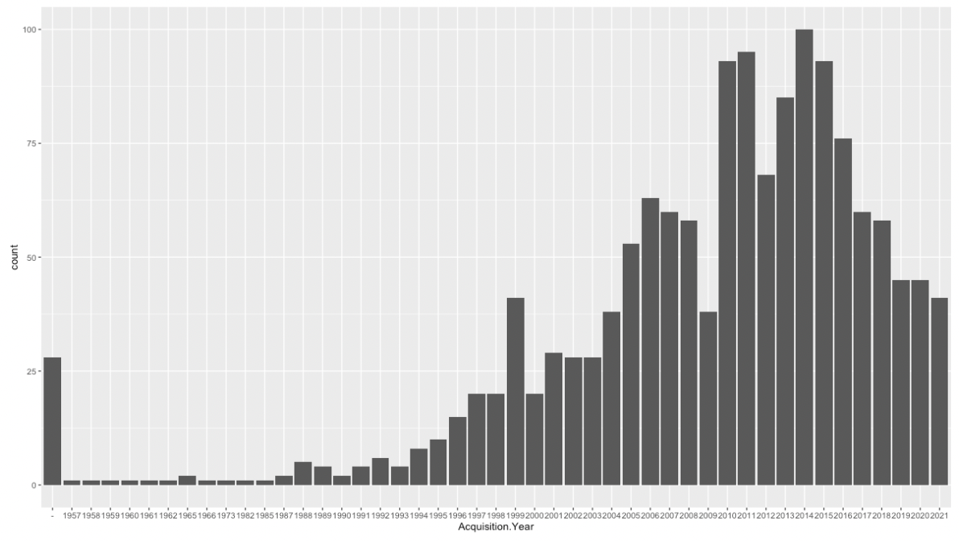
Number of Acquisitions made by the year

Slide 6
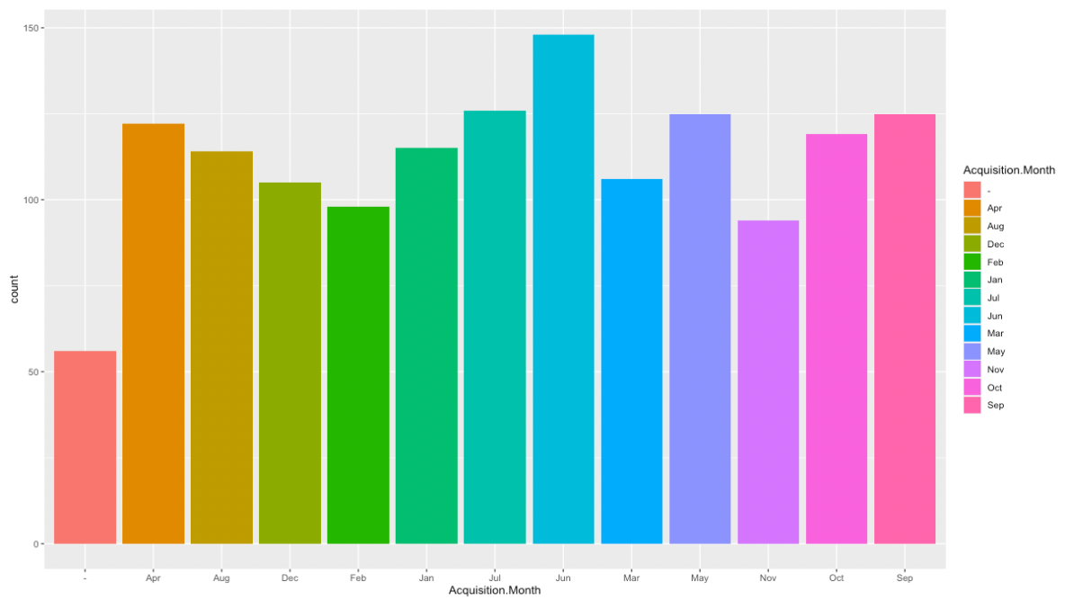
Acquisitions made by the month

Slide 7
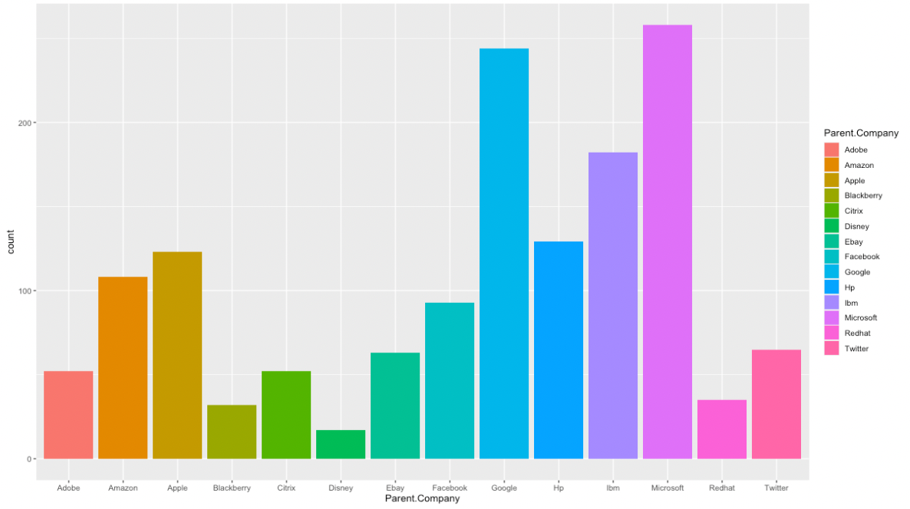
Acquisitions made by each company

Slide 8
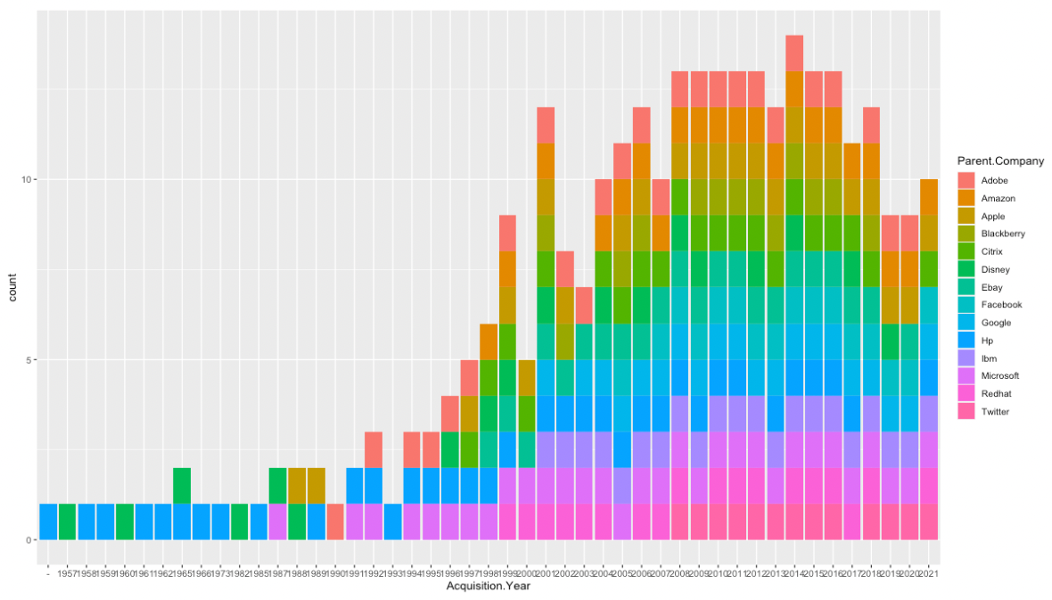
Acquisitions made by each company throughout the years

Slide 9
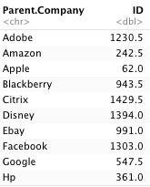
Average price of acquisition

Slide 10
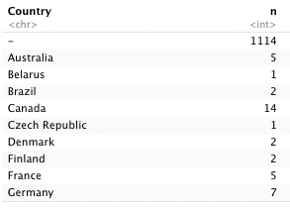
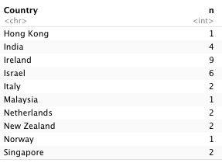
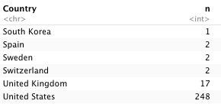
Companies origin countries

Slide 11

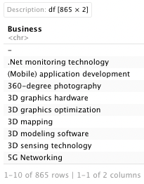
Type of business/wordcloud

